Slide 1
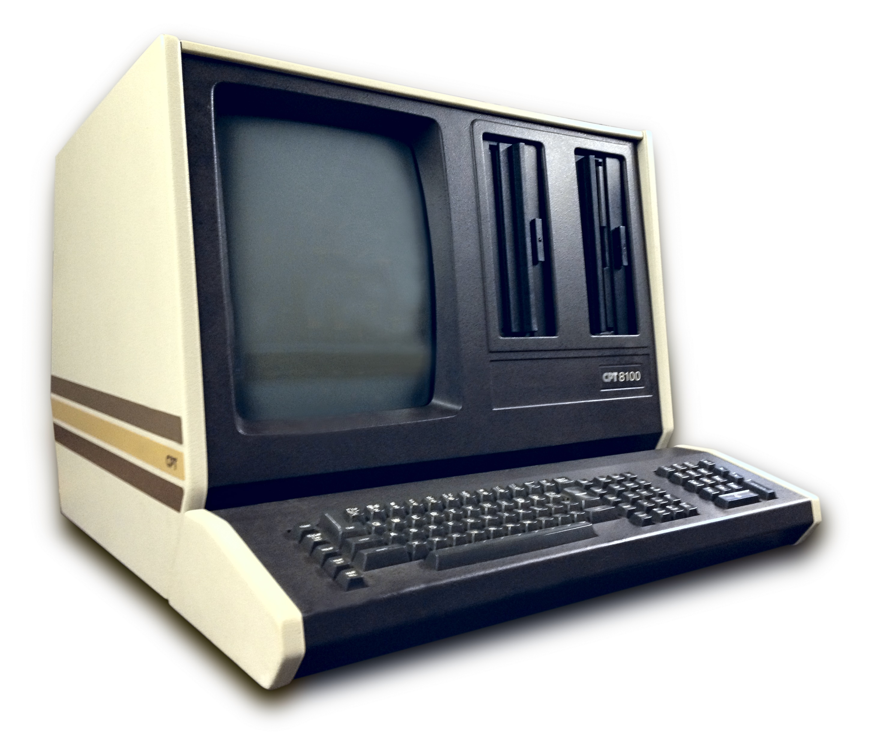
COMPUTER
MICRO COMPUTER
A microcomputer is a small, relatively inexpensive computer having a central processing unit (CPU) made out of a microprocessor. The computer also includes memory and input/output (I/O) circuitry together mounted on a printed circuit board (PCB).

Slide 2
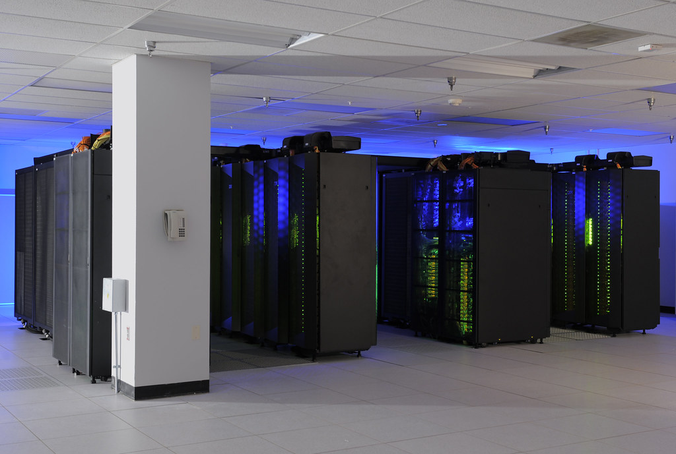
SUPER COMPUTER
Supercomputers are general-purpose computers that function at the highest operational rate or peak performance for computers. Processing power is the main difference between supercomputers and general-purpose computer systems.

Slide 3
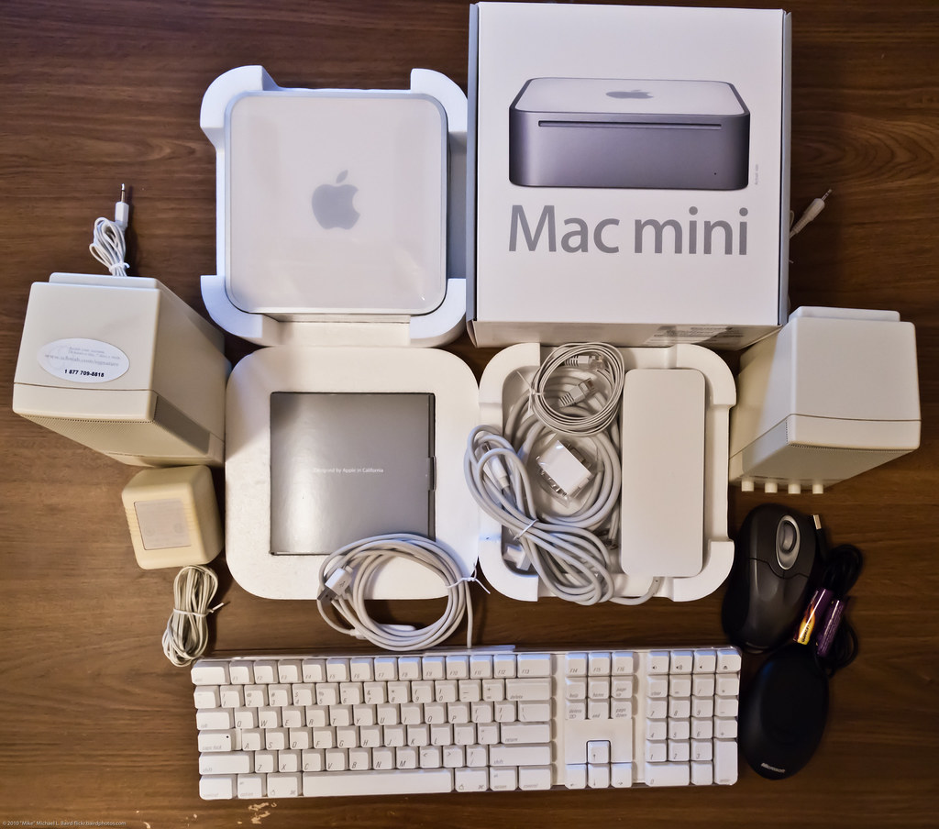
MINI COMPUTER
The minicomputer came into existence in the mid of 1960s. At that time, it was the only small computer that uses transistors and core memory technologies. The first minicomputer was known as Digital Equipment Corporation.

Slide 4

HYBRID COMPUTER
Hybrid computer is a computer intended to provide functions and features in both analog and digital computers. Developing a combined or hybrid computer model aims to produce a functional device that incorporates the most beneficial aspects of both computer systems.

