Slide 1
UC007 / CAPSTONE PROJECT
Claims Processing
Agent
EVIDENCE
↓
RULES
AI prepares claims, rules validate evidence, humans make decisions.
↓
HUMAN
PRIYANKA KARUPPUSAMY FDEUSER41
Claims workspace | Evidence-grounded preparation
UC007 / 01

Slide 2
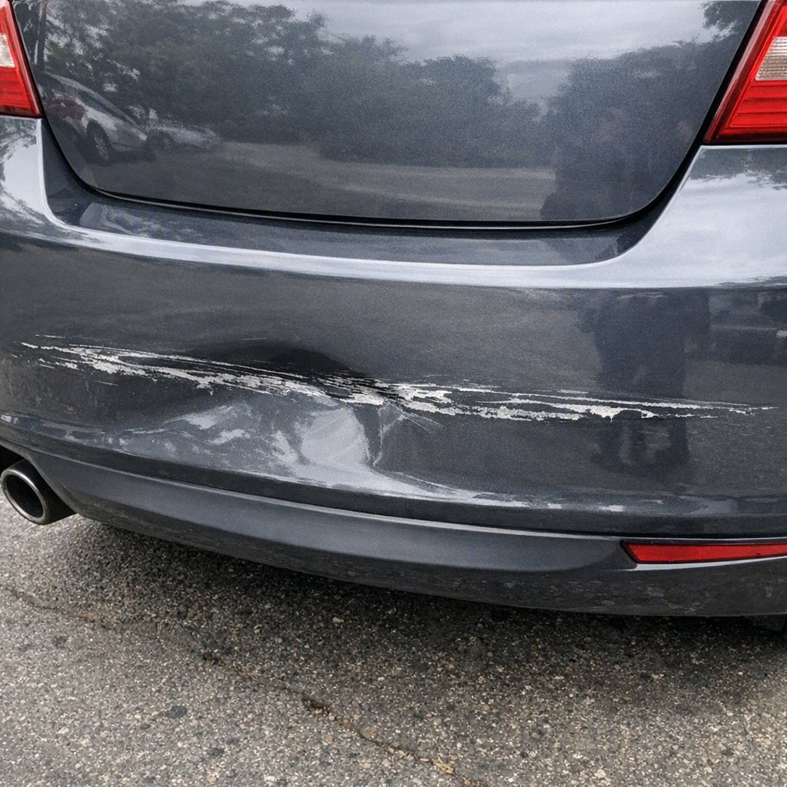
THE OPERATING CHALLENGE
Claims arrive as evidence, not answers
Handlers must turn mixed documents and photographs into a defensible preparation view.
Mixed evidence
Manual verification load
Claim forms, policy schedules, repair estimates, statements, police reports, invoices and photographs arrive together.
Handlers must compare facts across sources before a claim can move forward.
The handler needs a consistent preparation layer
Damage photograph from sample claim
COMPLETE
Are required documents present?
CONSISTENT
Do dates, VINs and damage locations agree?
COVERED
Does the policy support the reported loss?
RISK-AARE
UC007 / 02

Slide 3
HOW IT WORKS
A staged pipeline with clear accountability
AI extracts and explains; deterministic rules validate; an authorised handler remains the decision-maker.
Frontend
React workspace
ACCOUNTABILITY LAYERS
↓
API
FastAPI
AI
Rules
Human
↓
Extraction
Image analysis
Summarisation
Completeness
Consistency
Recommendation logic
Final decision
authority
Pipeline
background orchestration
↓
Document Extraction
fields + confidence + source span
↓
Vision Processing
damage + repair band
↓
Validation Engine
evidence-citing rules
Traceable handoff
Findings carry evidence references; extracted fields carry confidence and source spans.
↓
Claims Agent
policy-grounded summary
↓
Human Review
accept / amend / reject preparation
UC007 / 03

Slide 4
VALIDATION IN PRACTICE
Five scenarios exercise the controls
The sample claims cover completeness, consistency, coverage and risk signals across real evidence patterns in the repository.
Complete
Missing evidence
Contradictions
01
All required evidence present; facts align.
02
Crime reference, statement and photos absent.
03
Date, VIN and damage location disagree.
PROCEED
REQUEST INFO
REQUEST INFO
Policy exception
Risk indicators
04
Loss outside cover; estimate over authority.
05
Light scuff versus high repair estimate; history signal.
REFER
REFER
The engine also checks hire-car periods, low-confidence fields, and duplicate identity.
UC007 / 04

Slide 5
EXTENSION WORK
Enhancements Beyond the Base Solution
Three implemented extensions turn a working lab flow into a more defensible operations workspace.
MY ENHANCEMENTS
BASE SOLUTION
Core preparation flow
Hire-car invoice
F1
New analyzer schema plus five period checks: invalid dates, before loss, after repair, too long and day mismatch.
Mixed evidence ingestion
Document extraction with traceability
Photo assessment
Verification queue
F5
Critical low-confidence fields are routed to the handler and must be confirmed before a decision.
Deterministic validation rules
Policy-grounded claim summary
Handler decision workspace
Batch metrics
F7
Persisted claims can be aggregated into operational counts, recommendation mix and drill-down views.
Implemented in backend, frontend, data and tests
UC007 / 05

Slide 6
RESPONSIBLE AI
Preparation is not adjudication
The system makes evidence visible and reviewable without taking the coverage decision away from authorised staff.
GUARDRAILS IN THE IMPLEMENTATION
Reject Preparation
≠
Reject Claim
No automatic approval, denial or payment
No such decision endpoint exists in the API.
No fraud accusations
Indicators are observations routed for enhanced review.
The workspace reviews the quality of preparation only.
Approval, decline and payment remain outside the tool.
Evidence traceability
Findings cite documents and fields; extraction retains source spans.
Policy grounding
The claims agent is grounded on the policy corpus over MCP.
Human review required
Low-confidence critical fields block the handler decision until confirmed.
UC007 / 06

Slide 7
READINESS CONTROLS
Operational controls are built into the flow
Implemented controls support repeatable processing, auditability and safe handoff; deployment hardening remains a separate next step.
IMPLEMENTED
FUTURE DEPLOYMENT ENHANCEMENTS
✓
Input and upload validation
+
Authentication
✓
Per-document error handling
Role-based access
+
✓
Structured logging
+
Monitoring and alerts
✓
Persistent audit history
✓
Configuration management
+
Production database
✓
Automated tests and claim scenarios
+
Secrets management
✓
Human-in-the-loop decisions
Implemented today
Hardening next
UC007 / 07

Slide 8
CLOSE
A foundation for explainable claims operations
The architecture is extensible, the controls are visible, and the final decision stays with people.
OUTCOMES FROM THE IMPLEMENTED FLOW
ROADMAP
Faster preparation
Evidence is assembled into a handler-ready view.
→
Additional document types
Improved consistency
The same deterministic checks run across claims.
→
Cross-claim analytics
Explainable findings
Every finding points back to evidence.
→
Advanced dashboards
Human oversight
Authorised staff confirm and record the decision.
→
Enterprise deployment
Extensible architecture
New evidence types and operational views fit the pipeline.
AI prepares. Rules validate. Humans decide.
UC007 / 08

Slide 9
MY ENHANCEMENT / HANDLER WORKFLOW
A claim moves through visible work queues
Submission, decision, missing evidence and duplicate handling are connected in the workspace.
1
Submit evidence
2
Awaiting handler decision
3
Handler action
4
Request information
→
→
→
New claim or
add evidence
Prepared claim
ready for review
Accept / reject /
request information
Upload missing docs
for the same claim
DECISION DESTINATIONS
Re-process
After documents are uploaded, the claim returns to handler review.
Accepted preparations
Rejected preparations
↩
Archive
DUPLICATE GUARD
A claim ID already used for a prepared or decided claim cannot be submitted again. Matching policy, vehicle and loss date routes a potential duplicate to handler review.
UC007 / 09

