Slide 1


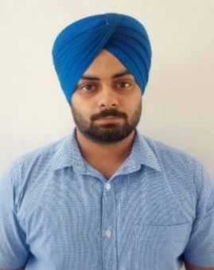

Skills
Mule 4.x
Agile Development
DevOps
JMeter Tools
XML, JSON
Competencies
Have basic understanding of Integration Principles and Design Patterns. Ability to Design using Anypoint Platform to discover, consume, build, deploy, manage, and govern APIs. Knowledge of MuleSoft Integration Best Practices. Good understanding on Agile Methodology. Hands on experience in building API-led and Connector-based integrations. Logical thinking and problem solving skills. Good communication skills and effective team player.
Priyanka Kumari
Priyanka.c.kumari@capgemini.com
9380977932,
Bachelor’s Degree in Computer Science
Mule Specifics
RAML
Exchange
Standard Connectors
API Manager
Runtime Manager
Access Management
Dataweave
Scheduler
Exception Handing
Logging
Munit
Monitoring
Integration Experience
Hands on experience in designing RAML specs and building api using api kit in mule applications . Basic knowledge of policies via API Manager like ‘Rate Limiting’ and ‘Client ID Enforcement’. Implemented basic Error handling strategies, Flow control, transformation and scopes. Used Dataweave transformations to handle diverse set of message formats like JSON, XML, CSV, etc. and have worked on various operators like map, pluck, Arrays, lookup and modules. Created CI pipeline in Jenkins to clone the source code from Git, execute MUnits and deployment on CloudHub. Hands on experience use mule connectors like fil Database, salesforce and JMS

