Slide 1
Sentiment Analysis on Social Media to Detect Depression Using Machine Learning and Deep Learning
Priyanka G
2019272030
MCA 3rd Year
Final Semester Project
Guided by Ms.R.L.Jasmine

Slide 2
Abstract:
In today's society, the use of social media has become a necessary daily activity. It is a valuable communication tool with others locally and worldwide, as well as to share, create, and spread information.
Although social media certainly has several remarkable features, the demerits are undeniable as well.
Recent studies have indicated a correlation between high usage of social media sites and increased depression.

Slide 3
This project aims to detect a probable depressed Twitter user based on his/her tweets. Machine Learning, Deep Learning and Natural Language Techniques are used for classification process and predicting whether the user is depressed or not.

Slide 4
Introduction
Sentimental Analysis is a process that are used to determine a piece of text and perform classification of tweets into positive, negative .
It provides a weight age score based on their sentiments and also categorizes the tweet data and is classified into positive, negative or neutral tweet.
The objective of this study is to use NLP technique that is for detection and determination of people emotions on twitter platform. The purpose of this study is to detect the depressed and non-depressed users from social media platforms Twitter.

Slide 5
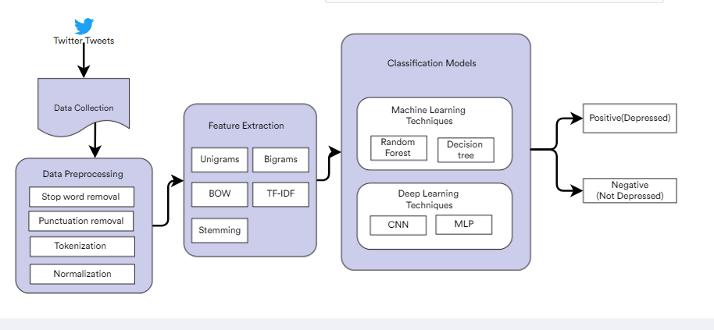
Architecture Diagram

Slide 6
Machine Learning Techniques:
Random Forest
Decision tree
Deep Learning Techniques:
CNN – Convolational neural network
MLP – Multi-layer perceptron

Slide 7
Feature Extraction Techniques:
Unigram
Bigram
Bag of Words
Term Frequency Inverse Document Frequency
Stemming

Slide 8
Dataset :
Sentiment140 dataset with 1.6 million tweets
It contains the following 6 fields:
target: the polarity of the tweet (0 = negative, 2 = neutral, 4 = positive)
ids: The id of the tweet ( 2087)
date: the date of the tweet (Sat May 16 23:58:44 UTC 2009)
flag: The query (lyx). If there is no query, then this value is NOQUERY.
user: the user that tweeted (robotickilldozr)
text: the text of the tweet (Lyx is cool)

Slide 9
Tools and Languages:
Python
numpy, scikit-learn, scipy,NLTK
TensorFlow
Kaggle

Slide 10
Reference:
[1] Sentiment Analysis in Social Media Data for Depression Detection Using Artificial Intelligence: A Review, SN Computer Science, Published: 19 November 2021, Article number: 74 (2022).
[2] Twitter Sentiment Analysis using Deep Learning , Researchgate, Published: June 13, 2021, DOI: 10.5281/zenodo.5059877

