Slide 1
TRAVEL PLANNER AGENT
CAPSTONE PROJECT
Presented By:
Priyanka Karale – [DY Patil Agriculture and Technical University] – Department of Data Science
📎 GitHub Repository: https://github.com/Priyanka2903184/TravelPlannerAgent

Slide 2
OUTLINE
Problem Statement
Proposed System/Solution
System Development Approach
Algorithm & Deployment
Result (Output Image)
Conclusion
Future Scope
References

Slide 3
Problem Statement
Today, many travelers struggle to plan personalized, cost-effective, and location-specific itineraries. Manually gathering information about places to visit, budget hotels, and local food can be time-consuming. There is a need for a smart travel assistant that can generate dynamic travel plans based on user preferences like destination, number of days, and budget.

Slide 4
Proposed Solution
The proposed solution is an AI-based Travel Planner Agent built using IBM Watsonx Prompt Lab. Key Features:
Uses foundation model :granite-3-8b-instruct
Takes 3 inputs: Destination, Days, Budget
Generates a structured travel plan including:
Day-wise sightseeing
Budget hotel options
Local food suggestions
No-code setup using Prompt Lab enables fast development and easy experimentation with structured prompts.

Slide 5
System Approach
Platform: IBM Watsonx Studio (Lite Plan)
Tools: Prompt Lab (Structured Mode)
Foundation Model: granite-3-8b-instruct
No-code/low-code interface
Input Variables: destination, days, budget
Output: Complete itinerary in response forma

Slide 6
Algorithm & Deployment
Prompt Engineering (No coding):
Structured prompt created using variables and few-shot examples
Tested with various cities and budgets
Deployment:
Deployed and tested live within Watsonx Studio
Ready-to-run without backend server

Slide 7
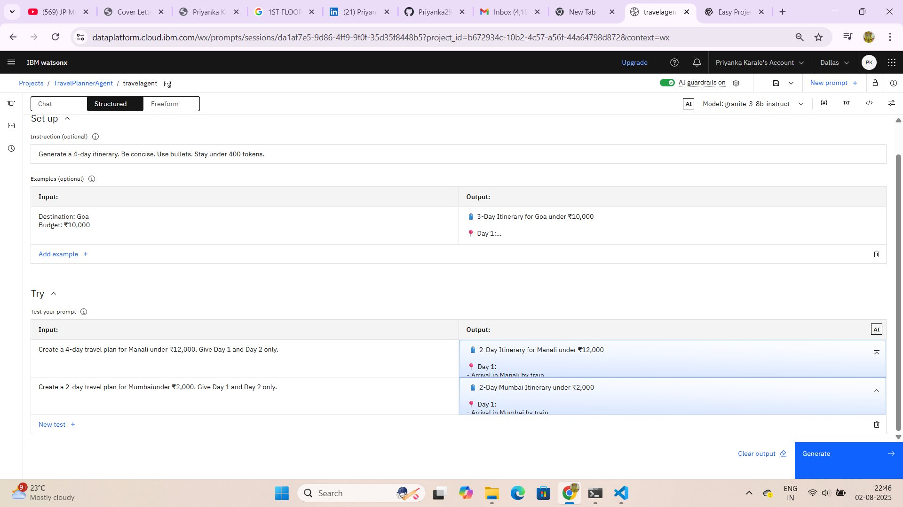
Result
.

Slide 8
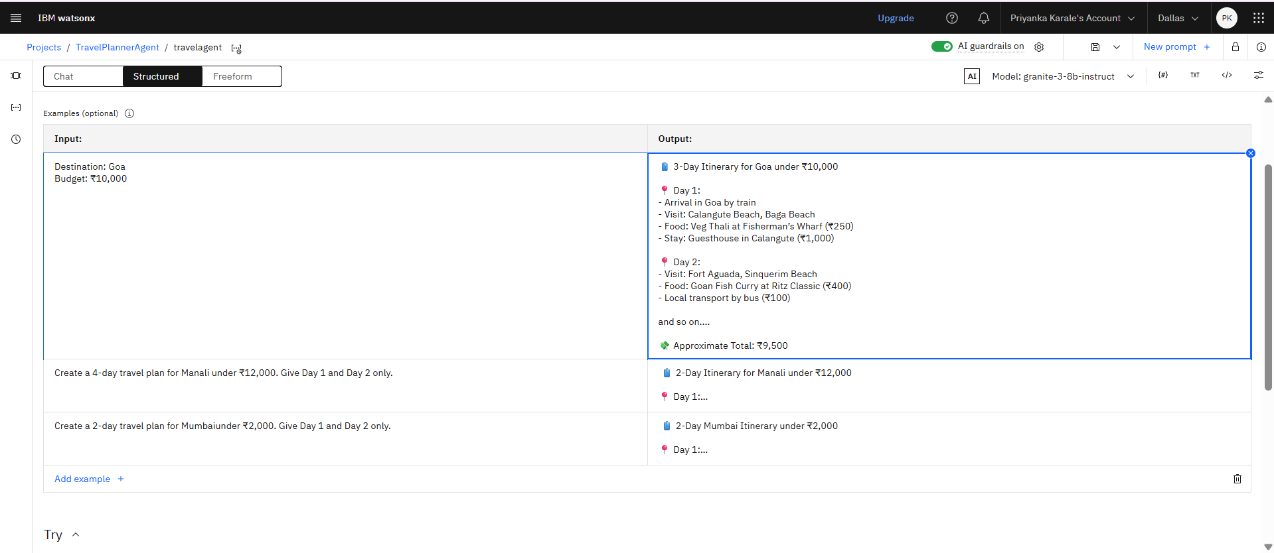
Result

Slide 9
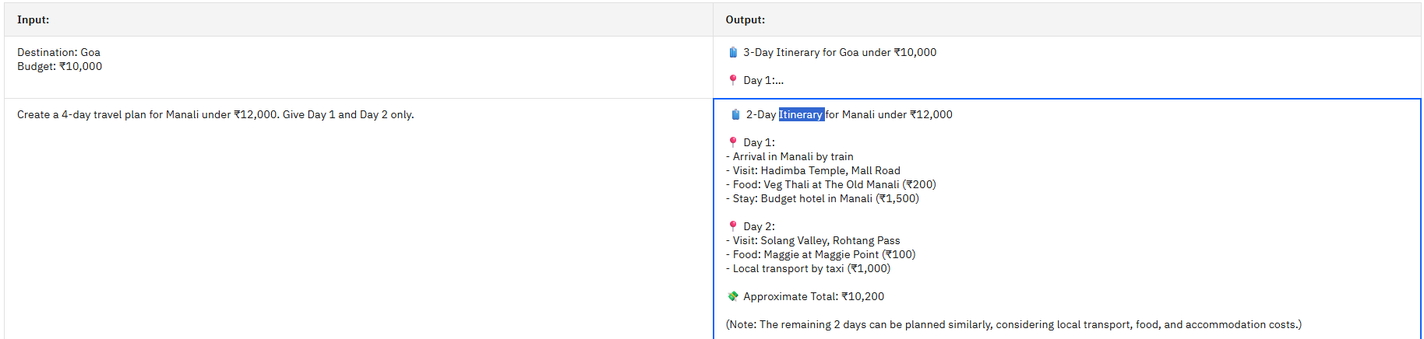
result
Prompt Engineering (No coding):
Structured prompt created using variables and few-shot examples
Tested with various cities and budgets
Deployment:
Deployed and tested live within Watsonx Studio
Ready-to-run without backend server

Slide 10
Conclusion
Successfully built a Travel Planner using Watsonx Prompt Lab
Project meets all challenge requirements
Simple no-code deployment
Easily scalable and customizable for any location or travel style

Slide 11
Future scope
Add support for real-time hotel and flight API integration
Extend prompt to multi-user chatbot interface
Integrate with Google Maps for location linking
Use Agent Lab or RAG with travel knowledge base

Slide 12
References
IBM Watsonx Studio: https://dataplatform.cloud.ibm.com/
IBM Granite Models
Prompt Engineering Guidelines (IBM docs)
Tourism Boards (for test data)

Slide 13
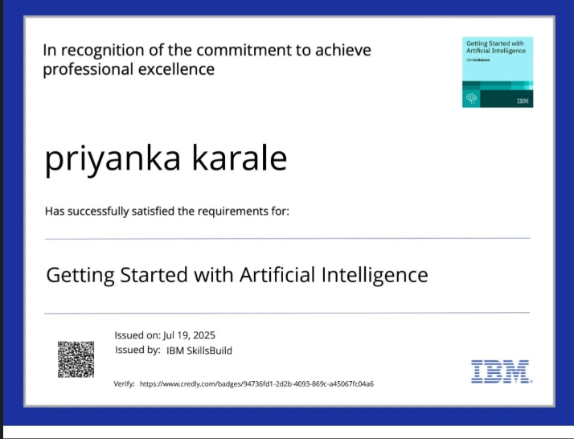
IBM Certifications

Slide 14
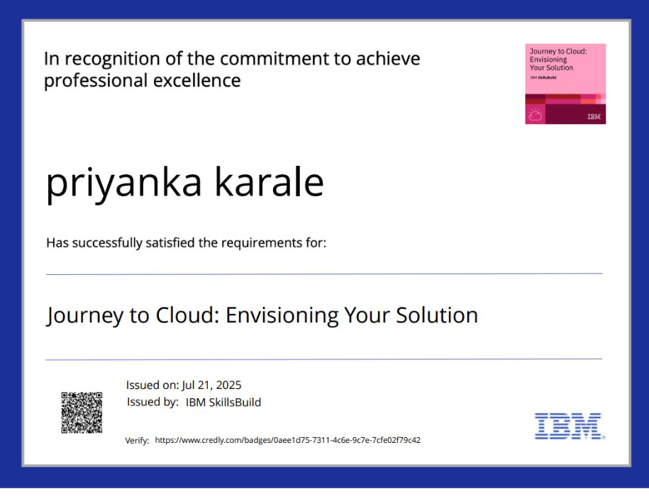
IBM Certifications

Slide 15
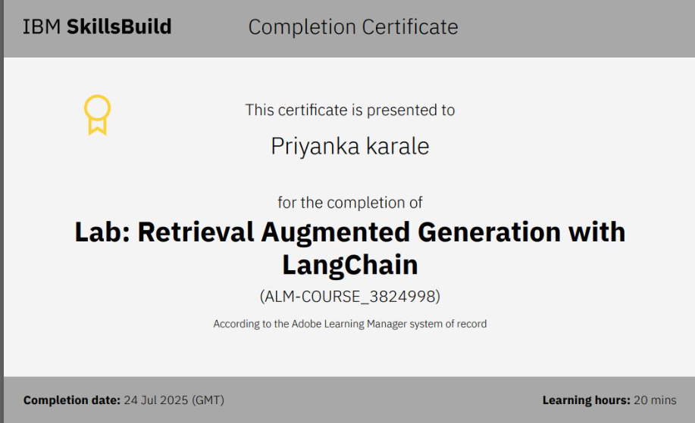
IBM Certifications

Slide 16
THANK YOU

