Slide 1

Crop Production Analysis
By Gelle Priyanka

Slide 2

Introduction
The agriculture business domain plays a critical role in the supply chain and is poised for significant evolution in the coming years, driven by advancements in the Future Internet. This paper introduces a novel Business-to-Business (B2B) collaboration platform tailored to the agri-food sector. The platform aims to facilitate effective and flexible collaboration among stakeholders from various associated business domains.

Slide 3
Problem Statement
The agriculture sector, a crucial part of the supply chain, is poised for significant advancements through Future Internet developments. This paper introduces a novel Business-to-Business (B2B) collaboration platform for the agri-food sector, designed to enhance cooperation among various stakeholders in a flexible and efficient manner. Using a comprehensive dataset on crop production in India spanning multiple years, the goal is to predict crop yields and uncover key insights, highlighting critical indicators and metrics that influence crop production.

Slide 4
Steps Overview
Data subset collected from Unified Mentor Pvt Ltd.
Understanding the Data.
Data Cleaning & Finding Missing values.
Data Visualization
Data Sources:
The Ministry of Agriculture & Farmers Welfare, Government of India, for providing comprehensive data on crop area, yield, and production through their online portal.
Data obtained from Unified Mentor Pvt Ltd
Data Manipulation:
Conduct exploratory data analysis (EDA) to identify and address missing values and data duplication. Prepare the data to create a dashboard for insights.

Slide 5
Researchers and Analysis:
Gratitude is extended to researchers and analysts who have previously investigated crop production in India. Their past work has informed the approach and methodology used in this analysis.
Aim to make production forecasts to predict future production.
Software and Tools:
Thanks to the developers of the software and tools used for data analysis and visualization, particularly #PowerBI. These tools facilitated the exploration and interpretation of the data.

Slide 6
Main KPIs
Top 5 Districts by Production: Identify the five districts with the highest crop production.
Top 3 States by Crop Area: List the three states with the largest crop areas.
Production by Crop: Highest: Highlight the crop with the highest production.
Production by Season: Highest: Indicate the season with the highest crop production.
Average Production by State: Highest: State with the highest average crop production.
Production by Crop Year : Analyze crop production trends over the years 1995-2015.
Area & Production by States: Provide a comparative analysis of crop area and production across different states.

Slide 7
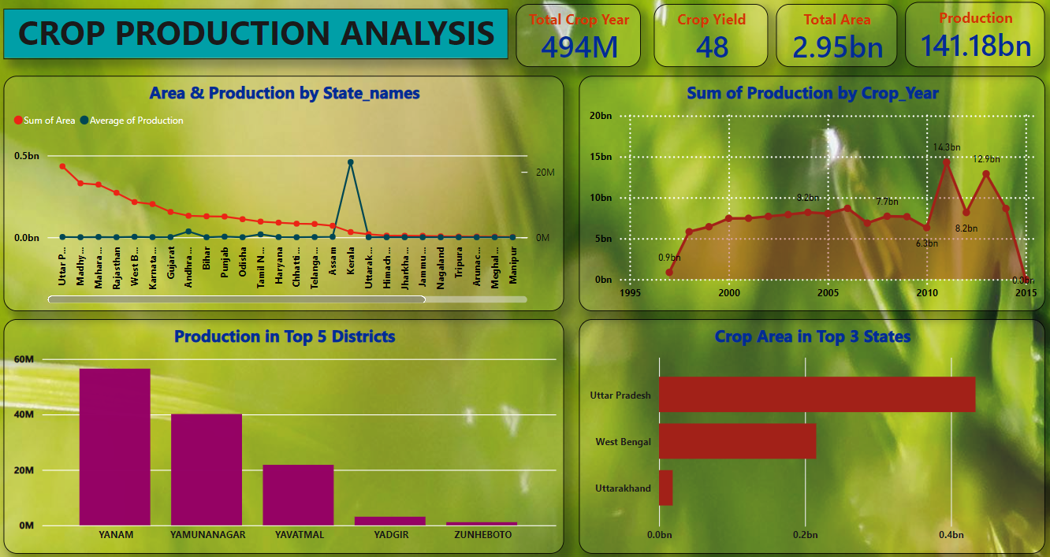
KPI Dashboards Overview

Slide 8
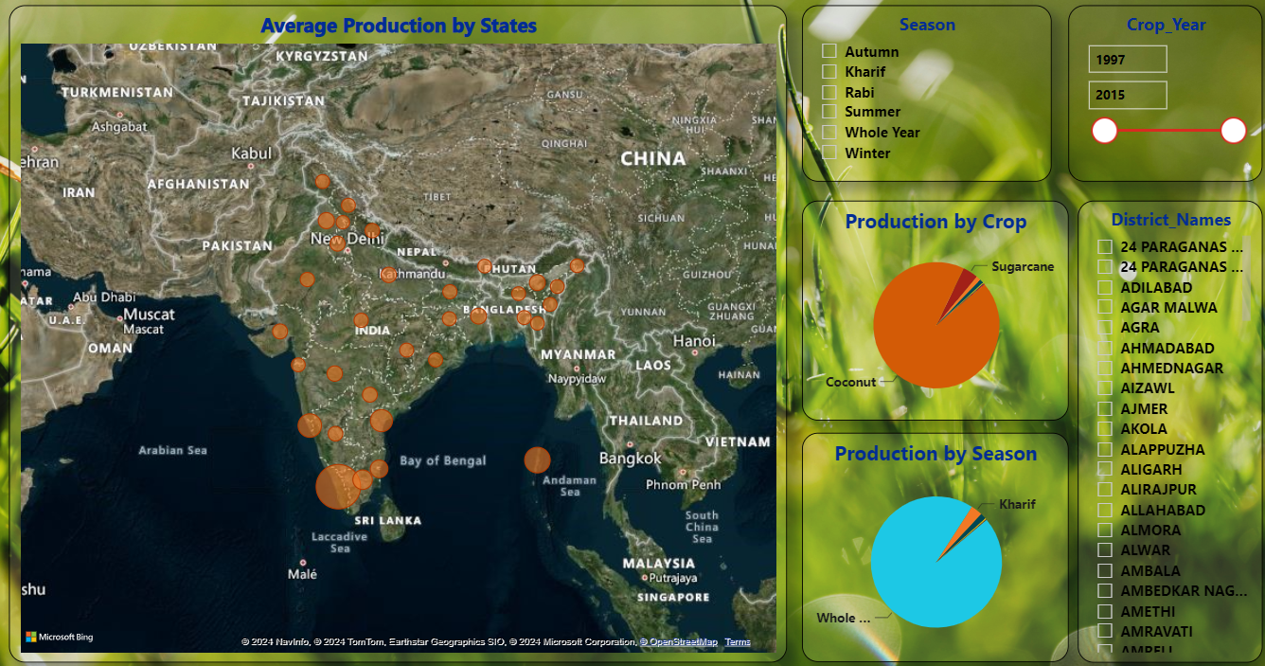

Slide 9
Thank you!

