Slide 1

Music store data

Slide 2
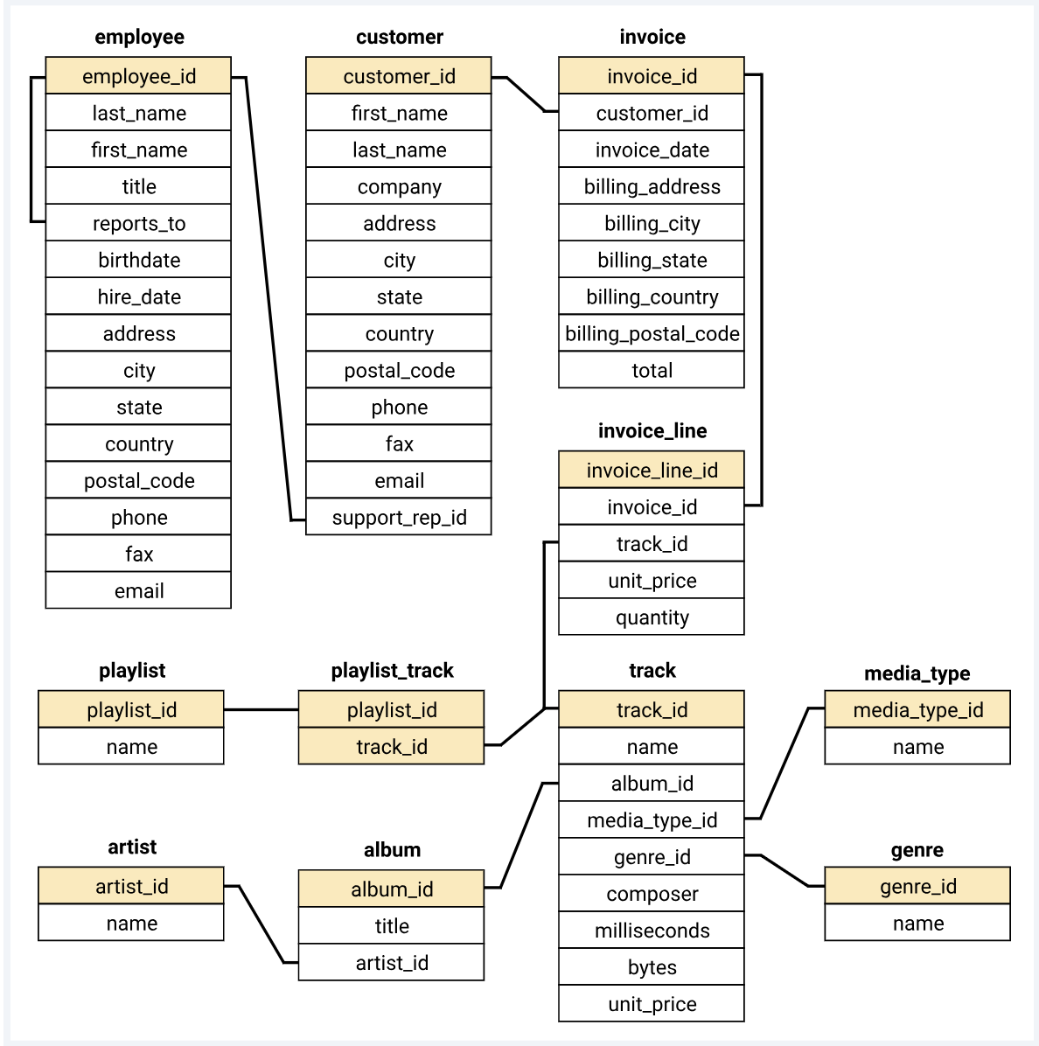
Overview
Objects with human and animal forms that may have been toys
have been found in deposits from ancient Sumer dating to 2600 BCE.
The global toys and games market size was estimated
at USD 291.72 billion in 2021.
Project Phase I
1. Who is the senior most employee based on job title?
2. Which countries have the most Invoices?
3. What are top 3 values of total invoice?
4. Which city has the best customers? We would like to throw a promotional Music Festival in the city we made the most money. Write a query that returns one city that has the highest sum of invoice totals. Return both the city name & sum of all invoice totals
5. Who is the best customer? The customer who has spent the most money will be declared the best customer. Write a query that returns the person who has spent the most money
Project Phase II
1. Write query to return the email, first name, last name, & Genre of all Rock Music listeners. Return your list ordered alphabetically by email starting with A
2. Let's invite the artists who have written the most rock music in our dataset. Write a query that returns the Artist name and total track count of the top 10 rock bands
3. Return all the track names that have a song length longer than the average song length. Return the Name and Milliseconds for each track. Order by the song length with the longest songs listed first
Project Phase III
1. Find how much amount spent by each customer on artists? Write a query to return customer name, artist name and total spent
2. We want to find out the most popular music Genre for each country. We determine the most popular genre as the genre with the highest amount of purchases. Write a query that returns each country along with the top Genre. For countries where the maximum number of purchases is shared return all Genres
3. Write a query that determines the customer that has spent the most on music for each country. Write a query that returns the country along with the top customer and how much they spent. For countries where the top amount spent is shared, provide all customers who spent this amount

Slide 3
Problem

Slide 4
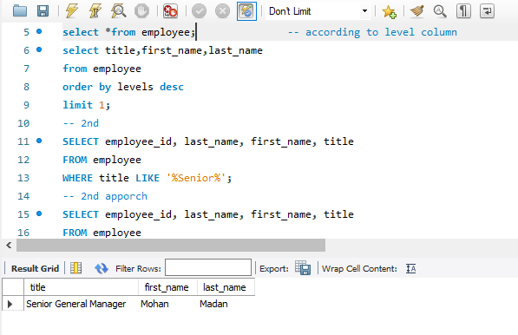
Insights
1. Who is the senior most employee based on job title?
Senior most employee is Mohan Madan (Senior General Manager)

Slide 5
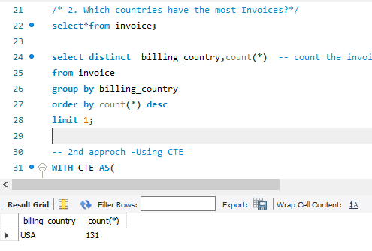
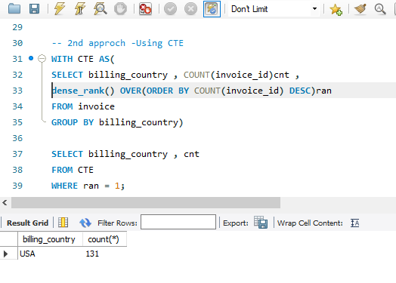
2. Which countries have the most Invoices?
It is clearly seen from the more the number of countries more will the number of invoices.
Maximum countries are from Europe only.
Europe is on the top in terms of invoices generated ,instead of this countries of Europe fail to be top in terms of invoices generated(Top country is of North America(USA).
USA played a major role in terms of invoices invoice generated in North America.

Slide 6
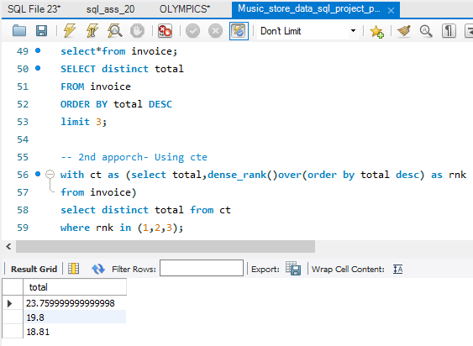
3. What are top 3 values of total invoice?
Top 3 values of total invoice contain 4 Countries.

Slide 7
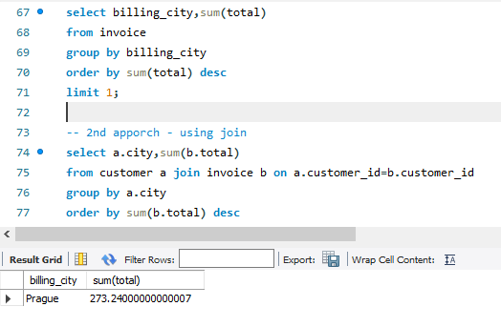
4. Which city has the best customers? We would like to throw a promotional Music Festival in the city we made the most money. Write a query that returns one city that has the highest sum of invoice totals. Return both the city name & sum of all invoice totals
These are the cities having in terms of maximum total invoice.
So for throw a promotional music festival , choose any one of these.
It is better to choose Prague because top 2 customers also belong to this city only(as shown next page graph).

Slide 8
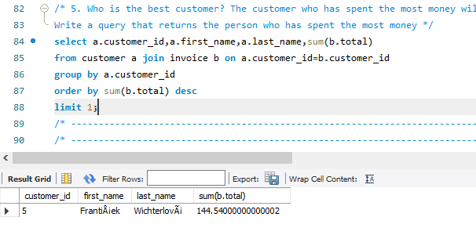
5. Who is the best customer? The customer who has spent the most money will be declared the best customer. Write a query that returns the person who has spent the most money

Slide 9
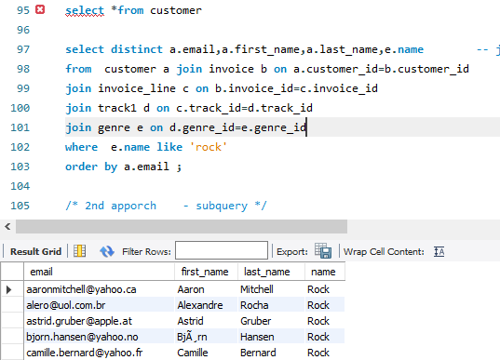
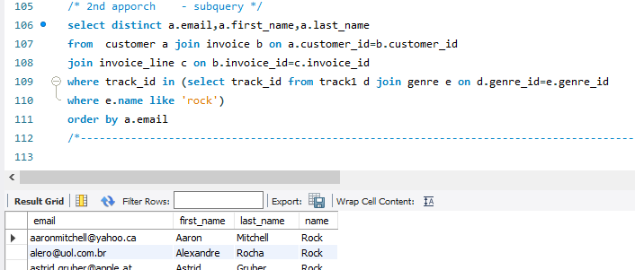
Project Phase II
1. Write query to return the email, first name, last name, & Genre of all Rock Music listeners. Return your list ordered alphabetically by email starting with A
Rock is the only music genre which is popular in all country except Argentina.

Slide 10
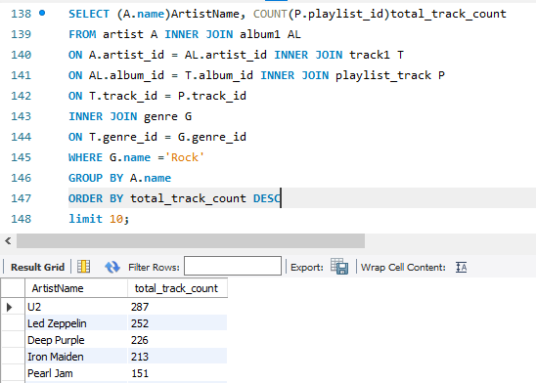
2. Let's invite the artists who have written the most rock music in our dataset. Write a query that returns the Artist name and total track count of the top 10 rock bands
it,

Slide 11
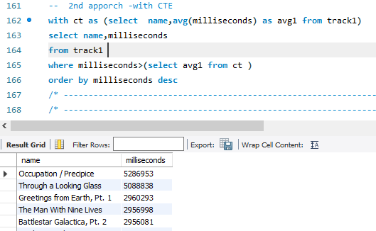
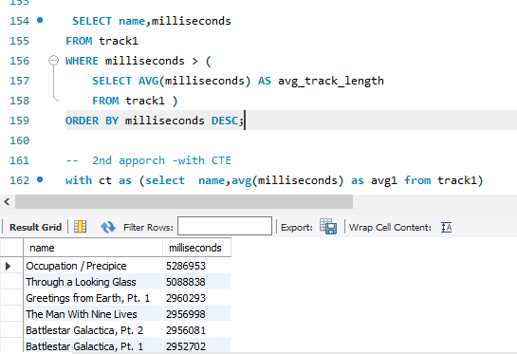
3. Return all the track names that have a song length longer than the average song length. Return the Name and Milliseconds for each track. Order by the song length with the longest songs listed first

Slide 12
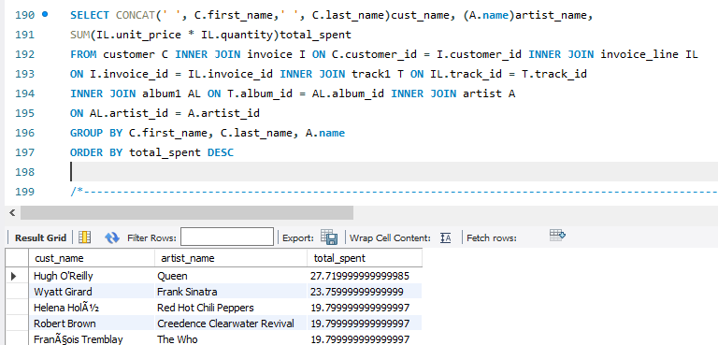
Project Phase III
1. Find how much amount spent by each customer on artists? Write a query to return customer name, artist name and total spent

Slide 13
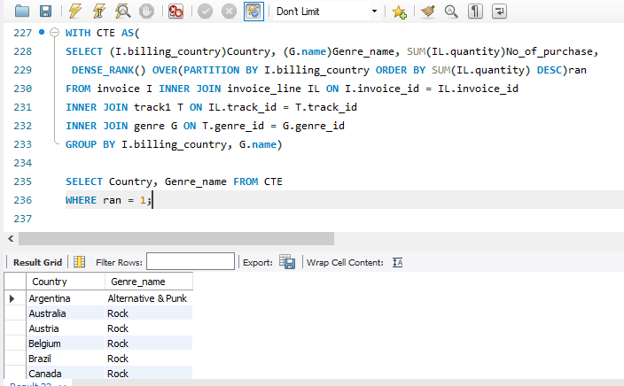
2. We want to find out the most popular music Genre for each country. We determine the most popular genre as the genre with the highest amount of purchases. Write a query that returns each country along with the top Genre. For countries where the maximum number of purchases is shared return all Genres

Slide 14
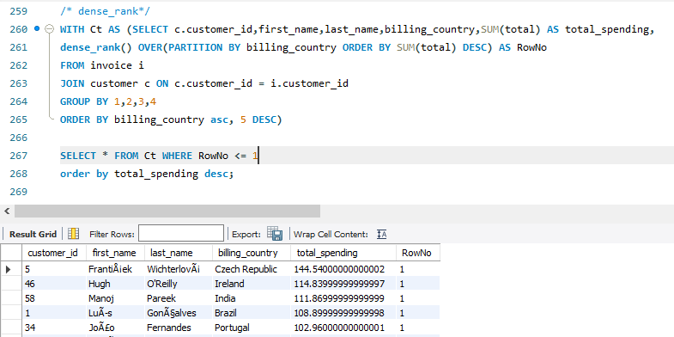
3. Write a query that determines the customer that has spent the most on music for each country. Write a query that returns the country along with the top customer and how much they spent. For countries where the top amount spent is shared, provide all customers who spent this amount

Slide 15
Thank YOU!
Priyanka Gaikwad

