Slide 1
PORTABLE
HOTBAG
By: Priyanka saraf
College: Amrita Vishwa Vidhyapeetham,Chennai

Slide 2
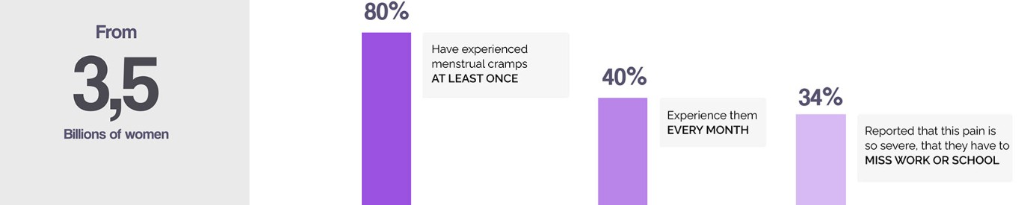
UNDERSTANDING THE FEMALE BODY
Women experience menstrual cramps every month, usually just before or during menstruation, leading to pain in the lower abdomen. This common occurrence affects many working women and female students, often disrupting their daily lives. Carrying a hot water bag, a common remedy for cramps, may be impractical in certain workplaces due to its lack of portability.

Slide 3
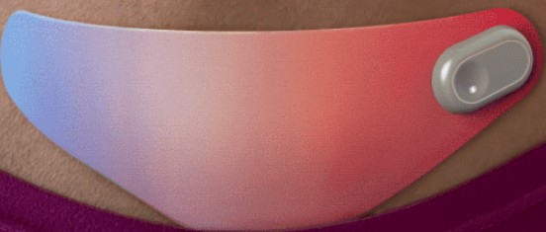
PORTABLE HOTBAG
The idea of creating a smart, portable hot bag for alleviating menstrual cramps is innovative and addresses a practical need for women on the go. This product could provide a convenient and discreet solution for managing menstrual discomfort, catering to the lifestyle of working women and students. The key features may include portability, user-friendly design, and smart heating technology. Exploring materials that are both effective in heat retention and lightweight would be crucial in the development process. Additionally, incorporating smart features, such as customizable temperature settings and a compact design, could make this product stand out in the market. Collaborating with health professionals and obtaining user feedback during the development phase would contribute to creating a successful and well-received product

Slide 4
Temperature control:
FEATURES OF HOTBAG
The proposed hot bag aims to integrate smart technology, combining style with portability for versatile use. This innovative approach seeks to enhance the user experience by making the hot bag not only effective in relieving menstrual cramps but also fashionable and easy to carry, providing a convenient solution that can be utilized anytime and anywhere.
01.
Self-regulating temperature: The bag could adapt its temperature based
on sensor readings to maintain a constant optimal warmth or adjust to user preferences.
02.
Power bank function:
The hotbag could double as a portable power bank to charge your devices on the go.
Massage functionality
The bag could vibrate gently or pulsate to provide a massaging effect, enhancing muscle relaxation.:
03.

Slide 5
Thank you !!

