Slide 1
Event-Related Potentials Classification using XDawn+LDA
Preksha Joon
Priyanka Aravindan
Chinedu Obiefuna

Slide 2
ERP Dataset
Limitations
Severe class imbalance (1:5): Only ~17% of trials are targets. This limits the signal-to-noise ratio for target-locked ERPs (P300) compared to non-target averages, and can bias classifiers if used for BCI decoding.
Low target count (~60–80 per participant): After artifact rejection, the usable target epochs may drop below 50, which is marginal for stable single-subject ERP averages.
Small sample (N=10): limited generalizability.
Each trial lasts 750 ms, so a 60-trial block takes ~45 s; over 5–6 minutes, this yields ~6–8 blocks (≈360–480 trials per participant; 3,600–4,800 total).
Each trial produces a 750 ms epoch; at 1000 Hz, that’s 750 samples per channel (~24,750 across 33 channels).
The target-to-non-target ratio is 1:5, resulting in ~60–80 target epochs per participant.
Pros:
High efficiency: 360–480 trials in 5–6 minutes, with abundant non-target data (~83%) for strong signal-to-noise and ERP analysis (e.g., N170/VPP).
Clean design: Simple 500 ms stimulus + 250 ms silhouette structure enables clear epoching and straightforward preprocessing.

Slide 3
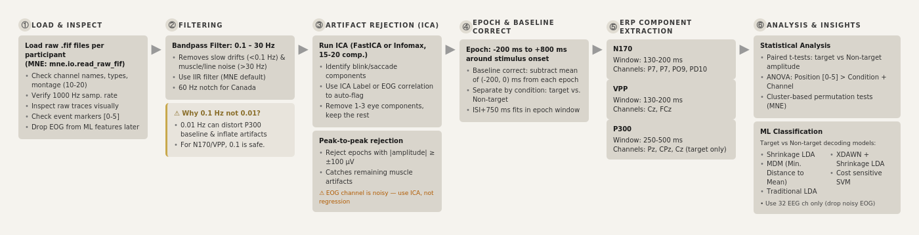
Pipeline

Slide 4
Preprocessing
Why ICA?
Steps
Loss pass (0.1 Hz)
High pass(30 Hz)
ICA
Core idea: Separates EEG into independent sources → isolates brain activity vs artifacts (blinks, muscle).
Why use it: Cleans data without rejecting trials, preserving statistical power.
How it works: Assumes EEG = linear mix → estimates components → remove artifact ones → reconstruct signal.
Pipeline: Preprocess → run ICA → identify artifacts → remove → rebuild EEG.
Benefits: Better SNR, clearer ERPs (e.g., N170, P300).
Limitations: Needs enough data/channels; component labeling can be subjective.

Slide 5
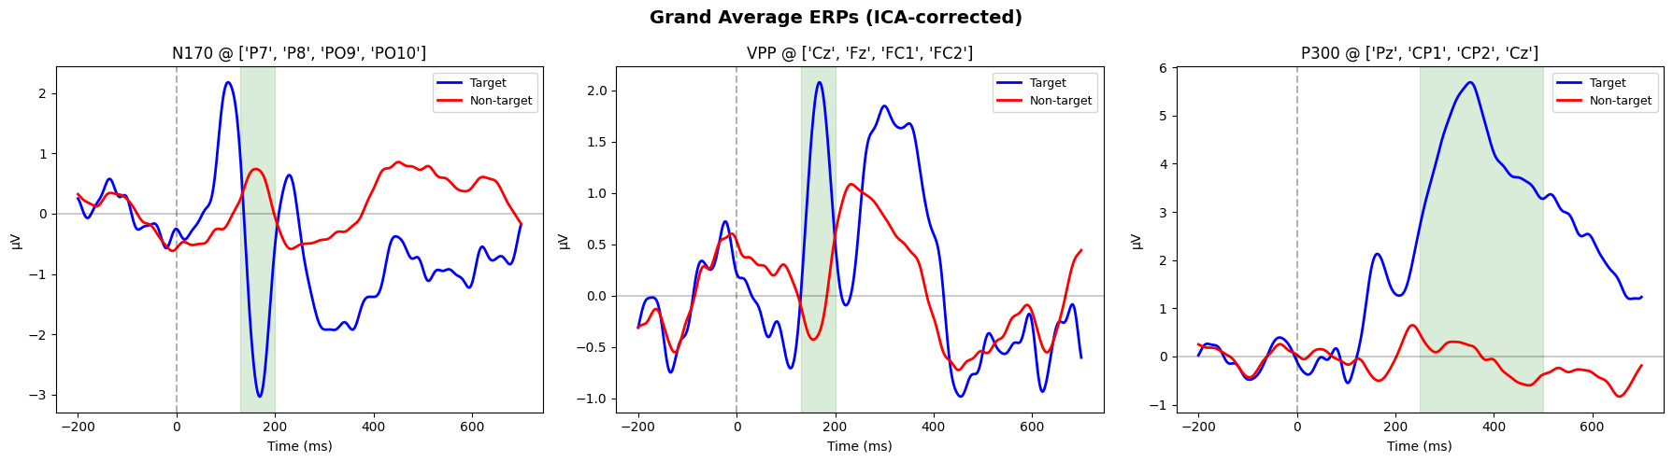
Analysis (P300 vs N170 vs VPP)

Slide 6
Modelling
Validation and Testing
Shrinkage LDA (due to small spiky dataset)
Traditional LDA
Cost sensitive SVM
MDM
XDAWN+Shrinkage LDA
Subject- Hold out (8/1/1), (9/1)
K-Fold (70/10/20)

Slide 7
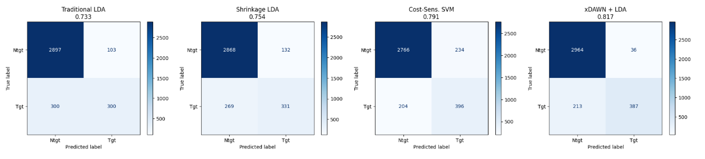
Insights and Results

Slide 8
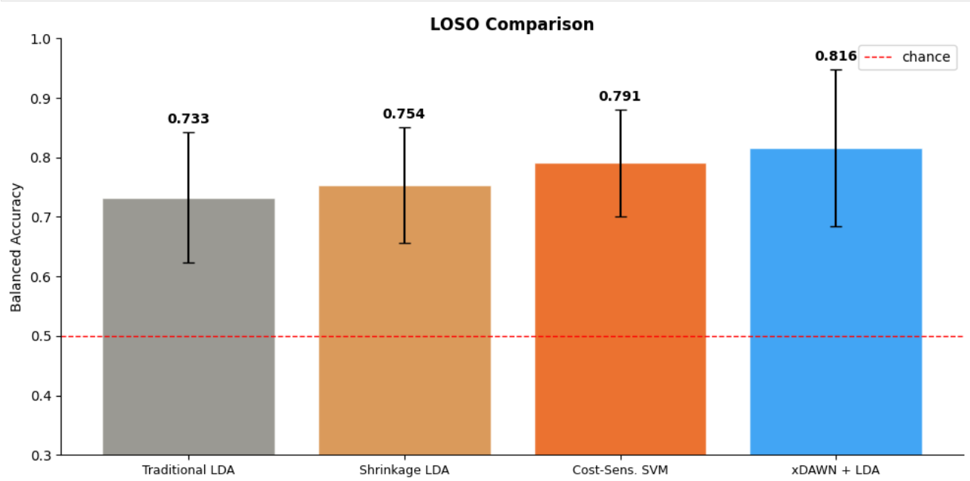

Slide 9
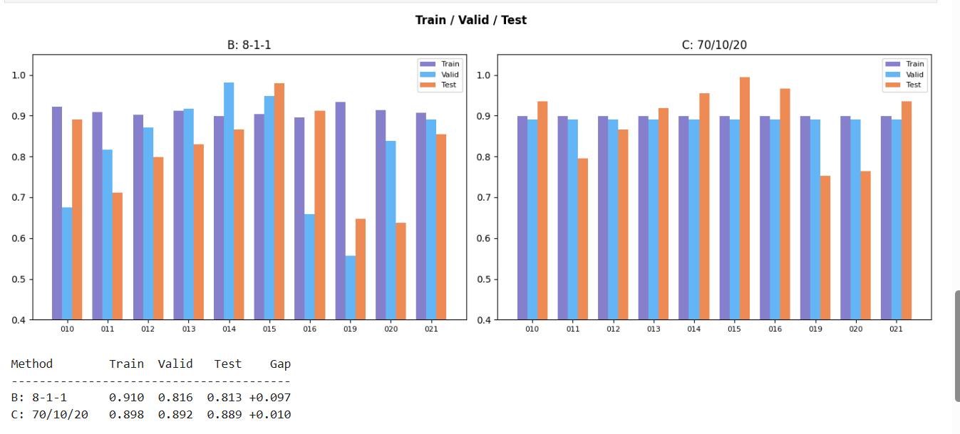
Future Work

Slide 10
Future Work
Practical Implications
Using Harmonic Mean Linear Discriminant Analysis
Specifying channels which can give good results
Applying more signal processing techniques
Increasing dimensionality with polynomial harmonics
Expand this understanding for FlickerOddball
BCI Spellers: 81.6% cross-subject accuracy with 60 trials → plug-and-play, no calibration.
Attention Monitoring: Detect rare events from a single trial (1:5 odds).
Clinical Screening: Large P300 effect (d = 2.02) flags conditions; atypical responses are informative.
Small-Data Playbook:
<20 subjects → domain features
Spatial boost → xDAWN
Fast models → Shrinkage LDA (seconds vs minutes)
Riemannian → only if 50+ subjects

Slide 11
References
The “Independent Components” of Natural Scenes are Edge Filters ANTHONY J. BELL*,† and TERRENCE J. SEJNOWSKI* *Howard Hughes Medical Institute, Computational Neurobiology Laboratory,1997
Simar, Cédric & Petit, Robin & Bozga, Nichita & Leroy, Axelle & Cebolla, Ana & Petieau, Mathieu & Bontempi, Gianluca & Cheron, Guy. (2022). Riemannian classification of single-trial surface EEG and sources during checkerboard and navigational images in humans. PLOS ONE. 17. e0262417. 10.1371/journal.pone.0262417.
https://www.frontiersin.org/journals/neuroscience/articles/10.3389/fnins.2023.1133933/full?utm_source=chatgpt.com#S3

