Slide 1

3,600
ERP Classification
Total Epochs
0.816
using xDAWN + LDA
Best Accuracy
Oddball Paradigm | 10 Subjects | 32 EEG Channels
4
Models Compared
d=2.02
P300 Effect Size
Preksha Joon
Priyanka Aravindan
Chinedu Obiefuna
NeuroHack 2026

Slide 2

The Dataset
Specifications
Challenges
Paradigm: Oddball (target/non-target)
Participants: 10 subjects, 5-6 min each
Channels: 32 EEG + 1 HEOG (dropped)
Sampling: 1000 Hz, avg referenced
Trials: 60 target + 300 non-target per subject
Ratio: 1:5 class imbalance
Epoch: 750 ms ISI, [-200, 700] ms window
Severe 1:5 class imbalance
Only ~60 targets per subject
Small sample (N=10) limits generalizability
Strengths
High efficiency: 360 trials in 5 min
Clean design for easy epoching
Abundant non-target data for ERP averaging

Slide 3

Processing Pipeline
1
Load
2
Clean
3
ICA
4
Filter
5
Epoch
6
Classify
Raw EEG
33 channels
1000 Hz
Drop HEOG
Keep 32 EEG
Avg-ref rank 31
1Hz copy → fit
Surrogate EOG
ID eye ICs
0.1–30 Hz
Apply ICA
Single path
[-200, 700]ms
Baseline correct
3,600 epochs
4 methods
LOSO eval
Balanced acc
▶
▶
▶
▶
▶
ICA uses a two-track strategy: aggressively filtered copy for training, gently filtered original for ERP preservation

Slide 4

Preprocessing: Why ICA?
Core Idea: ICA separates EEG into independent sources, isolating brain activity from artifacts (blinks, saccades, muscle). It cleans data without rejecting entire trials, preserving statistical power for ERP analysis.
Surrogate EOG
Eye IC Detection
Apply to Original
VEOG = (Fp1+Fp2)/2
HEOG = F8 - F7
Built from EEG channels
4 criteria voting system:
EOG correlation + topography
+ ICLabel (need 2+ votes)
ICA matrix from 1Hz copy
applied to 0.1-30 Hz data
Preserves slow P300

Slide 5

ERP Components & Statistics
N170
VPP
P300
Face-sensitive negative peak at posterior sites
Vertex positive potential, frontal mirror of N170
Target detection response, strongest ERP effect
-2.13 uV
+1.47 uV
+4.30 uV
target amplitude
target amplitude
target amplitude
Window
130-200 ms
Window
130-200 ms
Window
250-500 ms
Channels
P7/P8/PO9/PO10
Channels
Cz/Fz/FC1/FC2
Channels
Pz/CP1/CP2/Cz
Cohen's d
-1.31
Cohen's d
+0.86
Cohen's d
+2.02
p-value
.003**
p-value
.023*
p-value
<.001***

Slide 6
Classification Methods
# | Method | Input | Key Idea | Acc
1 | Traditional LDA | 64 features | Mean amplitude in N170+P300 windows | 0.733
2 | Shrinkage LDA | 192 features | Ledoit-Wolf regularization for p > n | 0.754
3 | Cost-Sensitive SVM | 192 features | RBF + class weights + GridSearch C | 0.791
4 | xDAWN + LDA | Raw epochs | Supervised spatial filter maximizes ERP SNR | 0.816
Evaluation Strategy
LOSO (9/1)
8/1/1 Split
Pooled 70/10/20
Train on 9 subjects, test on 1. Strictest cross-subject test.
8 train, 1 validation, 1 test. Checks model stability.
Stratified per-subject split. Tests within-subject generalization.

Slide 7
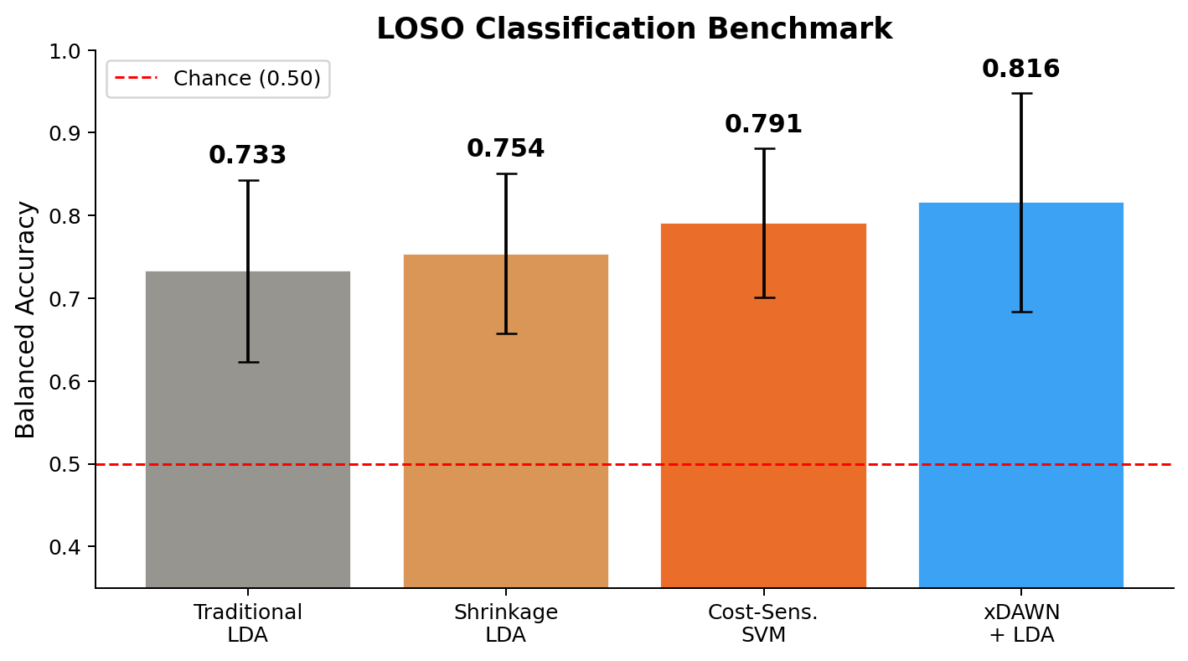
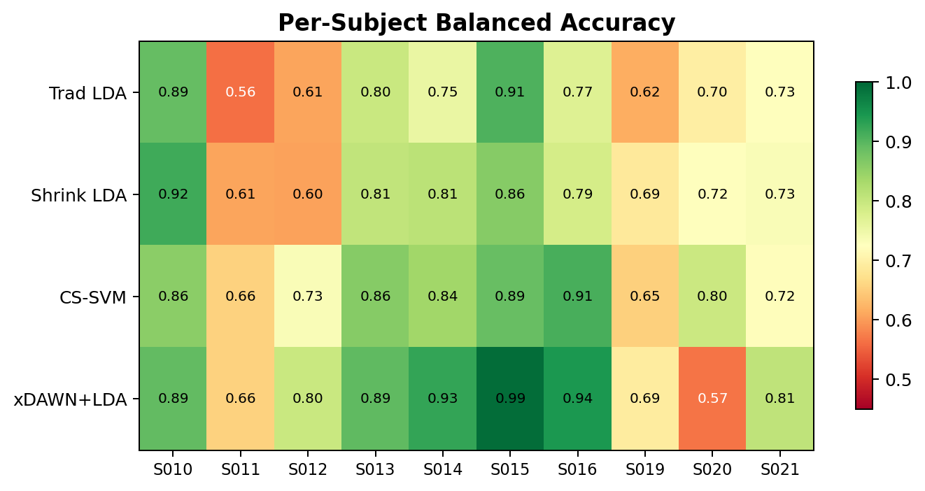
Results: LOSO Benchmark
Winner
xDAWN + LDA
0.816 balanced accuracy
Statistically significant over Traditional LDA (p=.037)
Key: xDAWN learns optimal spatial filters from data, compressing 32 channels into 8 virtual channels that maximize target-evoked SNR. It bridges data-driven learning with regularized classification.
Per-subject balanced accuracy

Slide 8




Key Insights
xDAWN wins without domain knowledge
Never told where P300 is, yet outperforms hand-picked features. Learns optimal spatial filters directly from the data.
Subject variability is the bottleneck
Sub-015 reaches 0.992 while sub-020 drops to 0.568. A 42-point gap on the same model — the algorithm isn't the limit, inter-subject differences are.
Rich features beat basic features
Shrinkage LDA (192 features: mean+peak+variance) scores 0.754 vs Traditional LDA's 0.733 (64 features: mean only). Variance captures temporal stability.
Domain knowledge still matters
Traditional LDA (0.733) uses 60 years of ERP literature to pick exact windows. It beats any method that ignores this knowledge entirely.
ICA doesn't affect classification much
With vs without ICA: <2% difference in balanced accuracy. ICA matters for ERP amplitude statistics, not for coarse binary classification.

Slide 9

Future Work & Practical Implications
Future Work
Practical Implications
Harmonic Mean LDA for better class separation
Channel importance analysis (which electrodes drive results)
Advanced signal processing (wavelet, time-frequency)
Polynomial feature expansion
Extend to FlickerOddball paradigm
Riemannian alignment for cross-subject transfer
BCI Spellers
81.6% cross-subject with 60 trials.
Plug in, skip calibration, start typing.
Attention Monitoring
Detect rare events from a single trial
at 1:5 odds. ATC, surgical monitoring.
Clinical Screening
P300 effect (d=2.02) flags neurological
conditions. Failures are diagnostic too.
Small-Data Playbook
<20 subjects: domain features.
Spatial boost: xDAWN. Speed: Shrinkage LDA.

Slide 10

References
Bell, A.J. & Sejnowski, T.J. (1997). The 'Independent Components' of Natural Scenes are Edge Filters. Vision Research, 37(23), 3327-3338.
Simar, C., Petit, R., et al. (2022). Riemannian classification of single-trial surface EEG and sources during checkerboard and navigational images. PLOS ONE, 17, e0262417.
Rivet, B., Souloumiac, A., Attina, V. & Gibert, G. (2009). xDAWN Algorithm to Enhance Evoked Potentials. IEEE Trans. Biomedical Engineering, 56(8), 2035-2043.
Barachant, A., Bonnet, S., Congedo, M. & Jutten, C. (2012). Multi-class Brain-Computer Interface Classification by Riemannian Geometry. IEEE Trans. Biomedical Engineering, 59(4), 920-928.
Ledoit, O. & Wolf, M. (2004). A well-conditioned estimator for large-dimensional covariance matrices. Journal of Multivariate Analysis, 88(2), 365-411.
Thank you

