Slide 1



“Rethinking Total Reward Management in the Post COVID-19 Era – Women Working Remotely in India”
MSc IB Advanced Research Project
CW3: Digital Presentation
Presented by
Varun Kumar, SID: 20054993
Under the Supervision of Prof. Mauro Giles

Slide 2
Declaration
I declare the assignment is my own work and is written by myself. I understand any forms of cheating, e.g. outsourcing and collusion will result in academic misconduct allegation and consequent fail of the module and record on my student file.
I declare that my Assignment involves ONLY non-plagiarised primary and secondary sources that any member of the public is legitimately free to access and use without obtaining permission.
I declare that I did NOT carry out any primary research without the University’s ethics approval, and the work does NOT include any first-hand data in breach of the University’s ethics protocol.
I declare that I understand what plagiarism, fake referencing and falsification mean, their practical application and have read the guidelines and regulations relating to them. I have also attended the AEB sessions and/or CASE support understanding and avoiding plagiarism.
I declare I have submitted my Assignment to Turnitin, checked the similarity score of my Assignment and where it falls within the unacceptable similarity score bands have reviewed the Assignment to ensure it is within the required bands. Furthermore, that despite an acceptable similarity score, high single sections of text have also been corrected.
I declare that I understand contract cheating/ essay milling / use of AI (bots) is a form of academic misconduct and is illegal in the UK. Any form of academic misconduct will be investigated by the University. Once found, the module grade will be penalised, and the misconduct will also be recorded on the Student Record. It may also lead to scams and other adverse consequences.
I declare I understand the deadline of the submission and the penalty it may occur for any unauthorised late submission.
I understand that failure to comply with the University of Hertfordshire Regulations on academic integrity and programme requirements will result in the application of penalties with repeated offence leading to disciplinary action. The ultimate penalty will be expulsion from the programme.
Varun Kumar, SID: 20054993

Slide 3
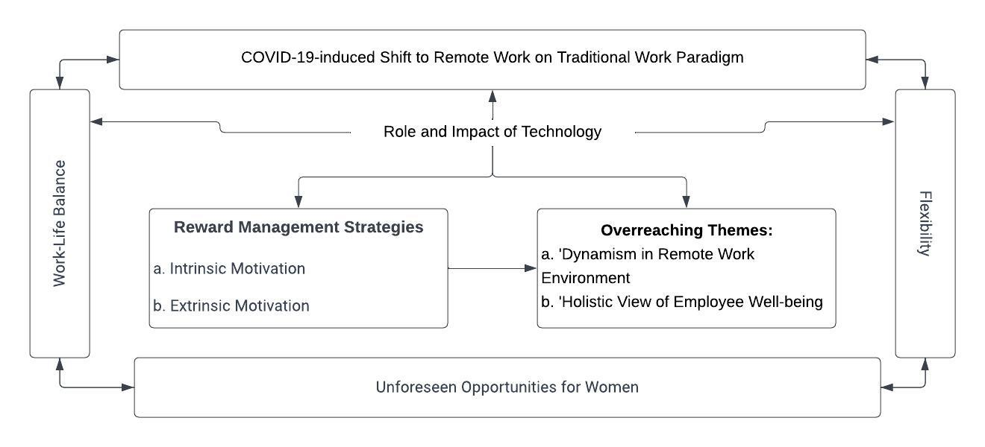
Theoretical Foundation and Research Landscape

Slide 4
Deciphering Remote Reward Management in India
Evolution of reward management from the Industrial Revolution to high-performance work systems
Impact of COVID-19 on reward management strategies
Emergence and acceleration of remote working trends
Financial benefits to firms from remote working
Investigation of benefits sharing with remote employees
Focus on women working remotely in India amidst sociocultural complexities
Future implications for organisational reward management strategies

Slide 5
Objectives: Predicting Post-COVID Reward Management
Aim
To predict the potential impact of the probable workplace scenario in the post-COVID-19 scenario and its impact on the theory and practice of reward management.
Objectives
To examine the historical changes in organisational reward management strategies.
To assess the impact of COVID-19 on organisational reward management strategies.
To predict the potential impact of the post-COVID-19 workplace scenario (future of work) on organisational reward management strategies.
To recommend reward management strategies to companies facilitating remote working.

Slide 6
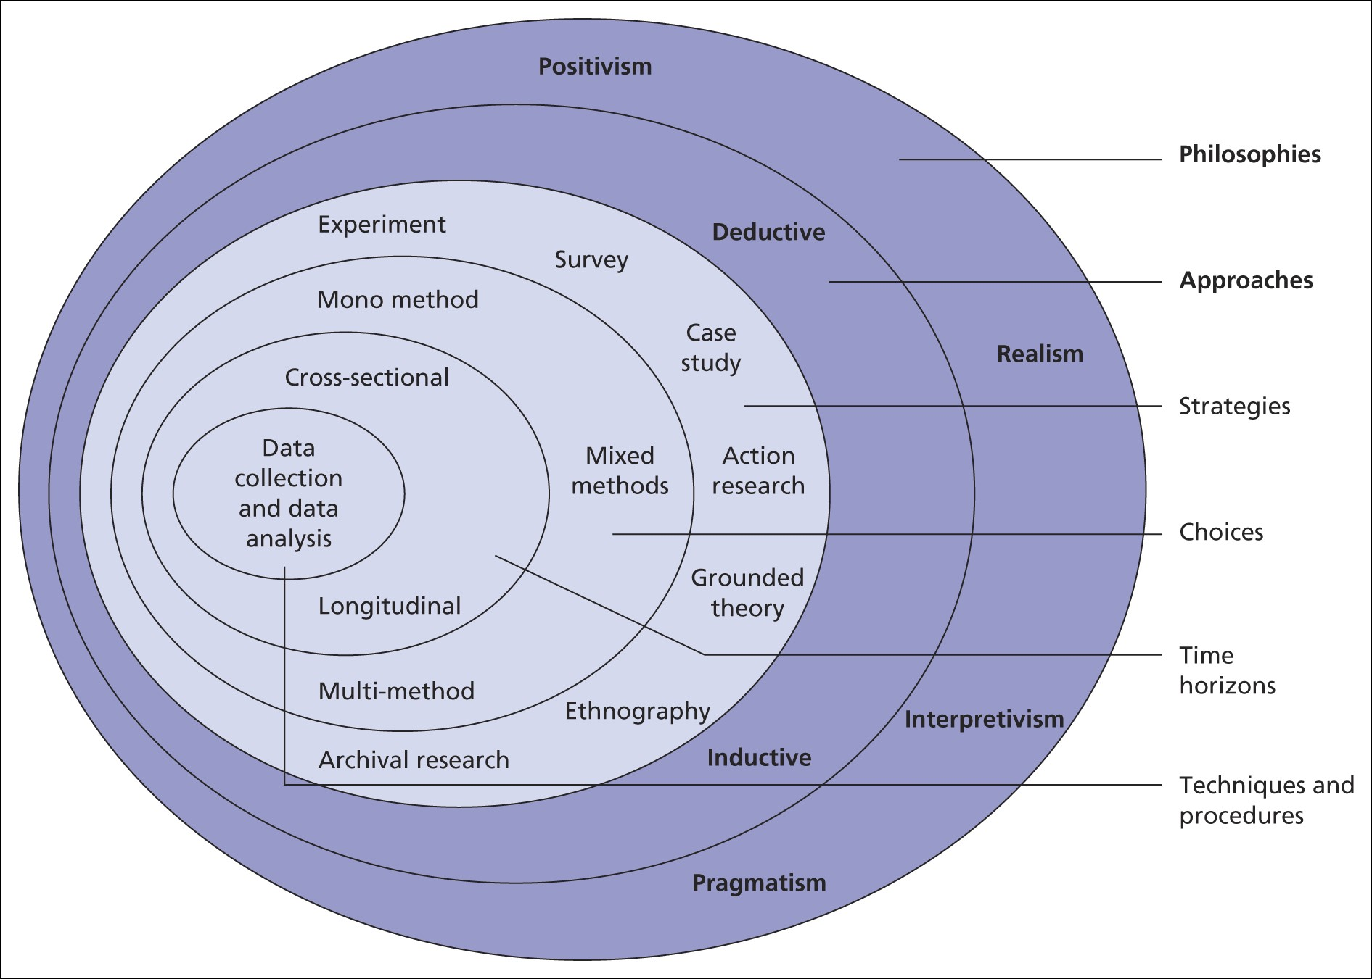
Methodological Approach: Peeling the Research Onion
Figure-1: Research Onion
Table-1 : Comparative Research Methodologies
Potential Methods | Chosen Methods & Justifications
Positivism, Realism | Interpretivism: Allowed understanding of remote women workers' subjective experiences.
Survey, Experimental Design | Case Study: Delved deep into real-world scenarios for female remote workers in India.
Quantitative Analysis, Descriptive Analysis | Thematic Content Analysis: Identified patterns and themes in data for detailed interpretation.
Primary Data Collection (Surveys, Interviews) | Secondary Data Only: Efficient and leveraged existing reliable sources for a comprehensive view.
Saunders et al., 2019

Slide 7
Dissertation Journey: Key Milestones
April-May 2023:
Topic Selection & Justification
Preliminary Literature Review
5 Key Research Papers Identified
Formulation of Research Question
Designing Research Approach
Drafted Proposal & Supervisor Approval
Regular Supervisory Sessions
Demonstrated Critical Writing Skills
May 2023:
CW-1: Literature Review Submission
June 2023:
CW-2: Methodology Submission
July-August 2023:
Thematic Literature Analysis
PPT Crafting & Refinement
Presentation Practice & Peer Feedback
Final Presentation Preparations
Thorough Proofreading & Editing
Digital Presentation

Slide 8
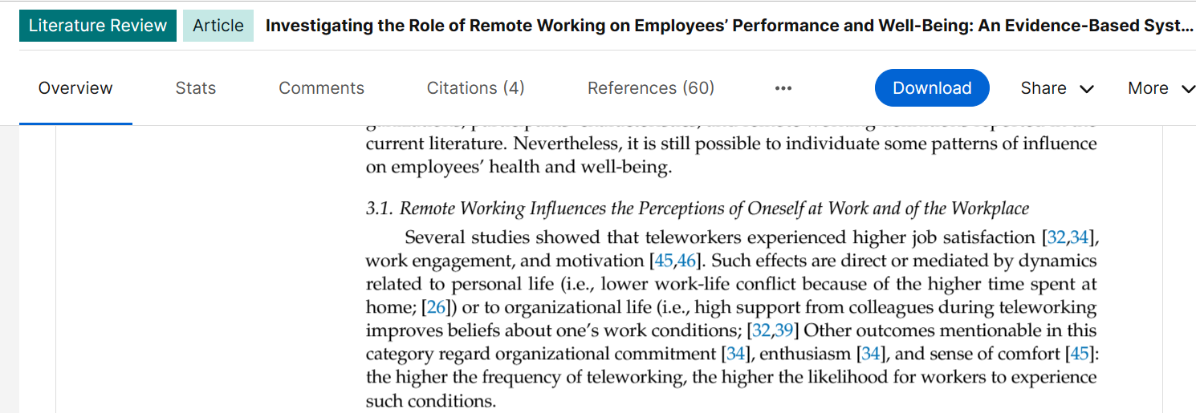
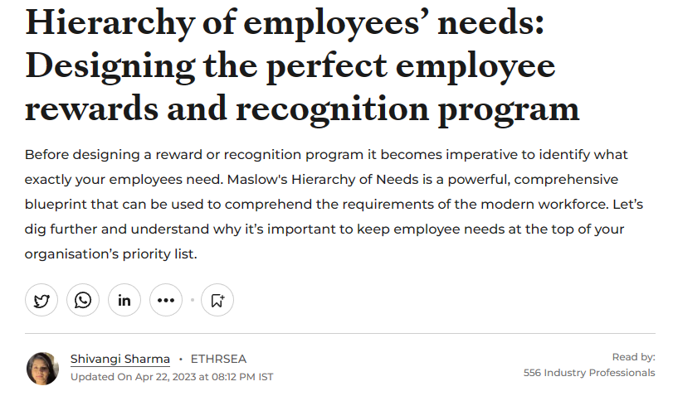
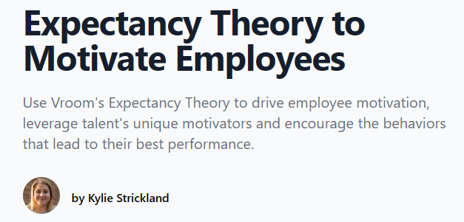
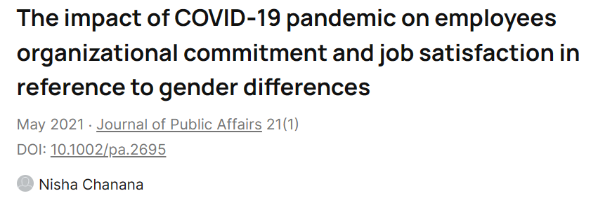
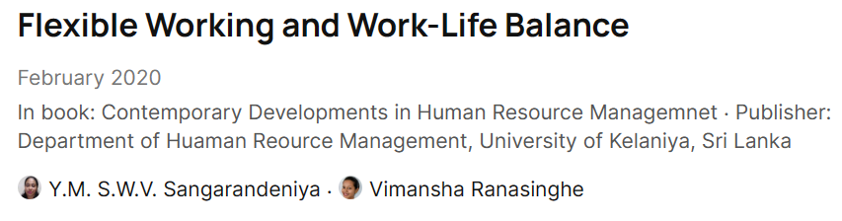
Literary Insights: Reward Management Evolution
Historical Changes
Pre-COVID-19: Dominated by traditional norms.
During COVID-19: Shift towards flexibility, job security.
Post-COVID-19: Balance between intrinsic motivators and extrinsic factors.
Key Theories Applied:
Maslow's Hierarchy of Needs: Address different employee needs.
Vroom's Expectancy Theory: Understand changing employee expectations during COVID-19.
Herzberg's Two-Factor Theory: Distinguish between intrinsic and extrinsic reward factors post-COVID-19.
Literature Gaps:
Effective incorporation of reward changes in organisations' strategies.
Francis et al., 2020
Sharma, 2023
Strickland, 2021
Chanana, 2021
Sangarandeniya & Ranasinghe, (2020),

Slide 9
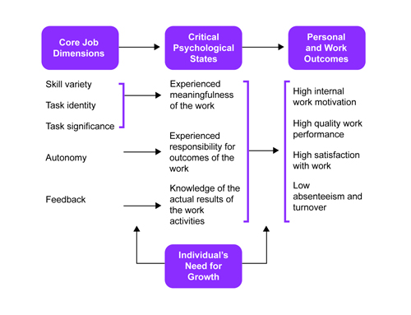
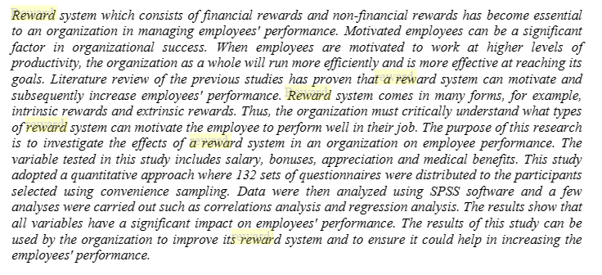
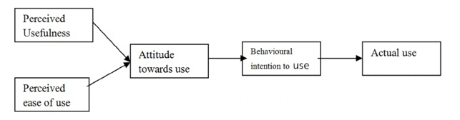
Impact of COVID-19 on Rewards
Remote Work Shift: Increased autonomy and flexibility; potential drawbacks.
Employee Needs: Changed post-COVID; balance of intrinsic and extrinsic motivators.
Technological Factors: Role in shaping reward perceptions; potential for disparities.
Re-imagining Rewards: Emphasis on personalisation and technology.
Sub-Topic | Key Finding
Remote Work Shift | Increased emphasis on non-monetary rewards in remote work (Sharma, 2023)
Employee Needs | Heightened need for flexible and personalised rewards (Cavrenne, 2022)
Technological Factors | Technology-enabled rewards enhance perceived value (Agarwal, 2016)
Figure 3: Job Characteristics Model
Noorazem et al., 2021
Source: Hackman & Oldham (1976)
Source: Based on Davis, (1989)

Slide 10
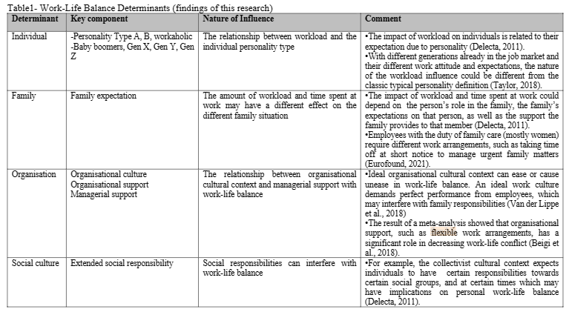
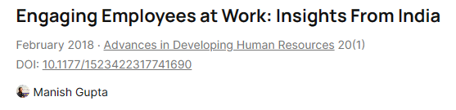
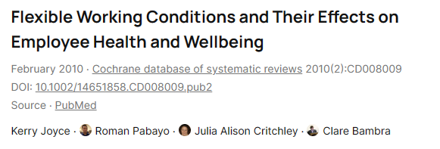
Future of Work: Reward Dynamics
Aspect | Literary Evidenc
Flexible Work Dynamics | Flexible work models foster better work-life balance and influence the perceived value of rewards (Joyce et al., 2010).
Altering Performance Metrics | Changes in performance metrics can significantly impact employees' goal orientations and reward perceptions (De-la-Calle-Durán & Rodríguez-Sánchez, 2021).
Wellbeing and Rewards | Wellbeing-focused initiatives in reward strategies enhance motivation and the effectiveness of rewards Carnevale & Hatak, 2020.
Flexible Work Arrangement
Challenging Goals
Task Performance
Work Outcomes (Goal)
Perception of Fairness in Rewards
based on Locke & Latham (1990)
Wiatr, (2021).
Gupta, (2017)
Flexible Work Arrangement
Job Satisfacion
Task Commitment
Financial Reward
Employee Centric Approach
Source: based on Mamatha and Lakshmi (2020)
Joyce et al., 2010

Slide 11
Thematic Analysis for Secondary Data: Insights & Rationale
Document Review: Deep dive into published materials.
Coding Process: Extraction of themes from literature sources.
Theme Formation: Collating common threads across sources.
Theme Validation: Cross-referencing for consistent representation.
Advantages: Rigorous method, unearthing underlying narratives.
Considerations: Reliance on prior work, potential for pre-existing biases.
Based on Braun and Clarke (2006)

Slide 12
Thematic Analysis: Reward Management Evolution
Thematic Analysis Stages | Applied Context
Familiarisation | Examined literature trajectory from pre-COVID-19, during, and post-COVID-19.
Coding | Identified pivotal points such as workplace norms, remote work dynamics, and employee needs.
Theme Formation | Historical changes, Pre-COVID-19 norms, COVID-19 impact, Post-COVID-19 expectations.
Theme Review | Analysed literature gaps; reward strategies' implications and adaptations.
Advantages | Comprehensive view of reward strategy shifts; based on various theories (Maslow, Vroom, Herzberg).
Consideration | Pre-existing biases; scope limitation to women working remotely in India.
Table Implications: findings implied a pressing need for ensuring job security and health benefits. Hedstrom and Munoz's (2021) research stressed the imperative of offering meaningful work and development opportunities. Lastly, insights recommended restructuring reward systems to encompass flexible work setups and work-life balance.
In addressing RO-1 (To examine the historical changes in organisational reward management strategies), the research discerned the historical evolution of reward management strategies for Indian women working remotely, marking significant shifts from the pre-COVID era through to the post-COVID landscape.
Pre-COVID-19: detailed how traditional norms governed reward strategies for remotely-working Indian women, with limited flexibility and a focus on office-centric work. Cardon & Patel (2020) highlighted that while competitive salaries and bonuses met physiological needs, there were challenges like the gender wage gap and limited career advancement, which could deter higher-order needs fulfilment.
COVID-19 Impact: acknowledged the pandemic as a catalyst for change in reward strategies, shifting expectations and preferences of remotely-working women in India. Sangarandeniya & Ranasinghe (2020) found a growing preference for rewards such as flexible working hours, while spotlighted the rise of job security's importance due to economic instability.
Post-COVID-19: The balance between Herzberg's intrinsic motivators and extrinsic elements shifted, as observed by with an increased focus on job security. Yet, Hedstrom and Munoz (2021) noted the heightened significance of professional development and meaningful work. emphasised the redefined reward perspective, though the longevity of these changes post-COVID-19 remained uncertain.

Slide 13
Thematic Analysis: Impact of COVID-19
Figure 2
Familiarisation: Unpacked literature on COVID-19 factors and reward management.
Coding: Identified keywords: Remote Work Shift, Employee Needs, Technological Factors.
Theme Formation: Derived key insights: autonomy, feedback, intrinsic/extrinsic motivators, technology-enabled rewards.
Theme Review: Validated with studies (e.g., Sharma 2017, Tsipursky 2023).
Advantages: Holistic view of changing dynamics in reward management.
Consideration: Need for further research on technology's role and alignment with women's motivation in remote work.
My research illuminated the profound influence of COVID-19 on reward management strategies, underscoring shifts in remote work dynamics, evolving employee needs, and the pivotal role of technology for remotely-working women in India.

Slide 14
Thematic Analysis: Post-COVID Reward Strategies
The third research objective revealed that post-COVID-19 workplace transformations, encompassing flexible work models, evolving performance metrics, and heightened employee well-being, significantly reshape organisational reward strategies, especially for remote female employees in India.
Familiarisation: Reviewed post-COVID-19 workplace transformations.
Coding: Identified 'Flexible Work Models', 'Performance Metrics', 'Employee Well-being', and 'Adapting Reward Strategies'.
Theme Formation: Highlighted flexible work benefits, performance evaluation shifts, and well-being importance.
Theme Review: Assessed impact on reward strategies for remote female employees in India.
Advantages: Enhanced job satisfaction, increased employee engagement, holistic approach.
Consideration: Balance work-life, prevent burnout, ensure comprehensive performance metrics.

Slide 15
Research Q&A: Thematic Analysis Outcomes
In summary, my research offers a comprehensive lens into the changing landscape of reward management, shedding light on its past, present, and potential future, with a keen focus on remotely working women in India.
RQ-1: Historical Evolution of Reward Management?
RQ-2: COVID-19 Impact on Reward Management?
RQ-3: Post-COVID Future of Reward Management?
Marked shifts in reward strategies for remote Indian women from pre-to-post-COVID era.
COVID-19 underscored shifts in remote work, evolving needs, and technology's pivotal role.
Future reward strategies are significantly influenced by flexible work, performance metrics, and employee well-being.

Slide 16
Conclusions: Reward Management - Evolving Landscape
In conclusion, this research unveiled the dynamic transformation of reward management strategies, profoundly influenced by COVID-19, with a special emphasis on remote female employees in India.
Historical shifts in reward management reflected changing workplace norms, especially for remote female employees in India.
COVID-19 intensified the need for understanding employee motivations, with technology playing a pivotal role in reshaping reward strategies.
Post-COVID era brought to light the importance of flexible work models, evolving performance metrics, and heightened emphasis on employee well-being.

Slide 17
Recommendations: Future-Ready Reward Strategies
In essence, these recommendations form a blueprint for organisations to navigate the intricate post-COVID landscape, especially when considering the unique needs of remotely working women in India.
Embrace technology-driven rewards, ensuring they align with remote working dynamics and needs.
Prioritise flexibility, enabling a work-life balance and preventing potential burnouts.
Reframe performance metrics, focusing on holistic evaluations for remote work scenarios.
Reinforce well-being initiatives, acknowledging its direct link to motivation and job satisfaction.

Slide 18
Unearthed Limitations: Remote Reward Study
While the research comprehensively analysed reward management for remotely working Indian women, it highlighted the need for broader global perspectives and a deeper dive into technology's role.
Reliance on secondary data.
Potential biases in the literature.
Regional focus: India-centric.
Theories may not capture contemporary nuances.
Limited perspectives on technological factors.

Slide 19
Directions for Future Research
This research opened doors for multifaceted investigations, emphasising the need for primary data and a broader geographical lens, alongside a nuanced understanding of technology in reward management.
Primary data collection on remote women workers.
Expanding geographical scope beyond India.
Analysing technological advancements in reward management.
Comprehensive evaluation of intrinsic vs extrinsic motivators.
Assessing longevity of post-COVID reward strategies.

Slide 20
Secondary Declaration Note:
"I hereby affirm that my research exclusively utilises secondary public sources, accessible and usable without requiring specific permissions."

Slide 21
Thank You Note:
Respected Professors and the University of Hertfordshire,
I extend my sincere gratitude for the guidance and support throughout the process of my research on "Rethinking Total Reward Management in the Post COVID-19 Era – Women Working Remotely in India". Your insights and expertise have been invaluable in shaping this project.
Special thanks to my Program Leader, Prof. Charlotte Bryce, Module Leader, Prof. Samantha Jones, Module Tutor, Prof. Siegrid Beck, and Personal Tutor, Prof. Mauro Giles. Your dedication and wisdom have been instrumental in guiding me through the intricate nuances of the research journey.
I am immensely thankful for the knowledge imparted, and I look forward to contributing further to the academic community with the skills and perspectives gained.
Warm Regards,
Varun Kumar, SID: 20054993
MSc IB Advanced Research Project
University of Hertfordshire

Slide 22
References
Agarwal, M. (2016) How Is Technology Helping The Rewards Space, Entrepreneur. Available at: https://www.entrepreneur.com/en-in/technology/how-is-technology-helping-the-rewards-space/276666
Braun, V., & Clarke, V. (2006) Using thematic analysis in psychology. Qualitative Research in Psychology, 3(2), 77-101. Available at: https://www.tandfonline.com/doi/abs/10.1191/1478088706qp063oa
Cardon, M. S. & Patel, P. C. (2020) Is stress worth it? Stress-related health and wealth trade-offs for entrepreneurs. Academy of Management Discoveries, 6(2), 212-237. DOI: 10.1111/apps.12021
Carnevale, J. B., & Hatak, I. (2020) ‘Employee adjustment and well-being in the era of COVID-19: Implications for human resource management’. Journal of Business Research, 116, 183-187. DOI: 10.1016/j.jbusres.2020.05.037
Cavrenne, P. (2022) How flexible rewards are playing a key role in employee engagement, Ey. Available at: https://www.ey.com/en_be/workforce/how-flexible-rewards-are-playing-a-key-role-in-employee-engagement
Chanana, N. (2021) ‘The impact of COVID‐19 pandemic on employee’s organisational commitment and job satisfaction in reference to gender differences’. Journal of Public Affairs, 21(4). DOI: 10.1002/pa.2695
Davis, F.D. (1989) Perceived usefulness, perceived ease of use, and user acceptance of information technology. MIS Quarterly, 13(3), 319-340. Available at: https://doi.org/10.2307/249008
De-la-Calle-Durán, M. C., & Rodríguez-Sánchez, J. L. (2021) Employee Engagement and Wellbeing in Times of COVID-19: A Proposal of the 5Cs Model. International journal of environmental research and public health, 18(10), 5470. DOI: 10.3390/ijerph18105470
Francis, F., Zirra, C.T.O., & Mambula, C.J. (2020) ‘Reward System as a Strategy to Enhance Employees Performance in an Organization’. Archives of Business Review, Vol.8, No.6. 156-164. DOI:10.14738/abr.86.8403
Gupta, M. (2017) Engaging Employees at Work: Insights From India. Advances in Developing Human Resources, Vol. 20(1). DOI: 10.1177/1523422317741690
Hackman, J. R., & Oldham, G.R. (1976) ‘Motivation through the design of work: Test of a theory’. Organisational Behavior and Human Performance, 16(2), 250-279. DOI: 10.1016/0030-5073(76)90016-7
Hedstrom, P. and Munoz, M. G. (2021) Remote Work’s Effect on Motivation: A study of how remote work during the covid-19 pandemic has affected employee motivation. Master of Science Thesis- TRITA-ITM-EX 2021:294, KTH Industrial Engineering and Management. Available at: https://www.diva-portal.org/smash/get/diva2:1592731/FULLTEXT01.pdf
Joyce, K., Pabayo, R., Critchley, J. A., & Bambra, C. (2010) Flexible working conditions and their effects on employee health and well-being. The Cochrane Database of systematic reviews, 2010(2), CD008009. DOI: 10.1002/14651858.CD008009.pub2
Locke, E. A., & Latham, G. P. (1990) A theory of goal setting & task performance. Englewood Cliffs, NJ: Prentice Hall
Mamatha, M. & Lakshmi, B. (2020) ‘Influence of Employees Perception on the Use of Flexible Work Arrangements,’ International Journal of Scientific & Technology Research, Volume 9, Issue 03. Available at: https://www.ijstr.org/final-print/mar2020/Influence-Of-Employees-Perception-On-The-Use-Of-Flexible-Work-Arrangements.pdf
Noorazem, N. M., Sabri, S., & Nazir, E. N. M. (2021) The Effects of Reward System on Employees’ Performance, Jurnal Intelek, Vol. 16, Issue 1. DOI:10.24191/ji.v16i1.362
Sangarandeniya, Y.M. S.W.V. & Ranasinghe, V. (2020) Flexible Working and Work-Life Balance, In book: Contemporary Developments in Human Resource Managemnet (pp.97 - 111) Publisher: Department of Huaman Reource Management, University of Kelaniya, Sri Lanka. Available at: https://www.researchgate.net/publication/340983177_Flexible_Working_and_Work-Life_Balance
Saunders, M., Lewis, P., & Thornhill, A. (2020) Research methods for business students. Pearson. Available at: https://www.pearson.com/nl/en_NL/higher-education/subject-catalogue/business-and-management/Research-methods-for-business-students-8e-saunders.html
Sharma, A. (2017) A Motivation Theory: Job Characteristics Model: Management Funda; V4 Issue 3, The HR Practice. Available at: http://www.thehrpractice.in/prerana-archives/2017/5/20/a-motivation-theory-job-characteristics-model-management-funda-v4-issue-3
Sharma, S. (2023) Hierarchy of employees’ needs: Designing the perfect employee rewards and recognition program, HR World. Available at: https://hrsea.economictimes.indiatimes.com/news/industry/hierarchy-of-employees-needs-designing-the-perfect-employee-rewards-and-recognition-program/94680824
Strickland, K. (2021) Expectancy Theory to Motivate Employees, People Goal. Available at: https://www.peoplegoal.com/blog/expectancy-theory
Tsipursky, G. (2023) The Power of Remote Work in Advancing Women’s Careers, Psychology Today. Available at: https://www.psychologytoday.com/intl/blog/intentional-insights/202305/the-power-of-remote-work-in-advancing-womens-careers
Wiatr, A. (2021) Flexible working arrangements – current conditions and research directions. Available at: https://www.researchgate.net/publication/350467266_flexible_working_arrangements_-_current_conditions_and_research_directions

