Slide 1


Members: Soham Roy, Priyanka Gogineni, Harish Datta Kari, Tim Daffner
< / ALPHA >

Slide 2
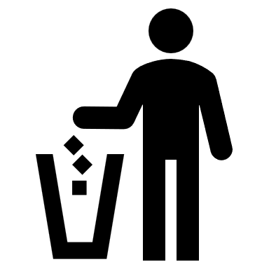
Green Count
A Product for the Earth Conscious
Recycling is currently a 60.41 Billion dollar a year business. That number is expected to grow to as much as 88.01 Billion by 2030. Recycling not only helps the earth but is big business as well. As people become more aware of the harm caused by landfills, recycling is growing at an exponential rate.
*Statistics from www.statista.com

Slide 3
What Does this product address?
People are more conscious of recycling so what info can they gain from it?
This product will help keep count of how many things people recycle per day.
The product will also let the user know exactly what they are recycling be it paper, plastic or cardboard.

Slide 4
How do we address this?
This product uses an IoT approach.
A camera will be attached to the users recycling bin. Every time an item is recycled, a picture is snapped.
That picture will be uploaded to a photo bucket where it will be analyzed by a Cloud service provider (AWS or Azure).
The user will get information back on a webapp that lets them keep track of what they are recycling and how much they are recycling per day.

Slide 5
Concept & Justification
The prototype unit will utilize a Raspberry Pi with a camera and motion sensor attached. When motion occurs at the recycle bin, the Pi will trigger the camera to snap a picture. Using WiFi, the Pi will then send the picture to a webserver using Amazon S3. The picture will then be analyzed using AWS Rekognition. Should it be the case that we cannot train Rekognition, there are other services we can use to support our project. The results will be sent to a webapp that the user can view.
The reason this product will be successful is that people, especially the younger generations, realize how important recycling is. They will want to keep track of their recycling and know that they are doing their part.

Slide 6
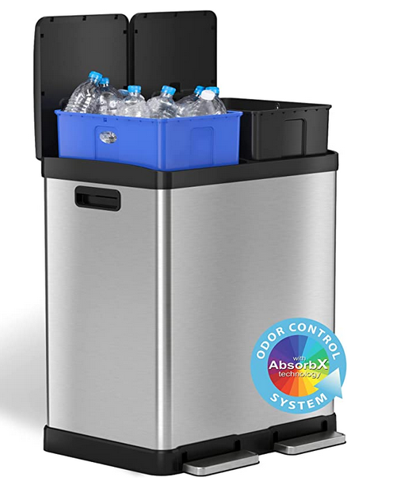
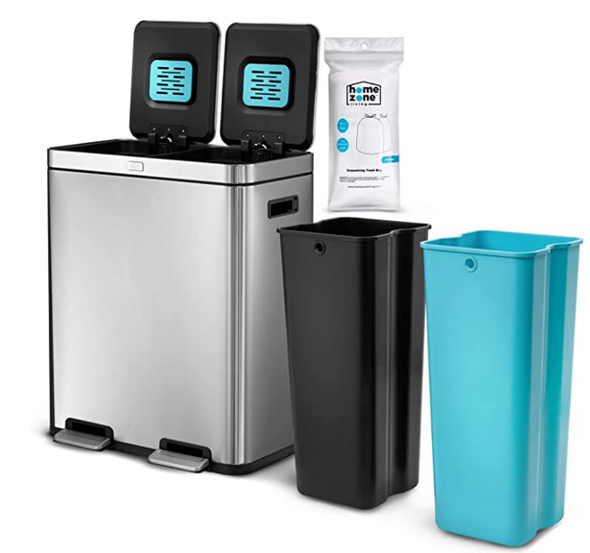
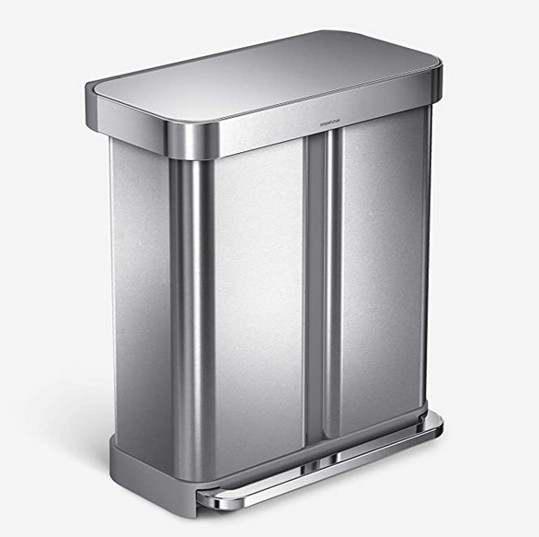
Market Research
Home Zone Living 16 Gallon Dual Trash Can for Recycling and Trash with CleanAura Odor Control
169.99 Dollars
iTouchless SoftStep 16 Gallon Dual Compartment Trash Can Recycler
189.99 Dollars
Simplehuman 58 Liter / 15.3 Gallon Rectangular Hands-Free Dual Compartment Recycling Kitchen Step Trash Can
197.99 Dollars

Slide 7
Market Research
Some of the current smart trash cans open automatically but that automation is limited to the lid.
The price range is 170 to 200 dollars.
Our smart recycle bin will let you know what you are recycling and how much of each item.
The prototype will only cost $70 dollars or so to implement.
We can scale that cost down with mass production.

Slide 8
Why Green Count?
We plan to offer a cost-effective solution that can be attached or mounted near any recycling bin. In other words, why overpay for a bloated product when our simple solution can be used instead.

Slide 9
Will this make money?
The short answer is yes! We plan to offer a small package that is made with minimal cost. We can then inflate the cost to sell to the average user. Although out prototype may a bit bulky using a Raspberry Pi, we can eventually port the code to an embedded system of a microprocessor, small camera and motion sensor. The cost should be minimal once production begins.

Slide 10
Expertise
Tim Daffner – Raspberry Pi, Python. If needed C#, C++ and Java. Working on learning AWS Rekognition and S3.
Soham Roy – Javascript, Python and AWS services
Priyanka Gogineni - Python, Testing. Learning AWS.
Harish Datta Kari - Python, AWS Rekognition and AWS S3

Slide 11
Collaborative Tools
Github to publish code and readme files
Discord for team communication and meetings
Meeting in person

Slide 12
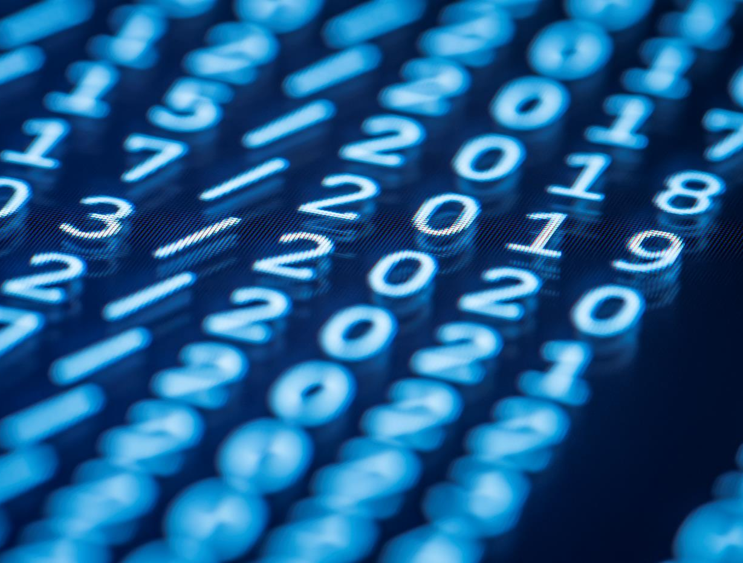
Thank You
Soham Roy – roy.28@wright.edu
Priyanka Gogineni – gogineni.36@wright.edu
Harish Datta Kari – kari.11@wright.edu
Tim Daffner – daffner.3@wright.edu

