Slide 1


Trash Sorting Using Artificial Intelligence
Malnad College of Engineering, Hassan
Department of Electronics and Electronics Engineering
Team Members:
Shivanand Manur Vikas P Vivekanandachar N L Yashswini K S
(4MC22EE077) (4MC22EE105) (4MC22EE107) (4MC22EE110)
Under the guidance of:
Dr. Kaveri K B Associate Professor Dept. of EEE MCE,Hassan

Slide 2
OVERVIEW:
Introduction
Literature Review
Problem statement
Objectives
Block diagram
Methodology
Results
Conclusion
Reference

Slide 3
INTRODUCTION :
Waste management has become one of the most critical global challenges of the 21st century due to rapid urbanization
Increased population growth, and a surge in consumerism.
Improper solid waste disposal leads to soil contamination, water pollution, harmful greenhouse gas emissions, and long-term health hazards.
Traditional waste sorting systems are slow, labour-intensive, inconsistent, and highly prone to human error.
As nations shift towards smart cities and digital automation, there is an urgent need for intelligent, automated, and efficient waste segregation technologies
Artificial Intelligence (AI), particularly Computer Vision powered by Convolutional Neural Networks (CNN), has emerged as a powerful tool to revolutionize garbage classification and sorting.

Slide 4
OBJECTIVES OF THE AI :-
To design and implement an AI-based intelligent trash sorting model using a Convolutional
Neural Network (CNN).
To automate the waste classification process using image recognition.
To improve the speed, accuracy, and safety of waste segregation.
To reduce human effort and risk associated with manual waste sorting.
To provide an efficient and eco-friendly method for recycling and waste disposal.
To integrate real-time object detection using a camera.
To demonstrate the application of AI in smart city waste management systems

Slide 5
Why CNN for Trash Sorting?
CONVOLUTIONAL NEURAL NETWORK (CNN)
CNN is a deep learning architecture widely used in computer vision tasks such as image classification, object detection, and segmentation.
Captures spatial features in images.
Automatically extracts edges, textures, shapes, and patterns.
High accuracy in real-time classification.
Robust against noise and background variations

Slide 6
HOW CONVOLUTIONAL NEURAL NETWORK (CNN) WORKS IN THE TRASH SORTING USING AI PROJECT
In this project, Convolutional Neural Networks (CNNs) act as the “brain” of the system.
Their main responsibility is to identify and classify waste items—whether they are plastic, paper, glass, metal, cardboard, or organic materials—based purely on an image captured by a camera.
CNNs excel in image-based tasks because they automatically learn features such as edges, colors,
textures, shapes, and complex object patterns without human intervention.
This system relies on a trained CNN model deployed on a Raspberry Pi. The camera captures real-time images of waste objects, and the CNN classifies them to direct the sorting mechanism. This enables automation, speed, and accuracy in waste segregation.

Slide 7
LITERATURE SURVEY :
"Trash Detection: Advanced Classification of Waste Materials Using ML Techniques,"
CNN-based ML enables accurate automated waste classification
"AI-Powered Trash Classification System for Lakes and Water Bodies Using Transfer Learning"
Fine-tuned ResNet-50 detects floating waste.
"Smart Waste Segregation for Home Environment"
Ultrasonic sensor + camera with CNN classifies home waste types.
“Clever Trash: An ML-based IoT system for waste sorting with continuous learning
cycle“
ML-based IoT smart bin improves waste sorting.

Slide 8
LITERATURE SURVEY :
“Development of automatic trash bin for sorting metal and non-metallic wastes using proximity
sensors and notifications via telegram"
Auto bin sorts metal vs non-metal and sends alerts. "Autonomous Boat: Floating Trash Collector and Classifier,"
GPS-enabled autonomous boat detects, collects, and sorts floating trash.

Slide 9
Problem Statement:
To design and implement an automated and intelligent waste segregation:
The increasing volume of improperly sorted waste poses a significant challenge to
effective waste management and environmental sustainability.
To develop an AI-based automated waste sorting system:
There is a critical need for an intelligent, automated solution that can accurately
identify and classify different types of waste at the source.
Health and Safety Concerns Worker Exposure:
Manual sorters are frequently exposed to pathogens, sharp objects (like needles or
broken glass), and toxic substances, posing significant long-term health risks.

Slide 10
OBJECTIVES:
To design and develop an intelligent trash-sorting system using Convolutional Neural Networks (CNNs)
To improve waste-separation accuracy
To integrate sensor-based inputs and CNN model predictions
To implement real-time waste detection and classification
To reduce human involvement in hazardous waste-handling environments
To develop a scalable and adaptive waste-management solution

Slide 11
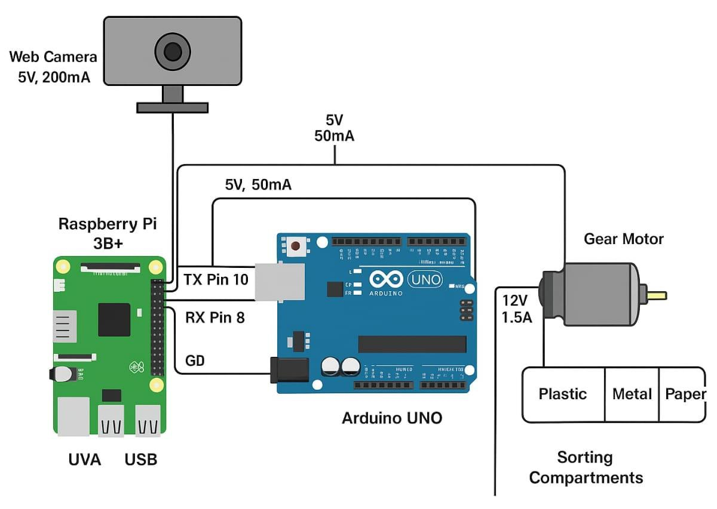
BLOCK DIAGRAM:

Slide 12
METHADOLOGY :
OS & Language: Raspbian OS using Python 3.
Key Libraries: OpenCV for image processing and Tkinter for the GUI.
Methodology Stages:
Dataset Creation: 50–400 labeled samples across four categories.
Preprocessing: RGB to HSV conversion and Canny edge detection.
Classification: Softmax normalization and temporal smoothing (majority-voting).
Overall, the hardware implementation successfully integrates image acquisition, AI processing, motor control, and mechanical actuation.
The process begins with a USB/Pi Camera, which captures real-time images of the waste placed in front
of the system.
The Arduino UNO operates as the actuator controller

Slide 13
RESULTS:
High Accuracy: Achieved a classification accuracy of over 95%.
Processing Speed: 0.6 to 1.0 seconds per frame.
Autonomous Operation: Full end-to-end solution without human intervention.
Interactive UI: Live video feed displaying predicted type and confidence levels.
Mechanical Actions:
Dry Waste: Flap moves 90 - 45.
Wet Waste: Flap moves 90 - 135.
E-Waste/Haz: Bottom motor aligns bin at 90.

Slide 14
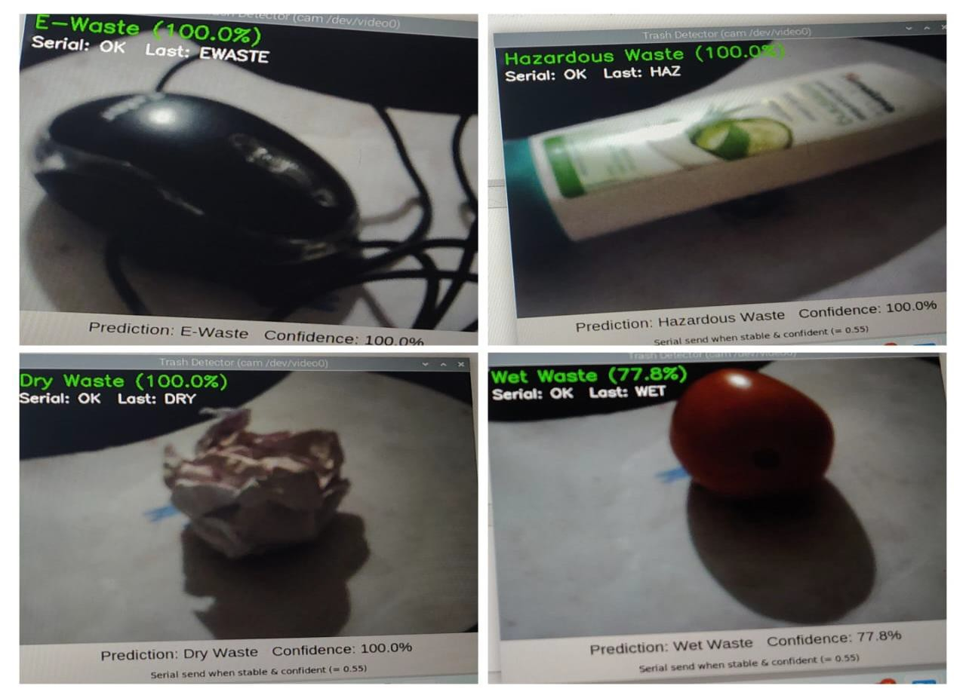
RESULTS:
Detection of waste
Classification Categories: Dry Waste, Wet Waste, E-Waste, and Hazardous Waste.

Slide 15
Conclusion
Classification Success Automated
The project successfully demonstrated an automated trash sorting system using AI and CNN, capable of classifying waste into multiple categories with high accuracy.
Efficient Dual-Controller Integration
The integration of Raspberry Pi for AI processing and Arduino UNO for actuation control
proved to be efficient and cost-effective.
Multi-Category Reliability
The CNN model achieved reliable performance in identifying Dry, Wet, E-Waste, and
Hazardous waste.
The model is highly effective for real-world deployment, providing a dependable solution for automated waste segregation and environmental management.

Slide 16
REFERENCE :
1. D. Khetarpal, I. Khetarpal, D. Rawat, H. Narang, S. Vats, and V. Sharma, "Trash Detection: Advanced Classification of Waste Materials Using ML Techniques," *Graphic Era Hill University*, Dehradun, In
2. S. Kundu, M. Shanna, and A. S. Pillai, “AI-Powered Trash Classification System for Lakes and Water Bodies Using Transfer Learning,” in Proc. 2024 3rd Int. Conf. Power, Control and Computing Technologies (ICPC2T), 2024.
3. U. L. M. Rijah and P. K. W. Abeygunawardhana, "Smart Waste Segregation for Home
Environment," Sri Lanka Institute of Information Technology, Malabe, Sri Lanka, 2023.
4. S. Puig and N. Foukia, "CleverTrash: An ML-based IoT system for waste sorting with continuous learning cycle," University of Applied Sciences HES-SO, Geneva, Switzerland, 2023.
5. P. Wiriwithya, S. Rungnarongruek, S. Pongamphai, S. Puapatanakul, and R. Chancharoen, "Smart Trash Classification Machine," in 2023 9th International Conference on Mechatronics and Robotics Engineering, 2023.

Slide 17
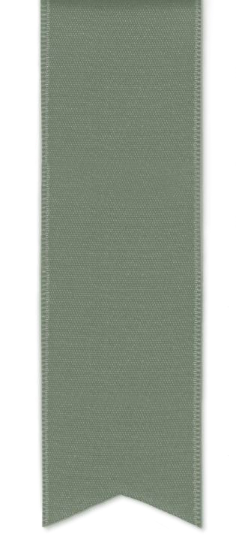
THANK YOU

