Slide 1





SPORTS PSYCHOLOGY APPOINTMENT SYSTEM

Slide 2

TEAM : TURTLE
PRIYANKA - 3BR22CS129
MEHTAAB - 3BR23CS408
B.FOUZIYA - 3BR23CS402
BHAVANA.C - 3BR23CS403

Slide 3

ABSTRACT
The Sport Psychology Appointment System is a Python solution designed to manage appointments, schedule sessions for athletes, and handle feedback efficiently
• It employs class definitions for appointments and the system, CRUD operations, and utilizes data structures like lists or dictionaries to manage collections of appointments.

Slide 4
INTRODUCTION
In this project, we introduce a groundbreaking Sports Psychology Appointment System designed to revolutionize the way athletes access mental support and guidance. Recognizing the critical role of psychological well-being in athletic success, this system aims to streamline the process of scheduling appointments with sports psychologists, providing athletes with timely and tailored interventions to optimize their performance.

Slide 5
MODULE DESCRIPTION
Appointment:
In this class we define __init__() method to initialize the attributes like appointment_id , athlete_id , date_time , notes , feedback
2. Appointment_system:
The module encapsulates the functionalities required to create,read,update and delete appointment data, ensuring the CRUD Operations

Slide 6
Create_appointment()
Allows users to create a new appointment and stores it in the appointments dictionary. Also writes the appointment details to a text file named "appointments.txt".
2. get_appointment()
Retrieves and displays appointment details based on the provided athlete ID.

Slide 7
3. Update_appointment()
When correspondence athlete_id is given it Updates an existing appointment's details such as appointment ID, date and time, and notes. Updates the details in the appointments dictionary and the "appointments.txt" file.
4. Delete_appointment()
Deletes an appointment based on the provided athlete ID. Updates the appointments dictionary and the "appointments.txt" file accordingly.

Slide 8
5. manage_session_feedback:
This module handles the management of session feedback, facilitating continuous improvement of sports psychology services.
6. schedule_sport_psychology_sessions()
Enables users to schedule a new sport psychology session and adds it to the appointments dictionary. Also appends the details to the "appointments.txt" file.

Slide 9
UNITTEST
Unit Testing Framework
The unit testing framework was originally inspired by JUnit and has a similar flavor as major unit testing frameworks in other languages
A test case is the individual unit of testing. It checks for a specific response to a particular set of inputs. unittest provides a base class, TestCase
A testcase is created by subclassing unittest.TestCase
The unittest module is used by importing a unittest
#import unittest

Slide 10
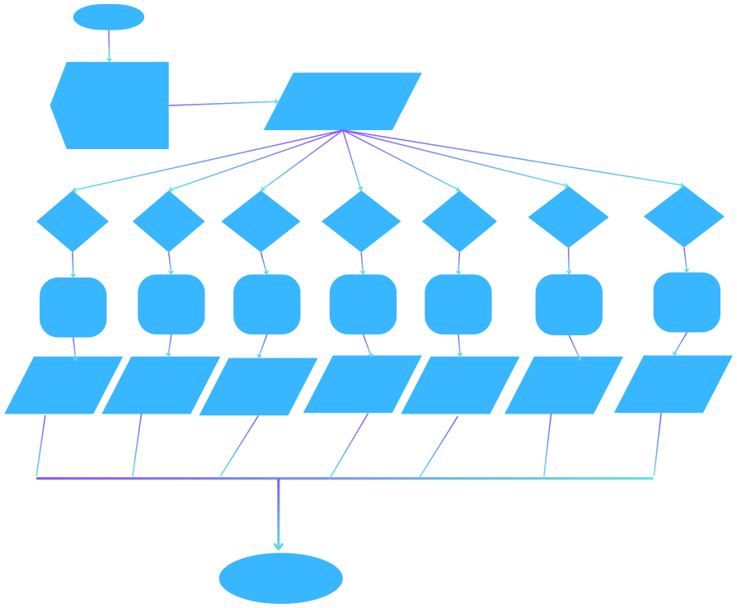
start
Menu:
1. Create appointment
2.get appointment
3.Update appointment 4.Delete appointment 5.manage session feedback 6.schedule sport psychology 7.Exit
Enter your choice(1:7):
choice=1
choice=2
choice=3
choice=4
choice=5
choice=6
choice=7
manage session feedback
schedule sport psychology sessions
Create appointment
get appointment
Update appointment
Delete appointment
Exit
Appointment created successfully
get appointment details
Appointment updated successfully
Appointment deleted successfully
session
feedback
psychology session
Exiting program!
end

Slide 11
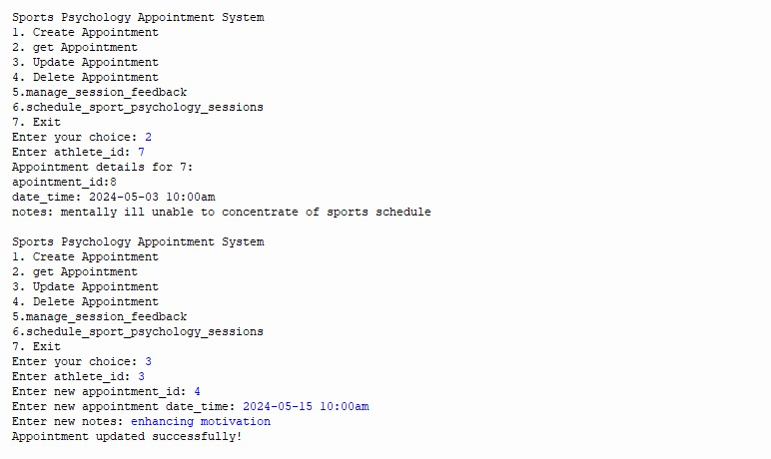
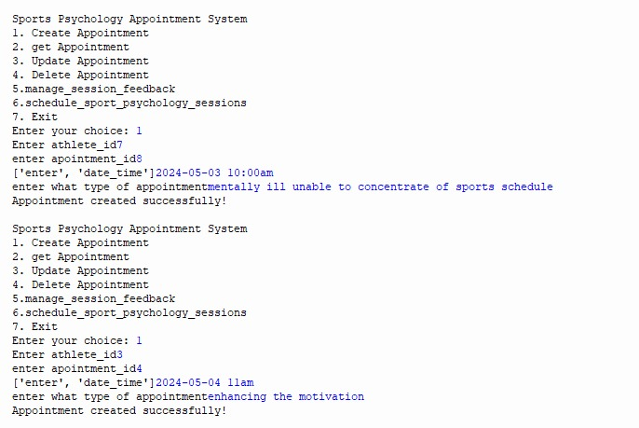
output:

Slide 12
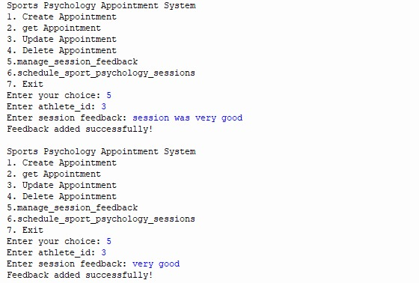
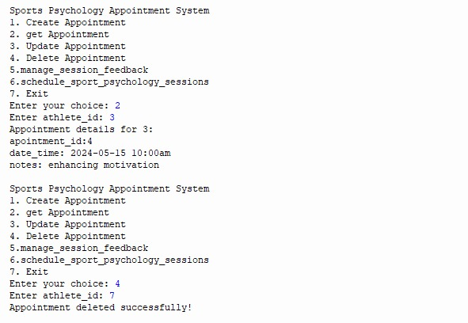

Slide 13
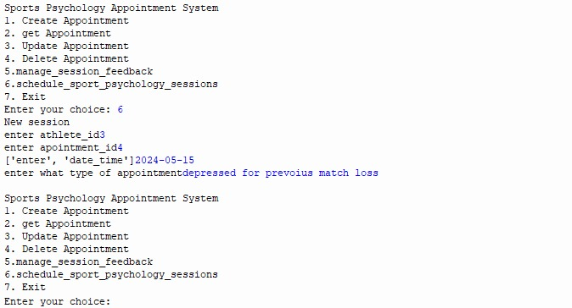
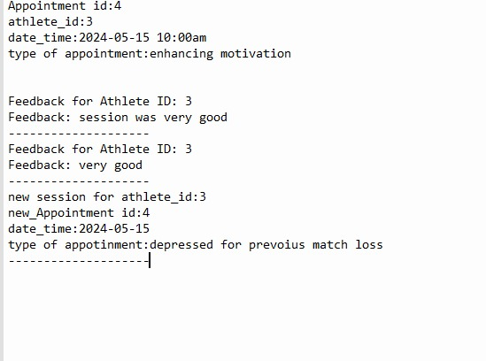

Slide 14
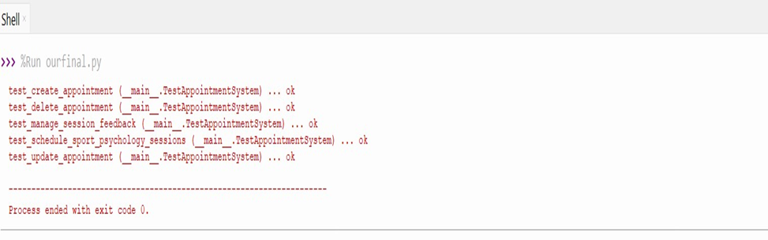

Slide 15
CONCLUSION:
This Sport psychology Appointment System lays the groundwork for an efficient system to support athletes' mental well-being and performance. By offering structured appointment management and feedback mechanisms, it fosters a proactive approach to mental health support within sports organizations.

Slide 16
BIBLIOGRAPHY
Google
2. Chatgpt
3. GitHub Accounts
https://github.com/bhavanaa24/sport
https://github.com/FOUZ-104CS2008/sport
https://github.com/mehtaab/Sport
https://github.com/priyanka/Sport

Slide 17

THANK YOU

