Slide 1



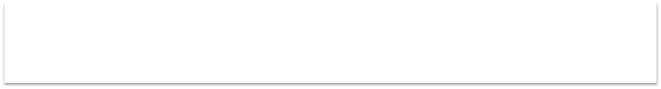
PHARMACY MANAGEMENT SYSTEM
PRESENTED BY:
PRIYANKA. I ECB2315 8115U23EC078

Slide 2


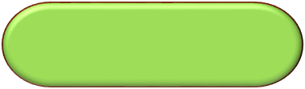
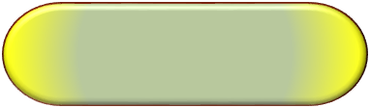
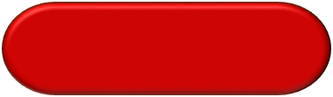
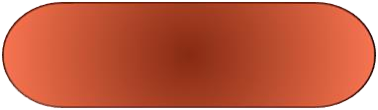
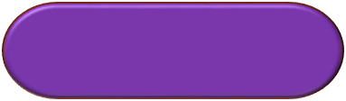

CONTENTS
1
2
3
4
INTRODUCTION
₅ FUTURE SCOPE
6
PROBLEM
IDENTIFICATION
CONCLUSION
FLOW CHART
JAVA USED

Slide 3

INTRODUCTION
The Pharmacy Management System is a tool designed to help pharmacies manage prescriptions and inventory efficiently. It allows pharmacists to input, verify, and dispense prescriptions while keeping track of available stock. The system also records all prescriptions for easy reference. By automating these processes, the system reduces errors and ensures medications are dispensed accurately and on time.

Slide 4
PROBLEM IDENTIFICATION
Inventory: There can be issues with updating inventory in real time, and it can be difficult to analyze inventory levels.
Reports: There can be consistency in errors when generating and sharing reports.
Patient records: Manually documenting patient records can be time-consuming.
Database: The system may not be able to create tables in the database properly.
Drug prescriptions: The system may not be able to handle drug prescriptions or drug details.
Account records: The system may not be good for keeping account records.
Business processes: Hospitals may have inefficient processes that are difficult to redesign.

Slide 5
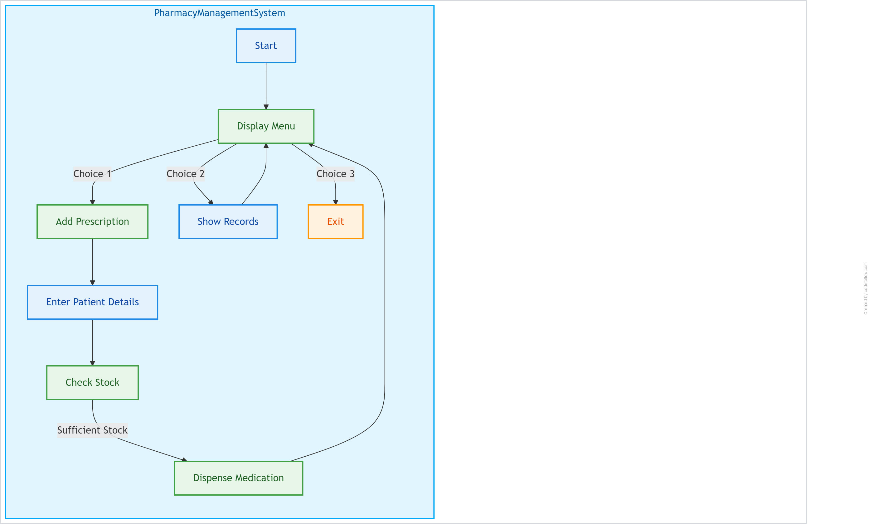
FLOW CHART

Slide 6
JAVA USED
Object-Oriented Programming (OOP):Classes: Defines Prescription and PharmacyManagementSystem classes to encapsulate related data and functions.
Encapsulation: Keeps prescription details and pharmacy operations organized.
Data Structures:
HashMap: Manages medication stock efficiently.
ArrayList: Stores prescription records dynamically.
Input Handling:Scanner Class: Captures user input for patient and medication details.Control Structures:
Conditional Statements: Checks stock availability before dispensing medication
Loops: Allows repeated menu display and user interaction.
Method Functionality:Methods: Breaks down tasks (like adding prescriptions and showing records) into reusable functions.
.

Slide 7
FUTURE SCOPE
Integration with EHR Systems: Facilitate seamless data sharing for better patient care
.Mobile Application Development: Enable easier access to pharmacy services for users.
Automated Inventory Management: Optimize stock levels and reduce waste through real-time tracking.
Telepharmacy Services: Expand access to consultations and medication delivery.Data Analytics: Provide insights into prescription trends for better decision-making.

Slide 8

CONCLUSION
The Pharmacy Management System in Java provides an efficient way to manage prescriptions and medication inventory. It automates the prescription process, reducing manual errors and saving time for pharmacy staff. The system tracks stock levels to prevent shortages, ensuring essential medications are available. Its user-friendly interface simplifies navigation, while detailed record-keeping enhances data management. Overall, this Java-based system improves operational efficiency and patient care, making it a valuable asset for pharmacies.

Slide 9


