Slide 1
Online Survey Platform Group 9
Team Members
Priyanka Jonnala
Venkata Naga Sai Goud Perika

Slide 2
Introduction and Objectives
Introduction: The Online Survey Platform is designed to provide an efficient, cost-effective,
and user-friendly
solution for survey creation, distribution, and analysis.
Objectives:
Simplify survey creation and management.
Enable dynamic data visualization with real-time response tracking.
Ensure secure user authentication and data integrity.
Create a scalable and modular platform for future enhancements.

Slide 3
Problem Statement
Existing survey platforms are either too expensive or overly complex.
Small businesses, students, and researchers lack access to affordable
tools that are easy to use and offer advanced features.
There is a need for a solution that balances simplicity, functionality, and
scalability.

Slide 4
Proposed Solution
Overview:
A lightweight web application built with Flask and Peewee ORM.
Allows users to design surveys, collect responses, and analyze results.
Offers dynamic visualizations using Chart.js and ensures secure data
management.
Benefits:
Cost-effective and user-friendly.
Modular design for seamless scalability.

Slide 5
Key Features
User Authentication and Role Management: Secure login and registration.
Survey Creation: Intuitive interface for creating and managing surveys.
Response Collection: Real-time response tracking and storage.
Data Visualization: Dynamic charts for analyzing survey responses
Scalability: Modular architecture for future feature additions.

Slide 6
Architecture/Workflow
Architecture:
Backend: Flask and Peewee ORM.
Database: SQLite for development and PostgreSQL for production.
Frontend: HTML, CSS, JavaScript, and Jinja2 templates.
Data Visualization: Chart.js for rendering interactive graphs.
Workflow:
User logs in/registers → Creates a survey → Shares unique link → Collects responses → Views results via charts.

Slide 7
Implementation Details
Backend:
Flask handles routing, authentication, and business logic.
Peewee ORM manages database operations.
Frontend:
Jinja2 templates for dynamic page rendering.
Chart.js for visualizing survey responses.
Security:
CSRF protection for form submissions.
Secure password hashing for user authentication.

Slide 8
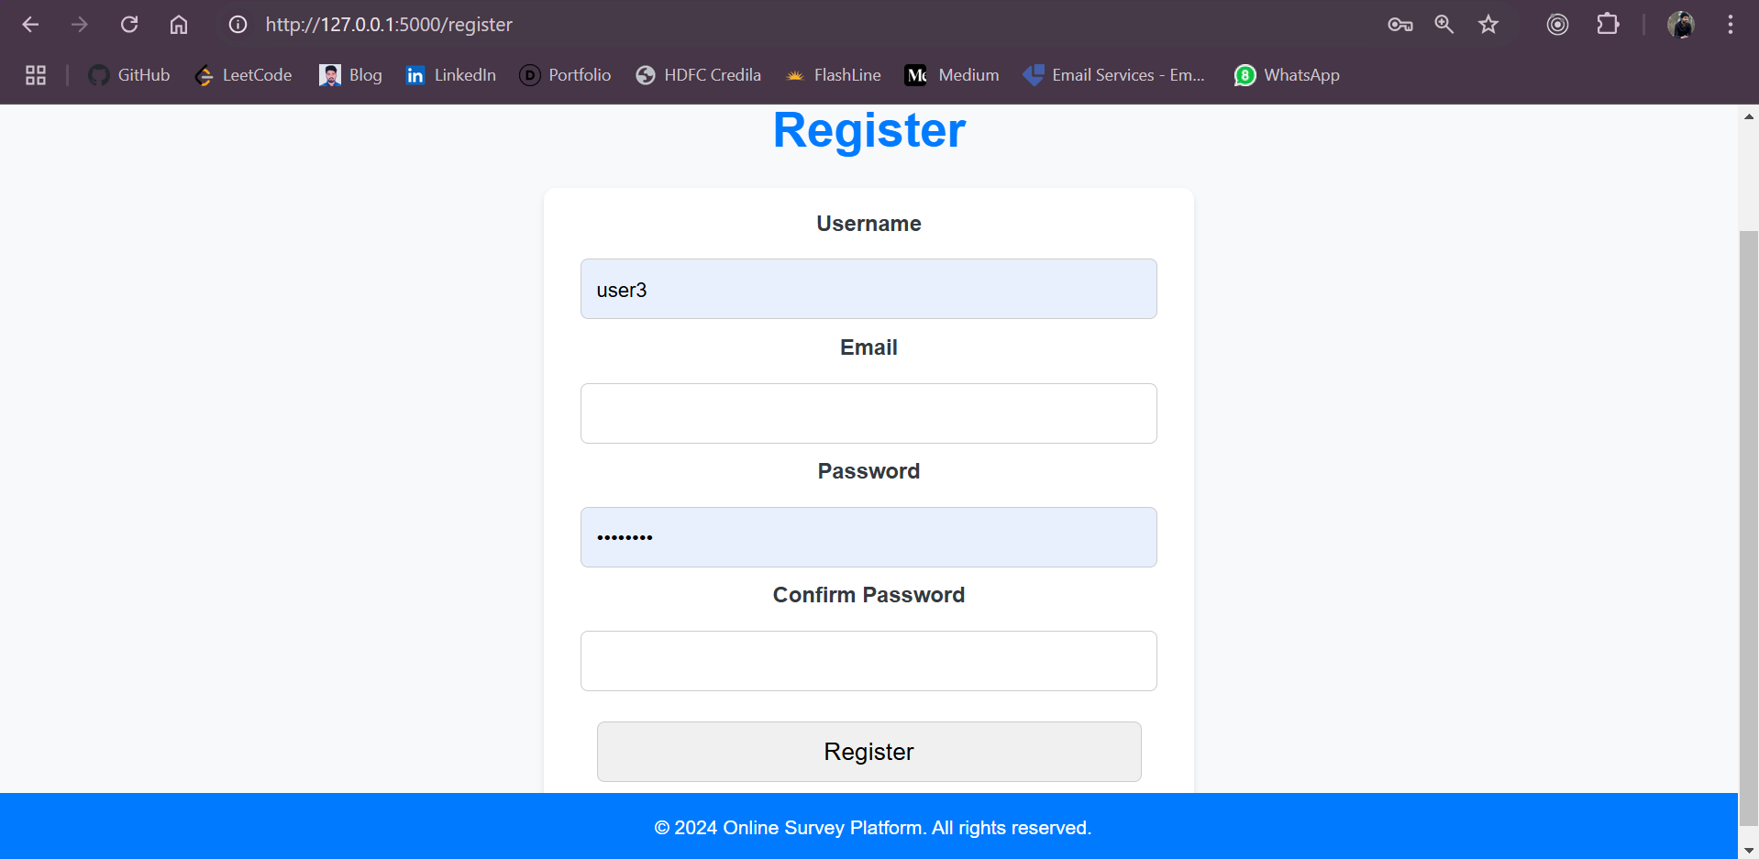
Results and Outputs

Slide 9
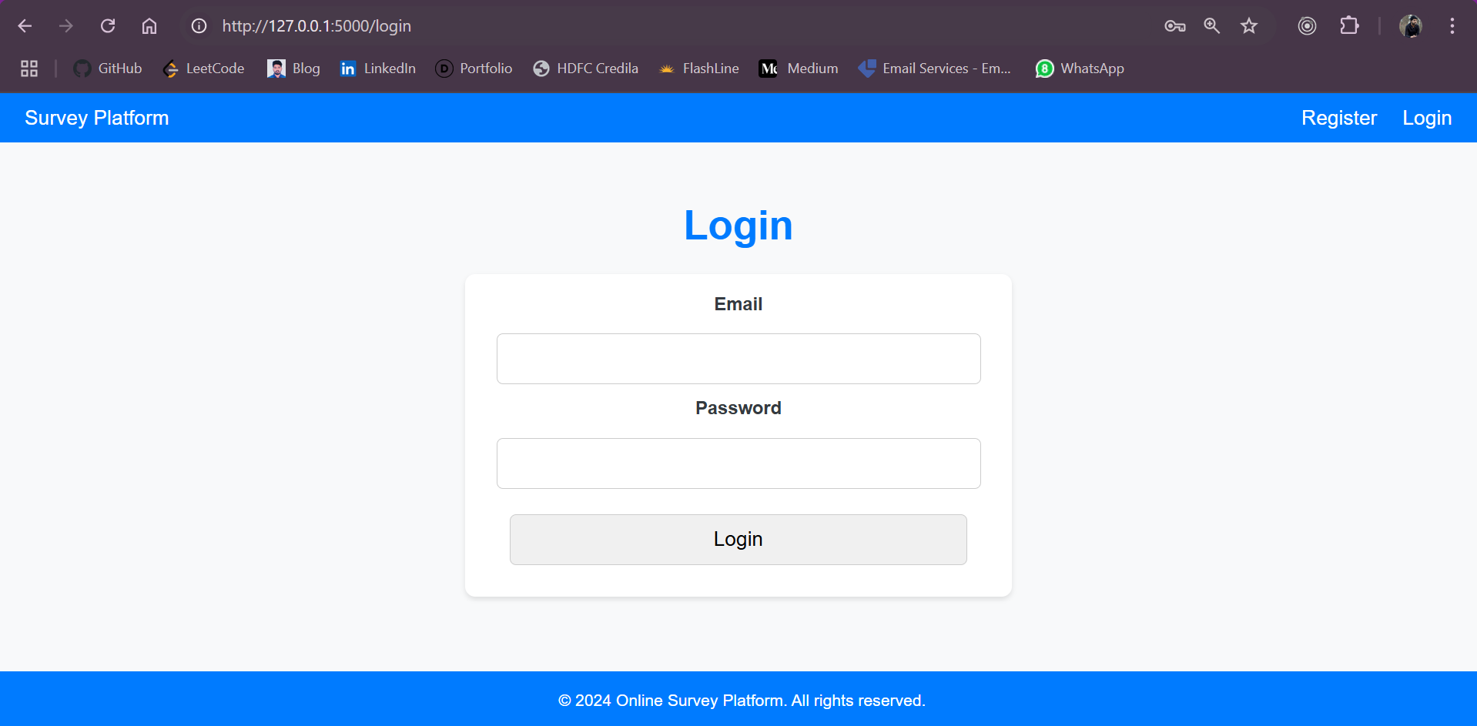
Results and Outputs

Slide 10
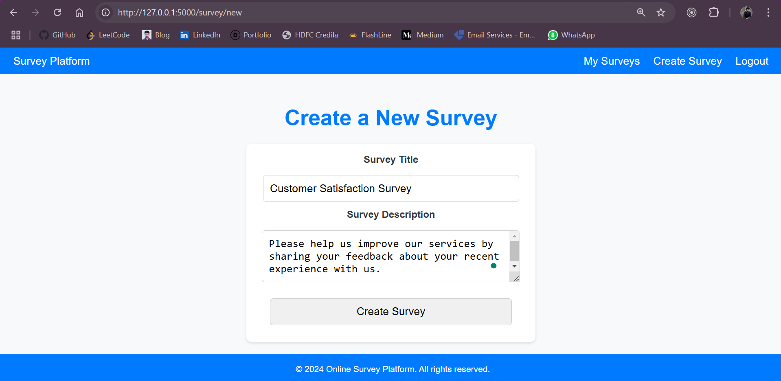
Results and Outputs
Survey creation page.

Slide 11
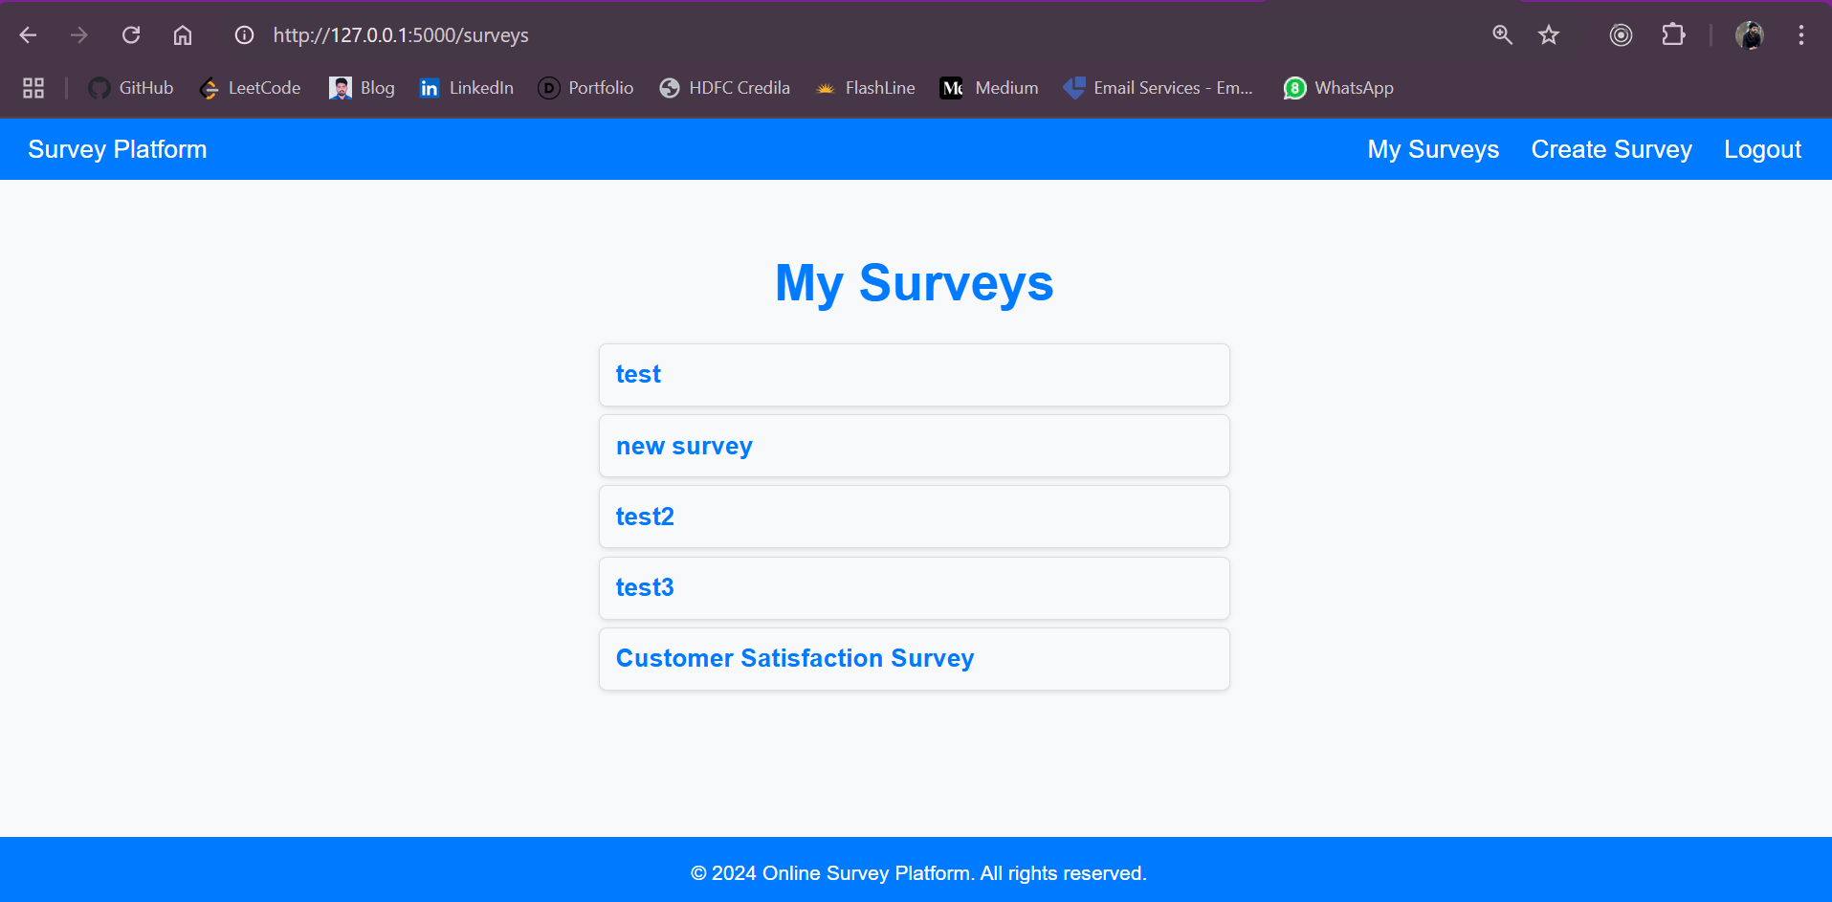
Results and Outputs
Surveys page

Slide 12
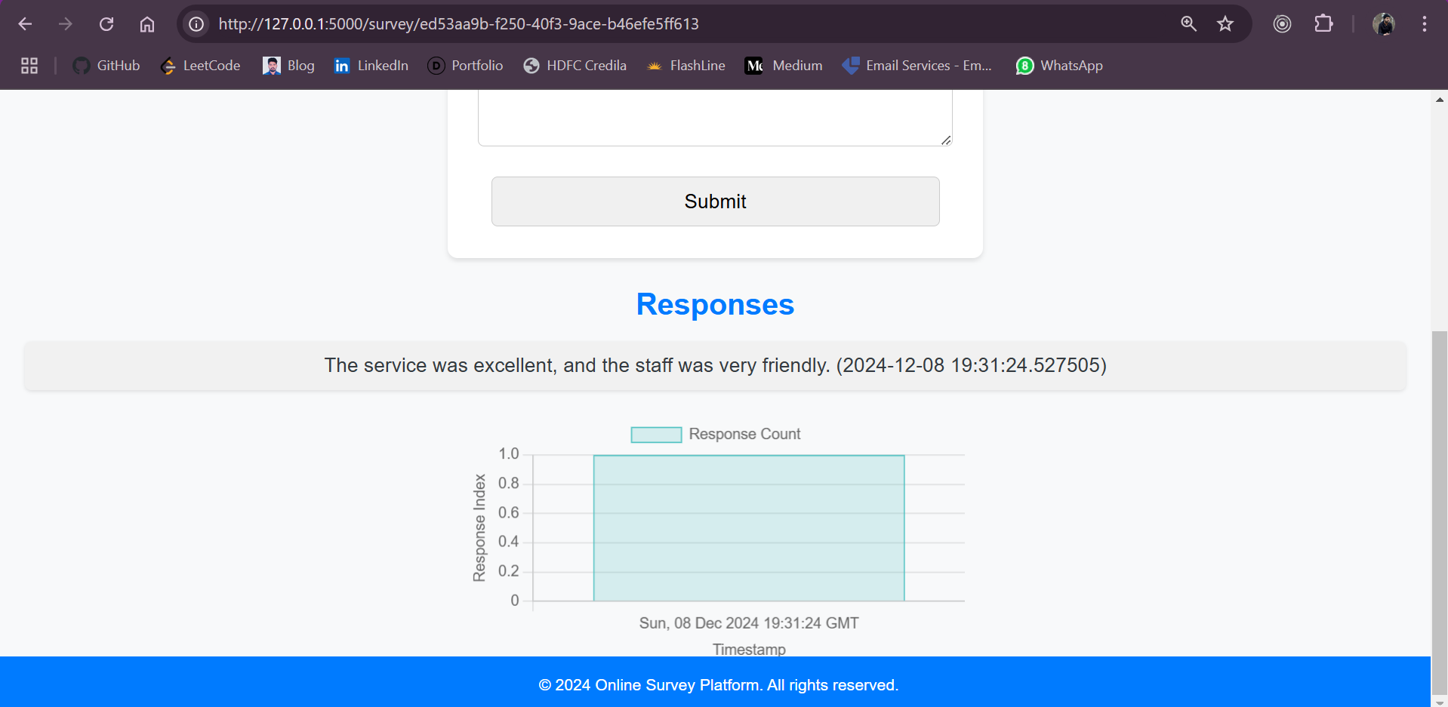
Survey response page with visualized data.

Slide 13
Outcomes:
Successfully created, shared, and analyzed surveys.
Demonstrated real-time response tracking and visualization.

Slide 14
Future Work and Conclusion
Future Enhancements:
Integration with third-party platforms like Google Sheets or Slack.
Advanced analytics, including sentiment analysis and predictive modeling.
Support for multi-language surveys.
Conclusion:
The Online Survey Platform addresses the gap in affordable and user-friendly survey tools.
It provides a scalable solution suitable for researchers, educators, and businesses.

Slide 15
Team Contributions
Backend Developer: Priyanka Jonnala
Implemented Flask-based backend.
Designed database models and routes.
Integrated user authentication and response tracking.
Frontend Developer: Venkata Naga Sai Goud Perika
Designed and styled the user interface using HTML, CSS, and JavaScript.
Created dynamic visualizations with Chart.js.
Authored project documentation and conducted user testing.

Slide 16

Thank You

