Slide 1

Spam Detection whether a message spam or not ?
Final Presentation
EXST 7152
Rahul Gupta

Slide 2
Agenda outline
Motivation/Problem Statement
Dataset
Data Cleaning
Shaping the data for ML modelling
Classification models
Comparison & Results

Slide 3
Motivation
Email spam, also known as junk email, is a type of electronic spam where unsolicited messages are sent by email.
The proportion of spam email was around 90% of email messages sent, in the end of 2014.*
It was estimated that in 2009 spam cost businesses around US$130 billion worldwide.#
Many solutions available to tackle this problem, but one of the most efficient is email filtering based on the content of the email.
*Email Metric Report
# Ferris Research : Cost of spam

Slide 4
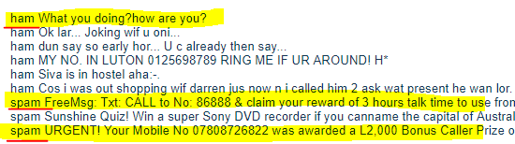
Dataset – SMS Spam Collection
Available at UCI Machine Learning Repository
Number of instances – 5572 ; no missing values
Number of columns – 2 (label & message)
Classification levels – 2 i.e. spam and not spam

Slide 5
High Level NLP flow
Tokenizing
Removing
Stop words
Stemming/
Lemmatizing
Vectorization
ML Modelling

Slide 6
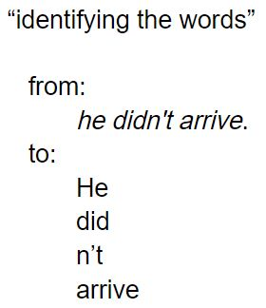
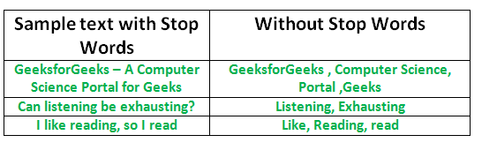
Understanding the NLP steps
Tokenization
Removing stop words

Slide 7
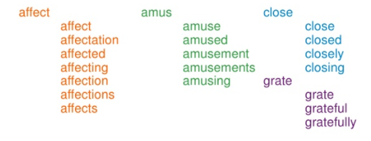
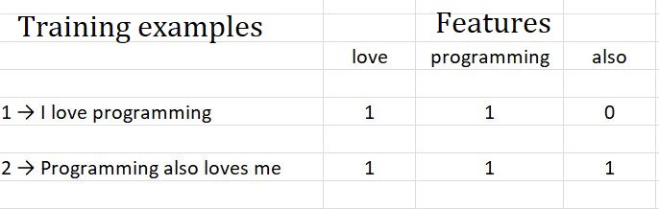
Understanding the NLP steps cont.
Stemming
Vectorization

Slide 8
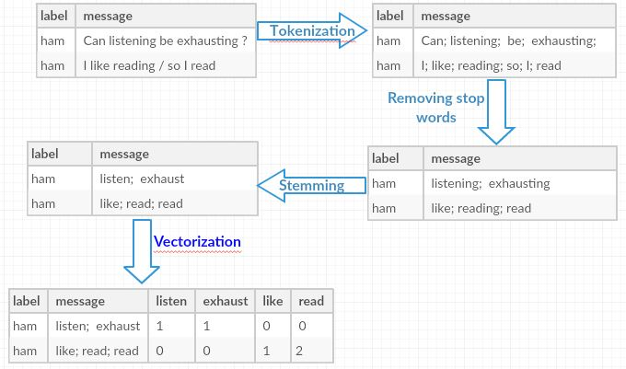
Putting it all together

Slide 9
Approach used in this project
Data Cleaning
Remove stop words
Vectorization
Vectorization
Term Frequency – Inverse Document Frequency (TF-IDF)
Stemming using PorterStemmer
Feature Creation
Created two new features:
Punctuation Percentage in the message
Now our data set has 4 columns (label, message, message_length, Punct %)
Length of message
Remove punctuations
Tokenization
Count Vectorization

Slide 10
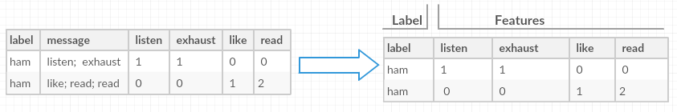
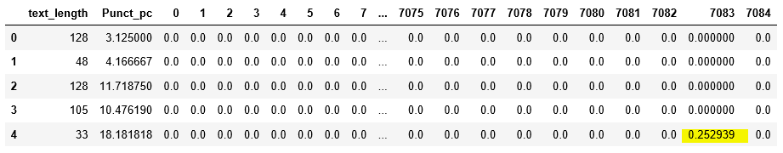
Dataset for ML models
Conceptually
Actual Train dataset

Slide 11
Dataset for ML modelling and testing
Raw data(5547 observations & 4 columns) is splitted into train and test set in 80:20 proportion
Proportion of classes : ~13% spam and ~87% not spam
Train data is passed through NLP pipeline to create vectorised features for ML model to train.
Same train pipeline is used to create test vectorised dataframe
Now we have two vectorised data frames (train and test) of the same width i.e. 7085 columns

Slide 12
Random Forest on TF-IDF based features
Used 5 fold cross validation
Set a grid with following hyperparameters:
n_estimators: [10,25,50,100,300],
max_depth : [10, 20, 50,100, No_limit],
max_features' : [10, 50,’auto’]
Test set results with chosen parameters :
Accuracy: 0.981 Precision: 1.0 Sensitivity: 0.863
mean_fit_time | mean_score_time | mean_test_score | mean_train_score | params
26.99229822 | 0.621764994 | 0.976441553 | 1 | {'max_depth': None, 'max_features': 'auto', 'n_estimators': 300}
28.31035862 | 0.702857351 | 0.976441553 | 0.999719558 | {'max_depth': 100, 'max_features': 'auto', 'n_estimators': 300}
5.898224545 | 0.381108761 | 0.976217186 | 0.999719511 | {'max_depth': 100, 'max_features': 'auto', 'n_estimators': 50}
10.44519248 | 0.538608599 | 0.975768454 | 0.999663473 | {'max_depth': 100, 'max_features': 'auto', 'n_estimators': 100}
6.218114805 | 0.366572475 | 0.974422257 | 1 | {'max_depth': None, 'max_features': 'auto', 'n_estimators': 50}
4.650475836 | 0.455021572 | 0.974422257 | 0.99837337 | {'max_depth': 100, 'max_features': 50, 'n_estimators': 50}

Slide 13
Random Forest on Count based features
Used 5 fold cross validation
Set a grid with following hyperparameters:
n_estimators: [10,25,50,100,300],
max_depth : [10, 20, 50,100, No_limit],
max_features' : [10, 50,’auto’]
Test set results with chosen parameters :
Accuracy: 0.975 Precision: 1.0 Sensitivity: 0.817
mean_fit_time | mean_score_time | mean_test_score | mean_train_score | params
10.18704305 | 0.648410463 | 0.974870989 | 0.999439116 | {'max_depth': 100, 'max_features': 'auto', 'n_estimators': 100}
6.785375261 | 0.390666723 | 0.974870989 | 0.99949517 | {'max_depth': 100, 'max_features': 'auto', 'n_estimators': 50}
10.81798997 | 0.481357288 | 0.974646623 | 0.999943915 | {'max_depth': None, 'max_features': 'auto', 'n_estimators': 100}
28.21744127 | 0.599344635 | 0.973973525 | 0.999719542 | {'max_depth': 100, 'max_features': 'auto', 'n_estimators': 300}
4.609863377 | 0.356288195 | 0.973749159 | 0.998822131 | {'max_depth': 100, 'max_features': 'auto', 'n_estimators': 25}
27.11894417 | 0.58904767 | 0.97307606 | 1 | {'max_depth': None, 'max_features': 'auto', 'n_estimators': 300}

Slide 14
Gradient Boosting on TF-IDF based features
Used 5 fold cross validation
Set a grid with following hyperparameters:
n_estimators: [100,150,250],
max_depth : [3,10]; learning_rate :[0.01,0.1]
max_features' : [300, ’auto’, no_limit]
Test set results with chosen parameters :
Accuracy: 0.978 Precision: 0.985 Sensitivity: 0.85
mean_fit_time | mean_score_time | mean_test_score | mean_train_score | params
39.99431233 | 0.237415791 | 0.974646623 | 1 | {'learn_rate': 0.1, 'max_depth': 10, 'max_features': 300, 'n_estimators': 250}
26.8036231 | 0.212120581 | 0.974197891 | 1 | {'learn_rate': 0.1, 'max_depth': 10, 'max_features': 300, 'n_estimators': 150}
20.11771297 | 0.186901331 | 0.973524792 | 1 | {'learn_rate': 0.1, 'max_depth': 10, 'max_features': 300, 'n_estimators': 100}
11.10455914 | 0.182823133 | 0.971056765 | 0.999719542 | {'learn_rate': 0.1, 'max_depth': 3, 'max_features': 300, 'n_estimators': 250}
485.6885274 | 0.195583725 | 0.968813103 | 1 | {'learn_rate': 0.1, 'max_depth': 10, 'max_features': None, 'n_estimators': 250}
542.9300895 | 0.246132135 | 0.968813103 | 1 | {'learn_rate': 0.1, 'max_depth': 10, 'max_features': 'auto', 'n_estimators': 250}

Slide 15
Xtreme Gradient Boosting on TF-IDF based features
Used 5 fold cross validation
Set a grid with following hyperparameters:
n_estimators: [100,200],
max_depth : [3,15]; learning_rate :[0.01,0.1]
colsample_bytree : [0.5,1]
Test set results with chosen parameters :
Accuracy: 0.978 Precision: 0.985 Sensitivity: 0.85
mean_fit_time | mean_score_time | mean_test_score | mean_train_score | params
177.456918 | 0.749632072 | 0.974422257 | 0.994222527 | {'colsample_bytree': 0.5, 'learn_rate': 0.1, 'max_depth': 15, 'n_estimators': 100}
348.7007547 | 0.904825687 | 0.973973525 | 0.995568777 | {'colsample_bytree': 1, 'learn_rate': 0.1, 'max_depth': 15, 'n_estimators': 100}
620.8932164 | 0.704964972 | 0.972851694 | 0.998373323 | {'colsample_bytree': 1, 'learning_rate': 0.1, 'max_depth': 15, 'n_estimators': 200}
362.5681489 | 0.751972103 | 0.972627328 | 0.997644136 | {'colsample_bytree': 0.5, 'learn_rate': 0.1, 'max_depth': 15, 'n_estimators': 200}
141.6597358 | 0.749316549 | 0.971954229 | 0.984126033 | {'colsample_bytree': 0.5, 'learning_rate': 0.1, 'max_depth': 3, 'n_estimators': 200}
234.6558568 | 0.816191387 | 0.971281131 | 0.982555567 | {'colsample_bytree': 1, 'learning_rate': 0.1, 'max_depth': 3, 'n_estimators': 200}

Slide 16
Results comparison
Model | Accuracy | Sensitivity | Precision | Fit Time | Score Time
RF with TF-IDF | 0.981 | 0.863 | 1 | 4.156 sec | 0.279 sec
RF with CountVector | 0.975 | 0.817 | 1 | 3.86 sec | 0.321 sec
GB with TF-IDF | 0.978 | 0.85 | 0.985 | 12.584 sec | 0.272 sec
XGB with TF-IDF | 0.978 | 0.85 | 0.985 | 95.347 sec | 0.592 sec
Random Forest with TF-IDF technique of vectorization gives best result
In all models, ‘length of the message’ is the most important variable
Other important words appear in importance list are : ‘call’, ‘text’, ‘free’
Scoring time also plays an important role in model selection, especially in high frequency message transfer environment

Slide 17
References
http://scikit-learn.org/
http://xgboost.readthedocs.io/en/latest/build.html#python-package-installation
https://en.wikipedia.org/wiki/Email_spam
https://images.google.com
https://www.nltk.org/py-modindex.html

Slide 18
Thank You!
Questions Please

