Slide 1
LEAD SCORING ASSIGNMENT

Slide 2
Problem Statement
An education company named X Education sells online courses to industry professionals. On any given day, many professionals who are interested in the courses land on their website and browse for courses.
Once these leads are acquired, employees from the sales team start making calls, writing emails, etc. Through this process, some of the leads get converted while most do not. The typical lead conversion rate at X education is around 30%.
Although X Education gets a lot of leads, its lead conversion rate is very poor.

Slide 3
Goals to be achieved
Build a logistic regression model to assign a lead score between 0 and 100 to each of the leads which can be used by the company to target potential leads.
A higher score would mean that the lead is hot, i.e. is most likely to convert whereas a lower score would mean that the lead is cold and will mostly not get converted.

Slide 4
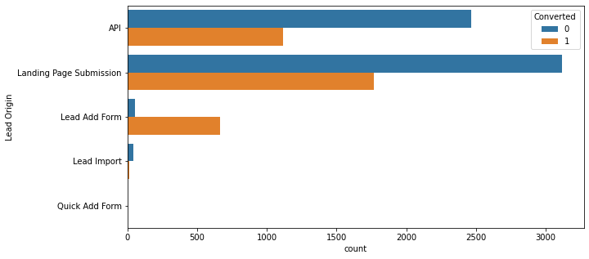
Exploratory Data Analysis
From Lead Origin finding, maximum lead conversion happened from Landing Page Submission.

Slide 5
EDA
From Lead Origin finding, maximum lead conversion happened from Landing Page Submission.

Slide 6
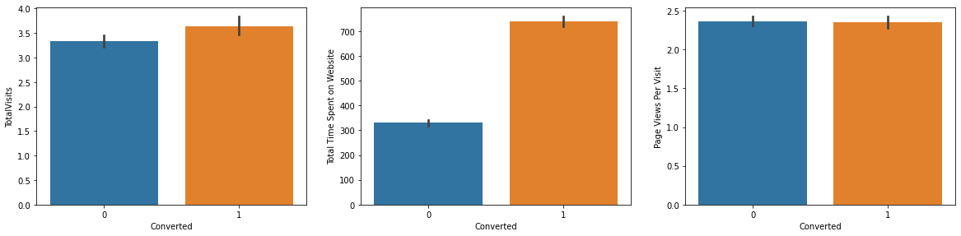
EDA
From the above graph, we have major lead conversion from Total Visits, Total Time Spent on Website, Page Views Per Visit.

Slide 7
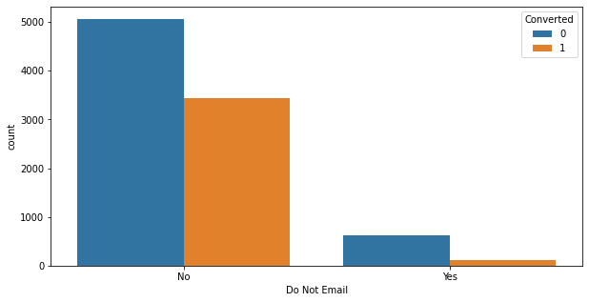
EDA
Based on the above graph , major lead conversion has happened from email that have been sent.

Slide 8
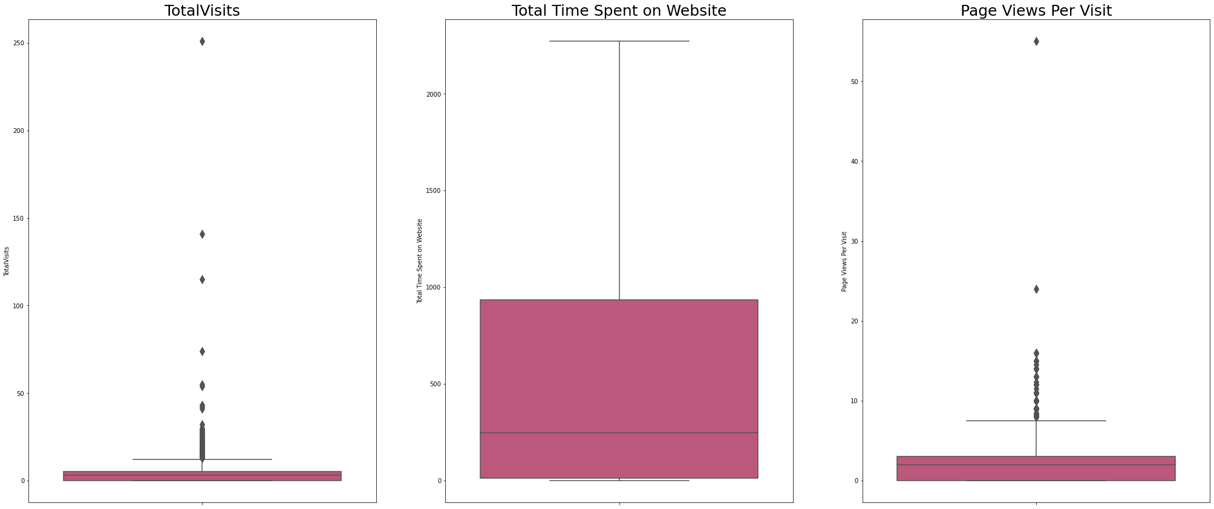
BOXPLOT
From the above boxplots we can now confirm that we have two outlier variables in our dataset ('Total Visits' and 'Page Views Per Visit').

Slide 9
Creating bins
After creating bins we removed the outliers and are now good to go. Before creating the dummy variables let's remove redundant columns/ variables.
Also from above we know columns : 'Last Activity', 'Tags', 'Last Notable Activity' activity columns came from sales team, thus we will drop these redundant columns.

Slide 10
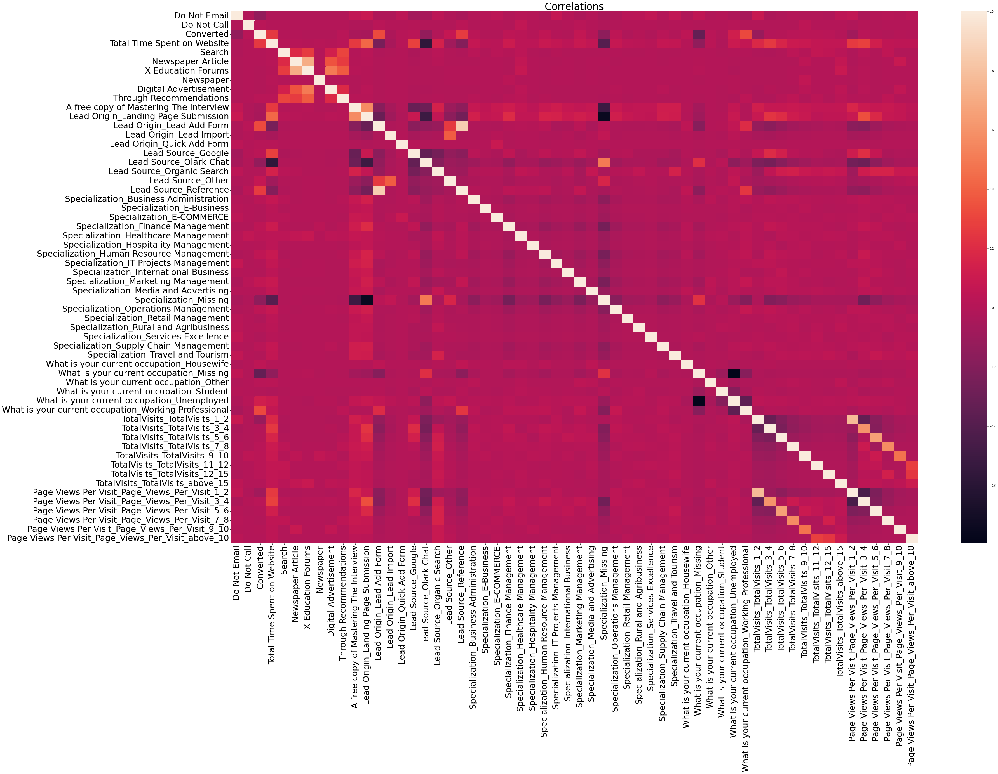
Heatmap

Slide 11
Building MODEL
Importing RFE and logistic regression libraries from scikit learn.
Creating RFE model with 15 variables.
Fitting the model
Listing which all columns are selected (True) by RFE & which all are rejected.
Storing selected columns by RFE in a list.
Listing features removed by RFE feature selection.
Creating new train dataframe with RFE selected features.

Slide 12
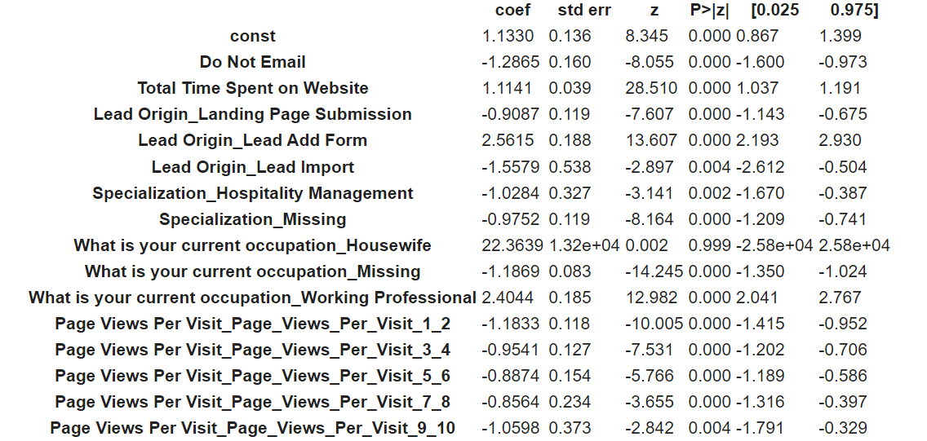
MODEL 1
Summary of features for model 1
We are dropping 'const',’ What is your current occupation_Housewife' due to high p-value

Slide 13
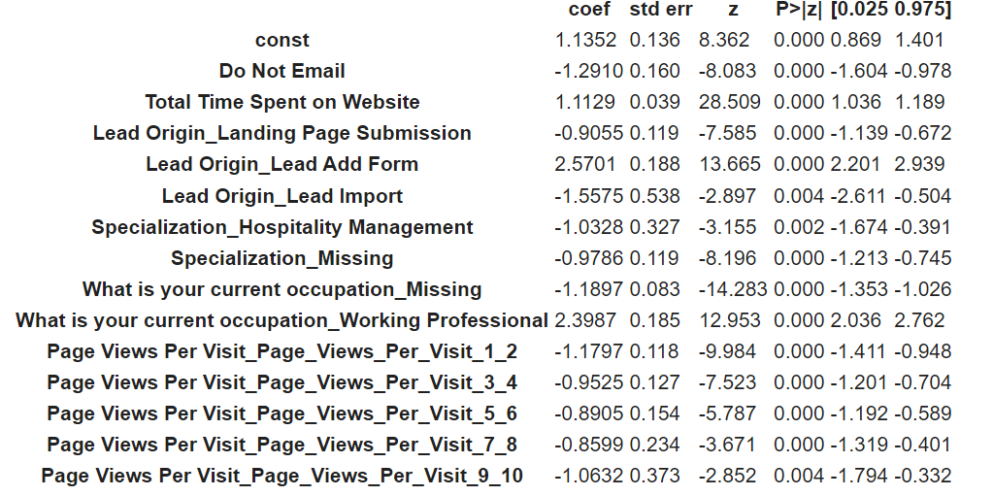
MODEL 2

Slide 14
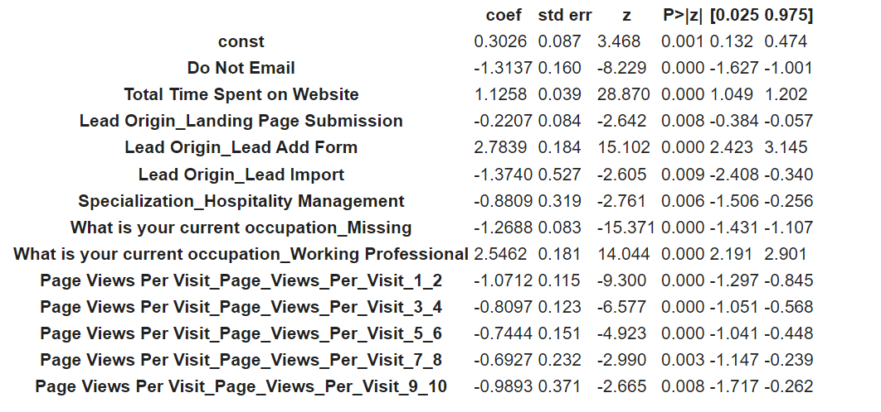
MODEL 3

Slide 15
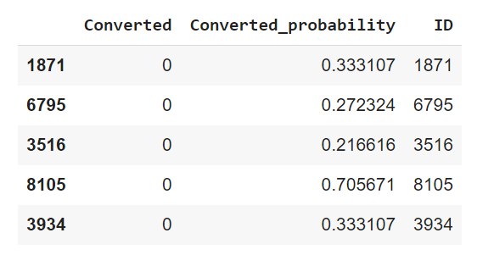
final model

Slide 16
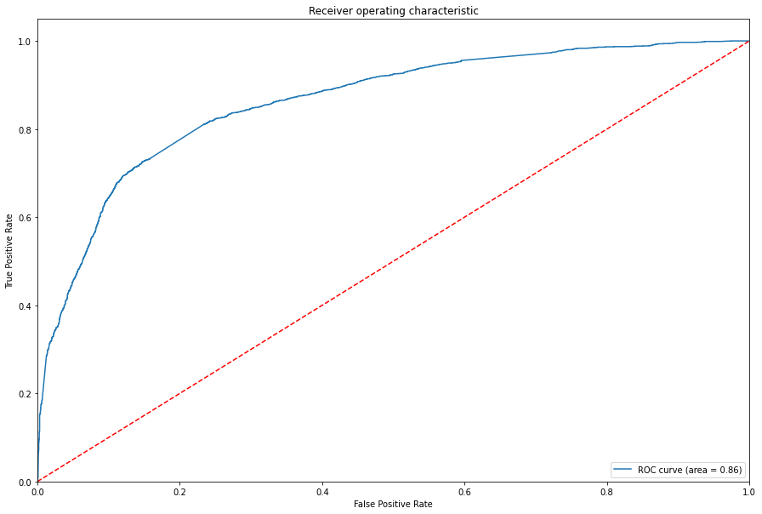
ROC

Slide 17
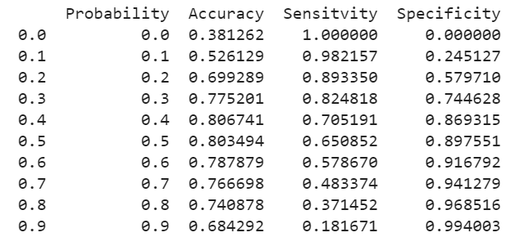
Accuracy, Sensitivity, Specificity

Slide 18
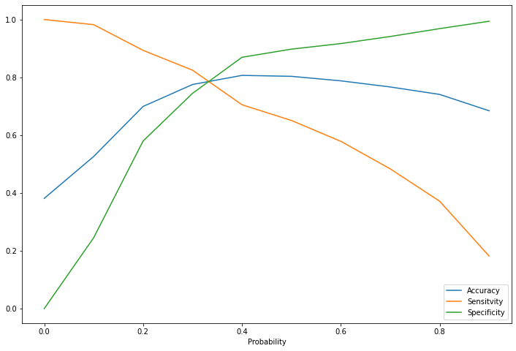
graph

Slide 19
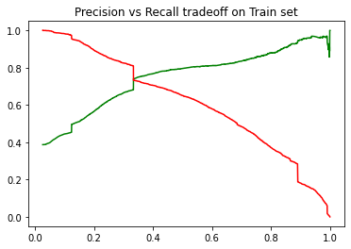
Precision vs recall tradefall

Slide 20

ROC CURVE

Slide 21
CONCLUSION
The sensitivity and specificity, Accuracy , Precision and Recall score we got from test set are almost accurate.
We have high recall score than precision score which is a sign of good model.
In business terms this model has an ability to adjust with the company’s requirement in coming future.
Important features responsible for good conversion rate or the ones which contributes more towards the probability of a lead getting converted are:
Lead Origin_Lead Add Form
Total Time Spent on Website
What is your current occupation_working professional.

