Slide 1
Wearable Computing Course Project
Design of a Smart Wearable System for Gold Jewellery Hallmark Recognition and Readability Assessment
Wearable Computing (BCSE315L) course project
Priyanka Lingesan, Riddhi Solanki, Pranathi Kaparthi, Krishnaraj N
Vellore Institute of Technology, Vellore, India
SIMULATION ONLY: no physical prototype | SYNTHETIC hallmark-style inscriptions | reads characters; NOT a purity, authenticity or BIS-certification check
Simulation-based study on SYNTHETIC data | no physical wearable built | reads characters only: no authenticity/purity claims
1
Notes:
Welcome. This project is a simulation-based study of a wrist-worn assistant that reads a hallmark inscription, estimates how trustworthy its own reading is, and tells the wearer how to retake a bad capture. Two disclosures up front: no hardware was built, and all images are synthetic. And it reads characters only; it never claims authenticity or purity.

Slide 2
Introduction and Motivation
• Gold jewellery carries small hallmark-style inscriptions: engraved / stamped / embossed / laser-marked
• Hard to read by eye: tiny, low contrast, worn, glare
• Failure mode: confident but wrong OCR output; a silent misread costs more than a retake
• Wrist camera: hands free, close-up view [1]; feedback helps capture [2]
• Reading a mark is NOT verifying gold purity, authenticity or BIS certification
• Design target: transcription RELIABILITY, not only accuracy
Simulation-based study on SYNTHETIC data | no physical wearable built | reads characters only: no authenticity/purity claims
2
Notes:
Hallmarks are small and low contrast. OCR engines return a confident string even when it is wrong, so a silent misread costs more than a retake. A wrist camera keeps both hands free and sees held objects at a useful scale (Ohnishi et al.), and finger-worn readers show that feedback on alignment and focus helps capture (FingerReader).

Slide 3
Problem Statement
• Input: frame x with a hallmark-style inscription y (unknown to the system)
• Output: transcription ŷ, calibrated score p(x), decision
  – ACCEPT if p(x) ≥ τ | RETAKE + hint | NO MARK
• Correct: c = 1[ŷ = y] (whitespace-insensitive exact match)
• Goal: keep accepted-error rate below a target at useful coverage
• Out of scope: authenticity, purity, BIS certification, hallmark-standard compliance
Simulation-based study on SYNTHETIC data | no physical wearable built | reads characters only: no authenticity/purity claims
3
Notes:
Formally: given a frame we output a transcription, a calibrated score and a decision. Correct means whitespace-insensitive exact match. The score should estimate the probability the transcription is right, and the threshold is chosen for a target accepted-error rate. Explicitly out of scope: purity, authenticity, standards compliance.

Slide 4
Objectives
• O1 Reproducible, labelled SYNTHETIC benchmark, item-level split
• O2 Benchmark OCR engines and preprocessing
• O3 Does quality + OCR-uncertainty beat raw OCR confidence?
• O4 Calibrated, risk-targeted acceptance; measure threshold transfer
• O5 Recapture guidance evaluated against known causes
• O6 Simulator that runs the REAL pipeline
• O7 Wrist unit <-> companion interface: one HTTP POST, receiver tested
• O8 Wrist electronics + camera/illumination design; firmware compiled and booted in Wokwi (no camera there)
• O9 Image acquisition: OpenCV webcam + image upload feeding the pipeline
Simulation-based study on SYNTHETIC data | no physical wearable built | reads characters only: no authenticity/purity claims
4
Notes:
Nine objectives, O1 to O9; O7 to O9 are the wearable interface, electronics and image acquisition. The central research question is O3: does combining image-quality assessment with OCR uncertainty reduce incorrectly accepted transcriptions compared to raw OCR confidence?

Slide 5
Literature Review (verified sources only)
• Mark analysis: goldsmith's-mark retrieval in silverware [3]
• OCR: Tesseract [4], PP-OCR [5]; scene-text surveys [6][7]
• Confidence: over-confident networks [8], MSP baseline [9], scene-text calibration [10]
• Selective prediction: Chow [11], El-Yaniv [13], Geifman [12], survey [14]
• Image quality: no-reference gradient and contrast statistics [15][16]
• No verified peer-reviewed work on OCR of engraved hallmarks found
Simulation-based study on SYNTHETIC data | no physical wearable built | reads characters only: no authenticity/purity claims
5
Notes:
The paper cites twenty verified sources, including three hardware and simulator documentation pages for the wearable design. Closest to our task: goldsmith's-mark retrieval in silverware, which identifies marks by retrieval rather than reading characters. For OCR: Tesseract and PP-OCR. For confidence: calibration, maximum-probability baselines, scene-text calibration. Selective prediction: Chow, El-Yaniv, Geifman. Quality: no-reference gradient and contrast statistics. No peer-reviewed work on OCR of engraved hallmarks was found in our bounded search.

Slide 6
Research Gap and Contribution
• Gap: no verified work combining quality + OCR uncertainty + calibrated abstention + recapture advice for engraved text
• Contributions:
  – Synthetic generator with per-factor labels
  – OCR benchmark + preprocessing ablation
  – Calibrated separated rejector with risk-controlled thresholds
  – Rule-based recapture guidance, evaluated on known causes
  – Simulator running the real pipeline
  – Acquisition app: webcam (OpenCV) + upload -> same pipeline
  – Wrist camera + companion design, one-request HTTP interface, Wokwi firmware check
• Novelty not claimed beyond this combination
Simulation-based study on SYNTHETIC data | no physical wearable built | reads characters only: no authenticity/purity claims
6
Notes:
The gap is a combination: quality assessment, OCR uncertainty, calibrated abstention, and recapture advice for engraved inscriptions on a wearable. This is a statement about our bounded search, not proof of absence; we claim no novelty beyond this combination.

Slide 7
Wearable Concept: Wrist Camera + Companion
• Wrist unit: XIAO ESP32S3 Sense + proposed camera module (OV5640 AF, unconfirmed; primary sensor), white LED (illumination only), button, OLED
• Companion laptop: Python pipeline does ALL recognition (quality, localisation, 2 OCR engines, readability, rejection, guidance)
• Link: one HTTP POST of the JPEG over Wi-Fi; 3-line text reply shown on the OLED
• Status labels used throughout:
  – PROPOSED design: physical wrist unit, camera, LED driver (not built)
  – IMPLEMENTED: Python pipeline + HTTP receiver (synthetic images)
  – SIMULATED: firmware compile + boot in Wokwi (NO camera part exists)
  – TESTED: HTTP receiver with a Python client only
Simulation-based study on SYNTHETIC data | no physical wearable built | reads characters only: no authenticity/purity claims
7
Notes:
The system has two parts. The wrist unit is one Seeed XIAO ESP32S3 Sense board with its proposed camera module (OV5640 with autofocus, unconfirmed until a kit is received) as the primary sensor, a white LED for illumination, a push button and a small OLED. The companion is a laptop running the Python pipeline, which does all recognition. When the button is pressed the unit lights the LED, captures a JPEG, sends it in one HTTP POST over Wi-Fi and shows the three-line text reply. Be clear about status: the physical design is proposed and was not built; the Python pipeline and the HTTP receiver are implemented; the firmware was only compiled and booted in Wokwi, which has no camera part; and the receiver was tested with a Python client, not with the device.

Slide 8
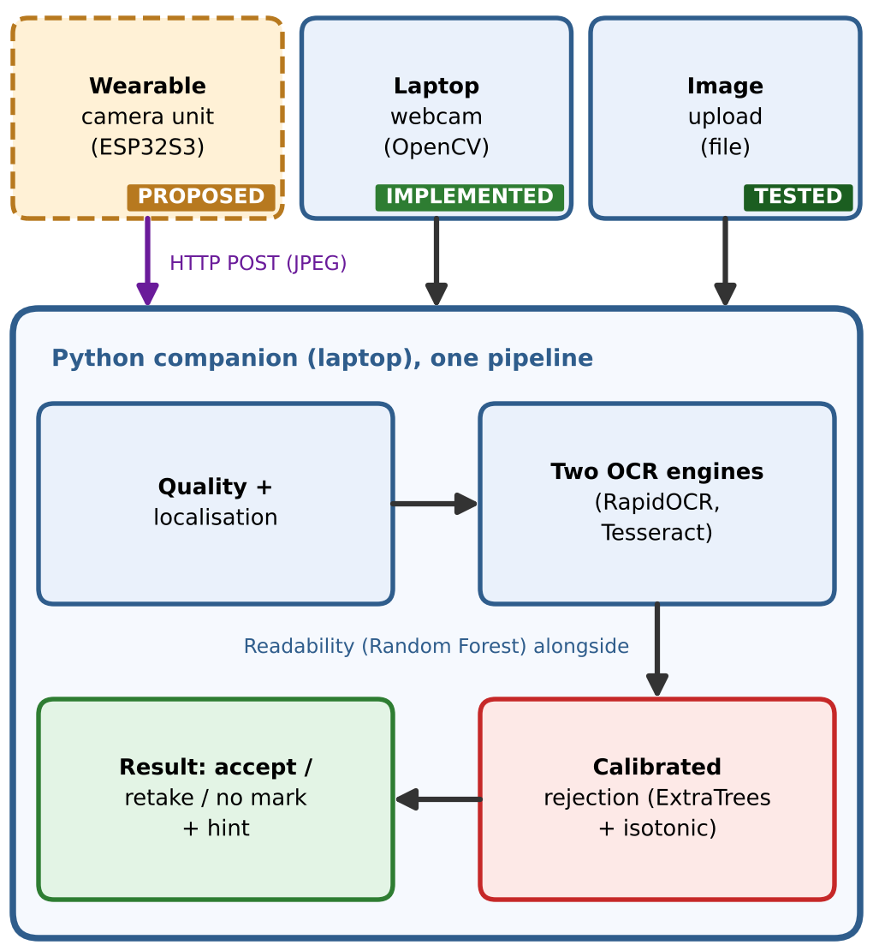
System Architecture
• Camera = primary sensor; LED = illumination only
• Recognition runs only on the companion laptop
• Wearable: one HTTP POST, 3-line text reply
• Wrist unit = PROPOSED, not built
Simulation-based study on SYNTHETIC data | no physical wearable built | reads characters only: no authenticity/purity claims
8
Notes:
Read the figure by section. Section A, the proposed wrist unit: the LED lights the hallmark, the proposed camera module (OV5640 with autofocus, unconfirmed) on the XIAO ESP32S3 Sense is the sensor, the same board sends the JPEG in one HTTP POST over Wi-Fi. Section B, the companion, which is implemented: acquisition, quality assessment, localisation, parallel OCR with RapidOCR and Tesseract, OCR uncertainty with the Random Forest readability class, calibrated rejection with ExtraTrees and isotonic calibration, and result plus guidance. The reply comes back in the same HTTP response as three lines of text and the board shows it on its OLED. The wrist block is proposed and not built.

Slide 9
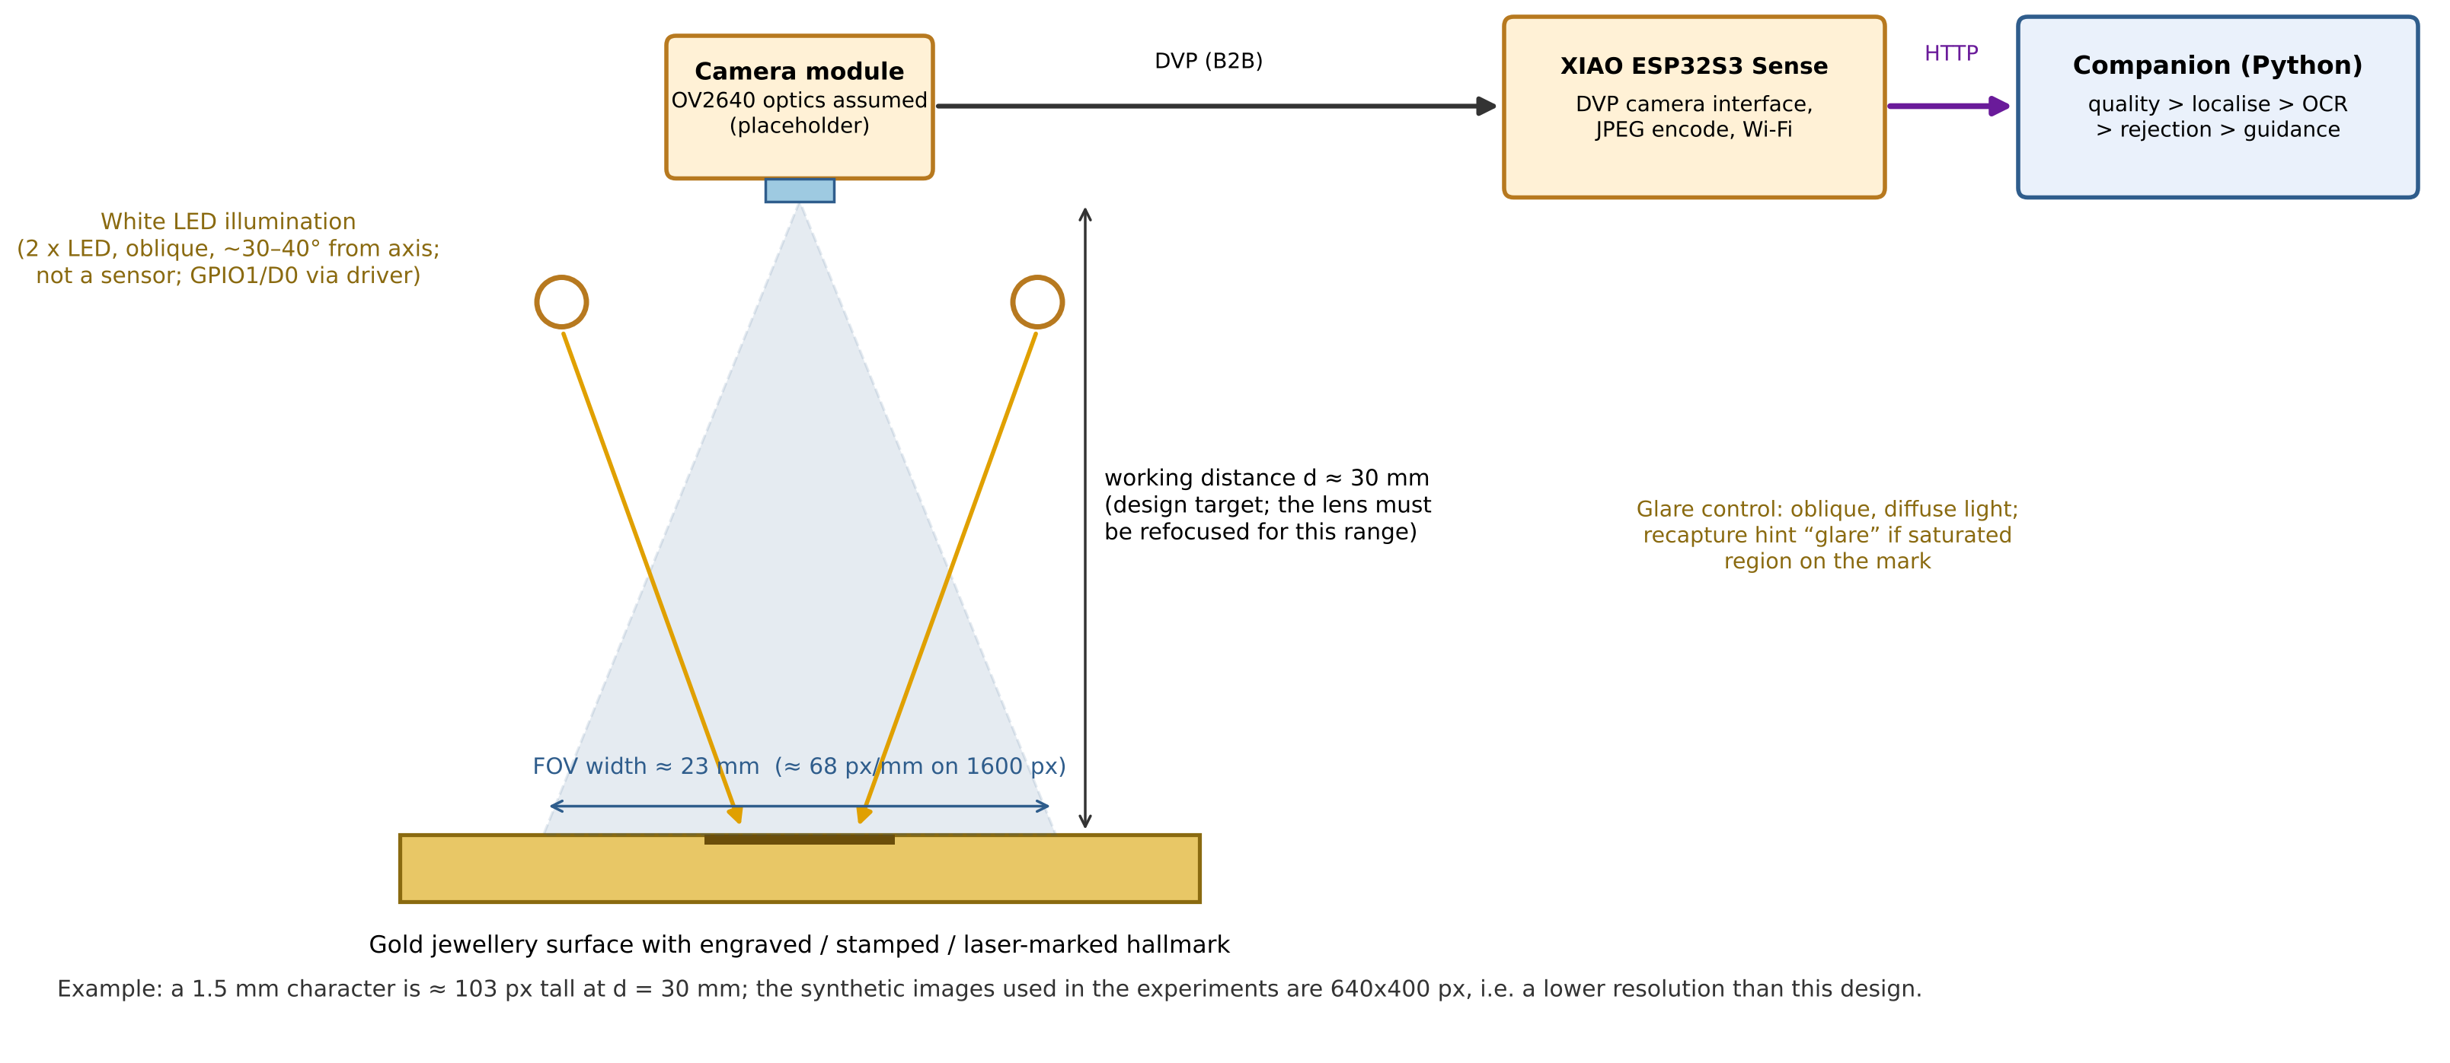
Camera and Illumination Design
• Proposed: XIAO ESP32S3 Sense + OV5640 AF; vendor says OV5640 or OV3660 may ship, so UNCONFIRMED [17]
• FOV and focus range: not listed by vendor
• Placeholder estimate from OV2640 [19], NOT OV5640 values: ~23 mm FOV, ~68 px/mm at 30 mm
• Illumination LED: D0/GPIO1 via NPN stage (not the sensor)
• Fallback: USB macro camera on the laptop
• NOT simulated in Wokwi; NOT built
Simulation-based study on SYNTHETIC data | no physical wearable built | reads characters only: no authenticity/purity claims
9
Notes:
We compared the XIAO ESP32S3 Sense, the AI-Thinker ESP32-CAM, the ESP32 DevKit-C V4 with a camera breakout, the Raspberry Pi camera and a USB macro camera. The XIAO ESP32S3 Sense is selected: the camera sits on the board-to-board connector and the board has eight megabytes of PSRAM and headers for the OLED, button and drivers. The proposed camera is the OV5640 autofocus module the vendor lists for the Sense, but the vendor also says boards may ship with an OV5640 or an OV3660, and older pages describe an OV2640, so the fitted module is unconfirmed. No field of view or focus range is listed, so the figures on this slide are an illustrative placeholder taken from the OV2640 Arducam page, not OV5640 values: about 23 millimetres field of view at 30 millimetres, about 68 pixels per millimetre. All optical values must be measured on the delivered module. A USB macro camera on the companion is the fallback. Wokwi cannot simulate a camera, so this is a drawing and the experiments use synthetic images.

Slide 10
Wearable Camera: Architecture Decision
Part | Connection | Status
Camera (proposed OV5640 AF, unconfirmed) | board-to-board connector; no external wiring | NOT TESTED
SSD1306 OLED | D4 = SDA (GPIO5), D5 = SCL (GPIO6), 3V3, GND | boot only in Wokwi
CAPTURE button | D1 (GPIO2) to GND, internal pull-up | boot only in Wokwi
White LED stage | D0 (GPIO1) -> 1 k -> NPN base; LED + resistor from 5 V | PROPOSED
Power | USB-C 5 V (power bank); no battery design | PROPOSED
Link | Wi-Fi 2.4 GHz, one HTTP POST to /api/wearable/upload | receiver tested (Python client)
• Why not DevKit-C V4: 14 DVP signals, no camera connector, PSRAM unverified
• Why not ESP32-CAM: only 6 spare GPIOs, shared with SD/flash LED [18]
• Selected: XIAO ESP32S3 Sense, 8 MB PSRAM, single board [17]
• Whole unit is PROPOSED, NOT BUILT, NOT TESTED; the full wiring diagram is Fig. 2 of the paper
Simulation-based study on SYNTHETIC data | no physical wearable built | reads characters only: no authenticity/purity claims
10
Notes:
The earlier circuit had no camera, which was a gap. A DVP camera needs fourteen signals: eight data lines, the clock, pixel clock, vertical and horizontal sync, and two for the camera I2C bus. A DevKit-C V4 is not a camera board and would have little I/O left, and we did not verify that its module has the PSRAM that large JPEG frames need. The AI-Thinker ESP32-CAM leaves only six GPIOs free, each shared with the microSD socket or the flash LED, has no USB port and wants a five volt supply of at least two amps, so it cannot also run an OLED, a button and an LED driver. The XIAO ESP32S3 Sense carries the ESP32-S3 and the camera on one small board, so one board both acquires the image and runs the interface. The camera pins are fixed by the board; our I/O is OLED on D4 and D5, button on D1 and illumination on D0. The image goes to the companion by one HTTP POST over Wi-Fi. All of this is a proposed design; nothing was built.

Slide 11
Wearable Camera: Verified vs Proposed
• DONE: board/camera/pin selection from vendor docs [17]
• SIMULATED: firmware compiles for XIAO ESP32-S3 and boots in Wokwi
• EXPECTED FAILURE: camera probe 0x106 (Wokwi has no camera part [20])
• TESTED (companion side): HTTP receiver, Python client
• NOT DONE: hardware, camera frame, firmware POST, round trip, power, optics
• Laptop webcam = separate path; NOT evidence of wearable integration
Simulation-based study on SYNTHETIC data | no physical wearable built | reads characters only: no authenticity/purity claims
11
Notes:
This slide separates what was actually done from what is proposed. Done: a literature and vendor-page search that fixed the board, camera and pin map; a short firmware (camera capture, LED, button, OLED, one HTTP POST) was compiled for the XIAO ESP32-S3 in the Wokwi build service and booted in the simulator; the camera probe fails there with not supported, as expected, because Wokwi has no camera part. The HTTP receiver on the companion was tested with a Python client. Not done: no physical board, no camera frame, no HTTP POST from the firmware, no button press or OLED screen verified in Wokwi, no round trip to the companion, no power measurement, no focus or field-of-view measurement. The laptop webcam is a separate implemented path, tested only with a test video, and is not evidence for the wearable camera.

Slide 12
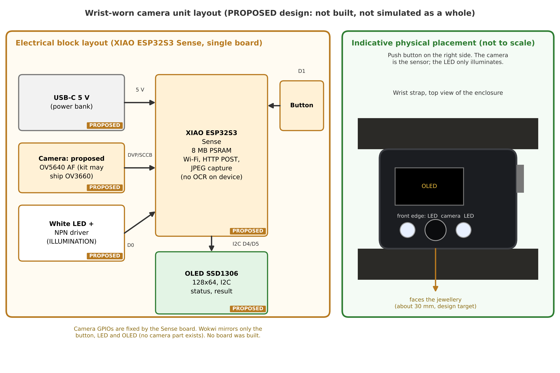
Proposed Wrist Unit: Electronics Layout
• Camera = primary sensor (proposed OV5640 AF module; unconfirmed)
• White LED = illumination only (NPN stage, 5 V)
• OLED D4/D5, button D1, LED D0
• Board runs capture + UI + comms; NO OCR
• PROPOSED: not built; Wokwi mirrors only button, LED, OLED
Simulation-based study on SYNTHETIC data | no physical wearable built | reads characters only: no authenticity/purity claims
12
Notes:
This is the proposed wrist unit, a design that was not built. One XIAO ESP32S3 Sense board carries the proposed camera module (OV5640 with autofocus, unconfirmed), which is the sensor, on its board-to-board connector. A white LED lights the hallmark through a transistor stage and is not a sensor. A button on D1 starts a capture and an OLED on D4 and D5 shows the result. The camera takes fixed pins; our I/O uses D0, D1, D4 and D5 and avoids GPIO3, a strapping pin. Nothing here is built or measured.

Slide 13
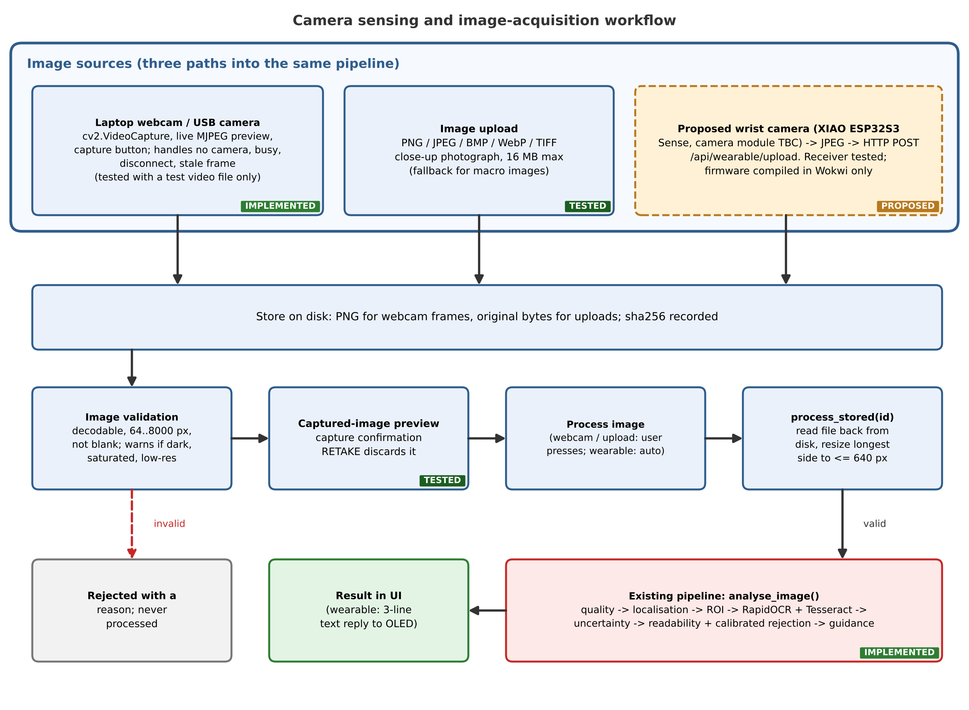
Image Acquisition Workflow (Implemented)
• Webcam (OpenCV): preview, capture, errors
• Upload: PNG/JPEG/BMP/WebP/TIFF
• Validate -> preview -> Retake / Process
• ONE entry point: process_stored()
• Webcam tested with a TEST VIDEO only (no camera in the sandbox)
Simulation-based study on SYNTHETIC data | no physical wearable built | reads characters only: no authenticity/purity claims
13
Notes:
This is the part that was missing and is now implemented: real image acquisition for the pipeline. There are two implemented software sources. First, a laptop webcam or USB camera through OpenCV, with live preview, camera selection, a capture button and error handling for no camera or a disconnect. Second, image upload, which matters because a normal webcam cannot resolve millimetre-high hallmarks. Both store the image on disk, validate it, show a preview with a retake option, and then use one function that reads the stored file back and runs the same pipeline. The proposed wrist camera and its HTTP sender are a design only. One honest limit: no physical webcam was available, so the webcam code was tested with a recorded test video.

Slide 14
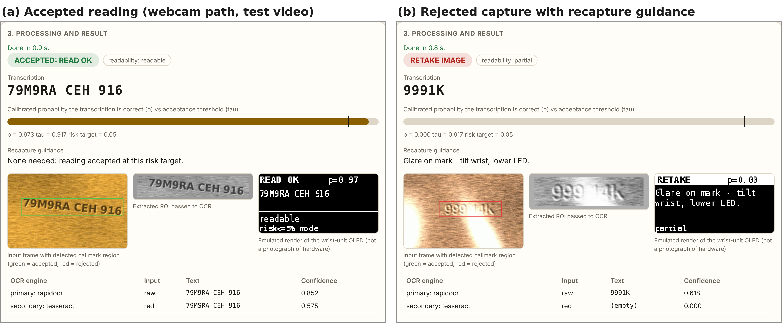
Application Demo: Webcam Path
Real screenshots (headless Chromium). Camera source = recorded TEST VIDEO of synthetic frames; no physical webcam. (a) accepted; (b) RETAKE.
Simulation-based study on SYNTHETIC data | no physical wearable built | reads characters only: no authenticity/purity claims
14
Notes:
These are real screenshots of the running application. In the left one the live preview shows the camera source, the frame was captured, saved and processed, and the result shows the transcription, calibrated probability against the threshold, both OCR readings, per-stage timings and the file hash. In the right one a glare frame was rejected with the hint 'Glare on mark: tilt wrist, lower LED'. Important: the camera source in these screenshots is a recorded test video of synthetic frames, because no camera was available in the environment. They demonstrate the software path, not a physical webcam or real jewellery.

Slide 15
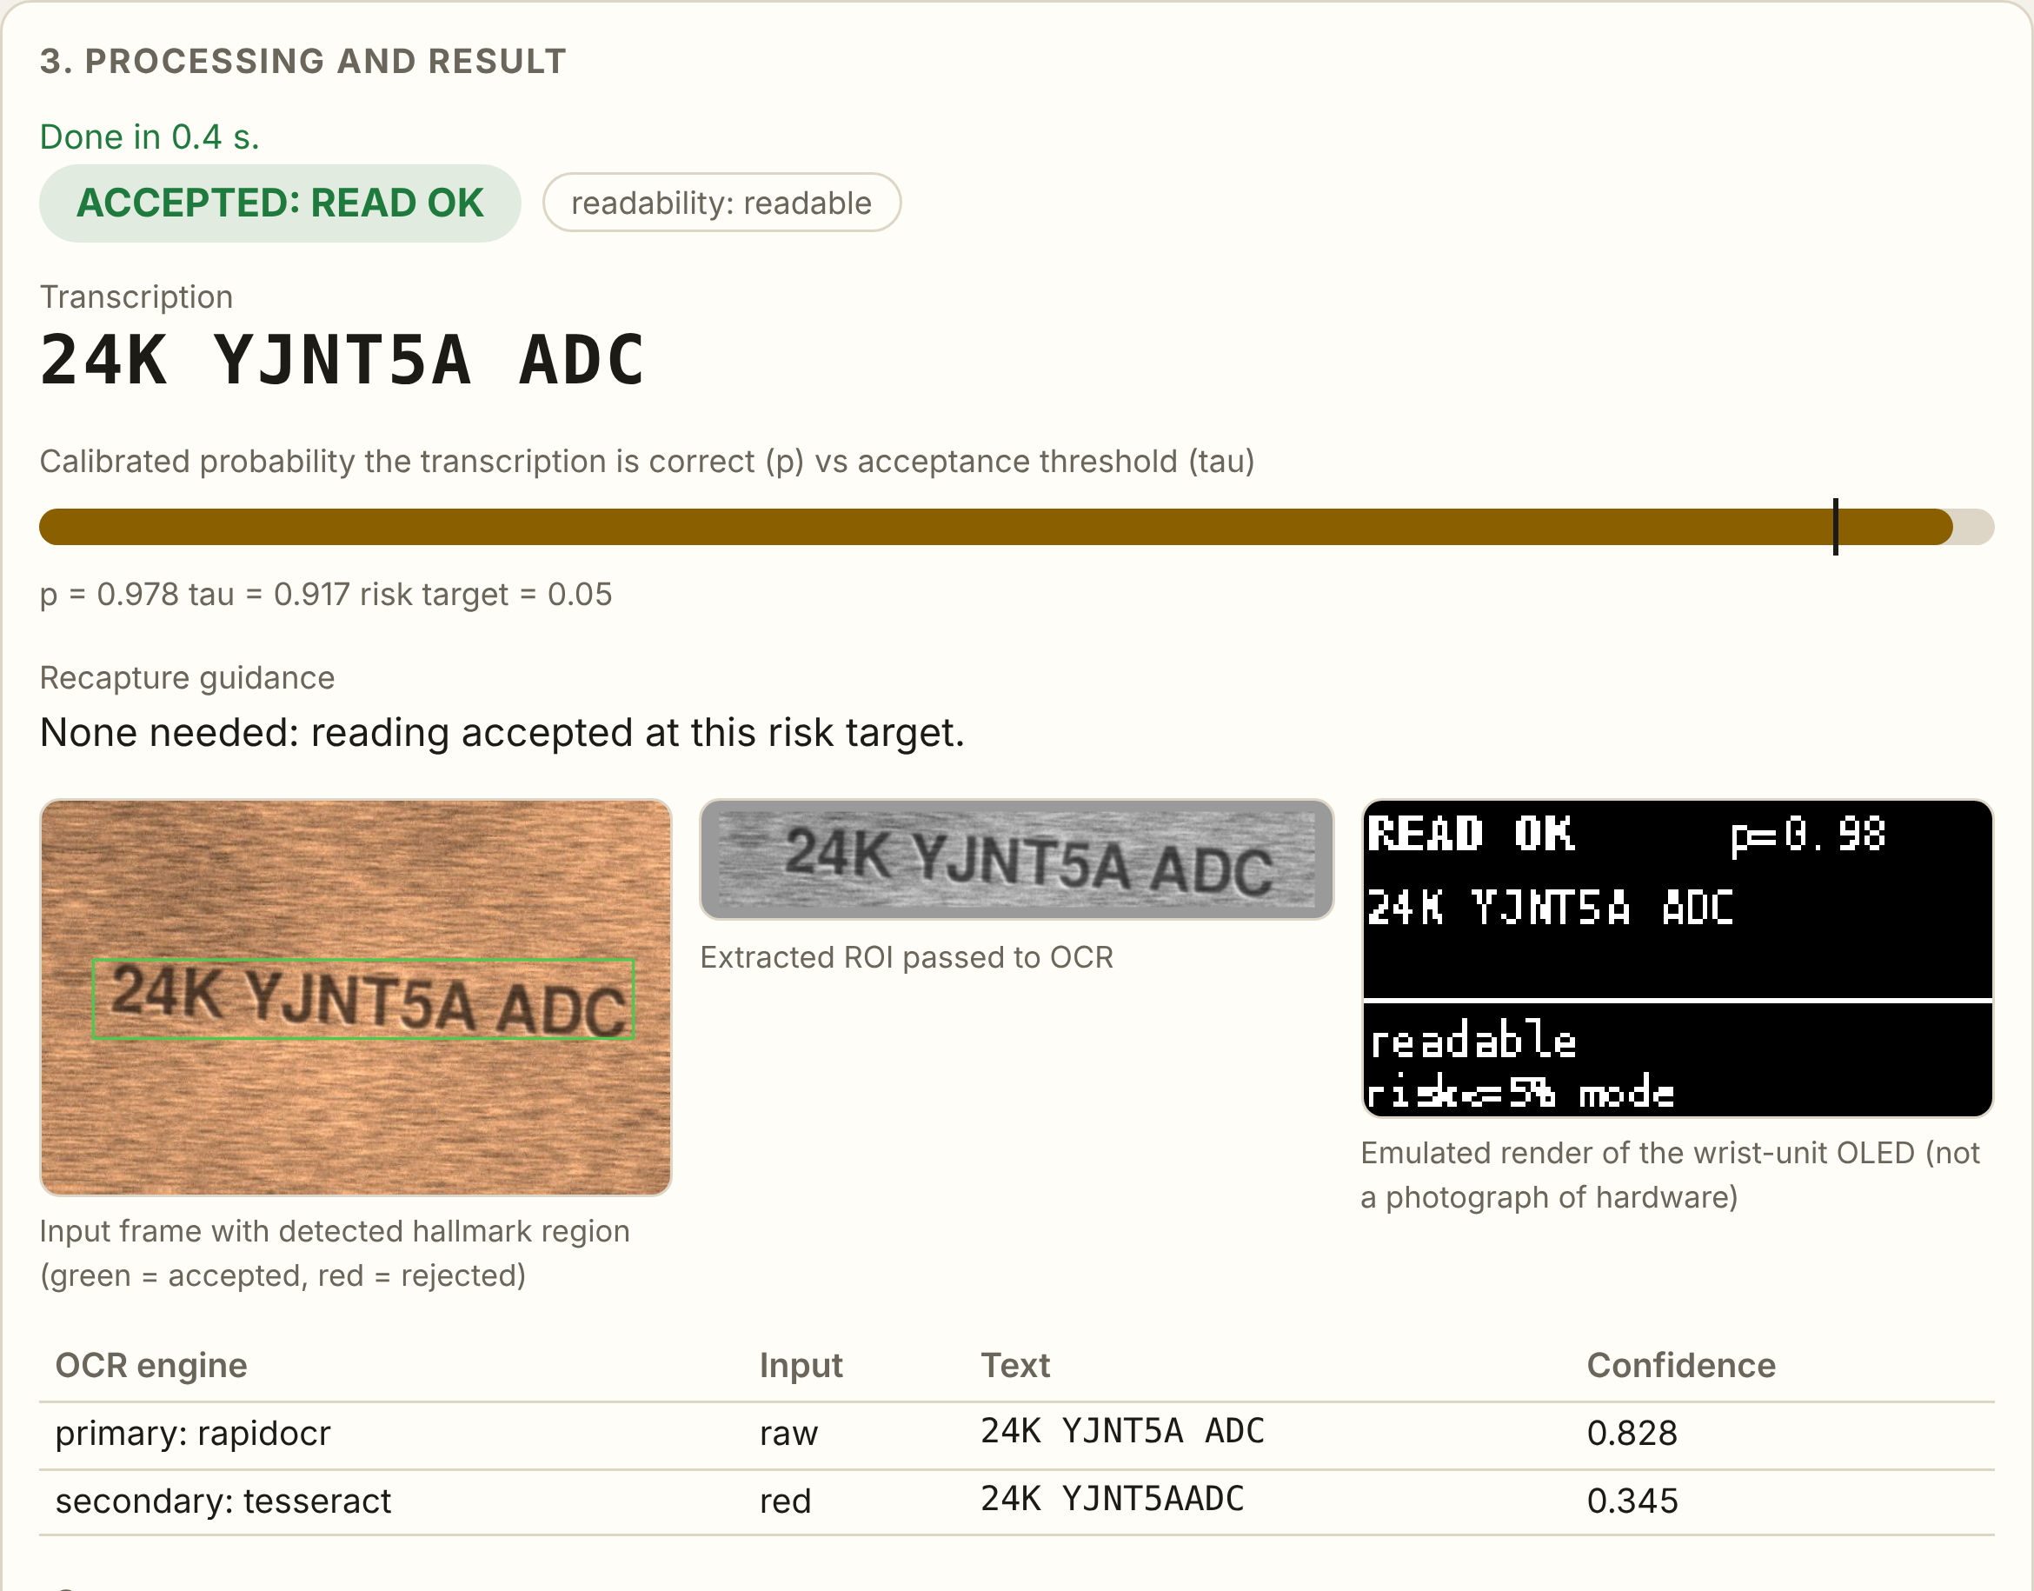
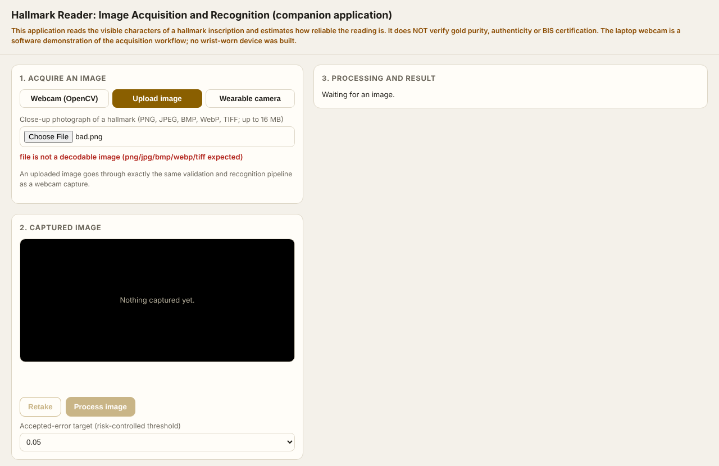
Application Demo: Image Upload and Errors
Real screenshots. Left: upload result (SYNTHETIC test image, not a jewellery photograph). Right: corrupt upload refused.
Simulation-based study on SYNTHETIC data | no physical wearable built | reads characters only: no authenticity/purity claims
15
Notes:
The upload path takes an image file, validates it and runs exactly the same pipeline. On the left the uploaded close-up was read and accepted. On the right a corrupt file is refused with a clear message and the Process button stays disabled. In the tests, a webcam frame and an uploaded file with identical pixels produced identical results, and the stored file's hash equals the uploaded bytes, which shows that the pipeline processes the actual input. The uploaded test image is a synthetic image saved as a file; no real jewellery photograph was processed.

Slide 16
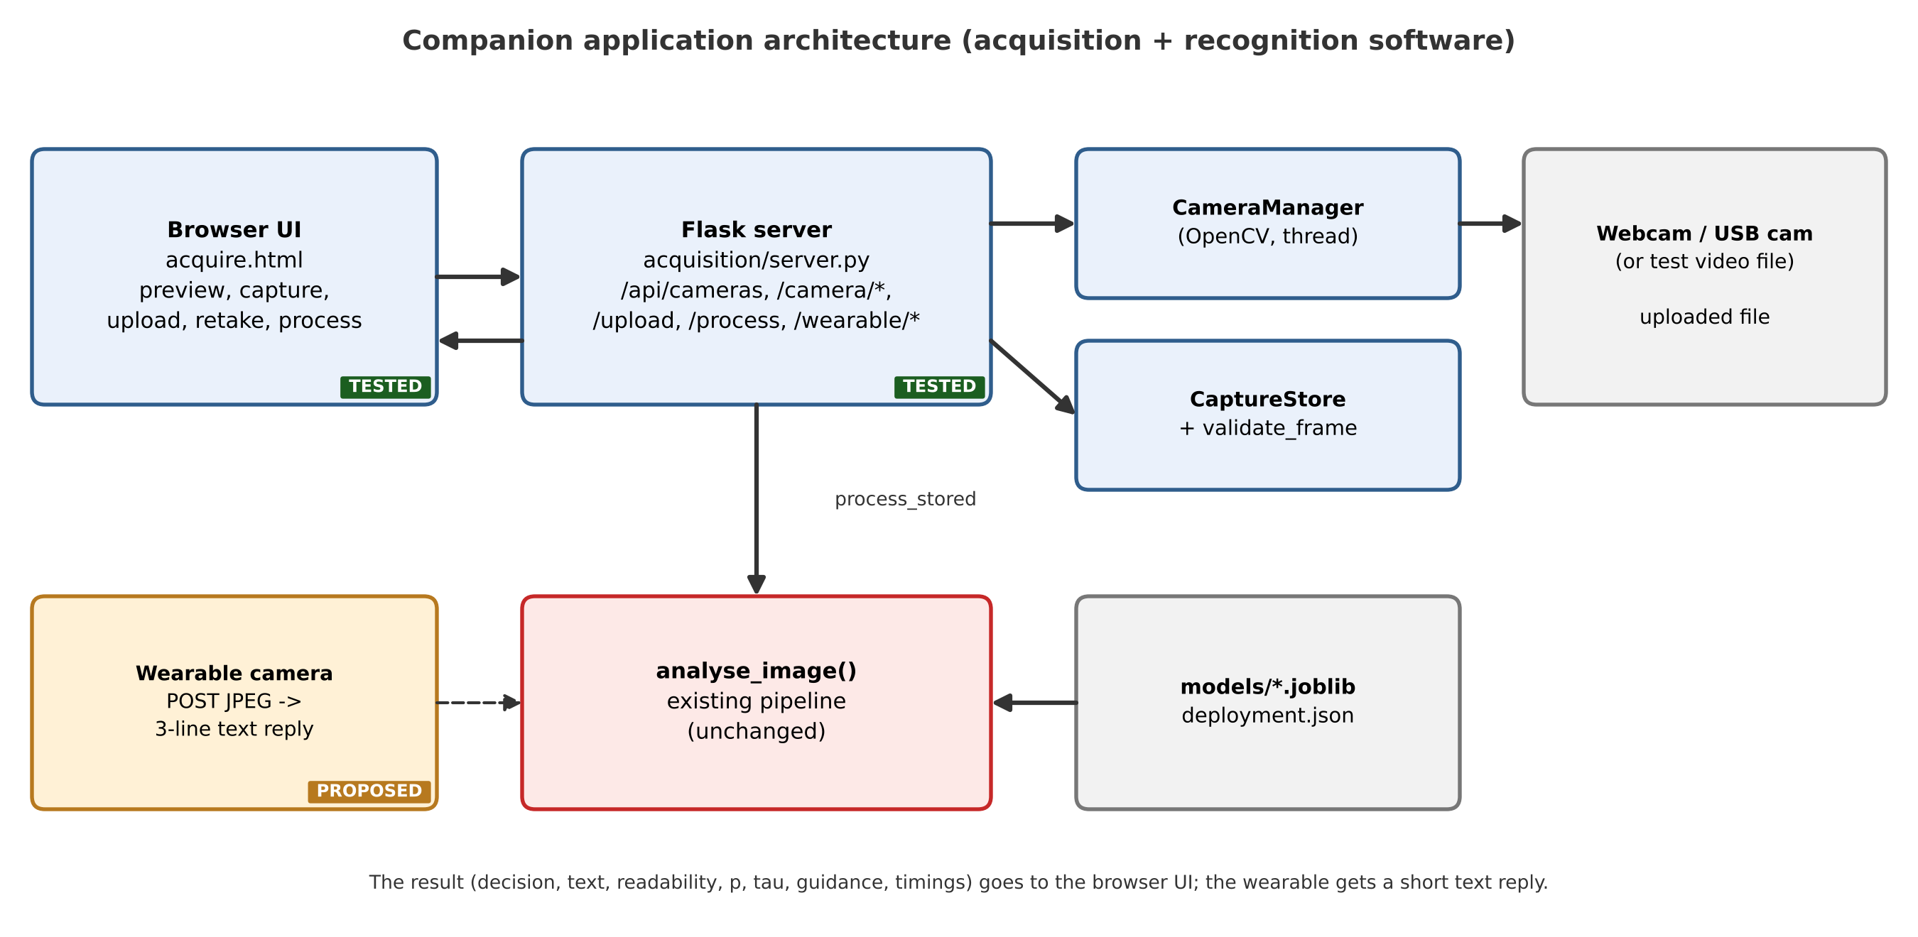
Software Application and Tests
• 27 automated tests pass
• Webcam rows use a TEST VIDEO, not a camera
• Same pixels via webcam or upload -> identical result
• Corrupt / blank / tiny / unsupported files refused
• Disconnect detected; capture refused
• Every control clicked in headless Chromium
Simulation-based study on SYNTHETIC data | no physical wearable built | reads characters only: no authenticity/purity claims
16
Notes:
The application is a Flask server with a browser interface. A camera manager runs the OpenCV capture in a thread and serves the preview; a capture store saves and validates every image; and one function reads the stored file back and calls the existing recognition pipeline unchanged. A wearable endpoint accepts a JPEG and returns a three-line text reply. Twenty-four automated tests pass, covering acquisition, the wearable endpoint and a headless-browser test of every control. The webcam tests use a recorded test video; no physical camera was tested.

Slide 17
Wearable HTTP Interface
• POST /api/wearable/upload, body = JPEG, Content-Type image/jpeg
• Reply (text, 3 lines): READ OK | RETAKE | NO MARK
  – line 2: transcription (READ OK) or recapture hint
  – line 3: readability label
• Bad body: 400/422, first line BAD IMAGE; error: 500, first line ERROR
• Same process_stored() entry point as webcam and upload
• TESTED: Python client (4 automated tests); no hardware
• NOT tested: camera capture, firmware POST, Wi-Fi; plain HTTP, no TLS/authentication
Simulation-based study on SYNTHETIC data | no physical wearable built | reads characters only: no authenticity/purity claims
17
Notes:
There is one exchange. The wrist unit POSTs the JPEG to slash api slash wearable slash upload. The companion stores the bytes, validates them, runs the same process-stored function as the webcam and upload paths, and replies in plain text with three lines: READ OK, RETAKE or NO MARK; the transcription or the hint; and the readability label. Bad images get a 400 or 422 reply starting with BAD IMAGE. There is no broker, no topics and no device state. What was tested: a Python client sending JPEG bytes; the reply equals a direct pipeline call, the stored file is byte-identical, and bad bodies are rejected. What was not tested: the camera, the firmware POST and any real Wi-Fi link.

Slide 18
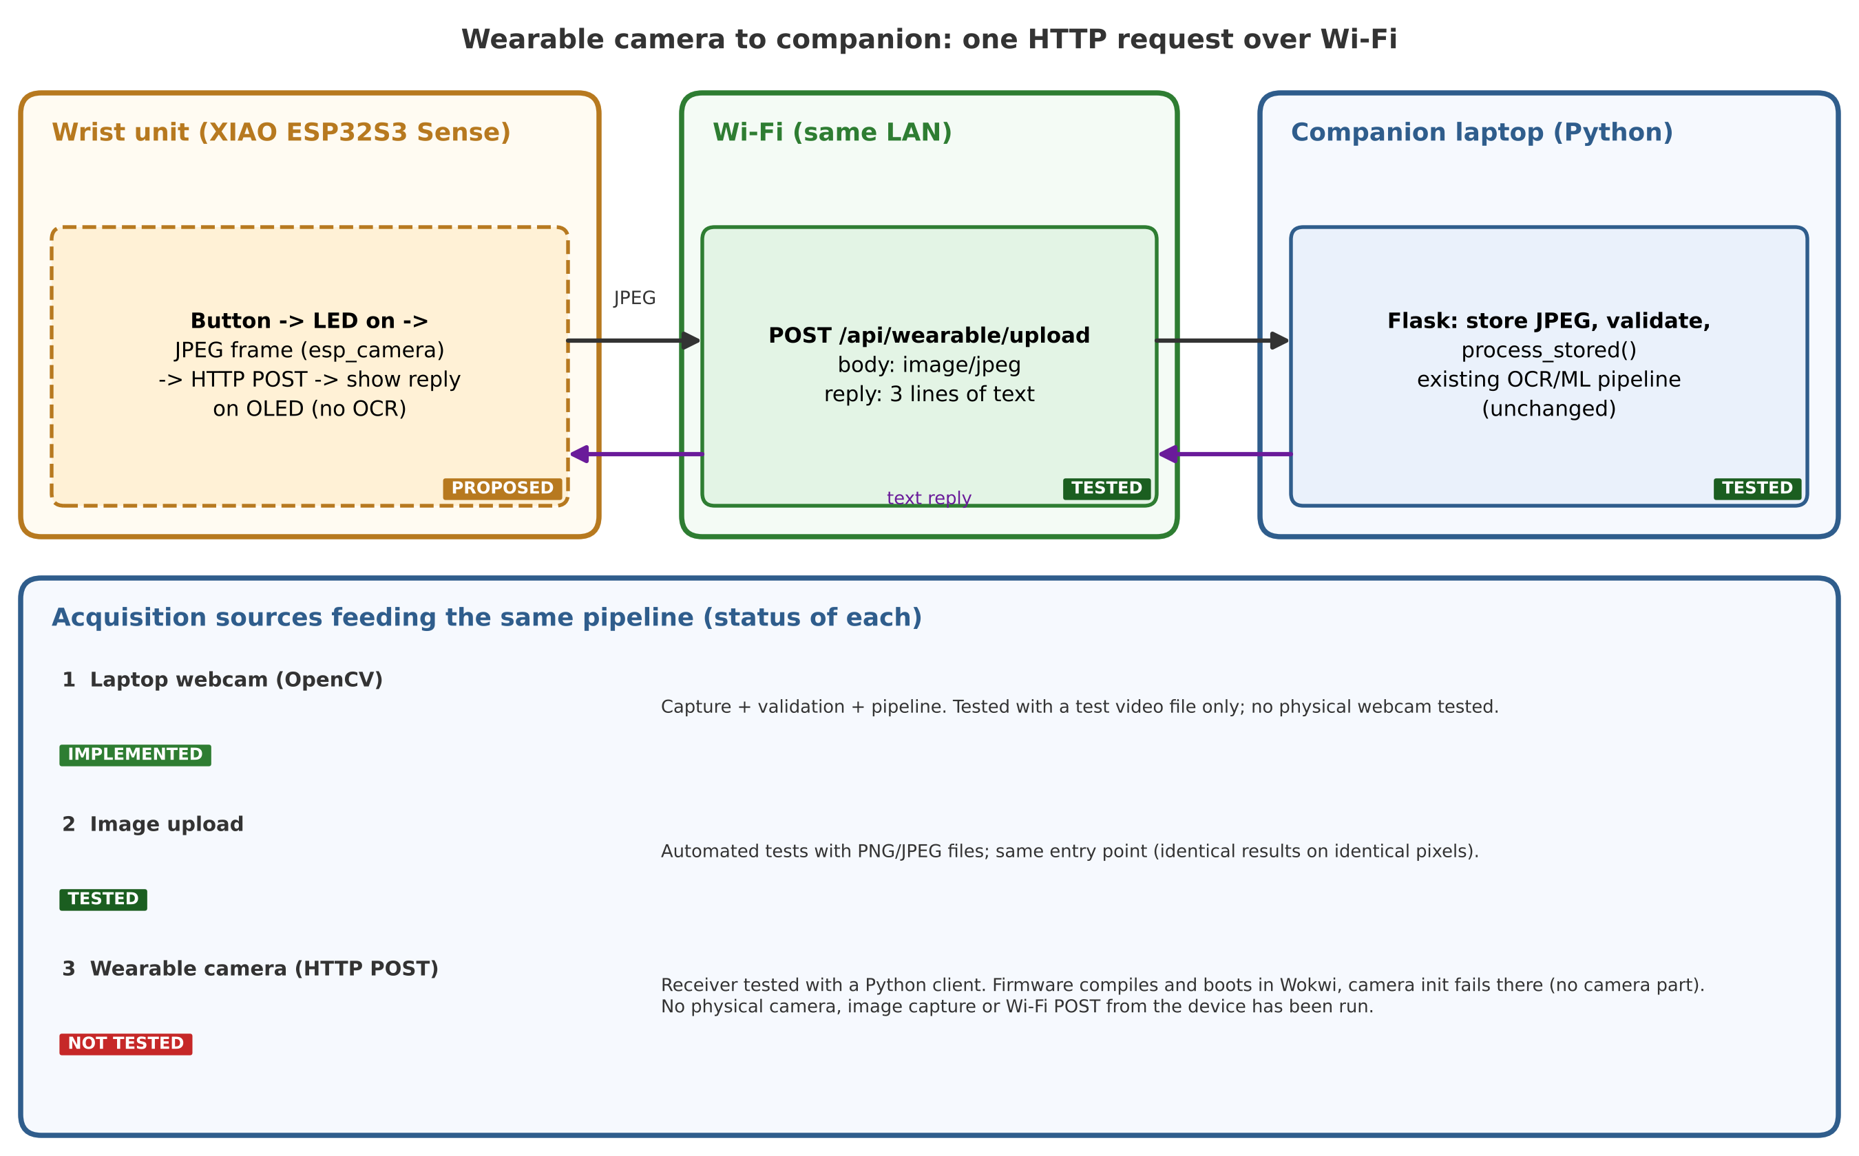
Communication Architecture and Test Status
• One HTTP POST over Wi-Fi
• Webcam: implemented; test video only
• Upload: implemented and tested
• Wearable camera: NOT built/tested
• Receiver tested with Python client
Simulation-based study on SYNTHETIC data | no physical wearable built | reads characters only: no authenticity/purity claims
18
Notes:
This diagram shows the one HTTP request from the wrist unit to the companion and states the status of each acquisition source. The laptop webcam feeds the pipeline and was tested only with a test video. Image upload is implemented and tested. The wearable camera is a proposal: the HTTP receiver was tested with a Python client, but the ESP32 sender and the camera were never built or run. I do not claim the wearable path is integrated.

Slide 19
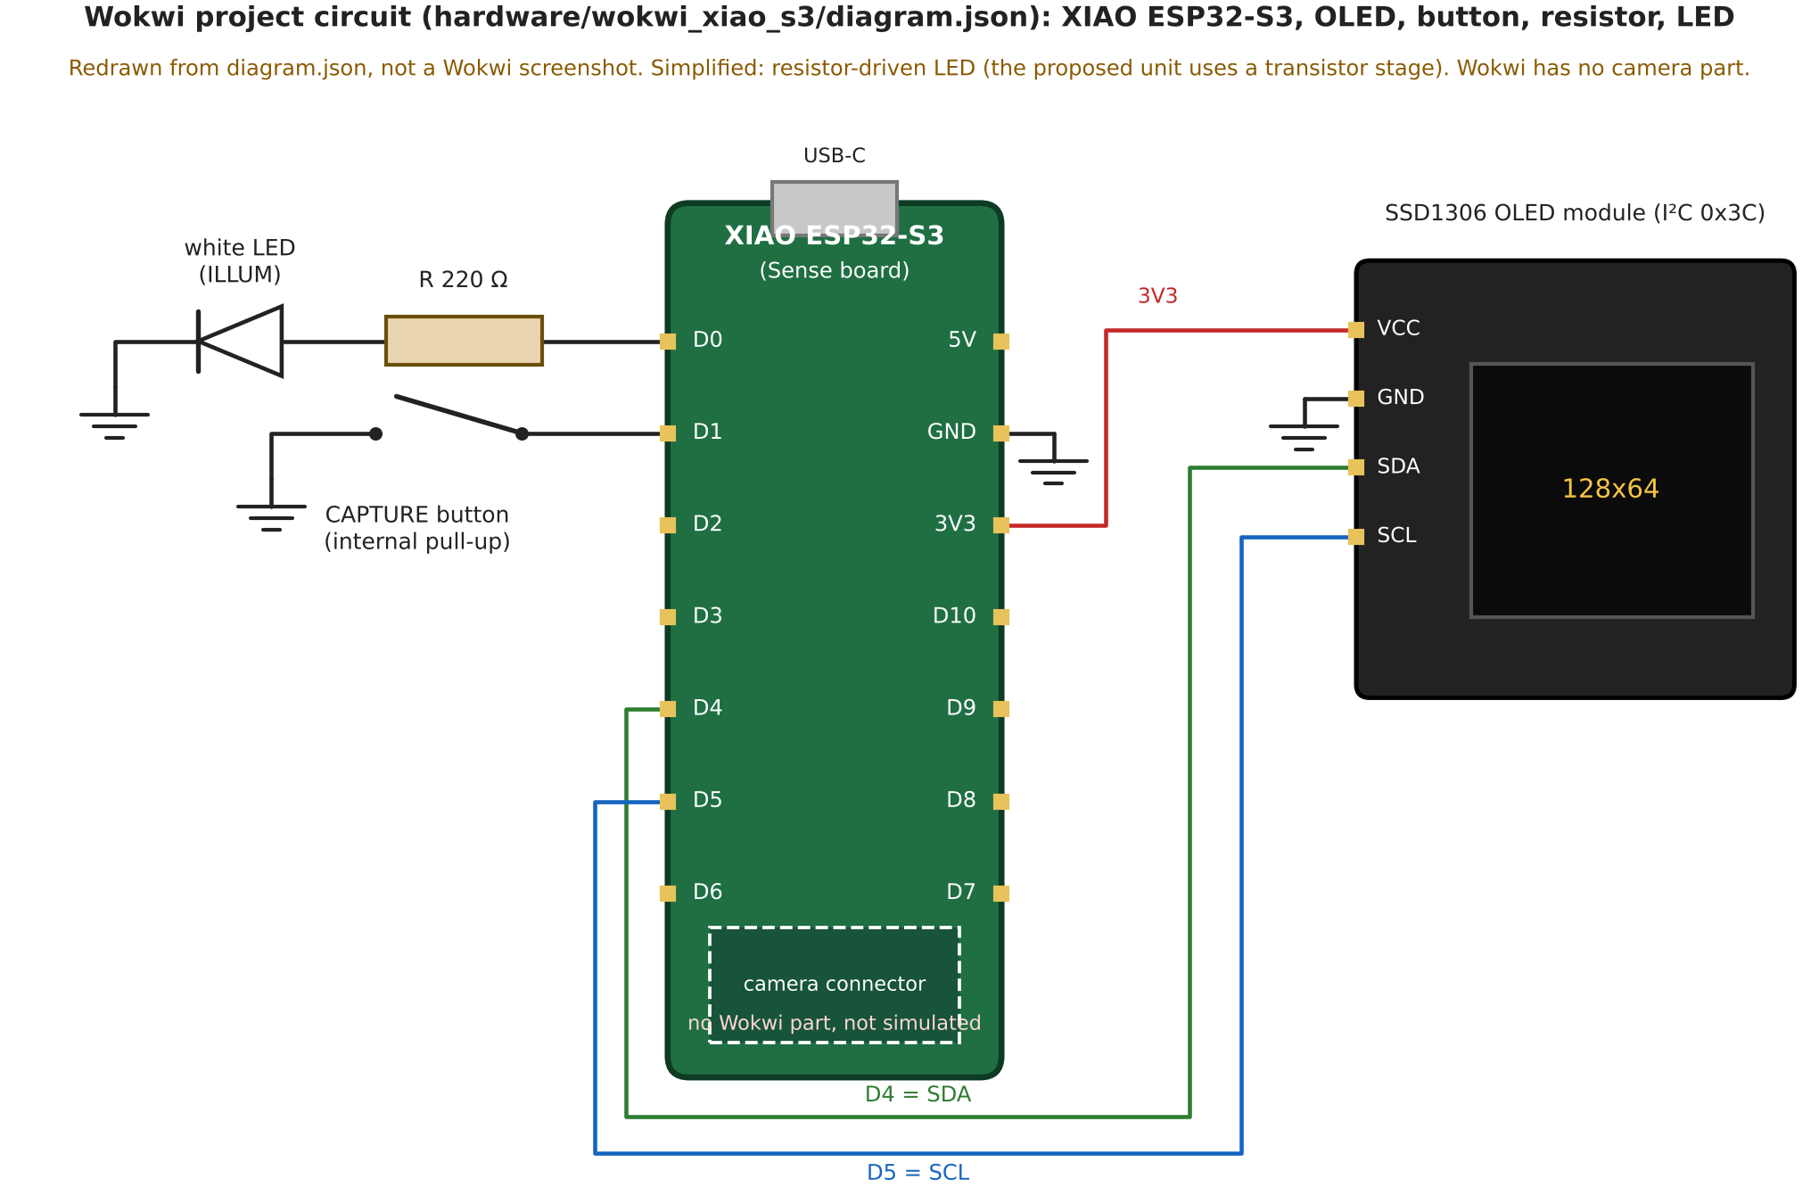
Wokwi Project Circuit
• Parts: XIAO ESP32-S3, SSD1306 OLED, button, 220 Ω resistor, white LED
• OLED: D4 = SDA, D5 = SCL, 3V3, GND
• Button: D1 to GND (internal pull-up)
• LED: D0 via 220 Ω (Wokwi has no NPN part)
• Redrawn from diagram.json; NOT a Wokwi screenshot
• No camera part in Wokwi: camera NOT simulated
Simulation-based study on SYNTHETIC data | no physical wearable built | reads characters only: no authenticity/purity claims
19
Notes:
This is the circuit of the Wokwi project in the hardware folder: the XIAO ESP32-S3 board, an SSD1306 OLED on D4 and D5, the capture button on D1 to ground, and the white LED on D0 through a 220 ohm resistor. It was redrawn from the project's diagram dot json file; it is not a screenshot of the Wokwi site, which could not be opened when the figure was made. Wokwi has no camera part, so the camera is not simulated. The transistor LED driver of the proposed design is also not in Wokwi, where a resistor drive stands in for it.

Slide 20
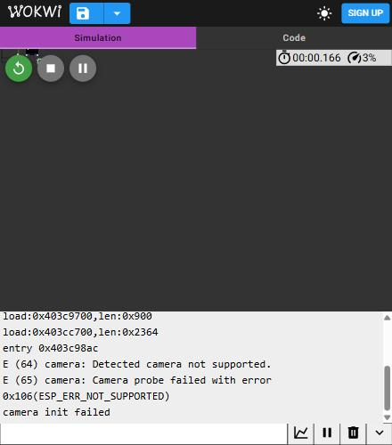
Wokwi Firmware Check (No Camera)
• Wokwi XIAO ESP32-S3 + SSD1306 OLED + button + LED
• Observed: compile, boot, camera probe fails (ESP_ERR_NOT_SUPPORTED)
• Expected: Wokwi has no camera part [20]
• NOT verified: button, OLED screens, Wi-Fi POST, any frame, round trip
• No claim that Wokwi tested the camera path
Simulation-based study on SYNTHETIC data | no physical wearable built | reads characters only: no authenticity/purity claims
20
Notes:
This is a real screenshot of the serial output from the Wokwi simulator. The wrist firmware, about eighty lines, was loaded on Wokwi's XIAO ESP32-S3 board with an OLED, a button and a white LED. It compiled and booted. The camera probe fails with not supported, because Wokwi has no camera part, and the firmware reports camera init failed. That is the expected result and it is the only thing this run shows. The button press, the OLED screens, the Wi-Fi connection of this firmware, the HTTP POST and any round trip to the companion were not verified. The earlier Wokwi projects that used a messaging protocol were removed.

Slide 21
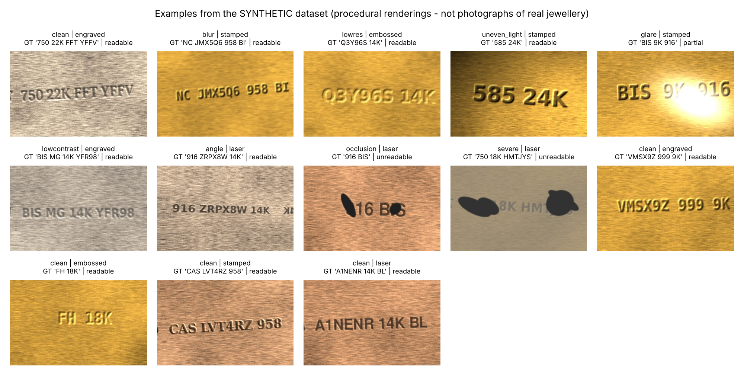
Dataset (100 % synthetic)
• 240 items × 6 acquisitions = 1440 images
• Split by ITEM: 144 / 48 / 48
• Designed to resemble gold-jewellery hallmark-style markings
• NOT real photographs; NOT official BIS samples
• Readability = generator-defined proxy
• Results = synthetic benchmark only
Simulation-based study on SYNTHETIC data | no physical wearable built | reads characters only: no authenticity/purity claims
21
Notes:
1440 procedurally generated images from 240 fictitious inscriptions. Split by item: 144, 48, 48 items. Per-factor labels come from the generator parameters, and the readability label is a generator-defined proxy, not human judgement. These images are not photographs of real jewellery.

Slide 22
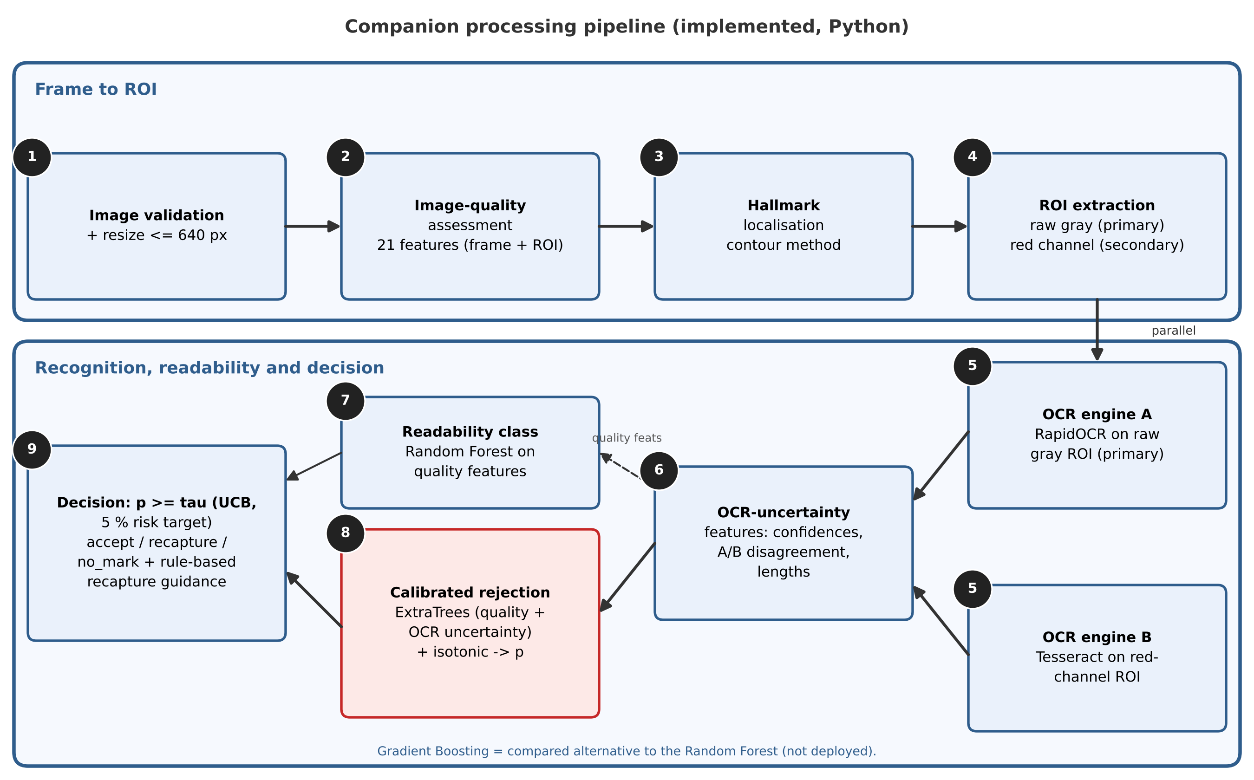
Companion Pipeline and Model Roles
• Primary OCR: RapidOCR (raw gray)
• Secondary OCR: Tesseract (red channel)
• Rejector: ExtraTrees + isotonic calibration
• Readability: Random Forest on quality features
• Gradient Boosting: compared, NOT deployed
• Guidance: rule-based
Simulation-based study on SYNTHETIC data | no physical wearable built | reads characters only: no authenticity/purity claims
22
Notes:
The companion runs the existing pipeline unchanged. Validation and resize, image-quality assessment with 21 features, contour-based localisation and ROI extraction. Then two OCR engines in parallel: RapidOCR on the raw grayscale ROI is the primary reading and Tesseract on the red channel is the secondary. OCR-uncertainty features feed an ExtraTrees rejector with isotonic calibration, compared with a threshold tau; a Random Forest on quality features gives the readability class; Gradient Boosting is the compared alternative and is not deployed; and rule-based guidance explains rejections.

Slide 23
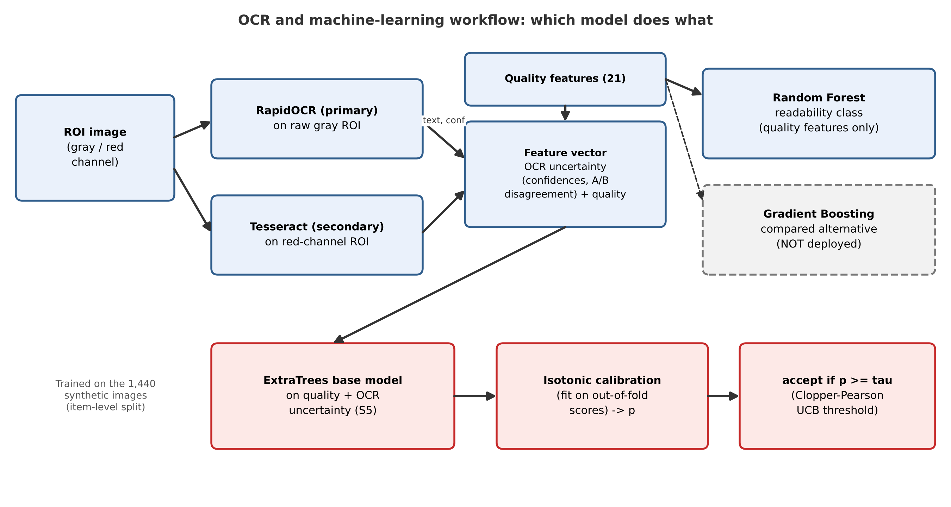
OCR and ML Workflow
Simulation-based study on SYNTHETIC data | no physical wearable built | reads characters only: no authenticity/purity claims
23
Notes:
Which model does what. Two OCR engines read the ROI. Their confidences, lengths and disagreement form OCR-uncertainty features, which are combined with the 21 quality features. A Random Forest on the quality features predicts the readability class, with Gradient Boosting as a compared alternative. An ExtraTrees base model on quality plus OCR uncertainty is calibrated with isotonic regression on out-of-fold scores, giving the probability p that the transcription is correct; the system accepts when p is at least the Clopper-Pearson upper-bound threshold. All models were trained on the 1440 synthetic images with an item-level split.

Slide 24
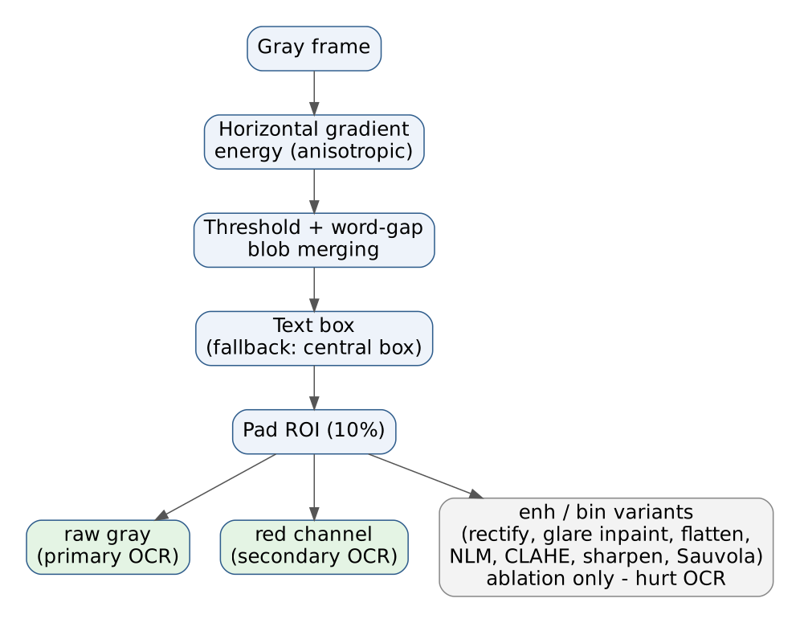
Image-Processing Pipeline
method | iou ge 0 5 | latency ms median
contour | 0.757 | 6.154
mser | 0.656 | 22.521
ocrdet | 0.809 | 133.041
full | 0.000 | 0.001
Localisation (test). full = full-frame baseline
Simulation-based study on SYNTHETIC data | no physical wearable built | reads characters only: no authenticity/purity claims
24
Notes:
Localisation uses the horizontal anisotropy of brushed metal: gradient energy then blob merging. It reaches IoU at least 0.5 on about three quarters of test images in six milliseconds, versus the PP-OCR detector at 133 milliseconds. Enhancement stages were ablated: they did not help.

Slide 25
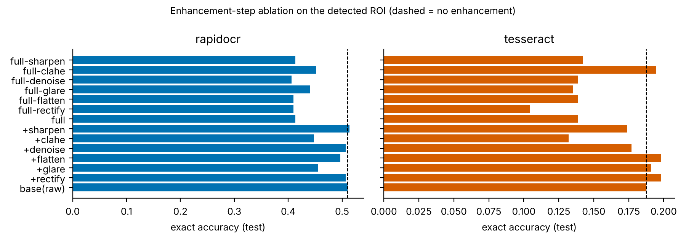
OCR Methodology
engine | input | test CER | test exact
tesseract | detected ROI, raw | 0.632 | 0.188
tesseract | detected ROI, red | 0.579 | 0.205
tesseract | detected ROI, enh | 0.714 | 0.139
tesseract | detected ROI, bin | 0.783 | 0.083
tesseract | GT-box ROI, raw | 0.558 | 0.222
tesseract | GT-box ROI, enh | 0.633 | 0.156
rapidocr | detected ROI, raw | 0.271 | 0.510
rapidocr | detected ROI, red | 0.286 | 0.472
rapidocr | detected ROI, enh | 0.342 | 0.413
rapidocr | detected ROI, bin | 0.469 | 0.205
rapidocr | GT-box ROI, raw | 0.197 | 0.580
rapidocr | GT-box ROI, enh | 0.261 | 0.431
Ablation: enhancement stages did not help these engines (negative result, synthetic data).
Simulation-based study on SYNTHETIC data | no physical wearable built | reads characters only: no authenticity/purity claims
25
Notes:
Two engines, neither fine-tuned. RapidOCR on the raw ROI reaches exact match 0.510; Tesseract 0.188. RapidOCR often drops spaces, so strict exact is much lower and WER is not meaningful; our primary metric ignores whitespace. Classical enhancement lowered accuracy.

Slide 26
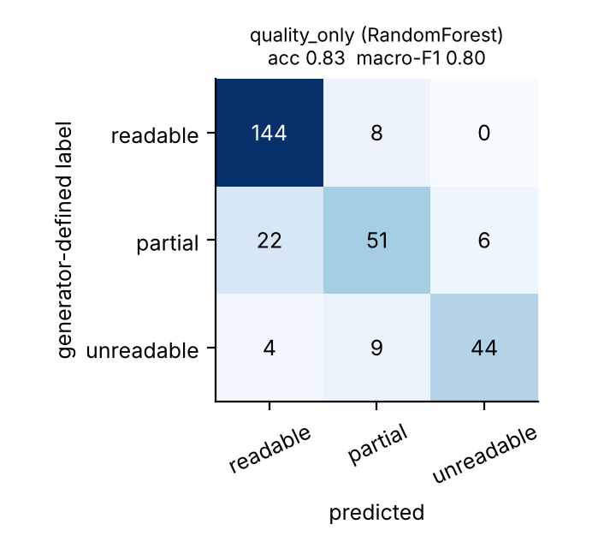
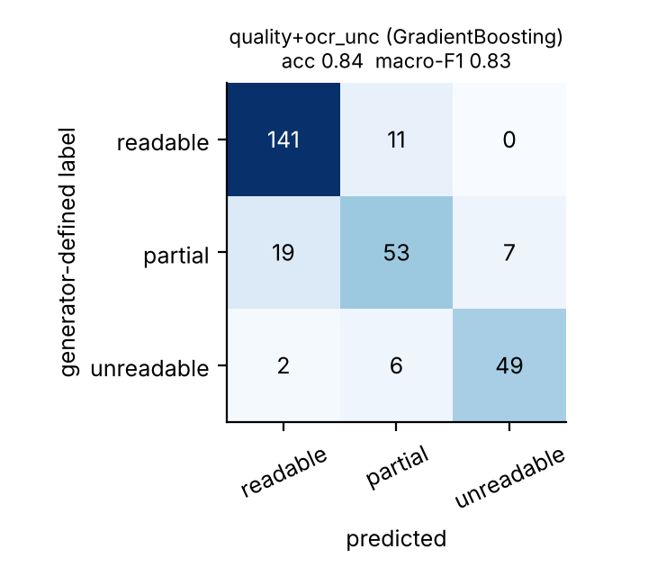
Readability Classification
Test confusion matrices (rows: generator proxy label). Quality-only left; quality + OCR-uncertainty right.
Simulation-based study on SYNTHETIC data | no physical wearable built | reads characters only: no authenticity/purity claims
26
Notes:
Seven classifiers compared by grouped cross-validation over development items; test used once. Quality-only random forest: accuracy 0.830, macro-F1 0.804. Adding OCR uncertainty gives 0.826, a difference within cross-validation spread. The label is the generator's proxy.

Slide 27
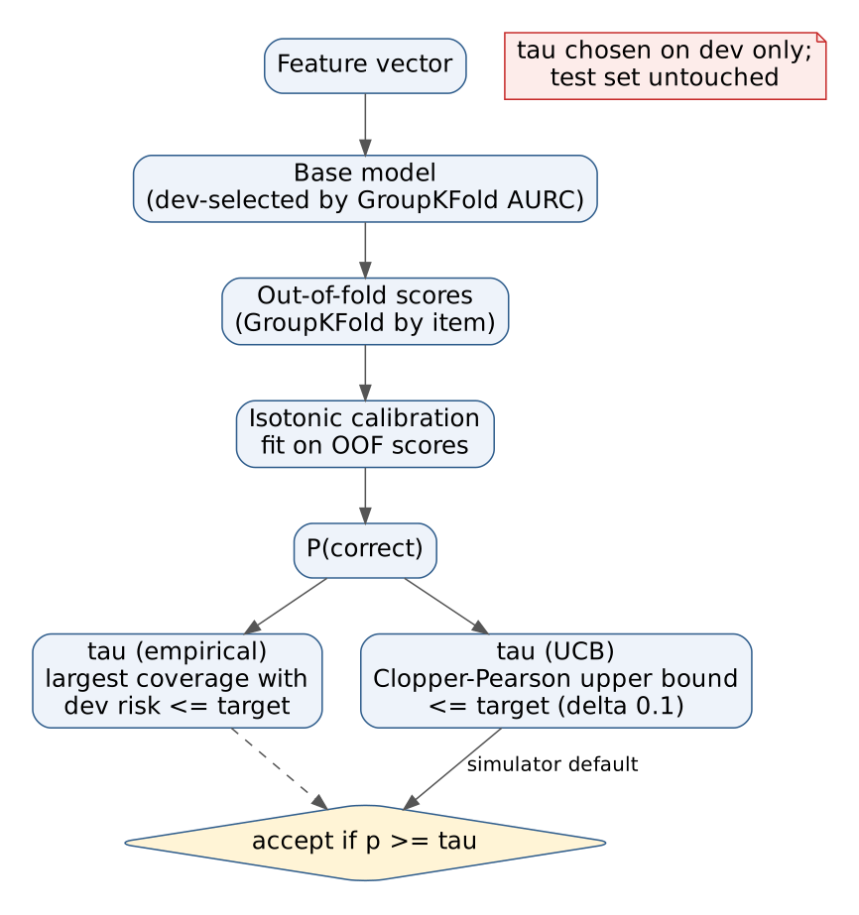
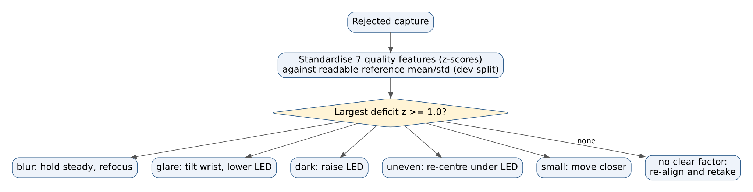
Confidence-Based Rejection and Recapture
Simulation-based study on SYNTHETIC data | no physical wearable built | reads characters only: no authenticity/purity claims
27
Notes:
Separated rejector: a base model is selected by grouped out-of-fold AURC, then isotonic-calibrated on out-of-fold scores. Thresholds are chosen on development data, empirically or with a Clopper-Pearson bound. When a capture is rejected, the largest standardised quality deficit selects the hint.

Slide 28
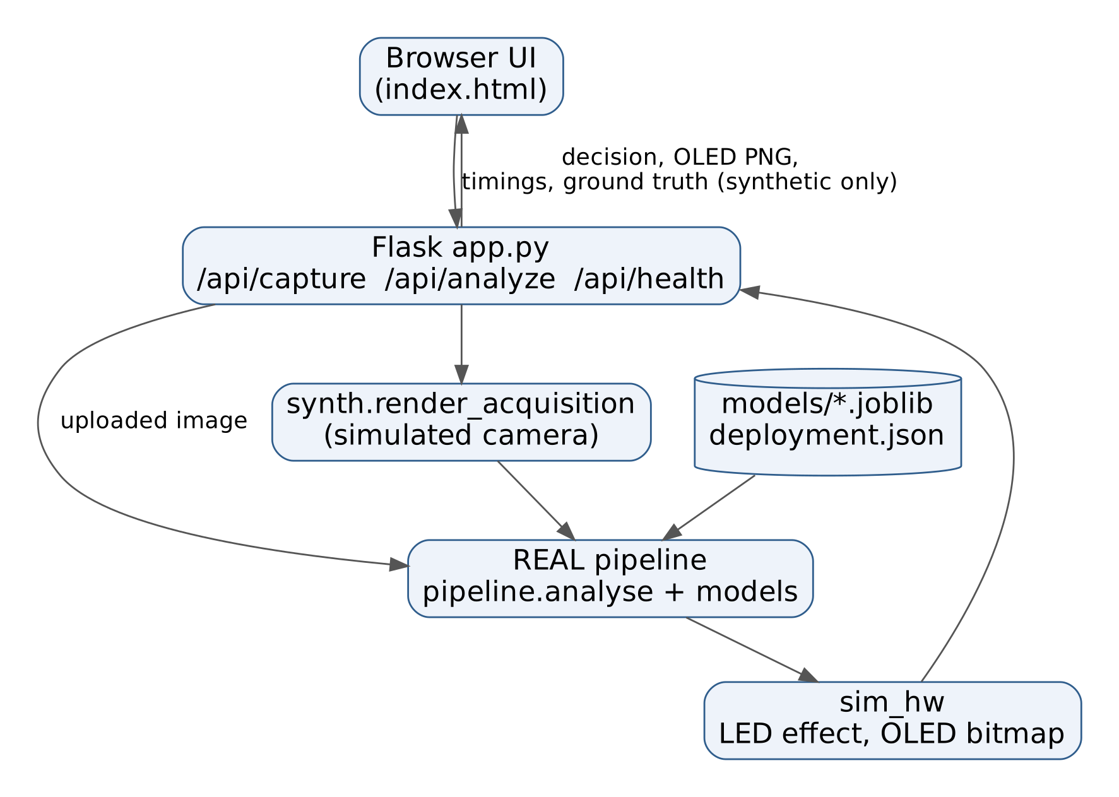
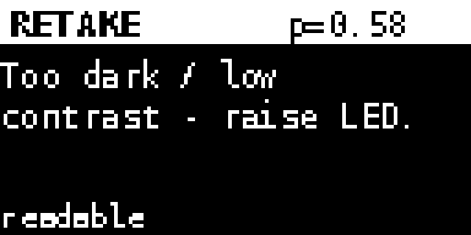
Original Simulator (Synthetic Camera)
• Simulated camera = synthetic renderer (not webcam)
• Real pipeline + saved models
• 27 automated tests pass overall
Simulation-based study on SYNTHETIC data | no physical wearable built | reads characters only: no authenticity/purity claims
28
Notes:
This is the original browser simulator, kept for the controlled demonstrations. Python, OpenCV, scikit-learn, Tesseract, RapidOCR ONNX, Flask. The simulator exposes a capture endpoint that renders a synthetic image under a chosen condition and runs the real pipeline, plus an upload endpoint. The OLED, LED and camera in the browser simulator are simulated and labelled as such. The companion application wraps the same analyse_image function.

Slide 29
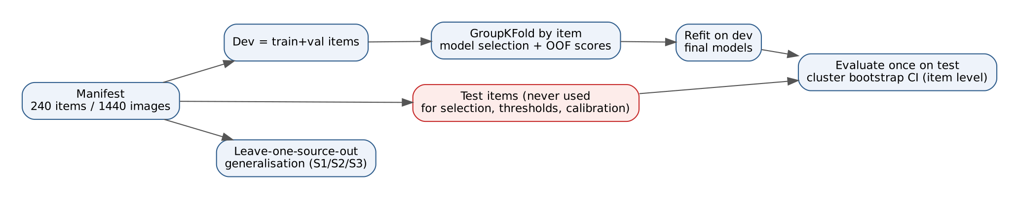
Experimental Methodology
Simulation-based study on SYNTHETIC data | no physical wearable built | reads characters only: no authenticity/purity claims
29
Notes:
Development equals train plus validation items. Model selection, calibration and thresholds use development data only, with grouped cross-validation by item. The test split, 48 items and 288 images, is evaluated once. Uncertainty is quantified with an item-level cluster bootstrap. We also run leave-one-source-out.

Slide 30
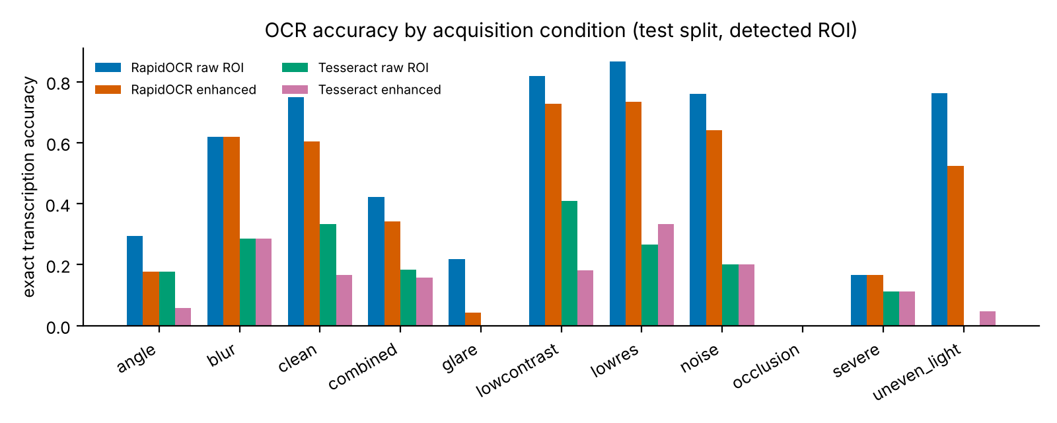
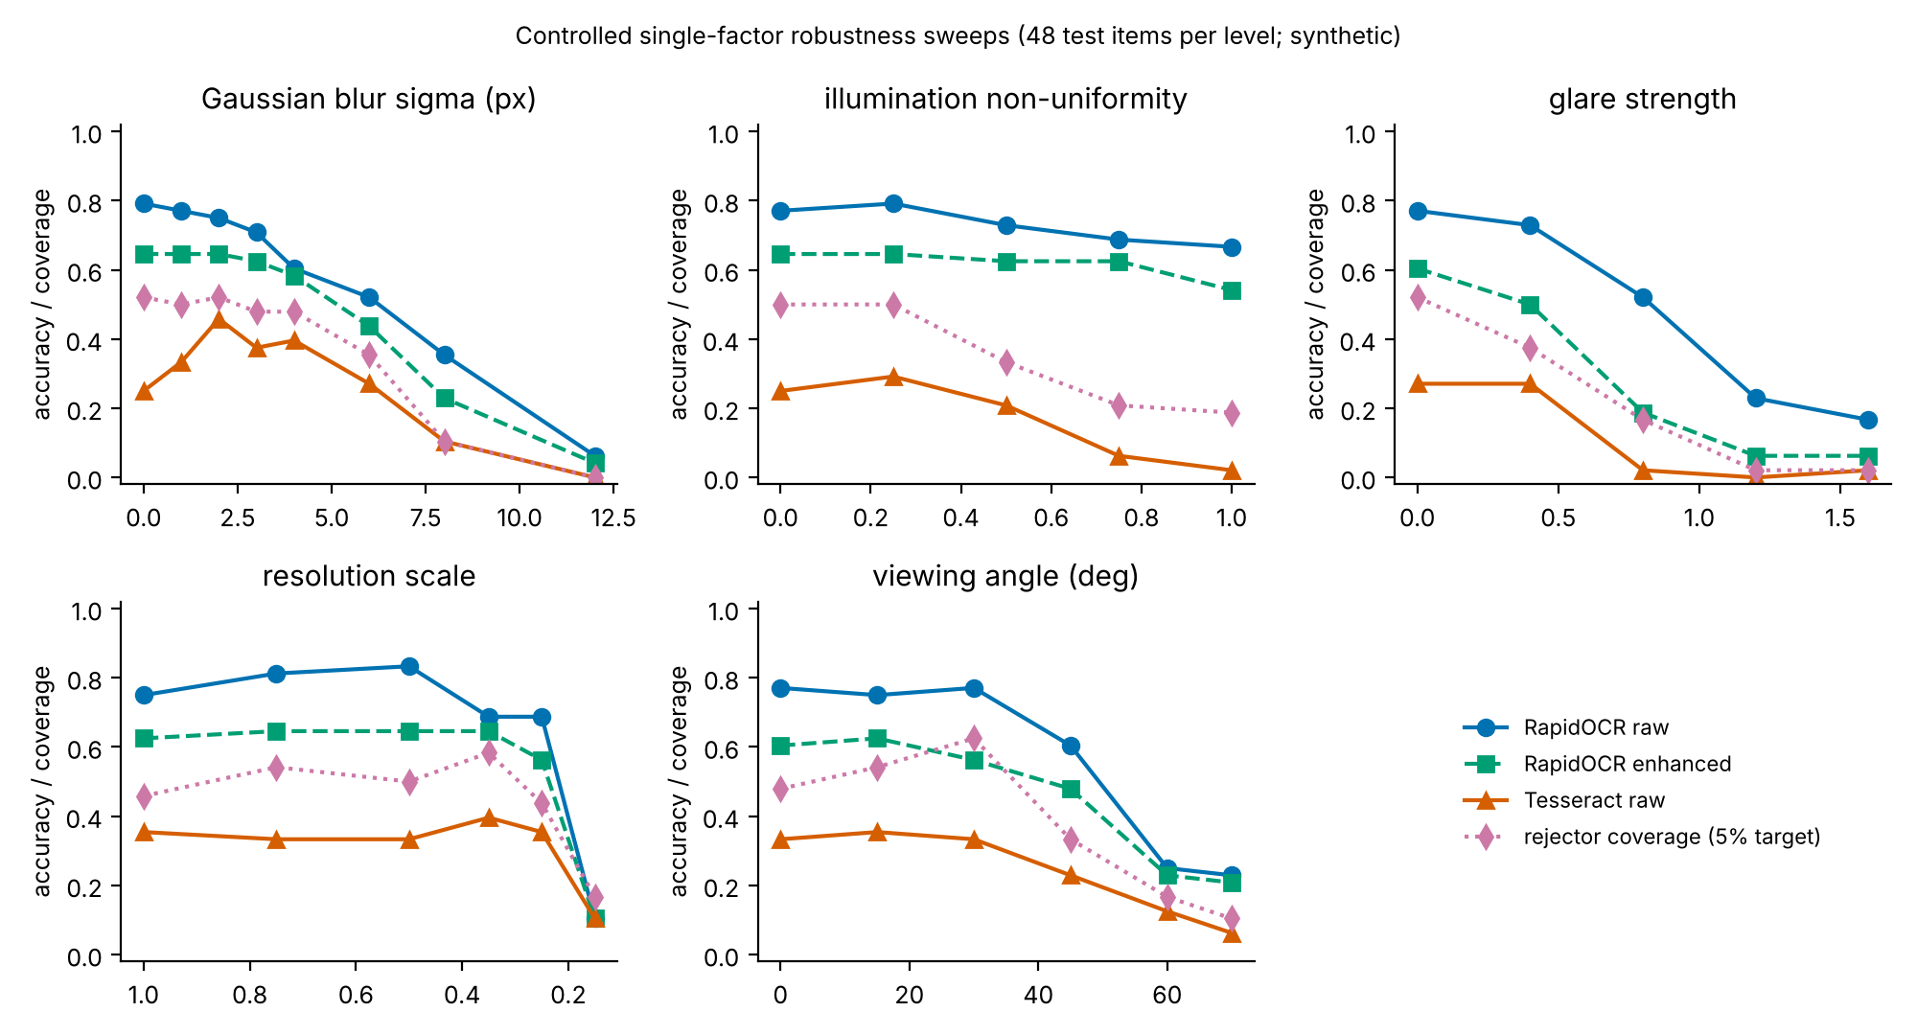
Results: OCR by Condition
Simulation-based study on SYNTHETIC data | no physical wearable built | reads characters only: no authenticity/purity claims
30
Notes:
RapidOCR exact 0.510, Tesseract 0.188 overall. Accuracy falls with glare, occlusion and combined degradations; severity sweeps show graceful decline under blur and lighting and collapse at extreme levels.

Slide 31
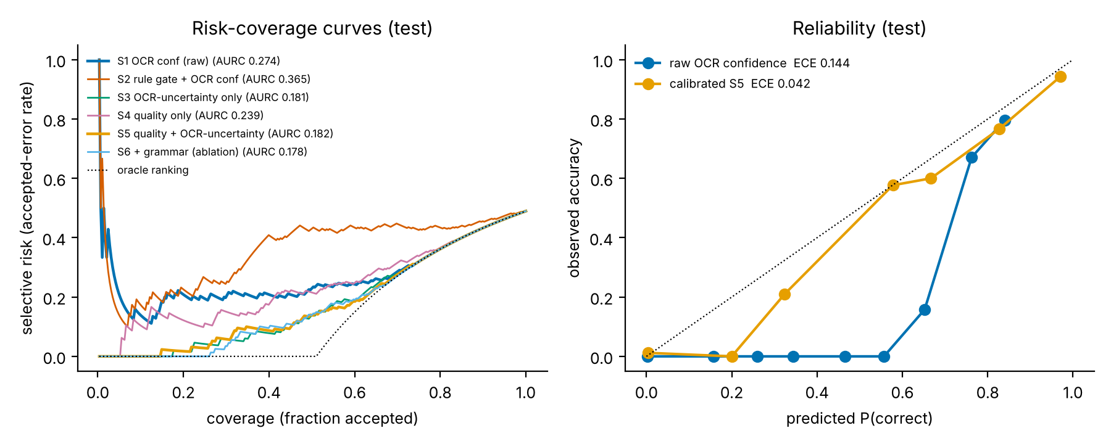
Results: Rejection
comparison | delta AURC | CI95
S5 vs S3 | 0.000 | [-0.009, +0.010]
S4 vs S1 | -0.034 | [-0.084, +0.009]
S3 vs S1 | -0.090 | [-0.146, -0.041]
S5 vs S4 | -0.056 | [-0.091, -0.028]
Paired ΔAURC (negative favours the first).
Simulation-based study on SYNTHETIC data | no physical wearable built | reads characters only: no authenticity/purity claims
31
Notes:
Raw OCR confidence has AURC 0.274 and ECE 0.144. The learned OCR-uncertainty rejector has AURC 0.181; the paired difference excludes zero. Adding quality features does not change AURC measurably. Quality alone is not significantly better than raw confidence.

Slide 32
Results: Thresholds, Guidance, System
• S5 @5 % target: 87 accepted, 5 errors (5.7 %); coverage 0.30
• Dev thresholds do not transfer exactly; 48 test items only
• Guidance top-1 hit 0.674 vs random 0.185 (n=135)
• Leave-one-source-out: learned rejector beats raw confidence on all 3 sources
• Latency (sandbox CPU): median 264 ms, p95 340 ms
• Peak RSS 176 MB (not measured on Pi)
Simulation-based study on SYNTHETIC data | no physical wearable built | reads characters only: no authenticity/purity claims
32
Notes:
Dev-selected thresholds do not transfer exactly: S5 at a 5 percent target accepted 87 with 5 errors. Guidance top-1 hit rate 0.674 versus 0.185 random. Latency is on a sandbox CPU, not a Pi. Peak memory 176 MB.

Slide 33
Discussion
• Learned OCR-uncertainty >> raw OCR confidence
• Quality features: no extra AURC gain here; they drive guidance
• Enhancement hurt RapidOCR (negative result)
• Threshold transfer is the practical weak point
Simulation-based study on SYNTHETIC data | no physical wearable built | reads characters only: no authenticity/purity claims
33
Notes:
Three findings. A learned OCR-uncertainty score, especially engine disagreement, rejects errors far better than raw confidence. Quality features add nothing measurable to rejection here, probably because OCR outputs already summarise degradation; their value is explanatory. Classical enhancement did not help modern recognisers.

Slide 34
Limitations
• Synthetic data only: no real gold jewellery imaged
• Labels defined from generator parameters
• Small test split (48 items): wide CIs
• Off-the-shelf OCR, no fine-tuning
• No hardware built; wearable camera never run; camera and transistor not simulable in Wokwi
• Device <-> companion link never run; HTTP receiver tested only with a Python client
• No user study; no Pi measurements
• Results do NOT establish real-jewellery performance
Simulation-based study on SYNTHETIC data | no physical wearable built | reads characters only: no authenticity/purity claims
34
Notes:
Be explicit: synthetic data only; proxy labels from generator parameters; small test split; off-the-shelf engines; no user study; no hardware built; wearable camera never run (not simulable in Wokwi); device-to-companion link never run; latency measured on another CPU; and the development process looked at dev results while refining the generator.

Slide 35
Conclusion and Future Work
• On the synthetic benchmark: calibrated OCR-uncertainty rejector beats raw confidence (ΔAURC −0.09, CI excl. 0)
• Quality features → explainable recapture hints; no extra AURC
• Design: proposed wrist camera unit + implemented Python companion + one-request HTTP receiver tested with a Python client
• Future: real annotated photographs, fine-tuned recogniser, build the wrist unit, send a real frame from the device, authenticated link, user study
Simulation-based study on SYNTHETIC data | no physical wearable built | reads characters only: no authenticity/purity claims
35
Notes:
A calibrated rejector on OCR-uncertainty features substantially improves reliability over raw confidence in this simulation; quality features support explainable hints but did not improve rejection. Next step: real photographs with provenance, fine-tuning, a built wrist unit with the macro camera, and a firmware-to-companion link that sends a real captured frame.

Slide 36
References
[1] K. Ohnishi, A. Kanehira, A. Kanezaki, T. Harada, "Recognizing Activities of Daily Living with a Wrist-Mounted Camera," Proc. IEEE CVPR, 2016. [Online]. Available: https://openaccess.thecvf.com/content_cvpr_2016/html/Ohnishi_Recognizing_Activities_of_CVPR_2016_paper.html
[2] R. Shilkrot, J. Huber, M. E. Wong, P. Maes, S. Nanayakkara, "FingerReader: A Wearable Device to Explore Printed Text on the Go," Proc. ACM CHI 2015, Seoul, 2015. [Online]. Available: http://hdl.handle.net/1721.1/95971
[3] A. Tiwari, V. Christlein, M. Fichtner, F. Gohlke, B. Schübel, T. Witting, H. Zech, M. Zinnen, "Automated Goldsmith's Mark Retrieval in Silverware," arXiv preprint arXiv:2609.20509, 2026. [Online]. Available: https://arxiv.org/abs/2609.20509
[4] R. Smith, "An Overview of the Tesseract OCR Engine," Proc. 9th Int. Conf. Document Analysis and Recognition (ICDAR), 2007. [Online]. Available: https://research.google/pubs/an-overview-of-the-tesseract-ocr-engine/
[5] Y. Du, C. Li, R. Guo, X. Yin, W. Liu, J. Zhou, Y. Bai, Z. Yu, Y. Yang, Q. Dang, H. Wang, "PP-OCR: A Practical Ultra Lightweight OCR System," arXiv preprint arXiv:2009.09941, 2020. [Online]. Available: https://arxiv.org/abs/2009.09941
[6] S. Long, X. He, C. Yao, "Scene Text Detection and Recognition: The Deep Learning Era," Int. J. Comput. Vis., vol. 129 (arXiv:1811.04256), 2021. [Online]. Available: https://arxiv.org/abs/1811.04256
[7] X. Chen, L. Jin, Y. Zhu, C. Luo, T. Wang, "Text Recognition in the Wild: A Survey," arXiv preprint arXiv:2005.03492, 2020. [Online]. Available: https://arxiv.org/abs/2005.03492
[8] C. Guo, G. Pleiss, Y. Sun, K. Q. Weinberger, "On Calibration of Modern Neural Networks," Proc. ICML, PMLR vol. 70, 2017. [Online]. Available: https://proceedings.mlr.press/v70/guo17a.html
[9] D. Hendrycks, K. Gimpel, "A Baseline for Detecting Misclassified and Out-of-Distribution Examples in Neural Networks," Proc. ICLR, 2017. [Online]. Available: https://arxiv.org/abs/1610.02136
[10] R. Slossberg, O. Anschel, A. Markovitz, R. Litman, A. Aberdam, S. Tsiper, S. Mazor, J. Wu, R. Manmatha, "On Calibration of Scene-Text Recognition Models," Computer Vision - ECCV 2022 Workshops, pp. 263-279, 2022. [Online]. Available: https://doi.org/10.1007/978-3-031-25069-9_18
[11] C. K. Chow, "On optimum recognition error and reject tradeoff," IEEE Trans. Inf. Theory, vol. 16, no. 1, pp. 41-46, 1970. [Online]. Available: https://researchweb.draco.res.ibm.com/publications/on-optimum-recognition-error-and-reject-tradeoff
[12] Y. Geifman, R. El-Yaniv, "Selective Classification for Deep Neural Networks," Advances in Neural Information Processing Systems (NeurIPS) 30, 2017. [Online]. Available: https://arxiv.org/abs/1705.08500
[13] R. El-Yaniv, Y. Wiener, "On the Foundations of Noise-free Selective Classification," J. Mach. Learn. Res., vol. 11, 2010. [Online]. Available: https://jmlr.org/papers/v11/el-yaniv10a.html
[14] K. Hendrickx, L. Perini, D. Van der Plas, W. Meert, J. Davis, "Machine Learning with a Reject Option: A survey," arXiv preprint arXiv:2107.11277, 2021. [Online]. Available: https://arxiv.org/abs/2107.11277
[15] A. Mittal, A. K. Moorthy, A. C. Bovik, "No-Reference Image Quality Assessment in the Spatial Domain," IEEE Trans. Image Process., vol. 21, no. 12, pp. 4695-4708, 2012. [Online]. Available: https://doi.org/10.1109/TIP.2012.2214050
[16] H. Li, F. Zhu, J. Qiu, "Towards Document Image Quality Assessment: A Text Line Based Framework and A Synthetic Text Line Image Dataset," arXiv preprint arXiv:1906.01907, 2019. [Online]. Available: https://arxiv.org/abs/1906.01907
[17] Seeed Studio, "XIAO ESP32S3 (Sense) pin multiplexing and getting-started wiki pages," Seeed Studio wiki (manufacturer documentation), 2026. [Online]. Available: https://wiki.seeedstudio.com/xiao_esp32s3_pin_multiplexing/
[18] JLCPCB, "What Is the ESP32-CAM, and How to Wire, Power, and Program It?," JLCPCB blog (secondary source), 2026. [Online]. Available: https://jlcpcb.com/blog/esp32-cam-guide
[19] Arducam, "Arducam OV2640 Camera Module (2MP Mini CCM, M0031) product page," Arducam (manufacturer page), 2026. [Online]. Available: https://www.arducam.com/product/arducam-ov2640-camera-module-2mp-mini-ccm-compact-camera-modules-compatible-with-arduino_m0031esp32-esp8266-development-board-with-dvp-24-pin-interface_/
[20] Wokwi, "Wokwi supported hardware," Wokwi documentation, 2026. [Online]. Available: https://docs.wokwi.com/getting-started/supported-hardware
Simulation-based study on SYNTHETIC data | no physical wearable built | reads characters only: no authenticity/purity claims
36
Notes:
These are the twenty references cited in the paper, in the paper's numbering; full entries are in the paper. Each was checked against its page.

