Slide 1
Enhancing Snake Game Intelligence:
A Deep Q-Learning Approach with Adaptive Rewards.
Chittineni Prameth Chowdary
Malisetty Priyanka
Abdul Mannan

Slide 2
About the project
Reinforcement Learning is a powerful method for teaching agents to make decisions. In our project, we use RL to play the Snake game. The agent learns to eat food and avoid obstacles by receiving rewards or punishments. We redesigned the agent's input and reward system to improve performance.

Slide 3
Existing work
Previous works used simple inputs such as direction and food location. The rewards were also basic, like +10 for eating and -10 for hitting a wall. These models struggled with strategy and long-term planning. Their performance was limited due to the small state space and static feedback.

Slide 4
Modifications done to the existing work
We made several changes to improve learning:
Added more state inputs like tail position, free space, and collision risk.
Designed a new reward system that gives small rewards for moving toward food and penalties for unsafe moves.
Used a deeper neural network with two hidden layers and ReLU activation.
Applied techniques like experience replay and epsilon-greedy policy.

Slide 5
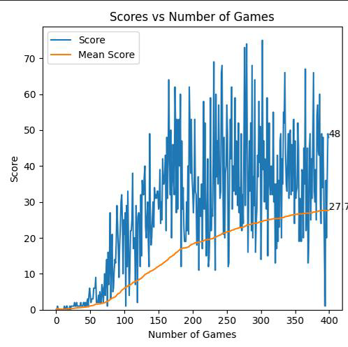
Results – existing work
Baseline Q-learning model:
Average Score: 17.26
Survival Time: 3.78 seconds
The basic model learned slowly and could not perform complex strategies.

Slide 6
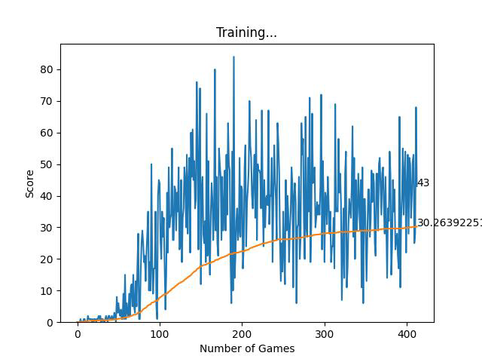
Results – Modified work
Our improved DQN model:
Average Score: 30.4
Survival Time: 9.01 seconds
The new model showed a 158% increase in score and 142% improvement in survival time. It made smarter decisions and avoided collisions more effectively.

Slide 7
References
A. Y. Ng, D. Harada, and S. Russell, "Policy Invariance Under Reward Transformations: Theory and Application to Reward Shaping," in Proc. 16th Int. Conf. on Machine Learning (ICML), 1999, pp. 278–287.
L. Sebastianelli, U. S. Latif, and G. L. Pan, "A Deep Q-Learning Based Approach Applied to the Snake Game," Journal of AI Research and Applications, vol. 4, no. 2, pp. 45–53, 2021.[
I. M. Rahman and M. M. Golov, "Comparative Evaluation of Reinforcement Learning Algorithms on the Snake Game," Proc. Int. Conf. on Computational Intelligence, 2023.
D. Hasselt, A. Guez, and D. Silver, "Deep Reinforcement Learning with Double Q-learning," in Proc. AAAI Conf. Artificial Intelligence, 2016, pp. 2094–2100.

