Slide 1
Boosting Algorithms -Regression

Slide 2
Boosting Algorithms - Regression
Ada Boost
XG Boosting
LG Boosting

Slide 3
Ada Boost
Adaptive Boosting is an ensemble method.
Combines multiple weak learners to form a strong learner.
Focuses more on difficult samples in each iteration.

Slide 4
Ada Boost - Regression
Used for predicting continuous target variables.
Weak learner is usually DecisionTreeRegressor.
Modifies weights of samples based on error.

Slide 5
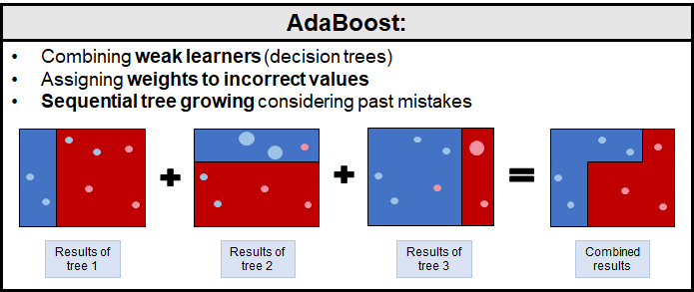
How it’s works??

Slide 6
How it’s work?
Step-by-process
1. Initialize the weight of module.
2. Train a weak learners to meet the goal
3. Evaluate the performance of learner.
4. Update the weights.
5. Repeat step 2 to 4 up to learner get stronger.
6. Weak learners to strong Learner.

Slide 7
What is XGBoost?
XGBoost stands for eXtreme Gradient Boosting.
It is an optimized distributed gradient boosting library.
Designed to be highly efficient, flexible, and portable.
Implements ML algorithms under Gradient Boosting framework.

Slide 8
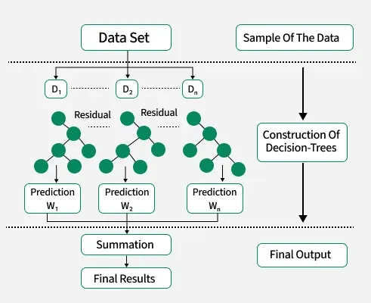
Implementation

Slide 9
How XGBoost Works
1. Initializes model with base prediction.
2. Adds decision trees iteratively.
3. Each tree corrects errors from previous ones.
4. Optimizes with gradient descent and regularization

Slide 10
Two methods are there create model
XGBRegressor
(this mehod from library XGBoost)
GradientBoostingRegressor
(This form SKLearn. Ensemble
Library)

Slide 11
Installation and Library implementation
Step1: Install the library
!pip install xgboost.
Step2: Import the Xgb regressor from xgboost library.
from xgboost import XGBRegressor

Slide 12
What is LightGBM?
Light Gradient Boosting Machine
Based on decision tree algorithms
Designed for speed and performance
Handles large datasets efficiently

Slide 13
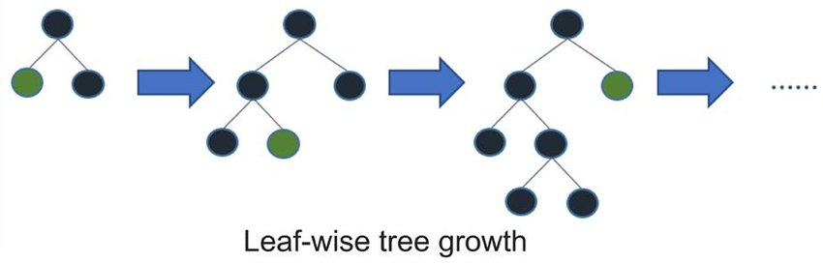
How it’s works?

Slide 14
How it’s Works?
Uses leaf-wise tree growth (vs. level-wise)
Finds the leaf with max delta loss to split
Can lead to deeper trees and better accuracy

Slide 15
Two methods are there create model
LGBMRegressor
(this mehod from library lightgbm)
GradientBoostingRegressor
(This form SKLearn. Ensemble
Library)

Slide 16
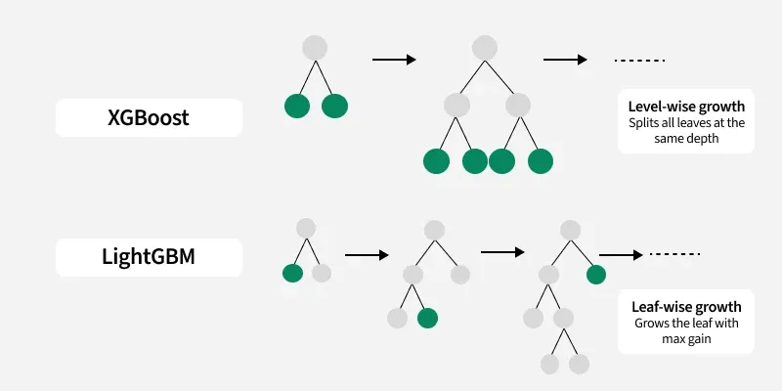
Comparsion of XGBoost and LightGBM

