Slide 1
Marvel’s Kart
Priyanka Math (015240134)
Jithesh Kurungote Balakrishnan (014654679)
Rajvi Shah (015523313)
Tharun Mukka (014640496)

Slide 2
INTRODUCTION - What is E-commerce?
Commonly known as electronic commerce or e-business.
That refers to buying or selling online over the internet.
Online shopping gained popularity because of speed and ease of use for customers as well as for sellers.
This saves a lot of time of customers and business owners as they can buy or sell online with an ease.
Also, e-commerce websites have gained popularity due to the COVID-19 pandemic.

Slide 3
OUR PROJECT
Our system is an e-commerce website from which;
1. Users can buy items and check their orders from it.
2. Seller can add items and view items on it.
3. An admin can control it.

Slide 4
FEATURES
A user will be able to sign up on the website.
A user will be able to sign in.
Roles such as, admin, seller, or customer will be assigned as per authentication.
A customer will be able to check products.
A customer will be able to order products.
A seller will be able to add products.
A seller will be able to view added products.
A seller will be able to order products.
An admin will be able to manage users.
An admin will be able to see all orders.

Slide 5
TOOLS & TECHNOLOGIES USED
For Back-end; Java (SpringBoot)
For UI; Angular
For Database; MS SQL
For Authentication and SSO - AWS Cognito
For Configuration; Jenkins
For Deployment; AWS
For Storage: S3

Slide 6
PROCESS OF THE MARVEL’S KART
STEP 1. User will sign up.
STEP 2. User will sign in.
STEP 3. Based on authentication; role will be assigned to the user to access the Marvel’s Kart.
STEP 4. Access based on assigned role.

Slide 7
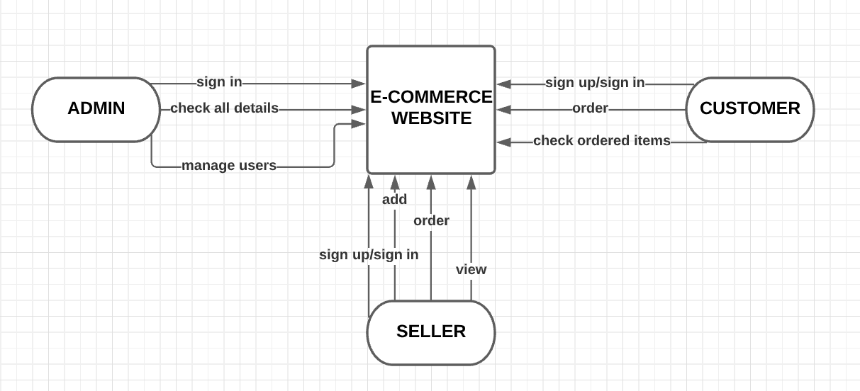
DATA-FLOW DIAGRAM

Slide 8
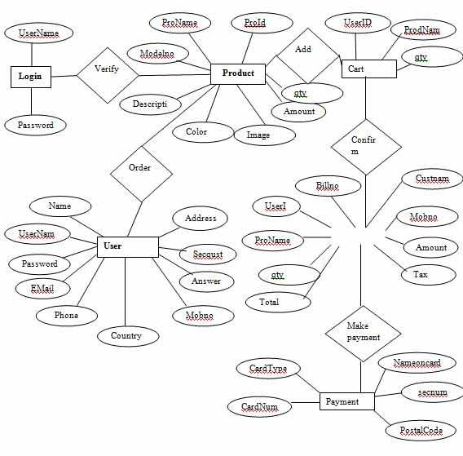
ER DIAGRAM

Slide 9
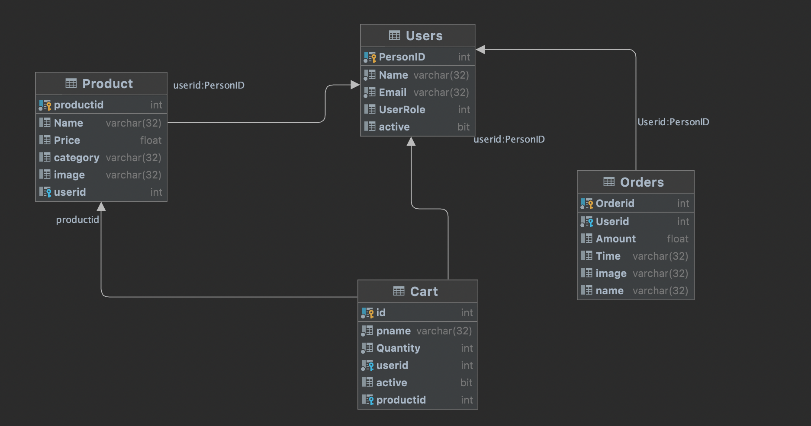
CLASS DIAGRAM

Slide 10
ADVANTAGES
Fast buying/selling products.
Ease in searching products.
Buying/selling: 24X7.
Low operational costs.
Better services.
No need for physical setups.
Ease in starting and managing business.

Slide 11
DISADVANTAGES
Not everyone is connected to internet.
Mechanical features can cause disruption in the process.

Slide 12
THANK YOU!

