Slide 1
Unsupervised Translation of Programming Languages

Slide 2
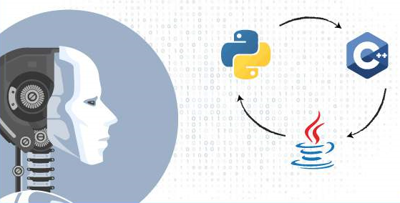
Transcompiler is a system that converts source code from one high-level programming language (such as C++ or Python) to another.

Slide 3
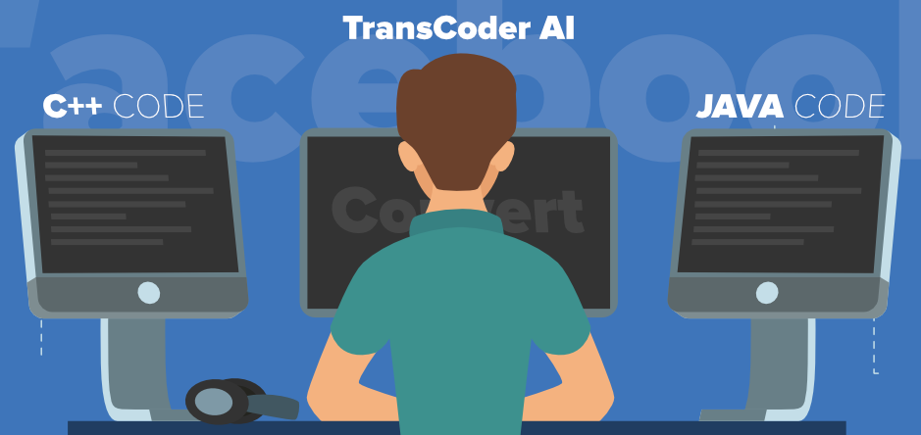
TransCoder
TransCoder is a sequence-to-sequence (seq2seq) model with attention [2], composed of an encoder and a decoder with a transformer architecture.
A single shared model is used for all programming languages.

Slide 4
‘TransCoder’ is trained using 3 principles of unsupervised machine translation
Cross Programming Language Model pretraining (Initialization)
Denoising auto-encoding (Language modeling)
Back-translation

Slide 5
1. Cross Programming Language Model pretraining (Initialization)
The first principle initializes the model with cross-lingual masked language model pretraining.
Pretraining is a key ingredient of unsupervised machine translation.
It ensures that sequences with a similar meaning are mapped to the same latent representation, regardless of their languages.

Slide 6
The cross-lingual nature of the resulting model comes from the significant number of common tokens (anchor points) that exist across languages.
In the context of English-French translation, the ‘anchor point’ consists essentially of digits and city and people names.
In programming languages, these ‘anchor points’ come from common keywords (e.g. for, while, if, try), and also digits, mathematical operators, and English strings that appear in the source code.

Slide 7
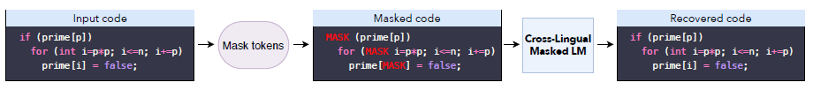
‘TransCoder’ follows the pretraining strategy where a Cross-lingual Language Model (XLM) is pretrained with a masked language modeling objective on monolingual source code datasets.
For the masked language modeling (MLM) objective, at each iteration we consider an input stream of source code sequences, randomly mask out some of the tokens, and train ‘TransCoder’ to predict the tokens that have been masked out based on their contexts.

Slide 8
2. Denoising auto-encoding (Language modeling)
Denoising auto-encoding, the second principle, trains the decoder to always generate valid sequences, even when fed with noisy data, and increases the encoder robustness to input noise.
XLM pretraining allows the Encoder-Decoder model to generate high quality representations of input sequences.

Slide 9
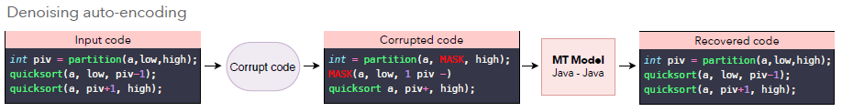
Model is trained to encode and decode sequences with a Denoising Auto-Encoding (DAE) objective.
DAE objective operates like a supervised machine translation algorithm, where the model is trained to predict a sequence of tokens given a corrupted version of that sequence.

Slide 10
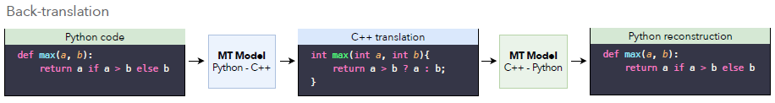
3. Back-translation
Back-translation, the last principle, allows the model to generate parallel data which can be used for training.
Back-translation(feedback) is one of the most effective methods to leverage monolingual data in a weakly(semi)-supervised scenario.
In the unsupervised setting, a forward source-to-target model is coupled with a backward target-to-source model trained in parallel.

Slide 11
The target-to-source model is used to translate target sequences into the source language, producing noisy source sequences.
The source-to-target model is then trained in a weakly supervised manner to reconstruct the target sequences from the noisy source sequences generated by the target-to-source model, and vice versa.
The two models are trained in parallel until convergence.

Slide 12
Experiments
Training data:
GitHub public dataset available on Google BigQuery is used as dataset.
C++, Java, and Python project files are selected.
‘TransCoder’ translates at function level.
‘TransCoder’ pretrains on all source code available, and train the denoising auto-encoding and back-translation objectives on functions only.
Comments in the source code increases the number of anchor points across languages, which results in a better overall performance.

Slide 13
Preprocessing:
Unlike multilingual natural language processing, universal tokenizer would be suboptimal in translation of programming languages, as different languages use different patterns and keywords.
The logical operators && and || exist in C++ where they should be tokenized as a single token, but not in Python.
The indentations are critical in Python as they define the code structure, but have no meaning in languages like C++ or Java.
Tokenizer used:
javalang5 tokenizer for Java
Python6 tokenizer for Python
clang7 tokenizer for C++

Slide 14
Evaluation:
Coding problems and solutions in several programming languages from ‘GeeksforGeeks’ are extracted, to create validation and test sets.
These functions not only return the same output, but also compute the result with similar algorithm.

Slide 15
Observations
‘TransCoder’ successfully understands the syntax specific to each language, learns data structures and their methods, and correctly aligns libraries across programming languages.
‘TransCoder’ successfully map tokens with similar meaning to the same latent representation, regardless of their languages.
‘TransCoder’ can adapt to small modifications.

