Slide 1
PANIMALAR ENGINEERING COLLEGE B.E. COMPUTER SCIENCE AND ENGINEERING 21CS1512 – SOCIALLY RELEVANT MINI PROJECT
DOMAIN: Web Development
TITLE: Website Creation For Automotive Sector
GUIDE:Mr.A.SATHEESH
(ASSISTANT PROFESSOR)
By: PRIYANKA D [Regno:211422104361]
SATHVIKA M [Reg no:211422104446]
III CSE- C

Slide 2
ABSTRACT :
This project will create a responsive website for Automotive sector, a leader in polymer-based sealing products for the automotive sector. The site will showcase products with detailed descriptions and images to engage users and include an "About Us" section to foster trust. Features like contact forms will enhance customer interaction. The website will prioritize fast loading, mobile responsiveness, and strong security, ensuring scalability for future growth.

Slide 3

ASP SEALING PRODUCTS LTD
ASP Sealing Products Ltd, part of the ASP
Group since 1989, makes EPDM rubber
weatherstrips and other sealing products.
A top supplier to major vehicle manufacturers
in India, covering heavy, medium, and light commercial vehicles. Products are also exported to over 40 countries. Known for quality and reliability, with over 300 customers in the aftermarket. Dedicated to innovation and constantly improving through global partnerships.

Slide 4
EXISTING SYSTEM:
ASP Group, a prominent automobile manufacturer, lacks a modern website to showcase its products and services, hindering customer engagement and brand visibility. This project aims to develop an attractive, user-friendly website to enhance ASP Group's online presence.
CHALLENGES:
User Experience Design: Creating an intuitive navigation structure.
Content Management: Developing relevant and accurate content.
Feature Integration: Adding features like contact forms and product catalogs.
Responsive Design: Ensuring compatibility across devices.It fits to any type of screen size.
Finally, the existing system lacks feedback mechanisms, making it difficult to track visitor interactions.

Slide 5
PROPOSED SYSTEM:
The proposed system aims to create a modern, user-friendly website that effectively communicates the company's products, services, and expertise. The website will include a Home Page with a company overview, a Products & Services Page featuring detailed product descriptions, and a Contact Us Page with an integrated form . The site will use HTML, CSS, JavaScript, and Web3Forms for backend form handling, ensuring security, responsiveness, and ease of navigation across devices.
ADVANTAGES:
1. Enhanced User Experience 2. Detailed Product Showcase
3. Improved Communication: 4. Responsive and Scalable
5. Maintenance and Security

Slide 6
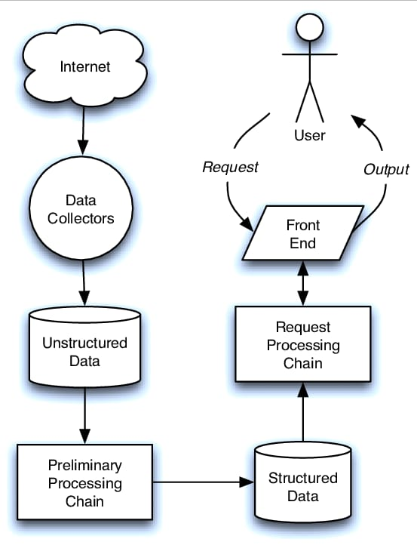
SYSTEM ARCHITECTURE:
The system architecture for the website integrates a front-end built with HTML, CSS, and JavaScript for a responsive user interface.Web3Forms handles form submissions securely without requiring a traditional backend.
This simple,efficient structure ensures smooth user experience while maintaining security through HTTPS and input validation

Slide 7
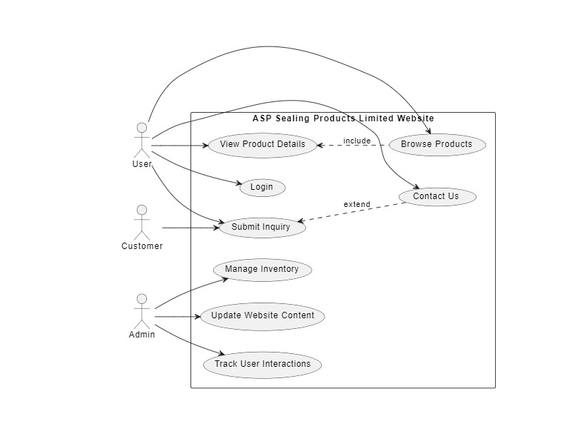
USE CASE DIAGRAM:
A Use Case Diagram for a website creation project in the automotive industry visually represents the interactions between various actors and the system's functionalities, such as browsing products and managing inventory.
It helps clarify user requirements and facilitates communication among stakeholders.

Slide 8
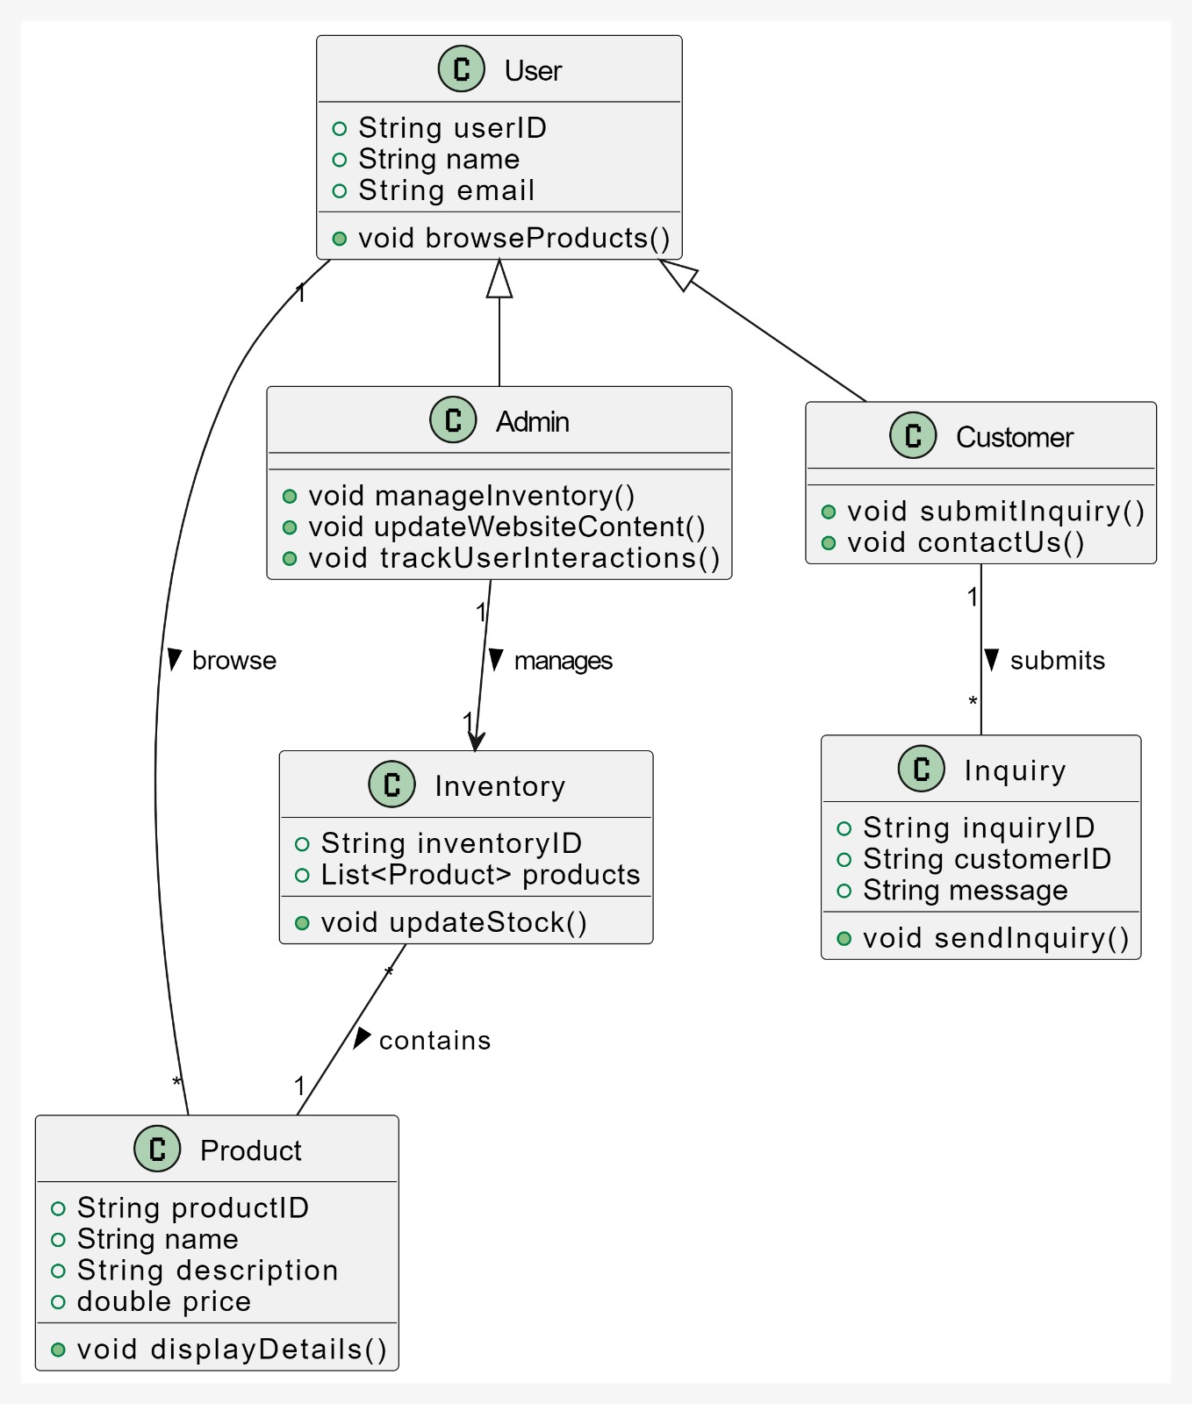
CLASS DIAGRAM:
The class diagram for the website project includes four main classes: Product for product details, User for browsing and inquiries, Admin for managing content and inquiries, and Inquiry for capturing user questions.
Relationships indicate user interactions with multiple products and inquiries, while admins manage product details and user communications.

Slide 9
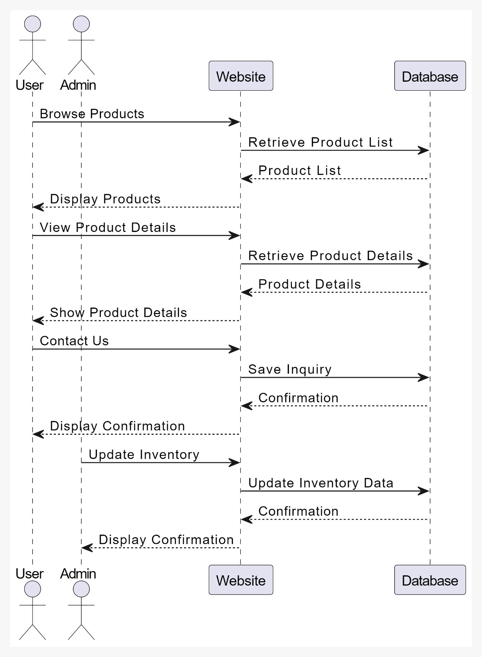
SEQUENCE DIAGRAM:
A sequence diagram for an automobile manufacturing website details the sequence of interactions between system components and users, illustrating how they collaborate to complete specific tasks.
This sequence diagram outlines interactions between users, admins, the website, and the database, illustrating processes like browsing products, viewing details, contacting support, and updating inventory.

Slide 10
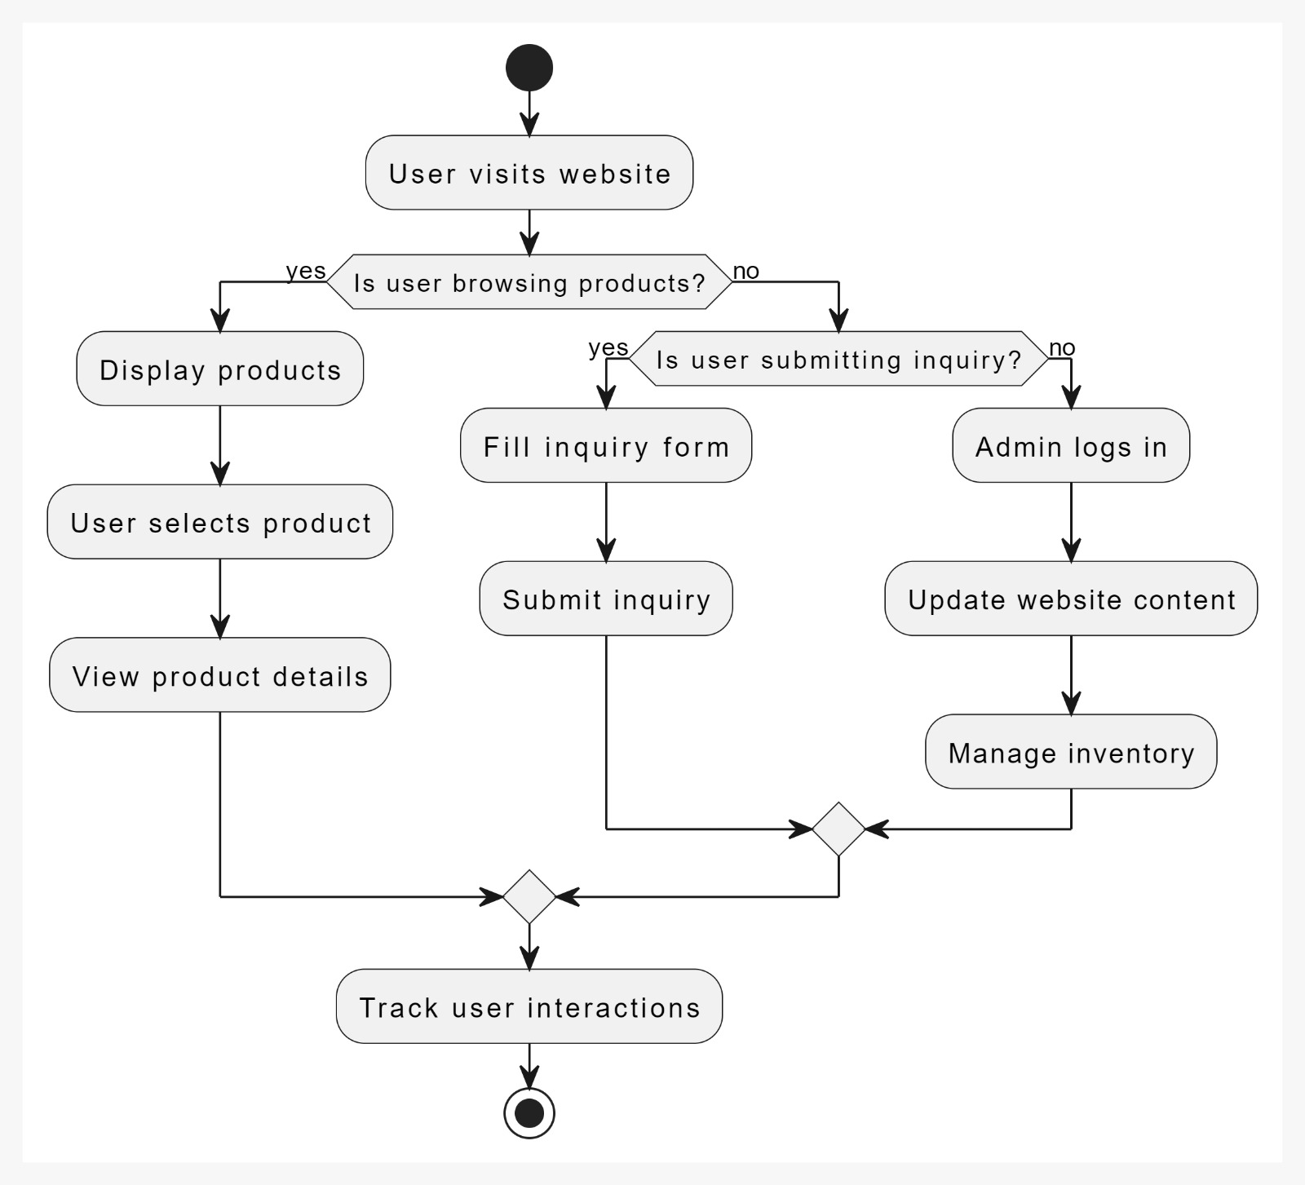
ACTIVITY DIAGRAM:
An activity diagram for an automobile manufacturing website maps out the workflow of processes and tasks, showing how activities are executed and decisions are made.
It highlights the sequence and branching of actions, ensuring that complex processes are clearly understood and managed effectively.

Slide 11
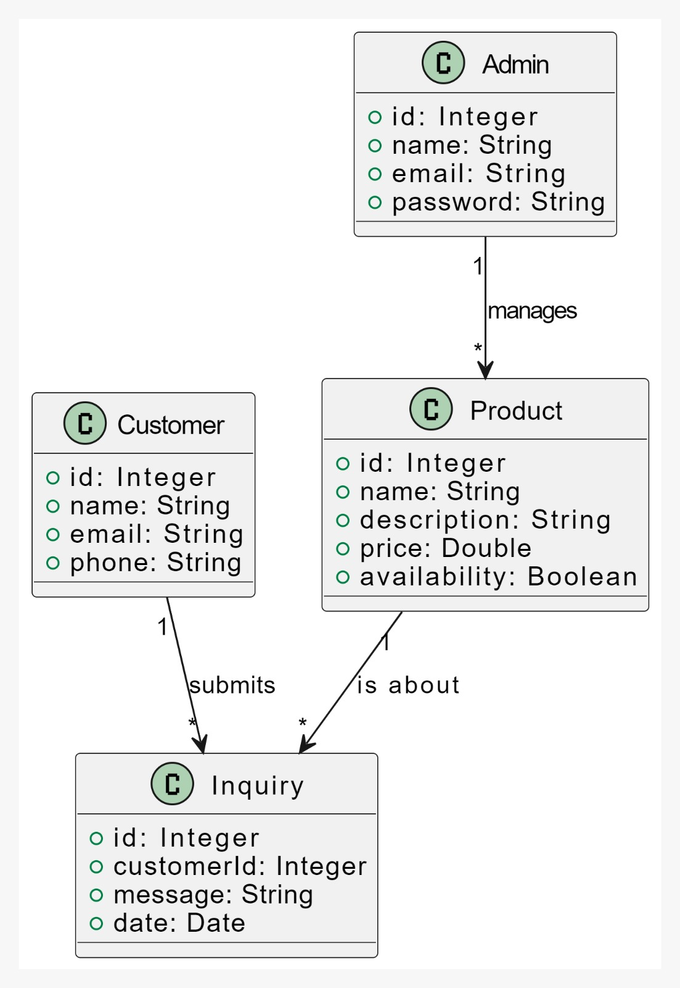
DOMAIN MODEL:
This domain model diagram represents the key entities of the website: Product, Customer, Admin, and Inquiry. Customers submit inquiries about products, while admins manage product details. Each inquiry links to a specific product, and admins handle product management.

Slide 12
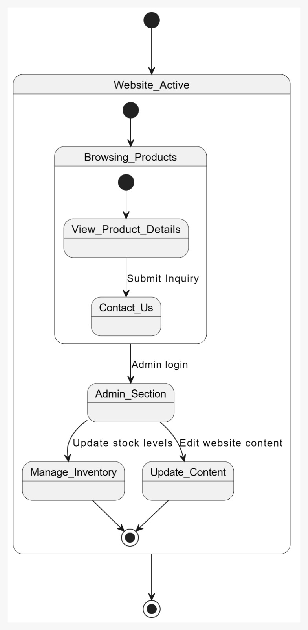
STATE DIAGRAM:
This diagram represents the website’s states from browsing products to admin actions like managing inventory and updating content.
Users transition through various actions depending on their role.

Slide 13
SOFTWARE ENVIRONMENT:
Operating System: Developed on Windows OS for reliability.
Development Environment: Utilizes Visual Studio Code for effective coding.
Programming Languages: Core technologies include HTML, CSS, and JavaScript for front-end development.
Backend Service: Form handling is managed by Web3Forms, allowing secure inquiry processing without a traditional backend.
Email Configuration: Automated email notifications.

Slide 14
MODULE DESIGN SPECIFICATION:
Home Module: Provides an overview of the company, featuring the logo and easy navigation, and highlights products.
Products Module: Displays a categorized showcase of sealing products with specifications and images for easy browsing.
About Us Module: Shares company details, including its mission and infrastructure.
Certifications Module: Highlights the company’s quality standards and certifications, boosting credibility.
Contact Us Module: Allows users to submit inquiries through a secure, validated form with email notifications.

Slide 15
FUTURE ENHANCEMENT:
AI Chatbots: Implement AI-driven chatbots for real-time customer support and to assist with product inquiries.
Search Engine Optimization (SEO): Strengthen SEO strategies to boost search engine visibility and attract more organic traffic.
E-Commerce Integration: Add features for direct online transactions, enabling customers to buy products directly.
Mobile Optimization: Further optimize mobile responsiveness for a seamless experience across devices.
Client Portals: Introduce personalized client portals for order tracking and exclusive content access

Slide 16
THANK YOU !!

