Slide 1
Amazon Reviews Sentiment Analysis
Priyanka Naidu

Slide 2
Problem Statement:
Today, organizations are increasingly using information from social media to inform their decisions.
For an organization, the evaluation of its products and services can also be obtained through the Internet.
Similarly, it is easy for governments to get public feedback on their policies, as well as to learn about important events in other countries.
Through comments and reviews, lots of information can be grabbed
However, due to the proliferation of various websites and number of comments, monitoring of opinion websites and extracting information from them is still a difficult task. The average human reader will have a hard time extracting and summarizing comments from them. Therefore, an automated analysis system is needed

Slide 3
Overview
We are using “Amazon Reviews” dataset from Kaggle and would like to do a sentimental analysis about the Amazon reviews using Python.
And can also detect the positive and negative feedback and visualize the contents by word cloud and by different plots.
And by applying Count and TF-IDF Vectorizers on reviews, we make them machine readable(numeric form)
Then using some classification models, predict the ratings from the reviews and compare the accuracy of different machine learning algorithms

Slide 4

About dataset:
The Amazon reviews dataset consists of reviews from amazon.
It contains 3600000 Amazon reviews from 6,643,669 users on 2,441,053 products, from the Stanford Network Analysis Project (SNAP).
The data span is a period of 18 years up to March 2013.
I have taken sample of 5000 rows to analyze the data.
The dataset contains polarity, title, text.
polarity - 1 for negative and 2 for positive
title - review heading
text - review body

Slide 5

Adopted steps
Import libraries and data
Exploratory data analysis
Reviews text
Tokenize, clean, remove( stopwords, punctuations, lemmatize)
Vectorize data
Model data using machine learning algorithms to predict reviews

Slide 6
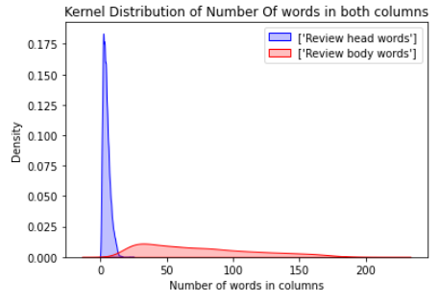
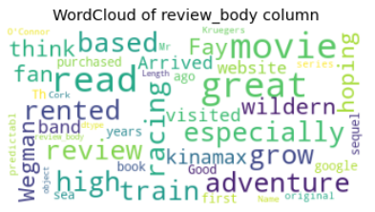
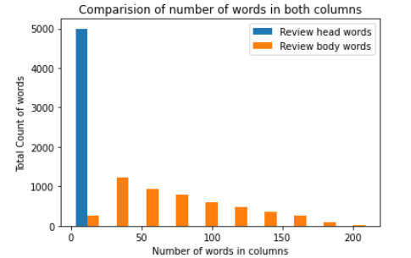
Exploratory data analysis:

Slide 7
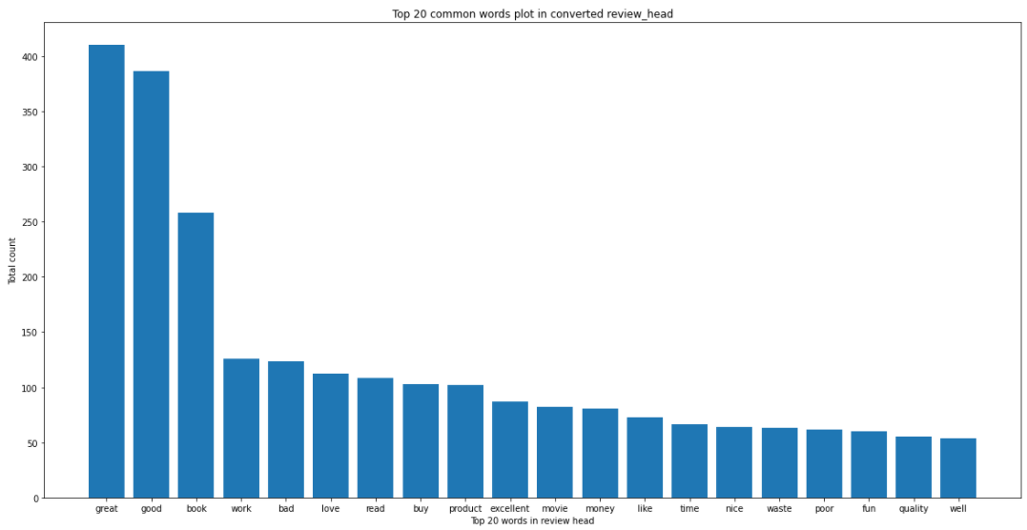
EDA..

Slide 8
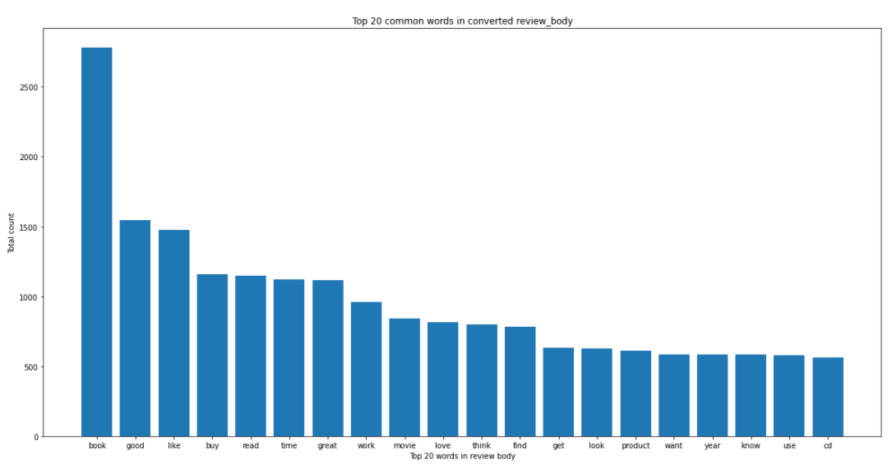
EDA..

Slide 9
Modelling:
Target Variable – Discrete
Classification models:
Support vector classifier
Random forest classifier
Gradient boosting classifier
Feature engineering:
CountVectorizer
TF-IDF(word level, n-gram,char level)
Evaluation metrics:
Accuracy
F1-Score

Slide 10
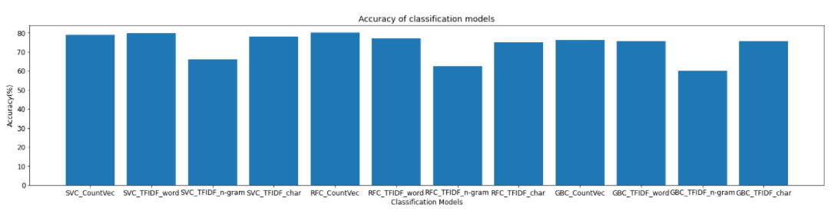
Models Comparison:
We can observe, RandomForest Classifier after using CountVectorizer has given highest accuracy which is 80.77
Then SupportVector classifier with both CountVectorizer and TF-IDF(word analyzer) follows with accuracies 78.8%,79.8% resp
GradientBoosting classifier with n-gram word analyzer is the least accurate model with 60.2%

Slide 11
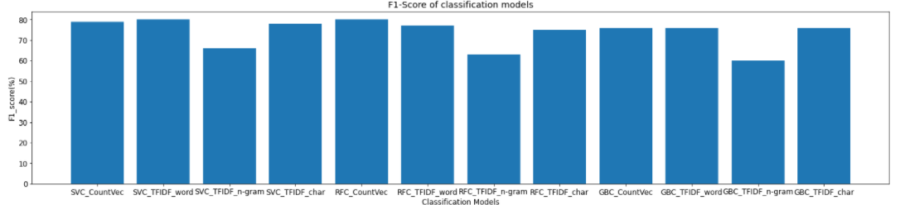
F1-Score comparison:
We can observe, RandomForest Classifier after using CountVectorizer and SupportVector classfier after using word analyzer are accurate with 80% both
Then SupportVector classifier with CountVectorizer follows with 79%
GradientBoosting classifier with n-gram word analyzer is the least accurate model with 60%

Slide 12
Let’s predict some reviews:
Review: ' good workout short time favorite leave sore strength exercise awhile light ab’
Predicted outputs using:
SVC – countvect :: [0]
SVC-wordanalyzer :: [0]
RFC-countvec :: [0]
We can interpret that these models predicted review as positive which are actually positive.

Slide 13
Thank you

