Slide 1








FIELD DEVICES
GATEWAYS
ANALYTICS
SENSOR SIGNAL
SIGNAL
ACTUATOR COMMANDS
ACTUATOR COMMANDS
USER COMMANDS
STATISTICS
USER INTERFACE

Slide 2
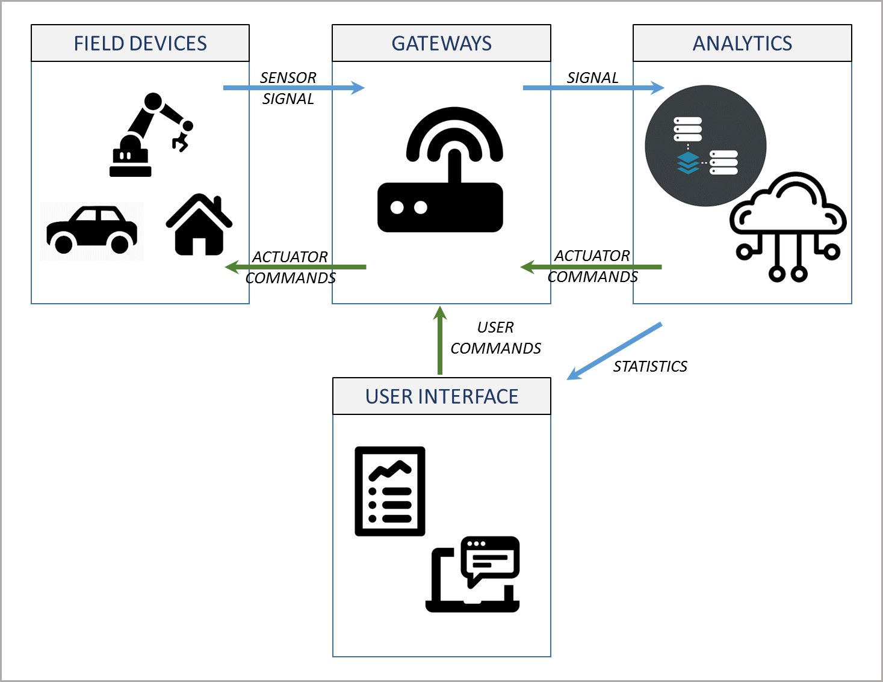

Slide 4
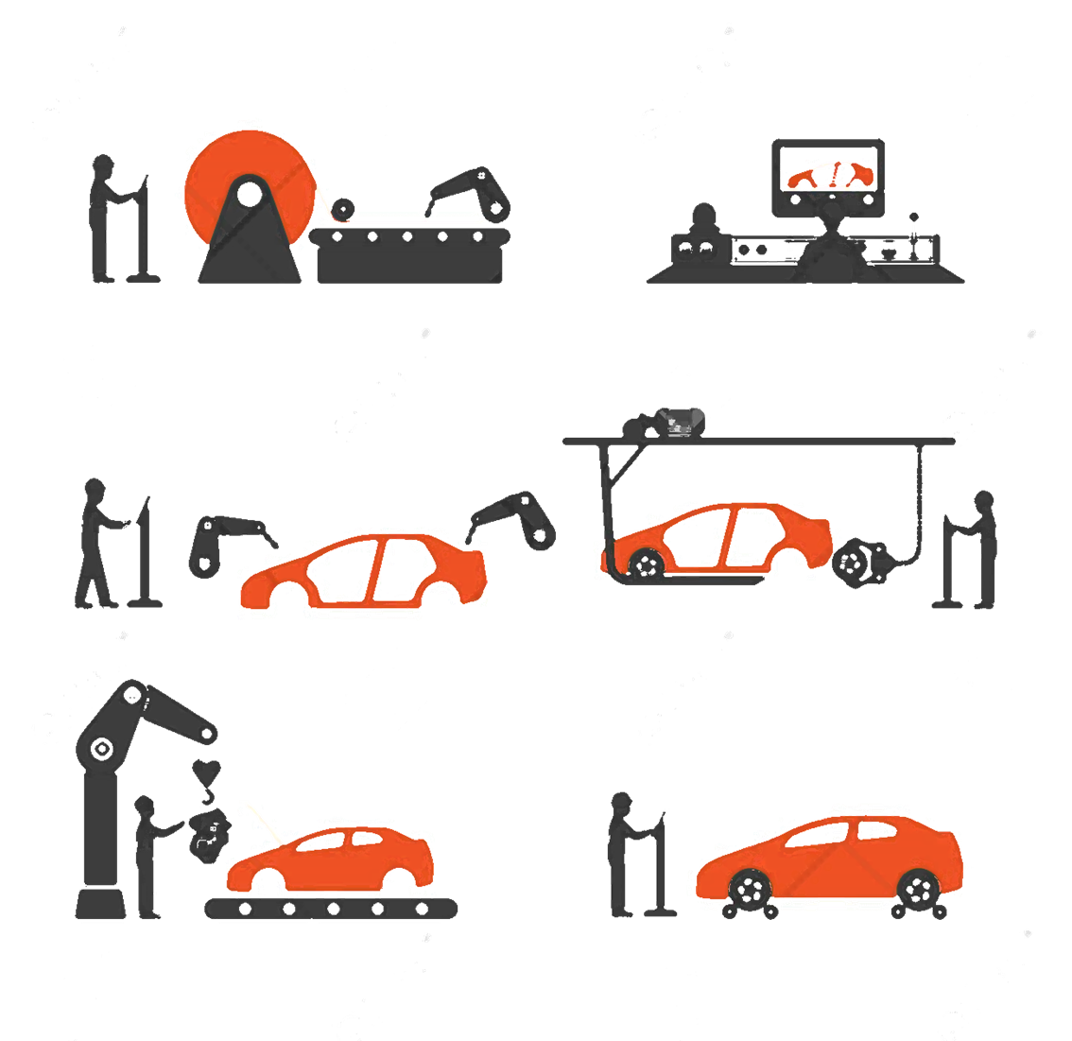
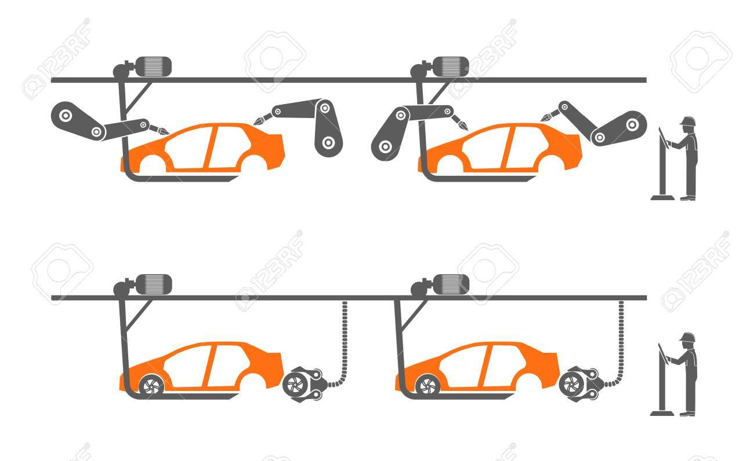
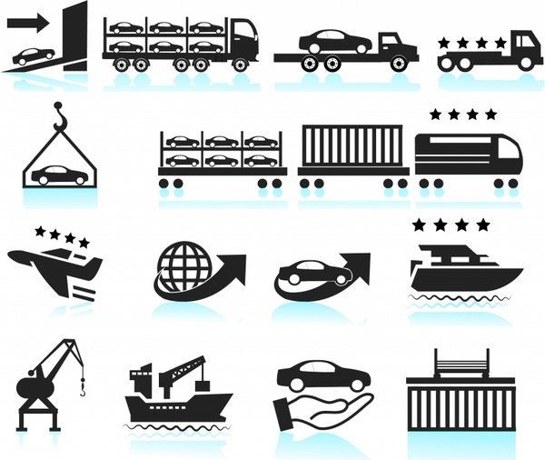
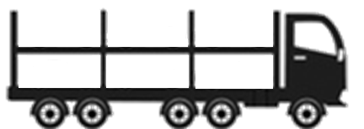



Slide 5


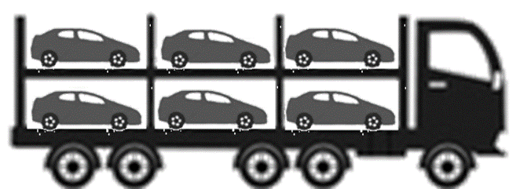





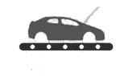
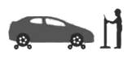


Production/Assembly flow real time monitor to eliminate defects
Manage equipments remotely, using control parameters to conserve energy and reduce costs
LOGISTICS
Inventory tracking to optimize supply and reduce shared cost in the value chain
Predictive maintenance to eliminate machine down-time and increase output rate
Operational information to OEM and to service center for remote service, alerts and suggesting predictive maintenance
Tracking information and quality parameters to monitor and reduce quality issues
ASSEMBLY SITE
CUSTOMER
Management
Information on status of assembly line and current order which is used for better planning and optimize operational cost
R&D
Operation and service information from field is used to analyze deterioration rate of the equipment which is in turn used for reengineering and future design
Operational information from field is used for alerting and suggesting predictive based maintenance to minimize failure and service cost
Field Service
GLOBAL OPERATIONS

Slide 6
System-of-Interest
exhibits
Architecture
1
1
1
1
has interest in
identifies
1..*
1
1
Stakeholder
identifies
1
Architecture Description
1..*
1
1..*
has
identifies
1..*
Concern
1..*
1..*
1..*
addresses
frames
1..*
1..*
1..*
1..*
Architecture Viewpoint
governs
Architecture View

Slide 7
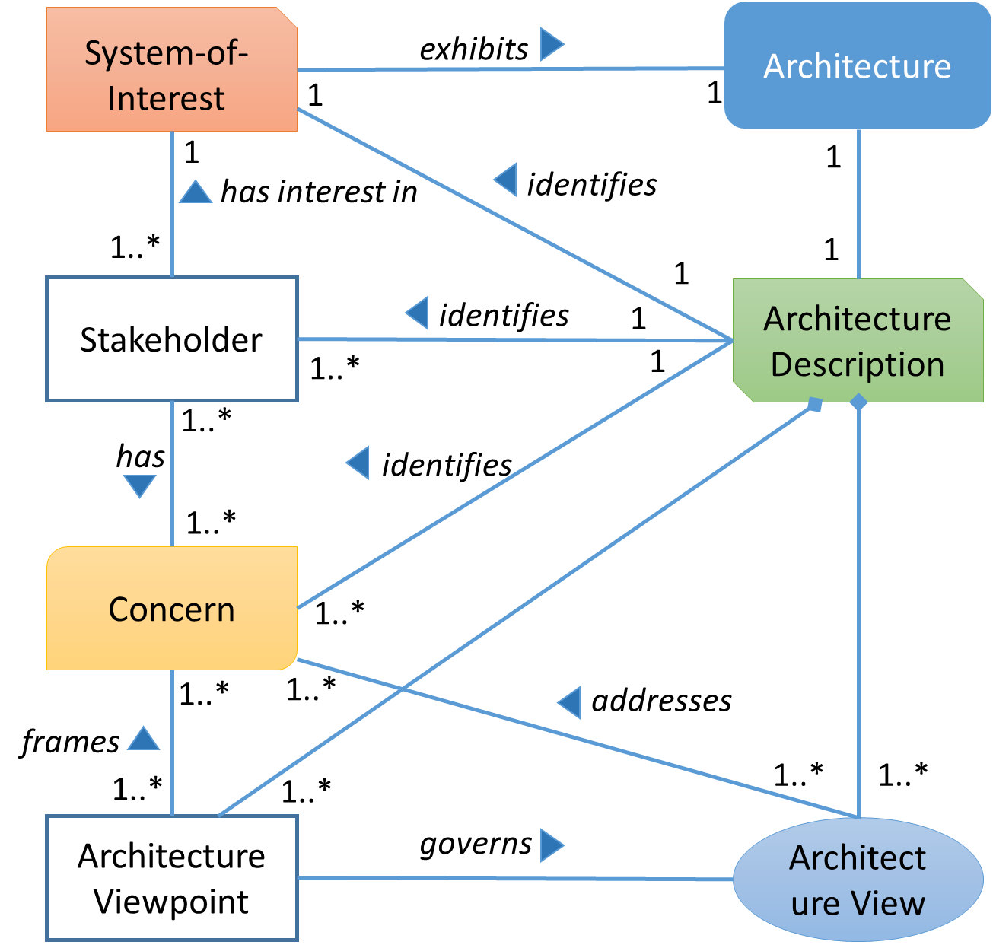
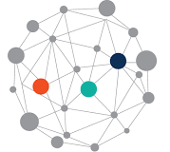
System-of-Interest
Architecture
exhibits
SUBJECT
1
1
1
1
has interest in
identifies
1..*
1
PREDICATE
1
Stakeholder
identifies
1
Architecture Description
1..*
1
OBJECT
1..*
has
identifies
1..*
Concern
1..*
1..*
1..*
addresses
frames
1..*
1..*
1..*
1..*
Architecture Viewpoint
governs
Architecture View

Slide 8
INTERNET OF THINGS
INDUSTRY INTERNET OF THINGS
INDUSTRY4.0
Some of the common concepts are Data management, Connectivity, Communication, Device Security, Secure Cloud

Slide 10


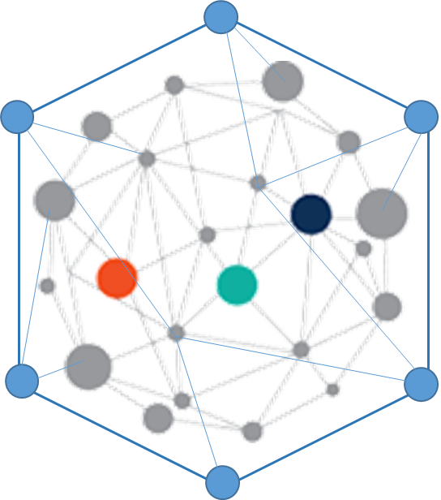


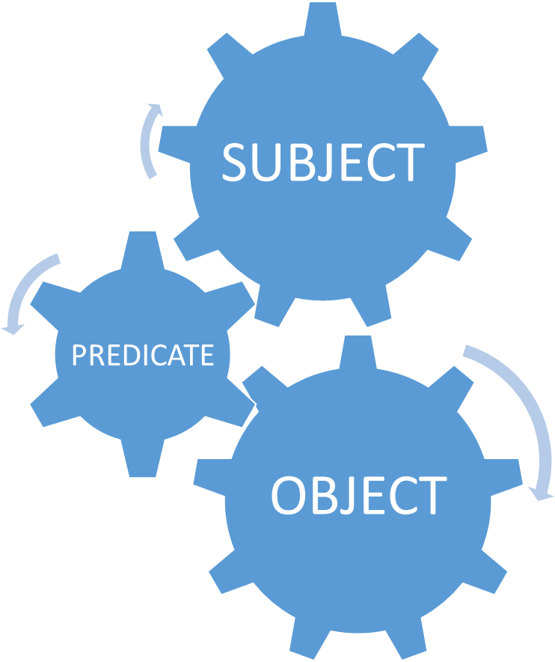

ONTOLOGY
DATA SOURCE
ANALYTICS
RESOURCE DESCRIPTION FRAMEWORK
KNOWLEDGE GRAPH
QUERYING

Slide 11
Trustworthiness
Privacy
Reliability
Safety
Resilience
Certification
Security
Authorization
InformationSecurity
NetworkSecurity
SystemRecovery
Compliance
ObjectSafety

Slide 12
BusinessContext
DataEconomy
BusinessSustainablity
Vendorlocking
Governance
DataMarkets

Slide 13
IoT
ThingMobility
ThingRepresentation
ConstrainedDevices
SpartialModeling
EnergyEfficiency

Slide 14
sto:StandardizationFramework
rdfs:label:string
rdfs:comment:langstring
sto:hasofficialResource:URI
rdfs:isDefinedBy:URI
1
sto:isDescribedIn
0..*
0..*
sto:StandardClassification
rdfs:label:string
rdfs:comment:langstring
sto:hasofficialResource:URI
rdfs:isDefinedBy:URI
sto:alignsWith
0..*
0..*
0..*
sto:hasclassification
sto:frames
0..*
1..*
sto:Standard
sto:Concern
sto:haswikipediaArticle:URI
sto:hasDbpediaResource:URI
0..*
sto_iot:hasTargetConcern
sto:haswikipediaArticle:URI
sto:hasDbpediaResource:URI
sto_iot:supports
0..*
sto:hasStakeholder
sto:Stakeholder
sto:haswikipediaArticle:URI
sto:hasDbpediaResource:URI

Slide 24
IIoT
INITIATIVE
CONCERNS 1
CONCERNS 2
FRAMEWORK 1
STANDARDS 1
STANDARDS 2

Slide 25
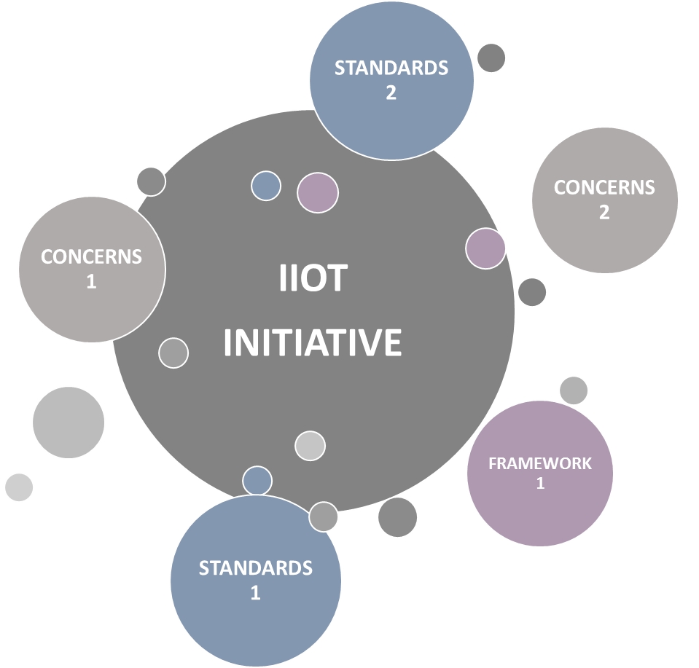

Slide 26
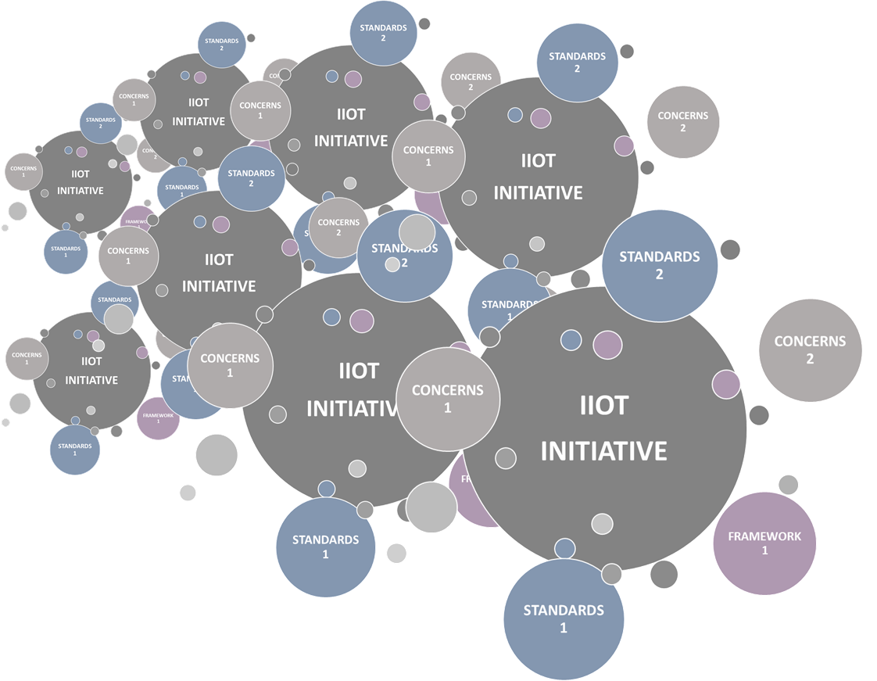

INFORMATION CLUTTERING
RELEVANT CONCERNS
RELEVANT STANDARDS
DOCUMENTATION SOURCE
SUITABLE FRAMEWORK
?
IIoT TECHNOLOGY
IIoT RESOURCES
IIoT STAKEHOLDERS

Slide 27



WEB RESOURCES
FILTERING IIoT RELEVANT RESOURCE
DOCUMENTS
REPORTS
ROADMAPS
WHITE PAPERS
EXTRACTING SCHEMA
SCHEMA
POPULATING KNOWLEDGE GRAPH
RDF REPRESENTATION
VISUALISATION
QUERYING DATA USING SPARQL & ANALYSIS
KNOWLDGE GRAPH
RESULTS

