Slide 1
Appium
-Priyanka Nigade

Slide 2
Contents
Introduction to Mobile Application Testing
Introduction to Appium
Appium Architecture
Appium Installation on Windows
Create Driver Session
Finding Locators(Android /IOS)
Handling Mobile UI Elements

Slide 3
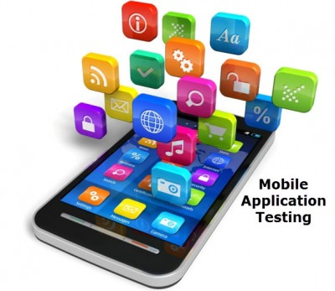
Mobile application testing
“Mobile application testing is a process by which software application developed for handheld mobile devices is tested for its functionality, usability, and consistency.
Mobile application testing can be automated or manual type of testing.”

Slide 4
Types of mobile testing
Software or Application testing:
The applications that work on mobile devices and their functionality is tested. It is called the “Mobile Application Testing”.
Hardware testing:
The device including the internal processors, internal hardware, screen sizes, resolution, space or memory, camera, radio, Bluetooth, WIFI etc.

Slide 5
Types of Mobile Applications
Native Applications
Mobile Web Applications
Hybrid Applications

Slide 6
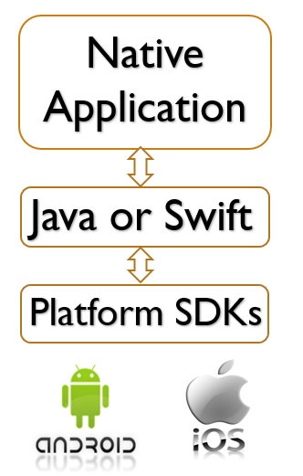
Native Mobile App
Native apps are those applications that are designed for a specific mobile Operating Systems like iOS or Android.
They are built using different programming languages like Swift or Objective-C for developing iOS app and Java (Android Studio)
Native Apps allows the access to the in-built device capabilities.

Slide 7
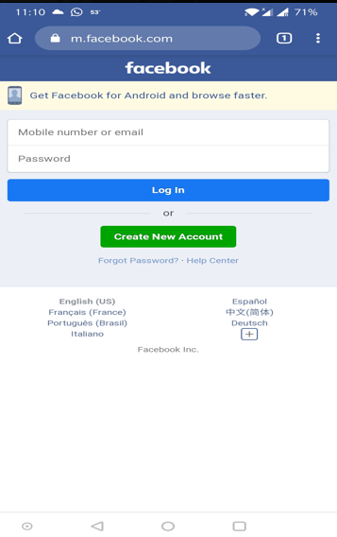
Mobile Web Application
Web Application is a self-sustaining software that completely runs on the web browser.
The web application does not need to be downloaded and installed on the local machine of the end user.
The web applications can span over multiple pages or be restricted to a single page.

Slide 8
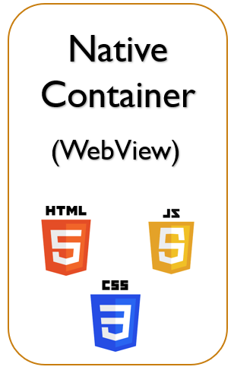
Hybrid Mobile App
The hybrid app allows you to easily build on multiple platforms like ios, android, windows so learning low-level languages like HTML, CSS, Javascript one can create powerful hybrid apps.
Hybrid apps run in a full-screen browser, called a web view to run a web application inside of a native app, that is invisible to the user.

Slide 9
Test conduct on Mobile Application
Functional testing
Performance testing
Security testing
Usability testing
User Interface testing
Compatibility testing
Configuration testing
Installation testing

Slide 10
Challenges In Mobile Testing
Different range of mobile devices
Wide varieties of mobile devices.
Different mobile operating systems
Different versions of operation system
Different mobile network operators.
Frequent updates

Slide 11

What is Appium
Appium is an open-source tool for automating native, mobile web, and hybrid applications on iOS mobile, Android mobile, and Windows desktop platforms.

Slide 12
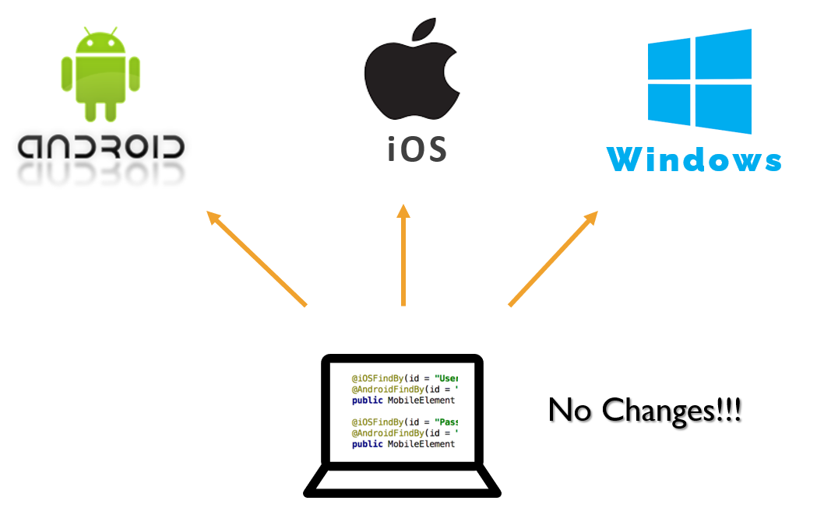

What is Appium
Appium is a cross platform (Android ,iOS ,Windows)
Appium Support multiple programming languages

Slide 13
Why Appium
Appium supports physical device as well as Android Emulator and iOS Simulator
No pre-compilation of your app
Cross platform and any WebDriver compatible language supported
Support for build In applications

Slide 14
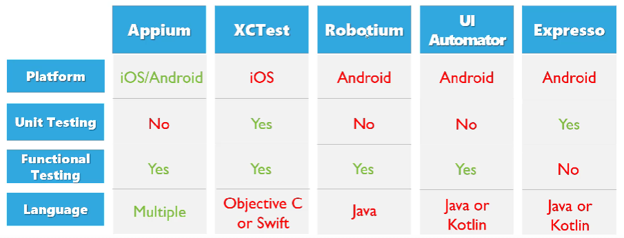

Slide 15
Limitations
IOS automation with local Appium server requires mac
Maintaining local Appium server labs need large resource
Documentation is limited and some times its too technical

Slide 16
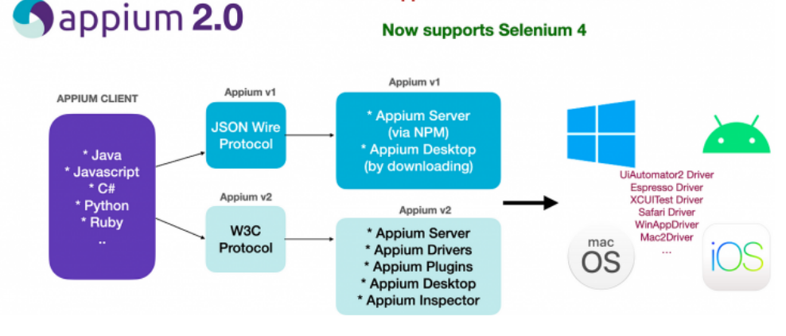
Appium Architecture

Slide 17
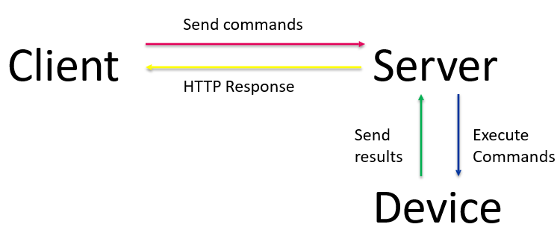
Appium Architecture
Client/Server Architecture Appium is at its heart a webserver that exposes a REST API.
It receives connections from a client, listens for commands, executes those commands on a mobile device, and responds with an HTTP response representing the result of the command execution.

Slide 18
Clients initiate a session with a server in ways specific to each library, but they all end up sending a POST /session request to the server, with a JSON object called the 'desired capabilities' object.
At this point the server will start up the automation session and respond with a session ID which is used for sending further commands.
Desired Capabilities
Desired capabilities are a set of keys and values (i.e., a map or hash) sent to the Appium server to tell the server what kind of automation session we're interested in starting up.
Appium Server
Appium is a server written in Node.js
Appium Clients
There are client libraries (in Java, Ruby, Python, PHP, JavaScript, and C#) which support Appium's extensions to the WebDriver protocol.

Slide 19
Appium Installation On Windows
Step 1:Install Appium Server through CLI interface
Step 2: Install Appium server desktop
Step 3: Install UiAutomator2 Driver using Appium CLI
Step4: Install Appium Inspector
Step5 : Install Android Studio & configure Java /Android Variable
Step6: Verify installation through Appium Doctor

Slide 20
Step 1 :Install Appium Through CLI
Commands to check if node and NPM (Node Package Manager) are installed:
node -v
npm -v
Install node.js (NPM is included) from link - https://nodejs.org/en/download/
Important note: Use the LTS and not current version.
Command to install Appium using npm: npm install -g appium@next
Note: @next will not be required once Appium 2.0 stable release is out to market.
Command to install specific version: npm install -g appium@<verion_number>
Command to start Appium: appium
Command to get installation location: where appium
Command to uninstall Appium: npm uninstall -g appium

Slide 21
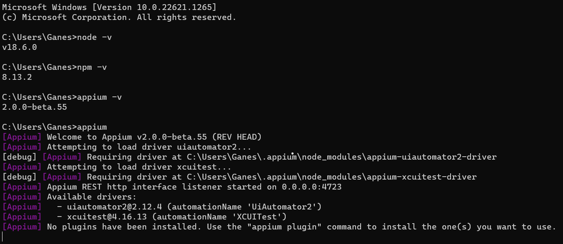
Appium Through CLI

Slide 22
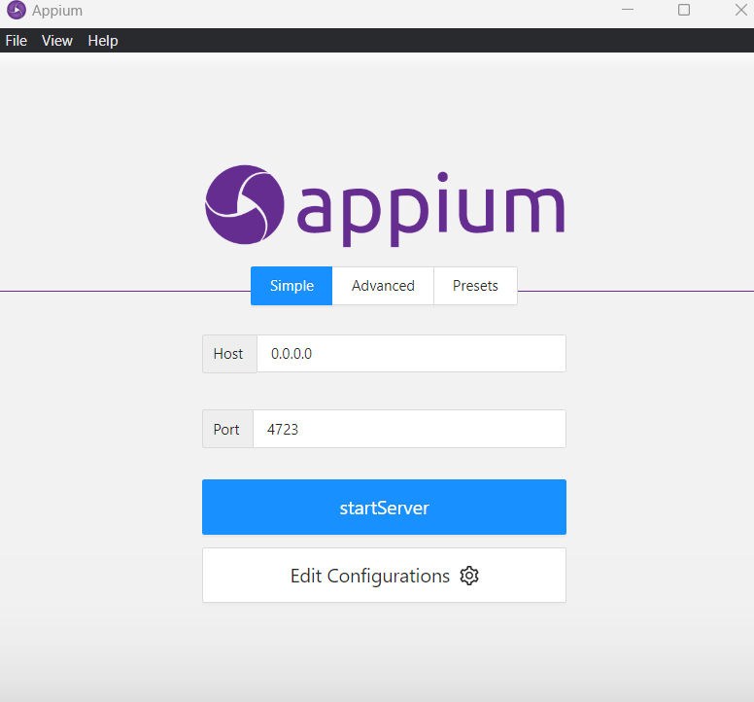
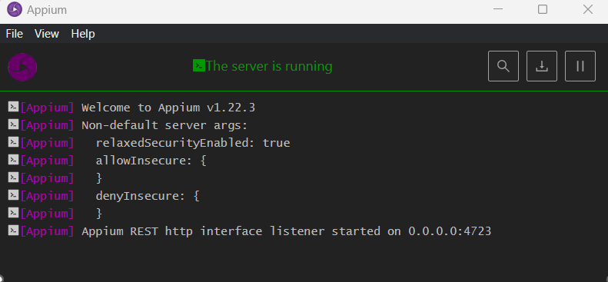
Step 2:Install Appium Desktop(optional)
https://github.com/appium/appium-desktop/releases

Slide 23
Step 3 :Install UiAutomator2 Through CLI
UiAutomator2 is UI Testing framework introduced by Google to facilitate automation on Android device or Emulator
Appium leverages this UiAutomator2 with its own wrapper and came up with UiAutomator2 Driver to automate the Android application.
Setup:
Get help: appium driver --help (or -h)
Get list of officially supported drivers: appium driver list
Install driver: appium driver install uiautomator2
Install driver with specific version: appium driver install uiautomator2@<version_number>

Slide 24
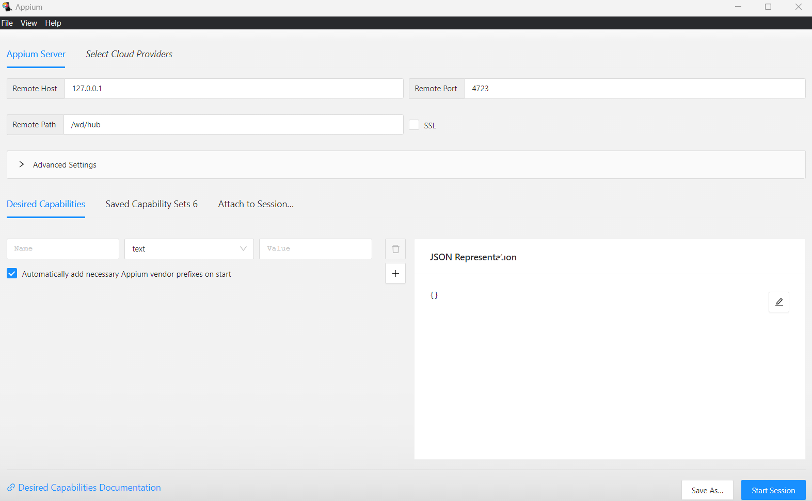
Step 4 :Install Appium Inspector
A GUI inspector for mobile apps and more, powered by a (separately installed) Appium server.
Appium Inspector is basically just an Appium client (like WebdriverIO, Appium's Java client, Appium's Python client, etc...) with a user interface.
There's an interface for specifying which Appium server to use, which capabilities to set, and then interacting with elements and other Appium commands once you've started a session.

Slide 25
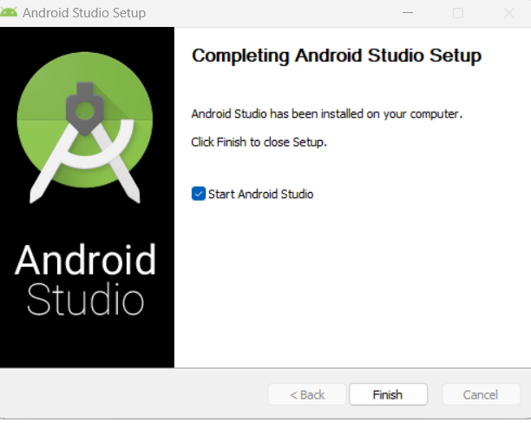
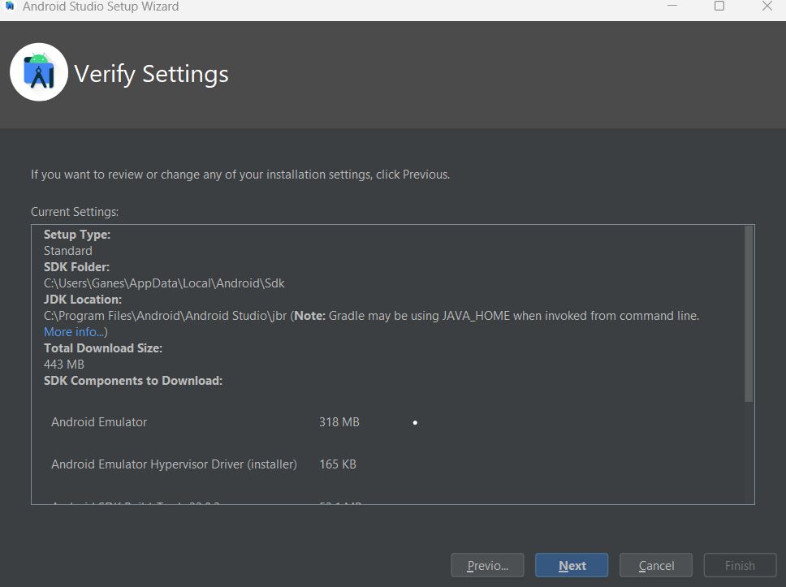
Step 5 :Install Android Studio
Download Android studio and do setup
https://developer.android.com/studio

Slide 26
Setup Java & Android variable
Create JAVA_HOME system environment variable and set it to JDK path (without bin folder).
Edit PATH system environment variable and add %JAVA_HOME%\bin
Note: Usually JDK path is "C:\Program Files\Java\<your_jdk_version>“
system environment variable and set it to SDK path. Create ANDROID_HOME
Edit PATH system environment variable and add below,
%ANDROID_HOME%\platform-tools
%ANDROID_HOME%\cmdline-tools

Slide 27
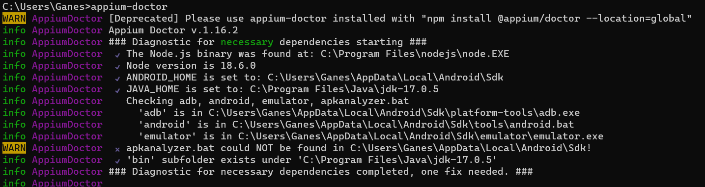
Step 6:Verify Installation Using Appium-doctor
Command to install appium-doctor: npm install -g appium-doctor
Command to get help: appium-doctor --help
Command to check Android setup: appium-doctor --android

Slide 28
Appium Driver Management
List driver:
appium driver list
appium driver list --installed
appium driver list –updates
Install driver:
appium driver install <official_driver_name>
appium driver install <official_driver_name>@<specific_version_number>

Slide 29
Appium Driver Management
appium driver install --source <source> --package <name>
source: npm (default), github, git, local
package: customDriver@1.0.0
Examples:
-> appium driver install --source npm appium-uiautomator2-driver
-> appium driver install --source git https://github.com/appium/appium-uiautomator2-driver.git --package appium-uiautomator2-driver
-> appium driver install --source github appium/appium-uiautomator2-driver --package appium-uiautomator2-driver

Slide 30
Appium Driver Management
Uninstall driver:
-> appium driver uninstall <official_driver_name>
Update driver:
-> appium driver update uiautomator2
-> appium driver update --unsafe
-> appium driver update installed

Slide 31
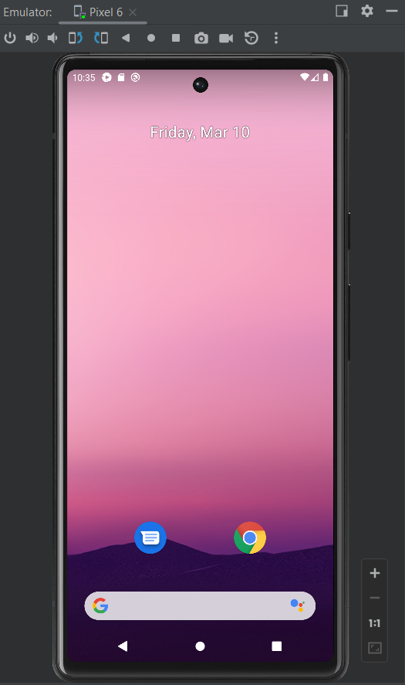
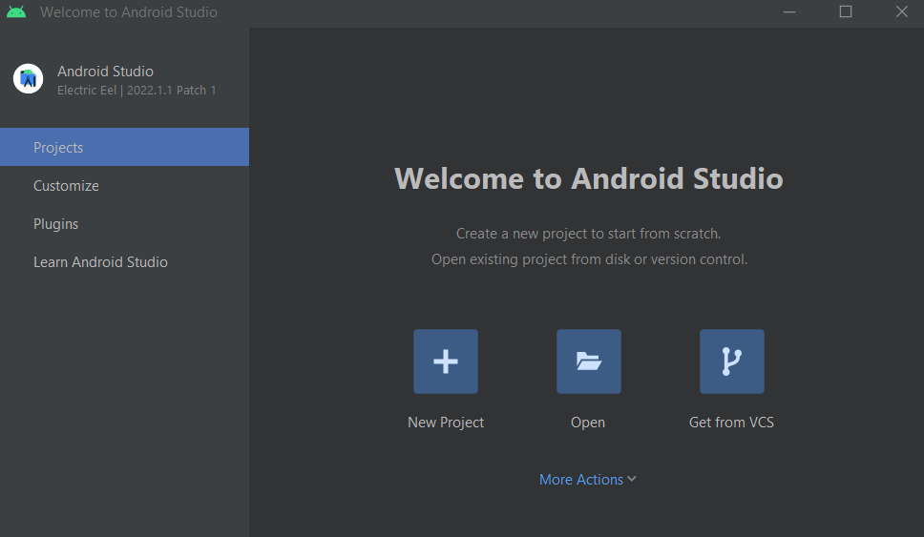
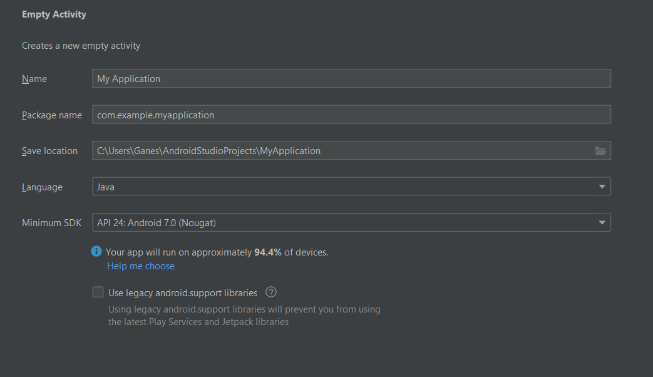
Android Emulator Setup

Slide 32
Create Driver Session

Slide 33
Desired Capabilities
Desired capabilities are a set of keys and values (i.e., a map or hash) sent to the Appium server to tell the server what kind of automation session we're interested in starting up.
There are also various capabilities which can modify the behavior of the server during automation.
Keys and values encoded in a JSON object, sent by Appium clients (e.g. Java Client) to the server when a new driver session is requested.
- Scripted through code or through the Appium Inspector
1. How you want your test to work 2. Device to connect 3. App to work with

Slide 34
Desired Capabilities
UiAutomator2 (Android) capabilities:
https://github.com/appium/appium-uiautomator2-driver?#capabilities
XCUITest (iOS) capabilities:
https://github.com/appium/appium-xcuitest-driver#capabilities

Slide 35
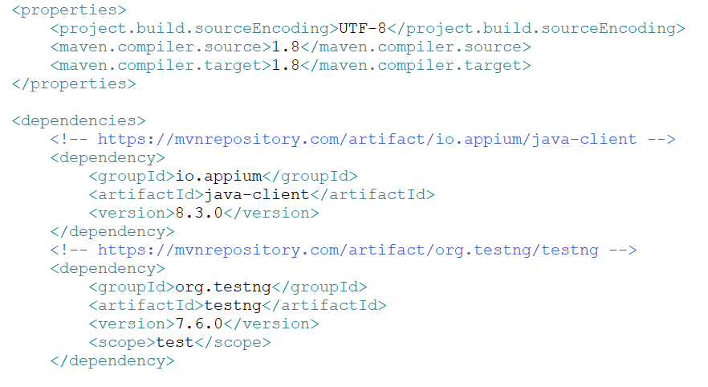
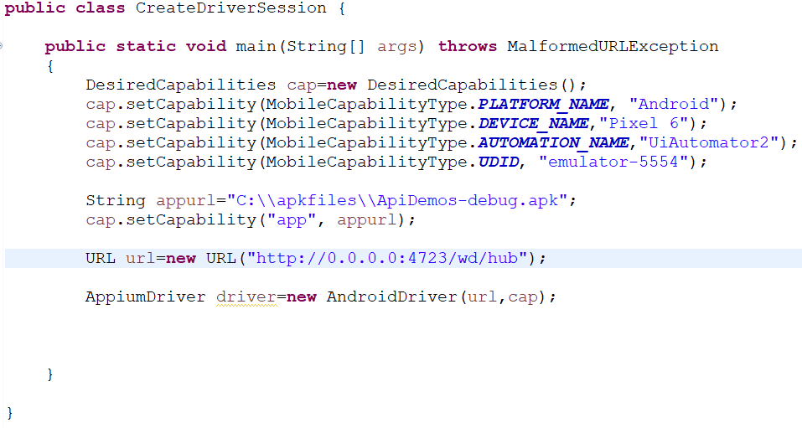
Android session

Slide 36
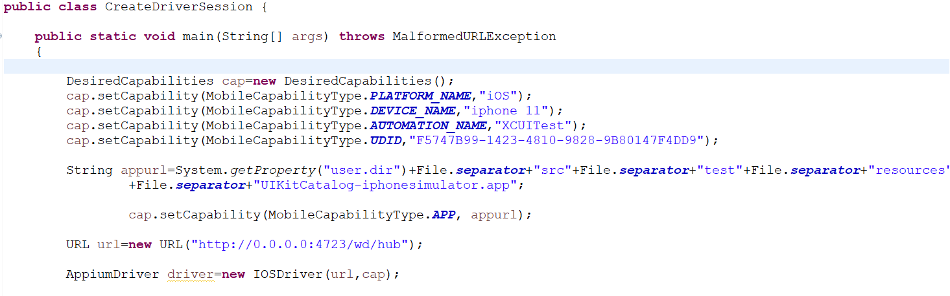
Create Driver Session for IOS

Slide 37
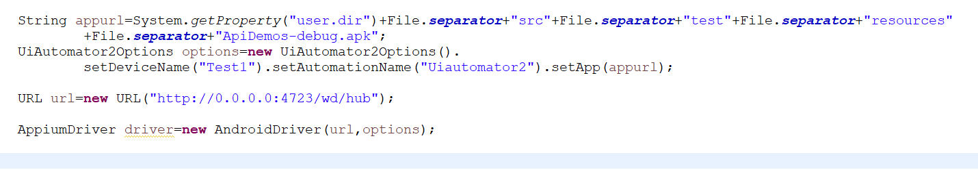
Create Android session Using Options Class

Slide 38
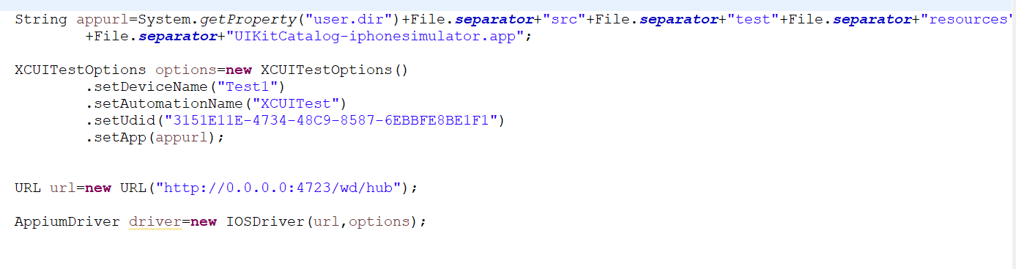
Create iOS session Using Options Class

Slide 39
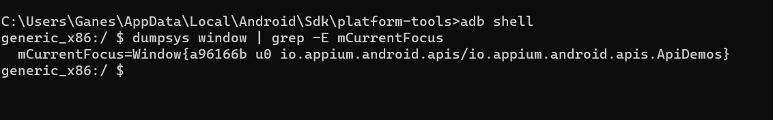
How to get App Package & App Activity
Launch app on the device and bring activity in focus
Launch terminal/CMD prompt and execute command (for older Android versions): adb shell
dumpsys window | grep -E mCurrentFocus
Command for Android 10 and above: adb shell
"dumpsys activity activities | grep mResumedActivity"
=> On windows, you might have to launch the adb shell first, using command “adb shell”, Then execute the remaining command

Slide 40
How to get Bundle Id for IOS
iOS: How to get bundleId? [If no access to Xcode and app’s source code]
.app file
Right click .app file
Show package contents
Launch info.plist file in Xcode
Search for Bundle identifier
Right click on project→show in system explorer→right click on UIkitapp→show package contents→info.plist →open →get buldleid

Slide 41
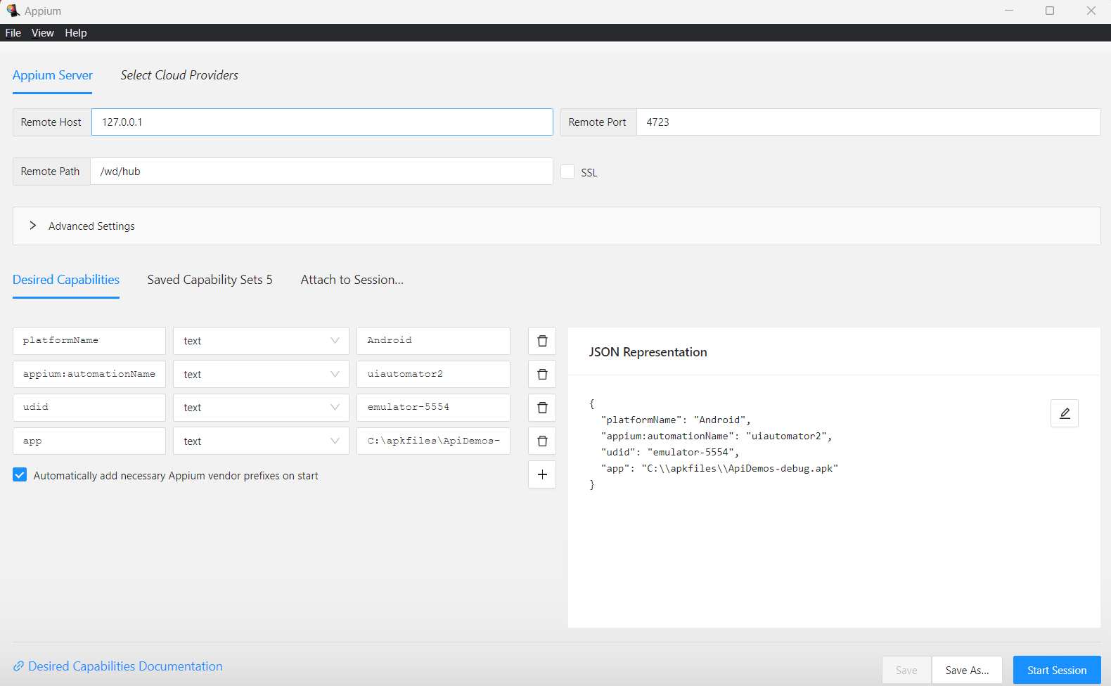
Create a Session Through Appium Inspector

Slide 42
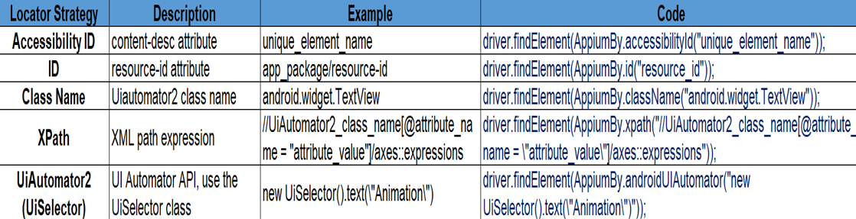
Locator Strategy for Android

Slide 43
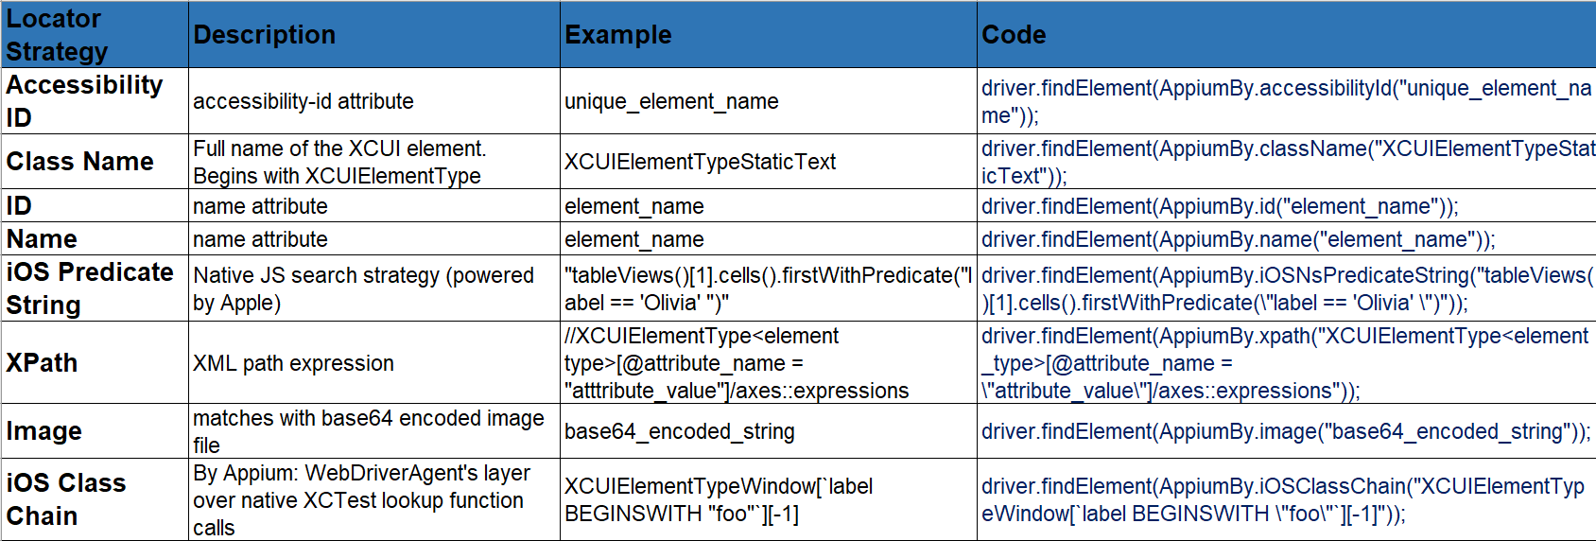
Locator Strategy for IOS

Slide 44
Mobile Gestures With UiAutomator2
https://appium.io/docs/en/writing-running-appium/android/android-mobile-gestures/
1.click
2.Long click
3.Drag and Drop
4.Scroll
5.Swipe

Slide 45
Mobile Guestures With XCUITest
https://appium.github.io/appium-xcuitest-driver/4.19/
Swipe
Scroll

Slide 46
Working with App
Terminate app - Terminates an existing app
((AndroidDriver)driver).terminateApp(“app package name");
Install Application - Test app upgrades
Note: Use terminate before installing
((AndroidDriver)driver).installApp(appurl1,newAndroidInstallApplicationOptions().withReplaceEnabled());
Remove app - Uninstalls app
((AndroidDriver)driver).removeApp("io.appium.android.apis");
Is app installed?
- Checks if an app is already installed

Slide 47
Working with App
Run app is background
- Sends app to background for specified time and then brings back to foreground
((AndroidDriver)driver).runAppInBackground(Duration.ofMillis(5000));
Activate app
- Activates an app and moves it to foreground (the app should be already running)
To activate any new app like Settings ((AndroidDriver)driver).activateApp("com.android.settings");
Query app state
- Returns current app state (for e.g. RUNNING_IN_FOREGROUND)
((AndroidDriver)driver).queryAppState("io.appium.android.apis")
Reset app
- Reset the app data

