Slide 1
Java-Selenium Basic to Advanced Training
-Priyanka Nigade

Slide 2
About trainer
13+ years experience.
ISTQB Certified
Full time software testing manual & automation trainer.
Conducted trainings for multiple corporates.
Trained 1000+ professionals.
You tube channel “Priyankaaz IT School”.

Slide 3

Training Flow
Fameworks
TestNG,Maven
Selenium WebDriver
Java Programming Overview
Selenium Introduction
Basics of Automation Testing

Slide 4
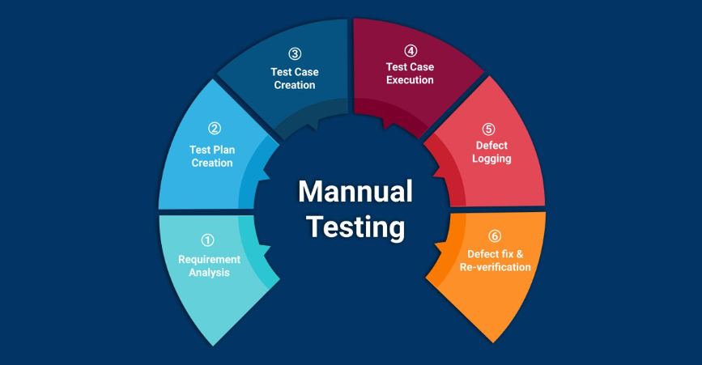
Prerequisite for Training

Slide 5
Automation Basics

Slide 6

Manual testing
Manual testing is process of manually testing software application with the intension of finding defects.

Slide 7
When is Manual Testing Good Idea?
Subjective Validation
New/Changing Functionality
Strategic Development
Complex Functionality

Slide 8

Manual Testing Challenges
Manual testing is traditional form of testing.
Repetitive
Coverage
Reliable
Reusable
Require more resource
Speed
Costly
More time & efforts

Slide 9

Automation testing
Automation testing is process of testing software application with the help of tool to find out defects from the application.

Slide 10
Need For Automation Testing
Every organization has unique reasons for automating software quality activities, but several reasons common across industries
Speed (fast to execute but except initial time)
Reliable
Repeatable
Saves time
Coverage
Reusable
Cost effective
programmable

Slide 11
When To Automate Application?
Requirements do not change frequently.
Projects that need to test the same areas often.
All manual testing process in place as per expected results and tested twice manually.

Slide 12
Types Of Automation Tests
Functional Automated Tests
Non Functional Automated Tests

Slide 13
Selection Of Automation Tools
First, Identify the requirements, explore various tools and its capabilities, set the expectation from the tool and go for a Proof Of Concept.
Tool should be compatible as per checklist.
Easy to learn and technical support should be available.

Slide 14
Availability of Various tools
Testing type | Mercury interactive | IBM (Rational Corporation) | Segue Software | Open source tools
Functional testing tool | QTP (VB script) | Rational Robot (SQA) | Silk Test | Selenium
Performance testing tool | Load Win runner (TSL) Runner | Rational Performance Tool | Silk Performer | JMeter
Test management tool | Test Director Quality center | Rational Management Tool | Silk Radar | TestLink

Slide 15
What is selenium…
Selenium is an open source Browser based test Automation.
Selenium is a suite of tools to automate web application testing
Works by simulating users action such as mouse click and key pressed.
Works anywhere JavaScript is supported.
Runs in many browser and operating systems.(IE, MozillaFirefox, Safari, Google Chrome and Opera…/Windows, Linux, Mac..)
Can be controlled by many programming languages and testing frameworks.
(HTML,PHP,C#,Java,Ruby,Python..etc.)

Slide 16
Selenium Phases
Selenium 4
Selenium 3
Selenium2
Selenium 1

Slide 17
Selenium Benefits
Open Source
Cross platform
Cross browser support
Remote execution
Parallel execution
Integration with multiple tools
And many more

Slide 18
Limitations
Can not automate windows applications
We can not read images
Bar code, Graphs, pie charts, OTP can not be automated

Slide 19
We can use Selenium
Functional testing
Smoke test scenario
Regression test
End to End Scenario

Slide 20
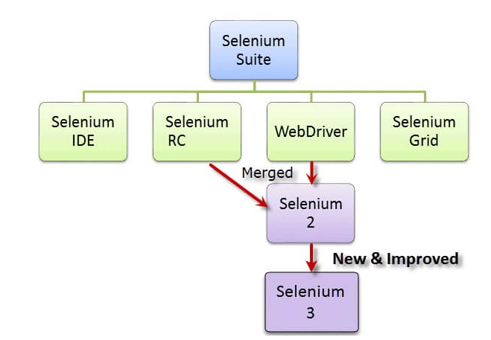
Selenium Components
Selenium is automated testing tool used to test web applications across various browsers.
Selenium Components

Slide 21
Selenium components
Selnium ide
Selenium Rc(deprecated)
Selenium WebDriver
Selenium grid

Slide 22
Selenium IDE
Integrated Development Environment for building Selenium test cases.
Operates as a Firefox add-on and provides an interface for developing and running individual test cases or entire test suites.
Selenium-IDE has a recording feature, which will keep account of user actions as they are performed and store them as a reusable script to play back.
Offers full editing of test cases.
Default source code language is HTML but it can changed to a programming language such as Java or C# or Python.
Runs on Mozilla Firefox ,Chrome as well (implemented as extension).
Notes:
22

Slide 23
Selenium IDE
Selenium IDE ceased to exist in August 2017
A robust version of IDE was released in 2018 by Applitools
The new IDE deploys a selenium Side Runner that allows all IDE tests to run on any browser
Selenium IDE is integrated with other suite components to provide a robust interface for application testing.
Used as Prototyping tool.

Slide 24
Same Origin Policy in Selenium
“Same Origin Policy” is introduced for security reason, and it ensures that content of your site will never be accessible by a script from another site.
As per the policy, any code loaded within the browser can only operate within that website’s domain.
Same Origin policy prohibits JavaScript code from accessing elements from a domain that is different from where it was launched.
This is the reason why prior to Selenium RC, testers needed to install local copies of both Selenium Core (a JavaScript program) and the web server containing the web application being tested so they would belong to the same domain.

Slide 25
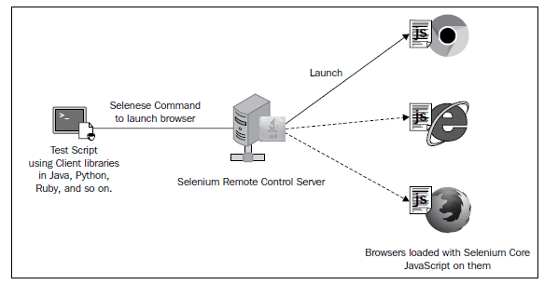
Selenium RC
Selenium Rc(Remote Control) is a server written in Java
Allows to write automated web application UI tests in any programming language against any HTTP website using any mainstream JavaScript-enabled browser.
Can be accessed on different browsers remotely.
Discontinued from Selenium Community.
Notes:
25

Slide 26
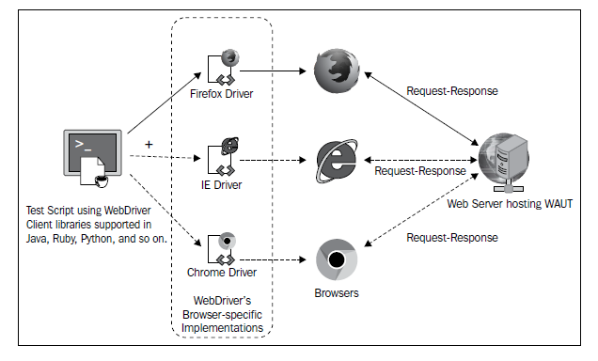
Selenium WebDriver
The first cross-platform testing framework
Programming interface to create & run test cases
Does not require a core engine like RC & interact natively with the browser application.
Supports Java ,Ruby ,C# ,Python ,PHP ,Perl,Support framework like TestNG,Junit,Nunit.

Slide 27
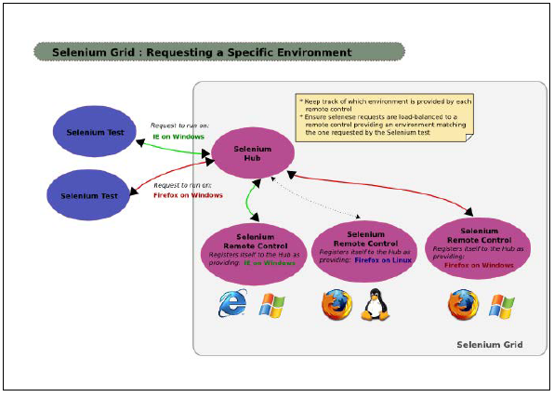
Selenium Grid
Scripts can be executed on different machines at the same time.
The main objective is to minimize test execution time.
Grid was designed to distribute commands to different machines simultaneously
Grid allows the parallel execution of test on different browsers and different operating systems
Works on switch-hub technology.
Notes:
27

Slide 28
Selenium IDE

Slide 29
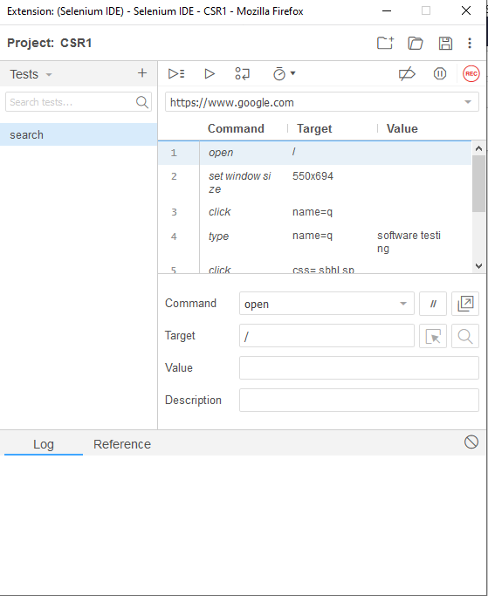

Slide 30
Working Principle
Record
Playback
Save

Slide 31
Selenium Commands
“Selenese”
Action
Accessor
Asserts

Slide 32
“Selenese command”
1.Actions are commands that generally manipulate the state of the application.
Action command directly interacts with application
Eg. Open, click, type etc
2.Accessors commands allow user to store certain values to a user define variable
Eg. Store, store Text ,store Title, store Value etc.
3.Assertion commands verify the current state of the application with an expected state.
Assertion commands available with 3 prefix.
1.Assert
2.Verify
3.Wait For

Slide 33
WebDriver

Slide 34
Selenium WebDriver
Latest component of Selenium suite.
It is web-UI automation framework that allows to test various functionalities of AUT.
Compatible with third party browsers such as IE, Chrome, Safari, Opera etc.
Supports different scripting languages like Java, PHP, C#, python ,Perl , Ruby , Scala and Groovy.
Works only on playback mechanism.
Selenium WebDriver is an INTERFACE.

Slide 35
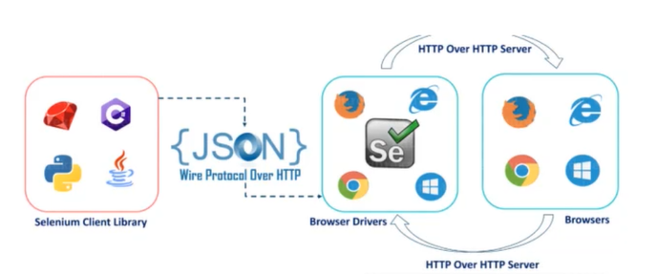
Selenium 3 Architecture

Slide 36
Architecture Components
There are four basic components of WebDriver Architecture:
Selenium Language Bindings
JSON Protocol
Browser Drivers
Real Browsers
HTTP(Json) request is generated and sent to the browser driver for each Selenium command.
Json WebDriver protocol defines tha way that browser actions are executed.
The driver receives the HTTP(Json) request through HTTP server.
HTTP Server decides all the steps to perform instructions which are executed on browser.
Execution status is sent back to HTTP Server which is subsequently sent back to automation script.

Slide 37
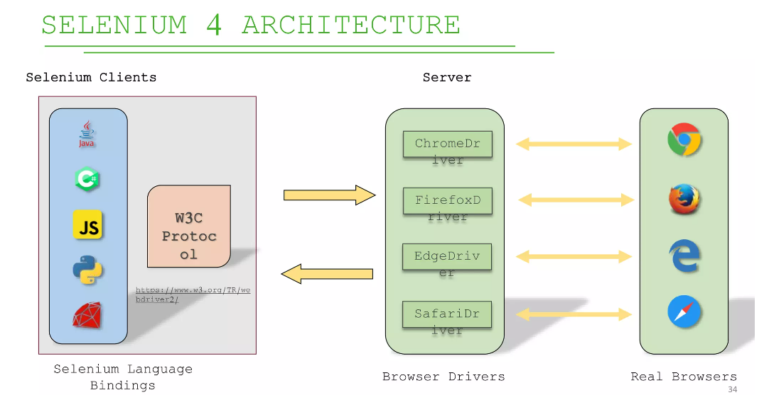


Slide 38
Architecture Components
There are four basic components of WebDriver Architecture:
Selenium Language Bindings
W3CProtocol
Browser Drivers
Real Browsers
In WebDriver W3C Protocol, there is a direct information transfer between the server and client without the necessity for the JSON Wire Protocol.
As both Selenium WebDriver and web browsers use the identical protocol, automated Selenium testing will run tests more consistently between various browsers.

Slide 39
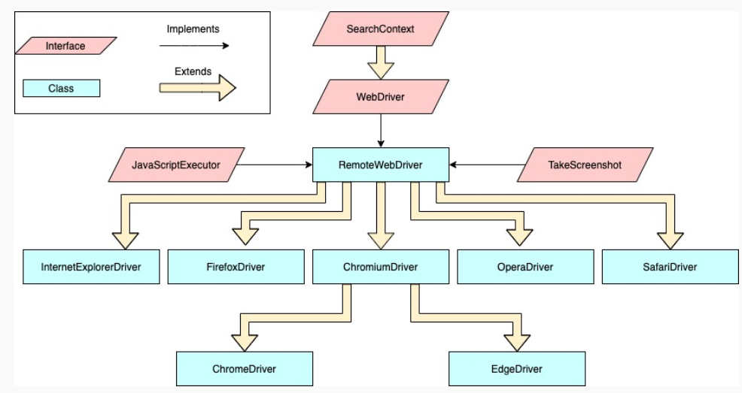
Selenium Interfaces and Classes Hierarchy

Slide 40
WebDriver Commands
1.Browser Commands
2.Navigation Commands
3.WebElement Commands

Slide 41
Element Locator
By Id
By name
By classname
By linkText
By partialLinkText
By tagName
By cssSelector
By xpath

Slide 42
CSS Selector & Xpath
Tag & Id/ #id
Tag & class name / .classname
Tag & attribute []
Tag, class and attribute
Xpath
Text()
Normalize-space()
Contains()

Slide 43
Browser Action
Opening Chrome
WebDriver driver=new ChromeDriver();
Maximize Window
driver.manage().window().maximize();
Close Browser
driver.close()
or
driver.quit()

Slide 44
Form Field
Text Field
driver.findelement(By.<elementlocator>("location of the element to be found")).sendKeys("<text to be entered>");
Button / Radio Button / Check box / Link driver.findelement(By.<elementlocator>("location of the element to be found")).click();

Slide 45
Form Filed
Select based Dropdown
Selectbyvalue
Selectbyvisibletext
Selectbyindex

Slide 46
Wait Condition In WebDriver
Implicitly Wait
Explicitly Wait
WebDriverWait
FluentWait

Slide 47
Wait Condition In WebDriver
Implicitly Wait - Enables Selenium to wait for certain amount of time before throwing an error if it cannot find the desired element.
It is applicable to overall script from the point of declaration.
Can be termed as global declaration.
Syntax
driver.manage().timeouts().implicitlyWait(Duration.ofSeconds(10));

Slide 48
Wait condition In WebDriver
Explicit Wait This is to wait for a certain condition to occur before proceeding further.
Need to specify an exact time period to wait
Applicable only for 1 condition at a time.
WebDriverWait(c) extends FluentWait(C) implements Wait(I)

Slide 49
Capabilities & ChromeOption Class
Capabilities are options that you can use to customize and configure a ChromeDriver session.
The WebDriver language APIs provides ways to pass capabilities to ChromeDriver.
Use the ChromeOptions class.
This is supported by Java, Python, etc.
Syntax: driver.getcapabilities();

Slide 50
Headless Browser
In technical terms-It is kind of web browser without graphical user interface.
In other words it is a browser , a piece of software that access a particular web page but doesn’t show them to any human being.

Slide 51
Headless Browser Testing
ChromeOptions class is used to manipulate various properties of Chrome driver.
Syntax:
ChromeOptions opt=new ChromeOptions();
opt.setHeadless(true);
WebDriver driver=new ChromeDriver(opt);

Slide 52
Handling Web Elements
Windows Handling
Alert/pop-up Handling
Frame Handling
SwitchTo() method of Selenium which will allow us to Control frames and multiple windows as well as Alerts/popups.

Slide 53
Alerts/Popups
In some application, while submitting a form or for confirmation a window comes that window known as Alert.
Alert is interface in Selenium
Alert Interface has some methods-
1- accept()- Will click on the ok button when an alert comes.
2- dismiss()- Will click on cancel button when an alert comes.
3-getText()-To get the text of alert
4-sendKeys()- To send the value to alert

Slide 54
Demo on Alert
Demo1:
https://mail.rediff.com/cgi-bin/login.cgi
Demo2:
https://the-internet.herokuapp.com/javascript_alerts
Demo3:
https://www.selenium.dev/documentation/en/webdriver/js_alerts_prompts_and_confirmations/

Slide 55
Handling Multiple Windows
Window Handling means how to switch from one window to another window
getWindowHandle()
Returns current window handle
getWindowHandles()
Returns set of window handles which can be iterate over all open windows
switchTo()
Return targetLocator which can be used to select a frame or window

Slide 56
Handling iFrame
An iframe is a space on the web page that embeds different kinds of media like images, documents, videos inside the main web page.
iFrame is a HTML document embedded inside an HTML document.
iFrame is defined by an <iframe></iframe> tag in HTML.
switchTo.frame(int frameNumber)
switchTo.frame(string frameNameOrId)
switchTo.frame(WebElement frameElement)

Slide 57
Demo
Demo1:
https://the-internet.herokuapp.com/iframe
Demo2:
https://www.selenium.dev/selenium/docs/api/java/overview-summary.html
Demo3:
https://the-internet.herokuapp.com/nested_frames

Slide 58
Actions class
Handling special mouse events are done using the Advanced user interaction API Action class.
Mouse Over
Mouse right click
Drag & drop
Slider
resizable

Slide 59
Actions Class
Actions class provided by selenium webdriver.
Handling special mouse events are done using the advanced user interaction API.
Actions class contains action methods that are needed when executing these events.
Note:
When you are performing single action then use perform() and when you are performing multiple actions then use build().perform()

Slide 60
Methods
contextClick():It performs rightclick at the current mouse location.
doubleClick():It performs double click at the current mouse location.
clickAndHold():It clicks without releasing at the current mouse location
dragAndDrop(source,target):It performs click and hold at source element ,move to that target element then release the mouse.
moveToElement(toElement):It moves the mouse to the middle of element.
release():Release the depressed left mouse button at the current mouse loaction

Slide 61
Right click and double click
Demo 1:
https://the-internet.herokuapp.com/context_menu
Demo2:
http://demo.guru99.com/test/simple_context_menu.html
Rightclick:
http://swisnl.github.io/jQuery contextMenu/demo.html
Doubleclick
http://api.jquery.com/dblclick/

Slide 62
MouseOver
Mouse over means when you move cursor on element automatically rest elements displayed.
Demo:
https://www.w3schools.com/jsref/tryit.asp?filename=tryjsref_onmouseover

Slide 63
Drag and Drop
http://www.dhtmlgoodies.com/scripts/drag drop custom/demo drag drop 3.html
http://jqueryui.com/droppable/#default
1.clickAndHold
2.moveToElement
3.Release

Slide 64
Slider, Resizing and Tooltip
Slider
https://jqueryui.com/slider/
Resizing
https://jqueryui.com/resizable/
Tooltip
https://jqueryui.com/tooltip/

Slide 65
Testing Framework & Tools
Data Driven
Keyword Driven
Hybrid

Slide 66
Framework
A framework is a set of assumptions, concepts and practices that needs to be followed.
It is nothing but a set of guidelines
These guidelines consist of coding standards, test-data handling, object repository treatment etc.
It is up to you whether to follow these guidelines while automating script.
However, it is always beneficial to follow these guidelines in order to produce effective outcomes such as increase code re-usage, higher portability, reduced script maintenance cost etc.

Slide 67
Benefits of Framework
Reusability of code
Maximum coverage
Recovery scenario
Low cost maintenance
Minimal manual intervention
Easy Reporting

Slide 68
TestNG
TestNG is a testing framework inspired from Junit.
TestNG has multiple classes interface and methods which will make testers task easy.
TestNg provides so many additional functionality using them you can create very robust framework itself.

Slide 69
Advantages
Default Reporting
Annotations
Run your test in arbitrarily big thread pools
Easy and flexible test configuration
Support for data driver testing using @DataProvider.
Support for Parameters.
Easy way to execute TestSuite
Supported by a variety of tools & plug-in(eclipse,Maven…etc)

Slide 70
Demo
TestNG first script with @Test annotation
TestNG Priority
TestNG Annotations
Creation of Suite (XML File)
Use external data for testing
Xml file(@Parameters)
Property file

Slide 71
TestNG XML File
TestNG.xml file is a configuration file that helps in organizing our tests.
It allows testers to create and handle multiple test classes, define test suites and tests.
Advantages
It provides parallel execution of test methods.
It allows the dependency of one test method on another test method.
It helps in prioritizing our test methods.

Slide 72
XML File Format
<?xml version="1.0" encoding="UTF-8"?>
<!DOCTYPE suite SYSTEM "https://testng.org/testng-1.0.dtd">
<suite name="TestNGXML" parallel="classes">
<test thread-count="5" name="TestNGXMLTest Test" verbose="2">
<classes>
<class name=“testNGDemo.TestNGXMLTest" />
</classes>
</test>
</suite>
parallel attribute tells TestNG to run the test suite classes in parallel

Slide 73
Data Driven Framework
As the name itself says Data Driven a Framework which is driven by data.
It can be used when one test case has to execute with different set of data.
Data Driven using @DataProvider
Ways:
Using Array
Using Excel File

Slide 74
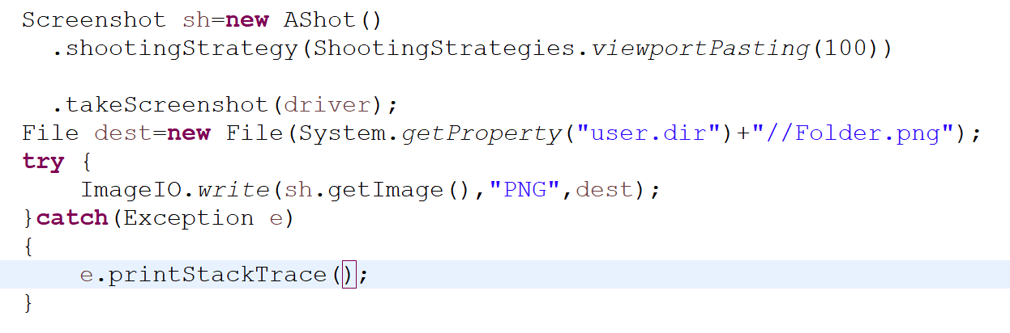
ScreenShot
Screenshot help us to understand the flow of application whether application is behaving correctly or not.
TakesScreenshot interface
Full Page – ashot utility
https://github.com/pazone/ashot

Slide 75
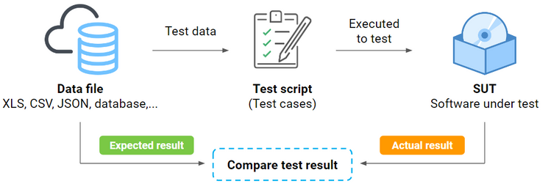
Data Driven Framework
A Data Driven framework in Selenium is the technique of separating the “data set” from the actual “test case” (code).
This framework completely depends on the input test data. The test data is fed from external sources such as an excel file, .CSV file or any database.

Slide 76
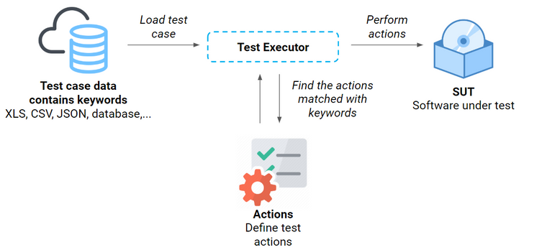
Keyword-driven Framework
A keyword-driven testing framework is a table-driven testing or action-based testing.
This is a technique in which all the operations and instructions to be performed are written separately from the actual test cases.

Slide 77
Hybrid Driven Framework
The best thing about such a setup is that it leverages the benefits of all kinds of associated frameworks.
Hybrid framework is a technique wherein we can make the best use of both Data-Driven and Keyword-Driven Testing Framework.

Slide 78
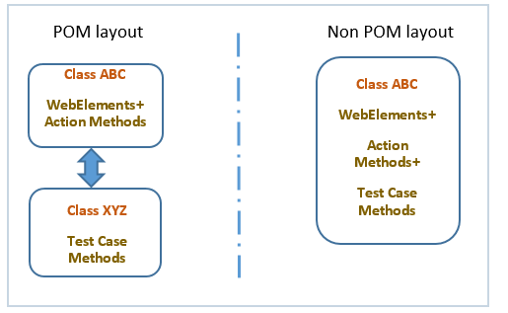
Page Object Model
Page Object is a Design Pattern which has become popular in test automation for enhancing test maintenance and reducing code duplication.
A page object is an object-oriented class that serves as an interface to a page of your AUT.
Every web page in the application should have a corresponding page class.

Slide 79
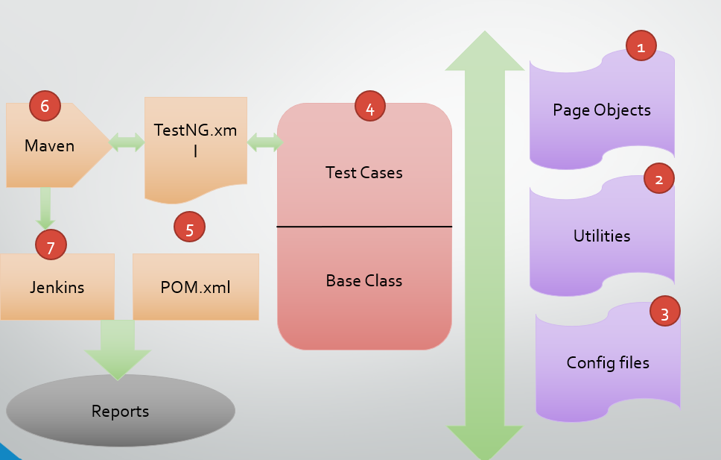

Slide 80
Reference
https://www.selenium.dev/
https://www.w3resource.com/java-tutorial
https//javatpoint.com

