Slide 1
JavaScript Basics
Priyanka Nigade

Slide 2
What is Javascript?
A high-level, interpreted programming language.
Initially developed by Brendan Eich at Netscape.
JavaScript is a cross-platform, object-oriented scripting language used to make webpages interactive (e.g., having complex animations, clickable buttons, popup menus, etc.).
There are also more advanced server side versions of JavaScript such as Node.js, which allow you to add more functionality to a website than downloading files (such as realtime collaboration between multiple computers).

Slide 3
What is an Interpreter - Based Language ?
In interpreter - based languages, there is no separate compilation phase.
Instead, the code is executed line by line at runtime.
This approach doesn't create intermediate files (like bytecode or object code),making it different from compiler-based languages.
Because it interprets each line as it’s executed, it can make changes and test them quickly,
though it can be slower than a fully compiled language for large programs.

Slide 4
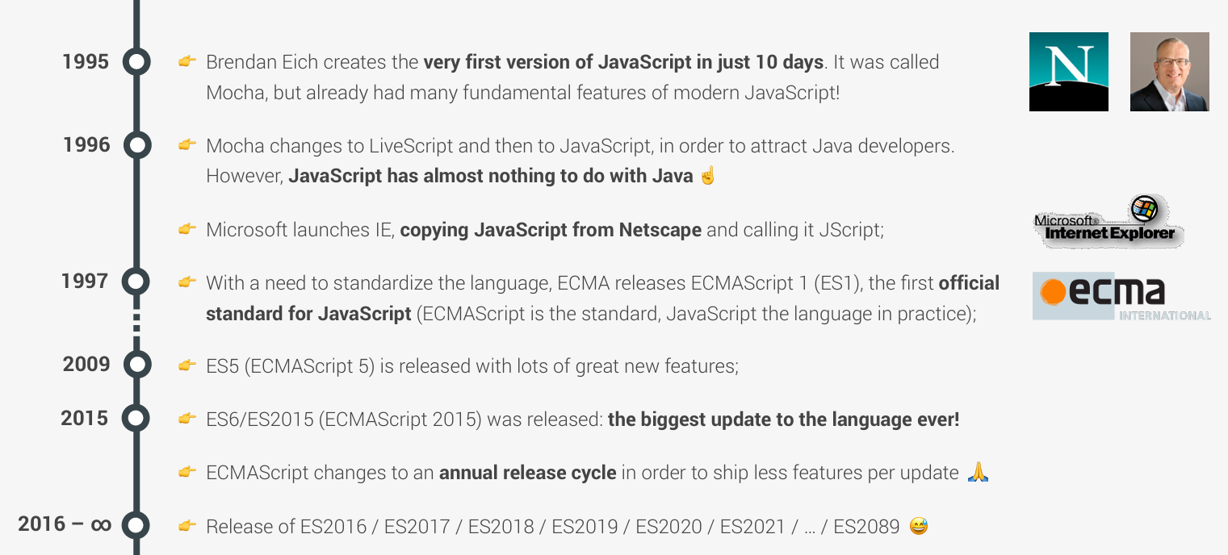
History (ECMA was formerly an acronym for the European Computer Manufacturers Association)
1995: JavaScript was created by Brendan Eich.
Initially called Mocha, then changed to LiveScript, and finally to JavaScript.
The language’s official specification is ECMAScript, standardized by ECma International.
Key Milestones:
ES3 (1999): Introduced many features, including regular expressions and better string handling.
ES6 (2015): Introduced major features like arrow functions, let, const, classes, promises, and more.

Slide 5
Features
Dynamically Typed: You don’t need to define the type of variable when declaring it.
Interpreted: JavaScript code is executed line by line, unlike compiled languages.
Object-Oriented: Supports objects, inheritance, and methods.
Functional Programming: First-class functions, higher-order functions.
Asynchronous Programming: Supports async/await, promises, and event-driven programming.
Multi-Paradigm: Supports object-oriented, imperative, and functional programming.

Slide 6
Envir0nment Set Up
Install Node Js
Install Visual Studio Code
Install code runner extension

Slide 7
Data Types
Primitive Types:
String: A sequence of characters.
Number: Includes integers and floating-point numbers.
Boolean: true or false.
Null: Represents the intentional absence of any object value.
Undefined: A variable that hasn’t been assigned a value.
Symbol: A unique and immutable data type (ES6+).
Non-Primitive Types:
Object: A collection of properties (key-value pairs).
Array: A collection of elements (indexed list).

Slide 8
JavaScript String
A string represents textual data. It contains a sequence of characters. For example, "hello", "JavaScript", etc.
In JavaScript, strings are surrounded by quotes:
Single quotes: 'Hello'
Double quotes: "Hello"
Backticks: `Hello`

Slide 9
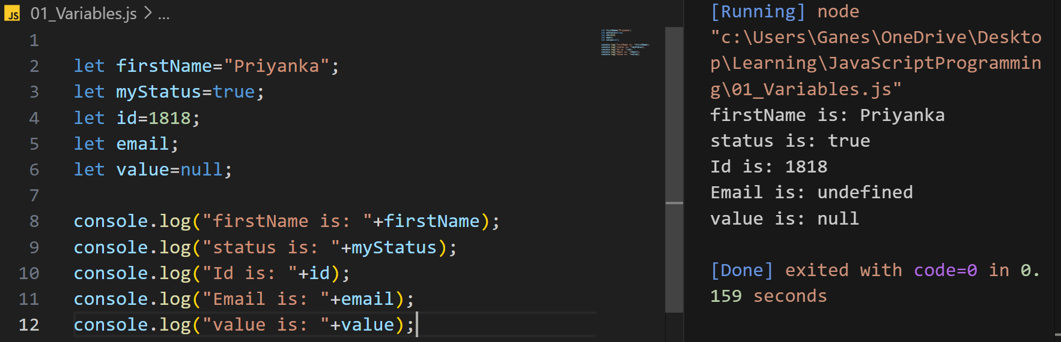
Examples

Slide 10
typeof Operator
`typeof` is used to determine the data type of a variable or value
let num = 10;
console.log(typeof num); // Output: "number"
num = "Hello";
console.log(typeof num); // Output: "string"
num = true;
console.log(typeof num); // Output: "boolean"
let unassignedVar;
console.log(typeof unassignedVar); // Output: "undefined"
let nullVar = null;
console.log(typeof nullVar); // Output: "object" (this is a known bug in JavaScript)

Slide 11
Working with Variables
1. No Need to Declare Variable Type
2. Same Variable Can Be Assigned Values of Different Types
3. No Scoping Information in Variable Declarations
4. Variable and Values Can Be Interrogated(Using typeof)

Slide 12
Variables
let: Block-scoped and Global variable.
const: Block-scoped,Global and read-only variable.
var: Function-scoped/global-scoped variable (older, generally avoided now).
let name = "Alice"; // Mutable
const country = "USA"; // Immutable
if (true) {
let temp = "Hot"; // Block-scoped
const pi = 3.14; // Block-scoped
}

Slide 13
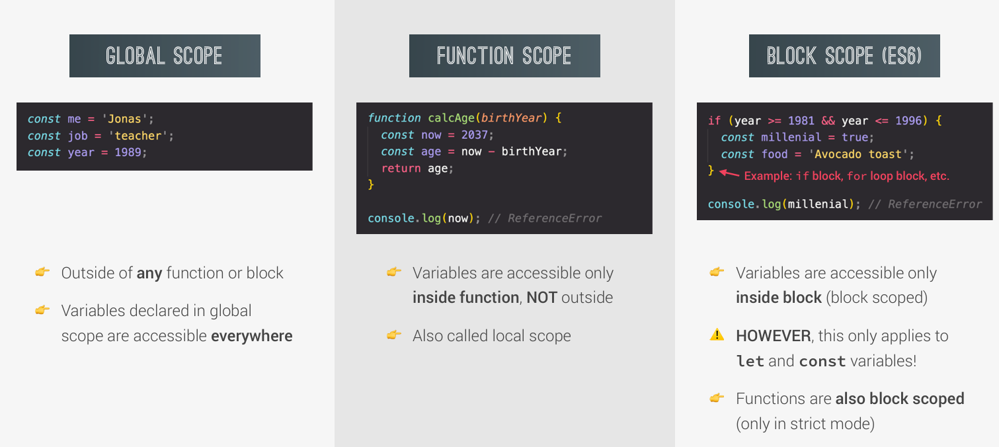
Understand Scope

Slide 14
Redeclaration for let and var
var userName = “Tom";
var userName = “Jerry"; // No error, `name` is re-declared and re-assigned
console.log(userName); // “Jerry“
let age = 25;
let age = 30; // SyntaxError: Identifier 'age' has already been declared
console.log(age); // "Bob"

Slide 15
Scope for var and let
if (true)
{
var x = 10;
let y = 20;
console.log("inside function y value " +y);
}
console.log(x); // 10 (accessible because `var` is function-scoped or globally scoped)
console.log(y); // ReferenceError: y is not defined (because `let` is block-scoped)

Slide 16
Working with constants
const PI = 3.14159; // A constant for the value of PI
Trying to reassign a const variable will cause an error
PI = 3.14; // ❌ Error: Assignment to constant variable
Use const for values that should not change
const BASE_URL = "https://api.example.com";
console.log(BASE_URL);

Slide 17
Hoisting in JavaScript
JavaScript moves variable declarations to the top of their scope (hoisting)
Only declarations are hoisted, not initializations
Hoisting is the behavior where you can able to access variable before even declaring it.
console.log(hoistedVar); // Output: undefined (variable declared but not initialized yet)
var hoistedVar = "I'm hoisted!";
console.log(hoistedVar); // Output: "I'm hoisted!"
Note: "let" and "const" are not hoisted in the same way as "var"; using them before declaration will cause an error
console.log(b); // ReferenceError: Cannot access 'b' before initialization
let b = 10;

Slide 18
Hoisting in JavaScript
var: Variables declared with var are hoisted to the top of their scope, meaning they are moved to the top of the function or global scope and are initialized with undefined.
However, they are only assigned a value when the code reaches their actual line of assignment.
let: Accessing a let variable before its declaration results in a ReferenceError due to the temporal dead zone(the period between the beginning of the block and the declaration line).

Slide 19
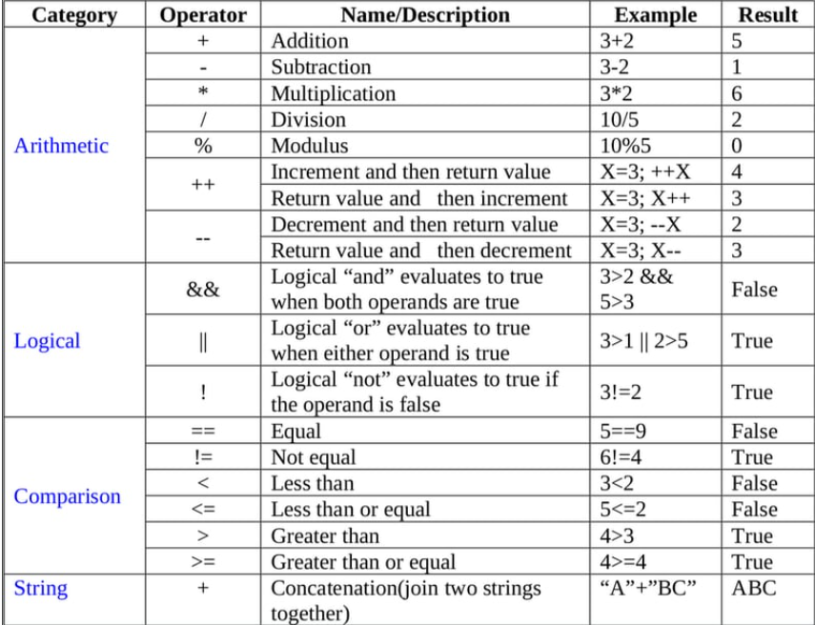
Operators

Slide 20
Loose Equality == Vs Strict Equality===
== (loose equality) compares values with type coercion.
It converts operands to the same type before comparing them.
=== (strict equality) compares both values and types without type coercion.
console.log(5 == "5"); // Output: true (because '5' is coerced to number)
console.log(5 === "5"); // Output: false (because types are different)
console.log(null == undefined); // true - Special case where null and undefined are loosely equal.
console.log(null === undefined); // false - Strict equality checks type and value, which differ here.

Slide 21
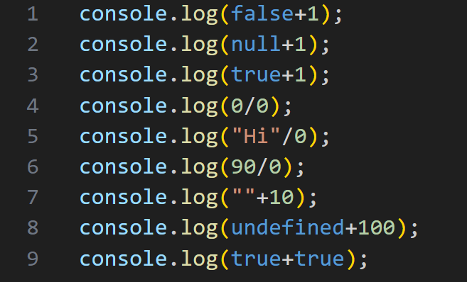
Guess Output?

Slide 22
Type Casting
1.Implicit:
Type Coercion: Automatic type conversion by JavaScript to make expressions work even if data types don't match.
2.Explicit conversion
Number
String
Boolean

Slide 23
String conversion
String conversion occurs when we output something, concatenate strings, or perform certain operations.
JavaScript implicitly converts other types to strings when they are used in string operations.
let result1 = "Hello" + " " + "World";
console.log(result1); // "Hello World"
Mixing Numbers and Strings in Concatenation
console.log("5" + 2 + 3); // "523" - Number 2 and 3 are coerced into strings and concatenated.
console.log(5 + 2 + "3"); // "73" - Number 5 and 2 are operate and concatenated.
console.log("hello" + true);//’hellotrue” – true coerced into string and concatenated
----------------------
Explicit String Conversion using String()
let value = 100;
Let convertedToString = String(value);
console.log(convertedToString); // "100"
console.log(typeof convertedToString); // "string"

Slide 24
Number Conversion
Numeric conversion happens when we perform mathematical operations.
JavaScript tries to convert values to numbers when used with arithmetic operators.
let result4 = "10" * 2;
console.log(result4); // 20 - "10" is coerced to number 10 for multiplication.
let result5 = Number("5") + 3;
console.log(result5); // 8 - Explicit numeric conversion using Number()
Edge Case - Non-numeric strings convert to NaN
let result6 = Number("abc");
console.log(result6); // NaN (Not a Number)

Slide 25
Truthy vs Falsy
Truthy values are values that evaluate to true in boolean contexts (e.g., all non-zero numbers, non-empty strings).
Falsy values are values that evaluate to false (e.g., 0, "", null, undefined, NaN, false).
console.log(Boolean(0)); // Output: false (falsy value)
console.log(Boolean(1)); // Output: true (truthy value)
console.log(Boolean("Hello")); // Output: true (truthy value)
console.log(Boolean("")); // Output: false (falsy value)
console.log(Boolean(null)); // Output: false (falsy)

Slide 26
Boolean Conversion
Boolean conversion occurs in logical contexts, and some values are inherently "falsy."
console.log(Boolean(0)); // false
console.log(Boolean("")); // false
console.log(Boolean(undefined)); // false
console.log(Boolean(null)); // false
console.log(Boolean("hello")); // true
console.log(Boolean(1)); // true
console.log(Boolean(10.0)); // true

Slide 27
Conditional Statements
Simple If
If- else
Ladder-if
Nested-If
Switch case

Slide 28
Loop
1. **While Loop**: Repeats a block of code as long as a specified condition is true.
2. **Do...While Loop**: Similar to the while loop but ensures the code runs at least once.
3. **For Loop**: A loop with initialization, condition, and increment all in one line, often used when the number of iterations is known.
4. **For...In Loop**: Used to iterate over the properties of an object.
5. **For...Of Loop**: Used to iterate over the values in an iterable, like an array or string.

Slide 29
For..of and for..in
for...of: Iterates over values of an iterable object (arrays, strings, maps, etc.).
Use when you need to iterate over the actual values, not the indexes/keys.
for...in: Iterates over keys of an object or indexes of an array.
Use when you need to access object keys or array indexes.

Slide 30
For-of
for (let element of iterable) {
// Code to execute for each element
}
example array
let fruits = ["Apple", "Banana", "Cherry"];
for (let fruit of fruits) {
console.log(fruit); // Prints "Apple", "Banana", "Cherry"
}
example string
let greeting = "Hello";
for (let char of greeting) {
console.log(char); // Prints "H", "e", "l", "l", "o"
}

Slide 31
For in
for (let key in object) {
// Code to execute for each key
}
Object
let person = {
name: "Alice",
age: 25,
city: "New York"
};
for (let key in person) {
console.log(key + ": " + person[key]); // Prints"name: Alice", "age: 25", "city: New York“ }
Array
let numbers = [10, 20, 30];
for (let index in numbers)
{
console.log(index + ": " +numbers[index]);
} // Prints "0: 10", "1: 20", "2: 30"

Slide 32
Array
Arrays store a list of values.
Methods to manipulate arrays: push(), pop(), shift(), unshift()
let numbers = [1, 2, 3, 4, 5];
numbers.push(6); // Adds 6 at the end
console.log(numbers); // [1, 2, 3, 4, 5, 6]
let squares = numbers.map(num => num * num);
console.log(squares); // [1, 4, 9, 16, 25, 36]

Slide 33
Array Methods
Add Element to an Array
We can add elements to an array using built-in methods like push() and unshift().
1. Using the push() Method
The push() method adds an element at the end of the array.
2. Using the unshift() Method
The unshift() method adds an element at the beginning of the array.
Remove elements from an array using pop() and shift() methods.
We can remove an element from an array using built-in methods like pop() and shift().
1. Remove the last element using pop().
2. Remove the first element using shift().
Length of an Array.
We can find the length of an array using the length property.

Slide 34
Array Methods
Remove Elements From an Array at specified index
We can remove an element from any specified index of an array using the splice() method.
let numbers = [1, 2, 3, 4, 5];
// remove one element starting from index 2
numbers.splice(2, 1);
console.log(numbers);
// Output: [ 1, 2, 4, 5 ]

Slide 35
Multi-Dimensional Array
In JavaScript, multidimensional arrays contain another array inside them.
// multidimensional array
// contains 3 separate arrays as elements
const data = [[1, 2, 3], [1, 3, 4], [4, 5, 6]];
console.log(data);
// Output : [ [ 1, 2, 3 ], [ 1, 3, 4 ], [ 4, 5, 6 ] ]

Slide 36
String
The JavaScript string is a primitive data type that represents textual data.
For example, let name = "John";
1. JavaScript Strings are Immutable
In JavaScript, the characters of a string cannot be changed.
let message = "hello";
message[0] = "H";
console.log(message); // hello
2. JavaScript Strings are Case-Sensitive
In JavaScript., the lowercase and uppercase letters are treated as different values. let value1 = "a";
let value2 = "A"
console.log(value1 == value2); // false

Slide 37
String Methods
charAt() Returns the character at the specified index.
concat() Joins two or more strings.
replace() Replace a string with another string.
split() Converts the string to an array of strings.
toLowerCase() Returns the passed string in lowercase.
toUpperCase() Returns the passed string in uppercase.
trim() Removes whitespace from the strings.
includes() Searches for a string and returns a boolean value.

Slide 38
Functions
Functions are reusable blocks of code designed to perform specific tasks. They allow us to execute the same code at multiple points in a program, making it easier to manage, debug, and maintain.
Functions are important for modular programming, enabling code reusability and reducing redundancy.
Types of Functions
-----------------------------------
Function Declaration: Defines a function with a name.
Function Expression: Functions assigned to variables.
Arrow Functions: A shorter syntax for writing functions (ES6+).

Slide 39
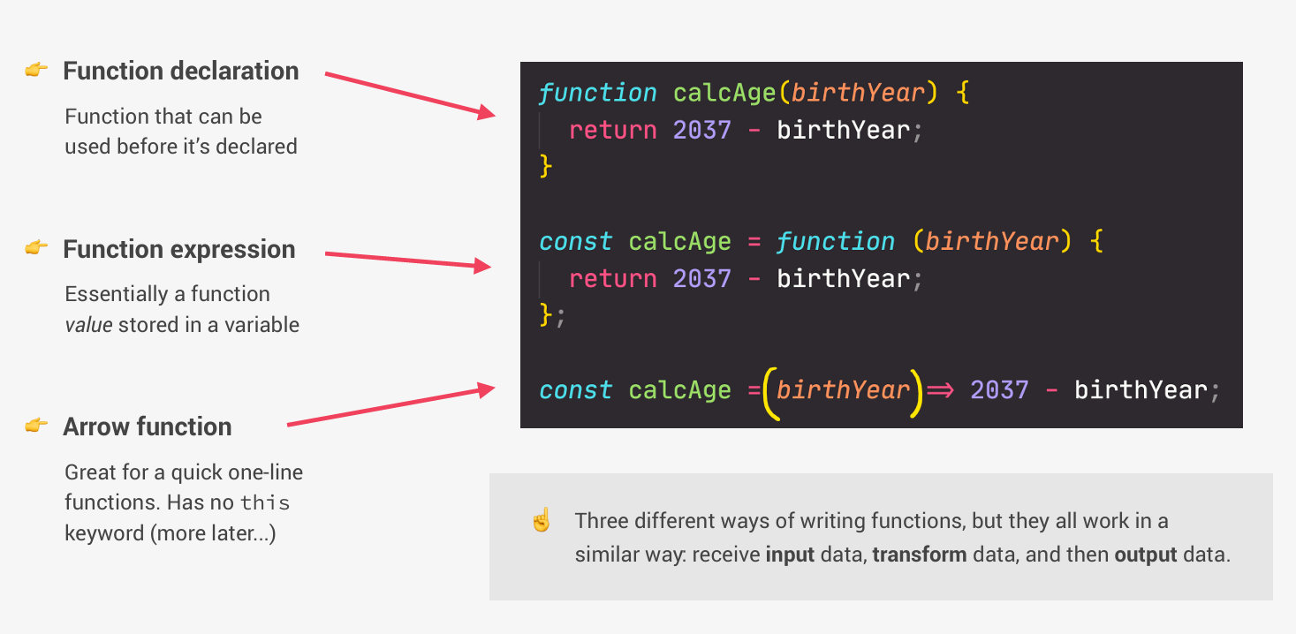

Slide 40
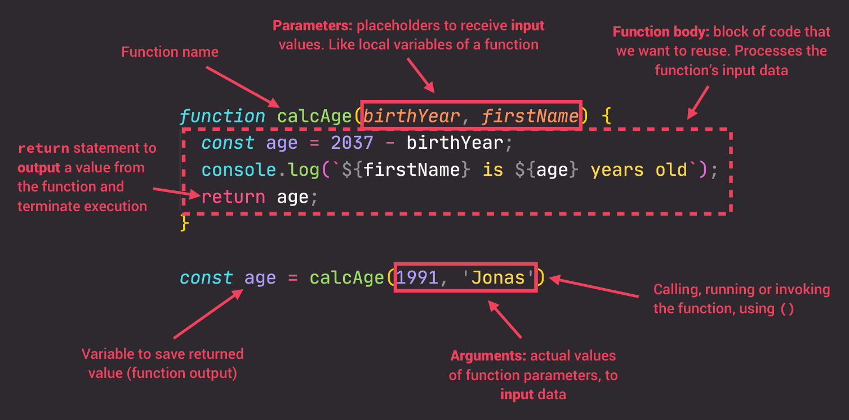

Slide 41
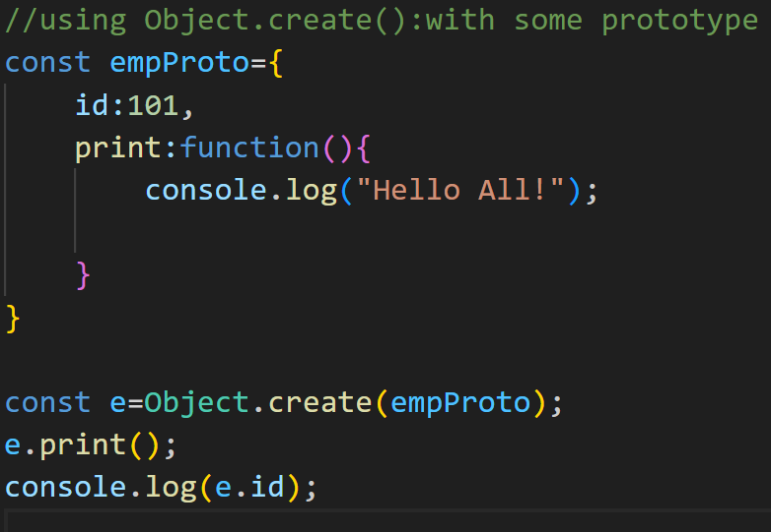
Object
Objects are collections of properties and methods.
Property: A key-value pair.
Method: A function that is a property of an object.
JavaScript object is a variable that can store multiple data in key-value pairs.
The syntax of JavaScript object is:
const objectName = {
key1: value1,
..,
keyN: valueN
};
// create person object
const person = {
name: "John",
age: 20
};console.log(person); // Output: { name: "John", age: 20 }

Slide 42
Constructor Functions
Constructor Functions: Special functions used to create and initialize objects.
new Keyword: Used to create a new instance of an object using a constructor.
Definition:
A constructor function is used to create and initialize objects.
Constructor functions are typically named with a capital letter

Slide 43
// Constructor Function
function Person(name, age) {
this.name = name;
this.age = age;
this.greet = function() {
console.log(`Hello, my name is ${this.name} and I'm ${this.age} years old.`);
};
}
let person1 = new Person("Alice", 30);
let person2 = new Person("Bob", 25);
person1.greet(); // "Hello, my name is Alice and I'm 30 years old."
person2.greet(); // "Hello, my name is Bob and I'm 25 years old."

Slide 44
This Keyword
Refers to the current object in which it is used.
In global context, this refers to the global object (window in browsers).
Inside methods, this refers to the object that owns the method.
In constructor functions, this refers to the newly created object.
function Car(brand, model) {
this.brand = brand;
this.model = model;
this.displayInfo = function() {
console.log(`Car: ${this.brand} ${this.model}`);
};
}
let myCar = new Car("Toyota", "Corolla");
myCar.displayInfo(); // "Car: Toyota Corolla"

Slide 45
OOP Principles
OOP Principles:Encapsulation: Bundling data (properties) and methods that operate on the data into a single unit (object).
Inheritance: A mechanism where one class can inherit the properties and methods from another class.
Polymorphism: The ability of different objects to respond to the same method in their own way.
Abstraction: Hiding the complex implementation details and showing only essential features to the user.

Slide 46
Encapsulation
Encapsulation refers to bundling data and methods that work on that data within a single unit.
It is achieved by using objects.
We can use closures or getter/setter methods to control access to object properties.

Slide 47
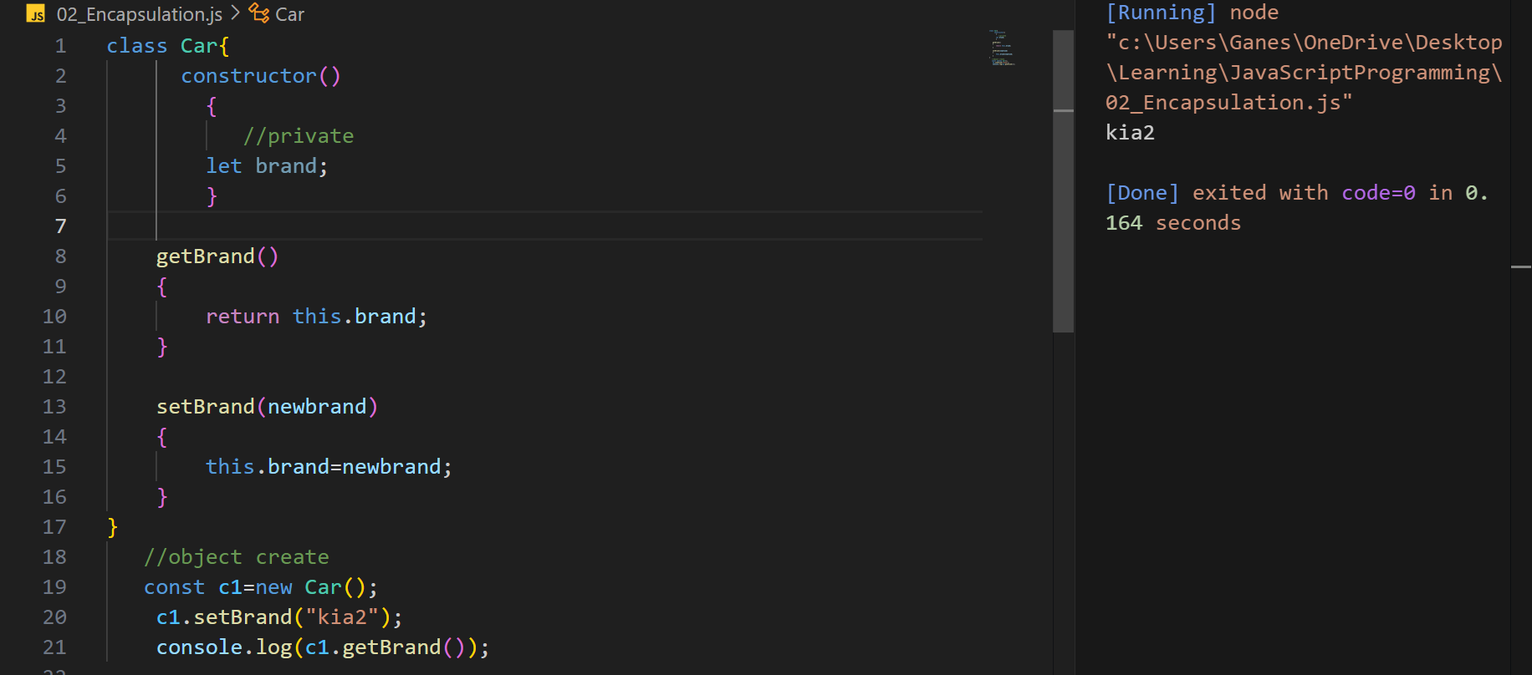

Slide 48
Polymorphism
Polymorphism allows different classes to have methods with the same name, but with different implementations.
Example of overriding methods in inheritance
JavaScript is interpreted programming language so decisions will be taking at run time not at compile time so method overloading is not supported
Method Overriding is possible

Slide 49
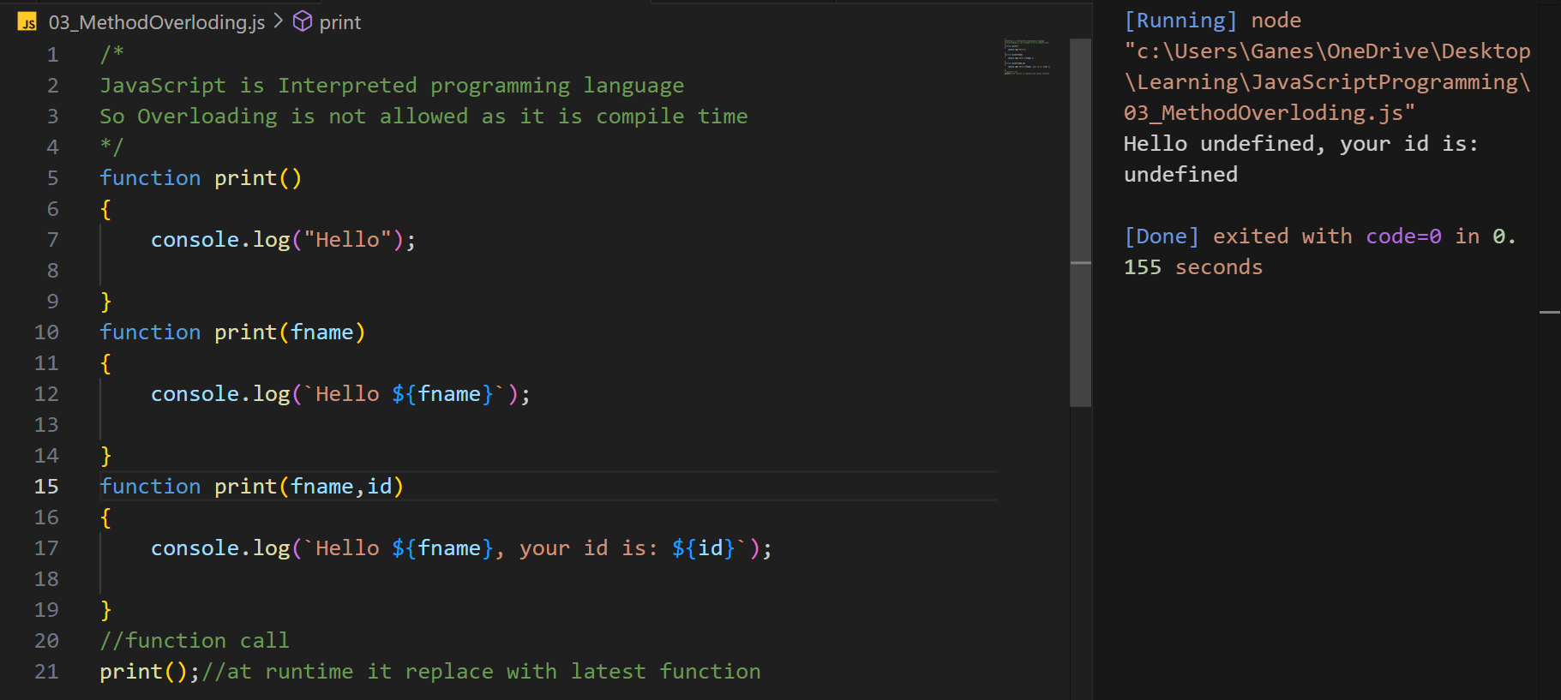

Slide 50
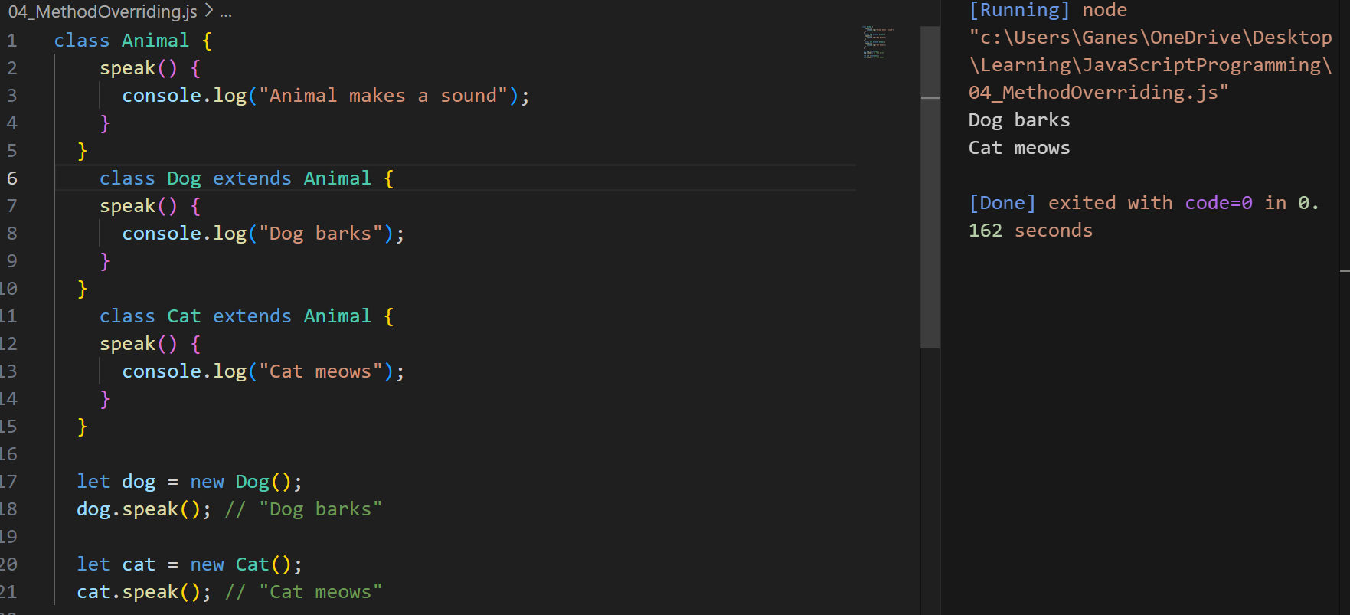

Slide 51
Inheritance
Inheritance allows one object (child) to inherit the properties and methods of another object (parent).
JavaScript uses prototype-based inheritance.
In programming, inheritance refers to passing down characteristics from a parent to a child so that a new piece of code can reuse and build upon the features of an existing one.
JavaScript implements inheritance by using objects.
Each object has an internal link to another object called its prototype. That prototype object has a prototype of its own, and so on until an object is reached with null as its prototype.
By definition, null has no prototype and acts as the final link in this prototype chain.
It is possible to mutate any member of the prototype chain or even swap out the prototype at runtime, so concepts like static dispatching do not exist in JavaScript.

Slide 52
Inheritance Types
Class A
Class A
Class D
Class A
Class B
Class C
Class B
Class C
Class B
Single level Inheritance
Multi-level Inheritance
Hierarchical Inheritance

Slide 53
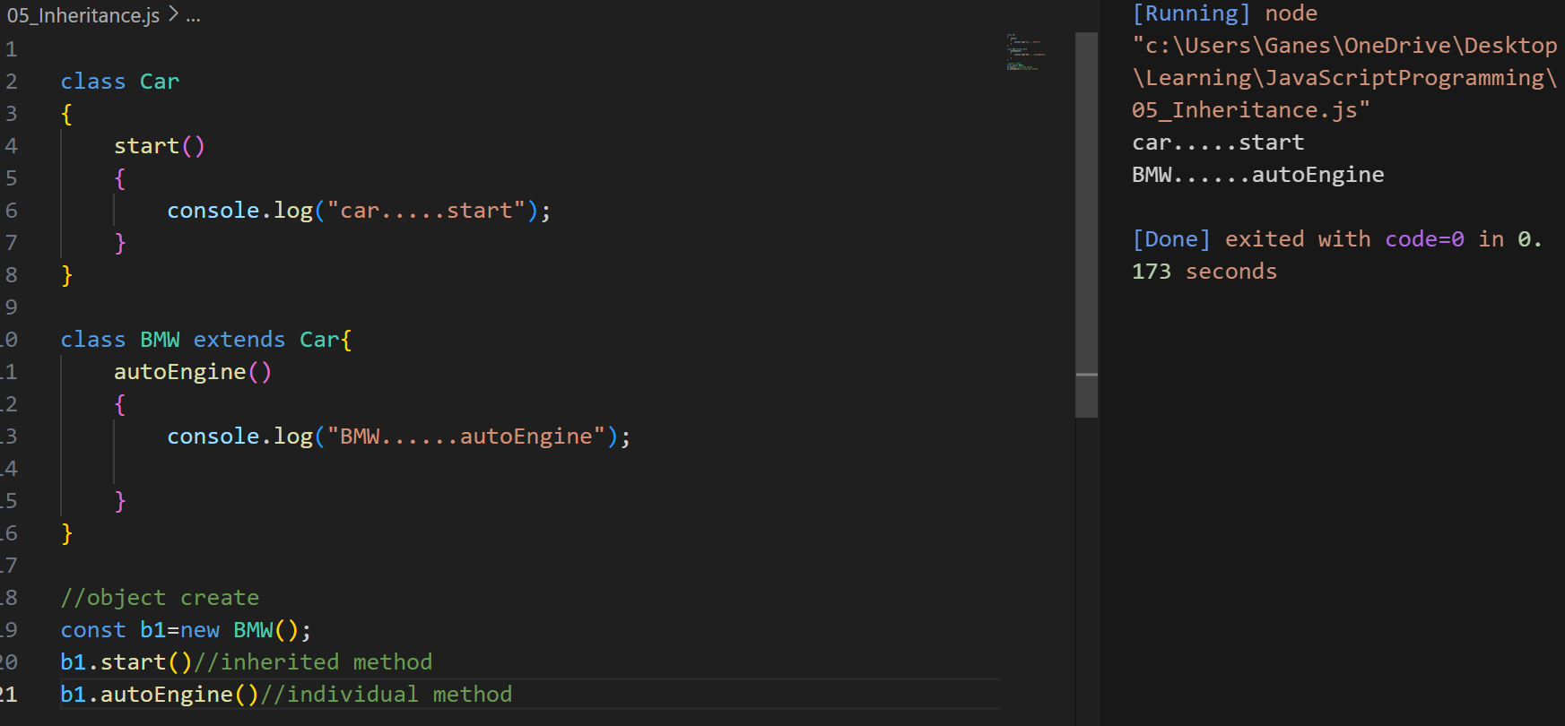

Slide 54
Prototypes
Every JavaScript object has a prototype. It is a reference to another object.
Prototypes allow inheritance and are a key part of object-oriented programming in JavaScript.
Prototype is an object that is associated with every function and object by default in javascript
Prototype is used to add new properties and methods to every function or object which is shared across all the instances.

Slide 55
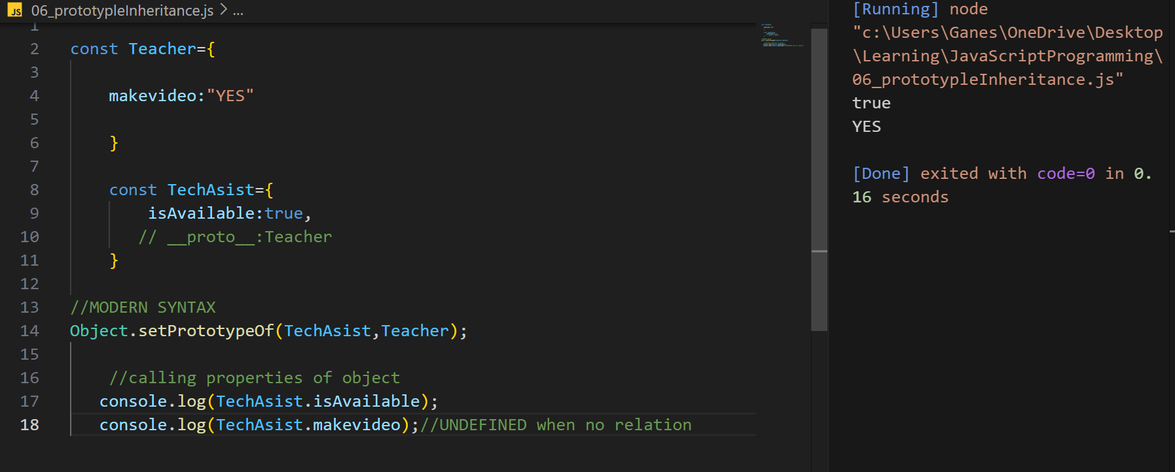

Slide 56
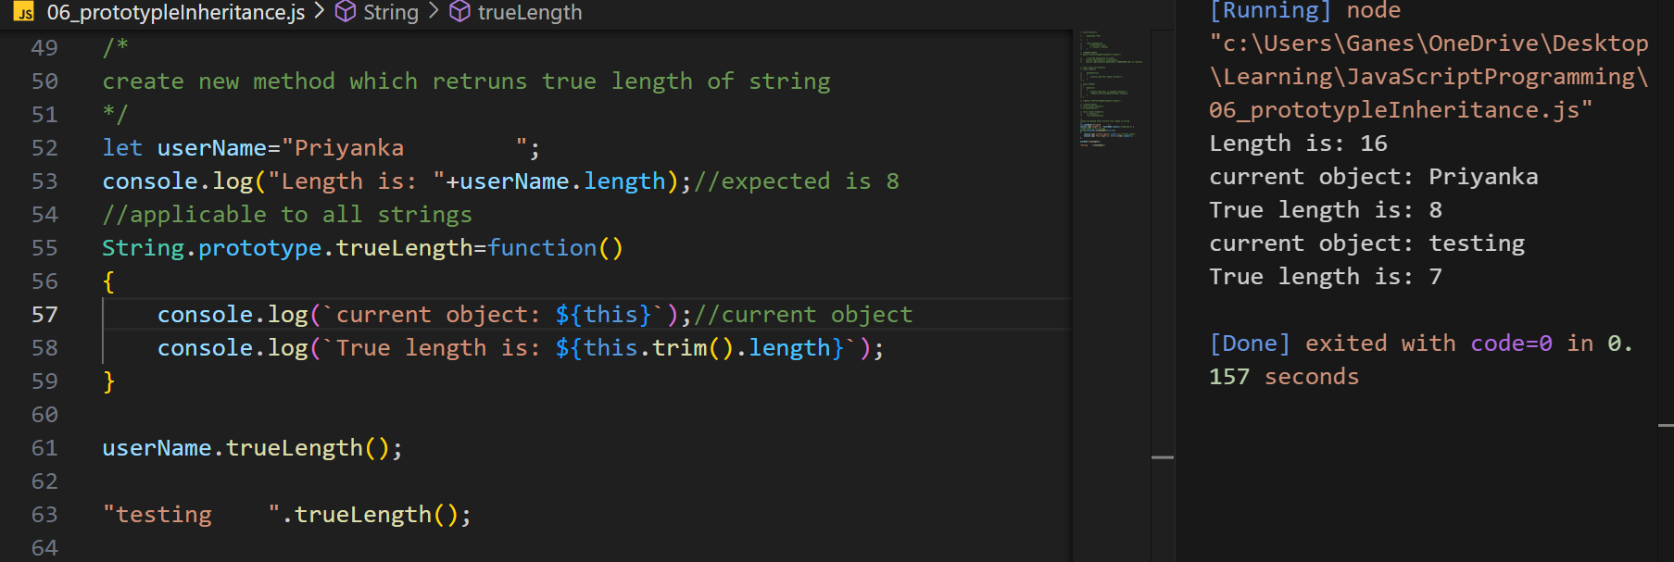

Slide 57
Converting JSON to JavaScript
A common use of JSON is to exchange data to/from a web server.
When receiving data from a web server, the data is always a string.
Parse the data with JSON.parse(), and the data becomes a JavaScript object.
The JSON.parse() static method parses a JSON string, constructing the JavaScript value or object described by the string.
const json = '{"result":true, "count":42}';
const obj = JSON.parse(json);
console.log(obj.count);
// Expected output: 42
console.log(obj.result);
// Expected output: true

