Slide 1
Cypress
-Priyanka Nigade

Slide 2
What is Cypress
Cypress is a robust JavaScript-based end-to-end testing framework designed to simplify and streamline web application testing.
It was built specifically for modern web development.
Cypress enables developers and testers to create and run tests directly within the browser, allowing real-time interaction with the application under test.
With its intuitive API, automatic waiting and retries, and seamless integrations with popular web technologies and frameworks, Cypress has become a popular choice for teams seeking to improve the efficiency and reliability of their testing processes.

Slide 3
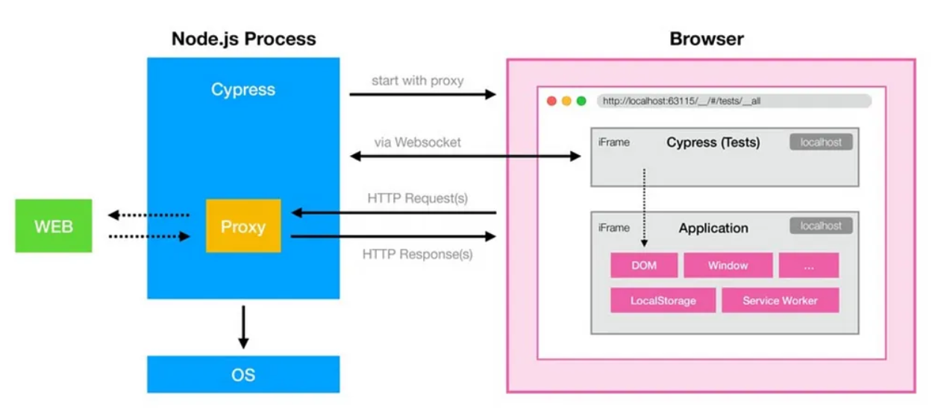
Cypress Architecture

Slide 4
Features
Automatic Waiting : Cypress has built in waits for different commands and assertion so no need to add sleep/wait in your test.
Architecture - Unlike other tools Cypress does not use Selenium in the backgroud and it runs within the browser.
Snapshots - Cypress takes screenshot as your test runs which can be great help if you want to see results after each steps (Before, After)
Debugging - Cypress run within the browser so you can directly debug the from devloper tools.
Screenshots and Videos- Cypress also takes screenshots and video for failure test when we execute from CLI.
Cross Browser Testing - Cypress test can be executed with Chrome, Firefox, Edge, Electron (Chrome-family browsers) locally.
Dashboard Service and Parallel Execution. Many more...

Slide 5
Limitations
Can not automate Mobile Native and windows based applications
Language and Framework Restrictions:
JavaScript/TypeScript Only: Cypress primarily supports JavaScript and TypeScript for writing test cases, limiting the flexibility for teams using other languages.
No XPath Locator Support: While Cypress supports CSS selectors, it doesn't offer native support for XPath locators, requiring the use of third-party plugins.
Limited iFrame Support: Automating scenarios that involve iFrames can be challenging in Cypress.

Slide 6
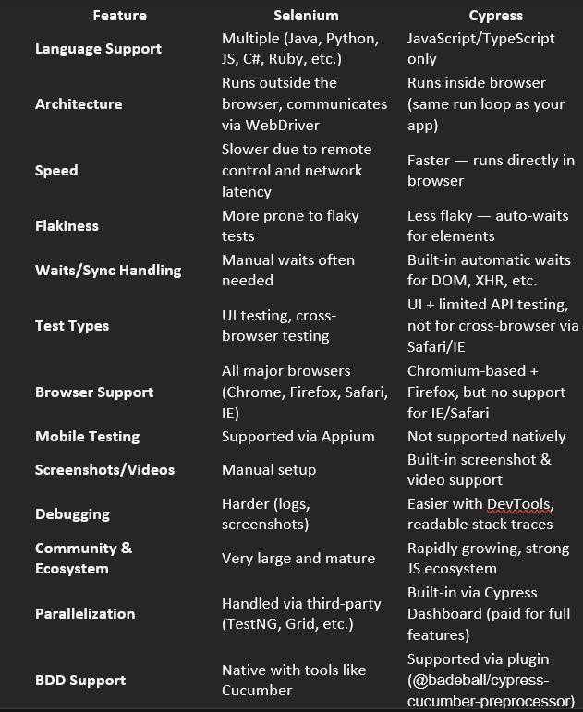


Slide 7
Environment SetUp
Download and Install node.js & Visual Studio Code
Create a new folder and open it in Visual Studio
Open Terminal and execute first command
npm init-y
This creates package.json file in project and stores information about project and its dependencies
Install Cypress as local dependency by command
npm install cypress - -save -dev
This command download latest version of cypress as a development dependency in your project & --save –dev flag ensures that dependency is saved in package.json file
To start cypress use command
npx cypress open

Slide 8
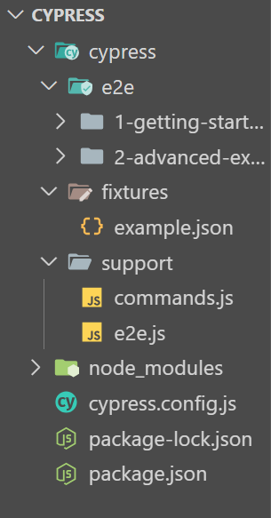
Folder Structure
cypress/: This folder contains all Cypress-related files, including tests, fixtures, and configuration.
fixtures/: This folder stores static data that users can use in their tests.
By default, Cypress includes an example JSON file (example.json) demonstrating how to use fixtures.
support/: This folder includes support files that will be executed before test files.
Depending on which testing type was selected (in our case, we are using both), Cypress automatically creates an example support file for each configured testing type, These files run before every single spec (test) file.
e2e/: This folder is the default location for storing end-to-end (E2E) tests.
Cypress will only look for E2E tests in the e2e/ folder by default.
However, you can configure Cypress to look for E2E tests by your custom path.
cypress.config.js: This is a default place for Cypress configuration where all the properties on which and how Cypress tests should behave will be set. Configurations can be customized according to the project's needs.
The default values of Cypress configurations can be found in the Settings folder of the Cypress Test Runner
Package.json The place where information about the project and its dependencies will be stored and package-lock.json: This file is automatically generated and updated by npm when installing packages. It locks the versions of the installed dependencies to ensure consistency across different installations of your project.

Slide 9
Mocha
Mocha is a testing library for Node.js.
Using Mocha we can quickly write unit test and End-to-End testcases
Mocha allows you to use any assertion library as per user choice.
Mocha is commonly used with Chai, a popular assertion library for Node.js and the browser.
Mocha also provides the hooks like before(), after(), beforeEach(), and afterEach().
We can use them as preconditions and postconditions after your tests depends on requirement

Slide 10
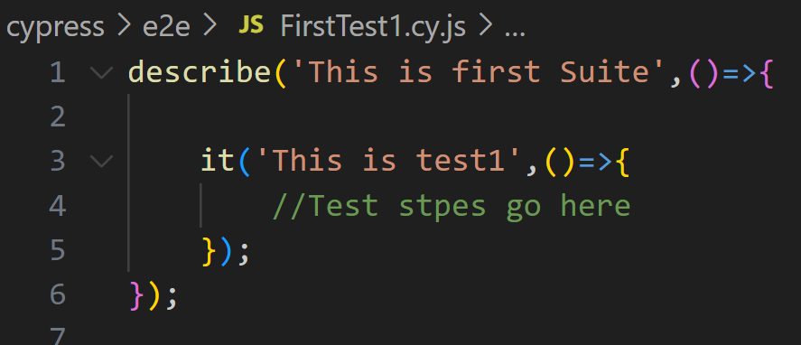
First Test Case
'describe': The describe() function that defines a test suites and we can also create nested test suites as well.
describe() takes two arguments: The name of the test group or test suite A callback function.
'it': The it() function that defines a test case.
it() takes two arguments: The name of the test case A callback function.

Slide 11
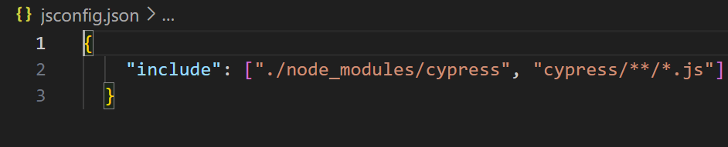
Note
For automatic cypress command support add triple slash directory in cy.js file
/// <reference types="Cypress" />
Ref: https://docs.cypress.io/app/tooling/IDE-integration
Reference type declarations via jsconfig
Instead of adding triple slash directives to each JavaScript spec file, some IDEs (like VS Code) understand a common jsconfig.json file in the root of the project.
{
"include": ["./node_modules/cypress", "cypress/**/*.js"]
}

Slide 12
it.only and it.skip:
These are special variants of the 'it' function.
it. only will ensure that only the specified test case will be run.
it.skip will exclude the specified test case from being run
These are very handy when debugging a failing test or having a test that we know will fail and don't want to run it

Slide 13
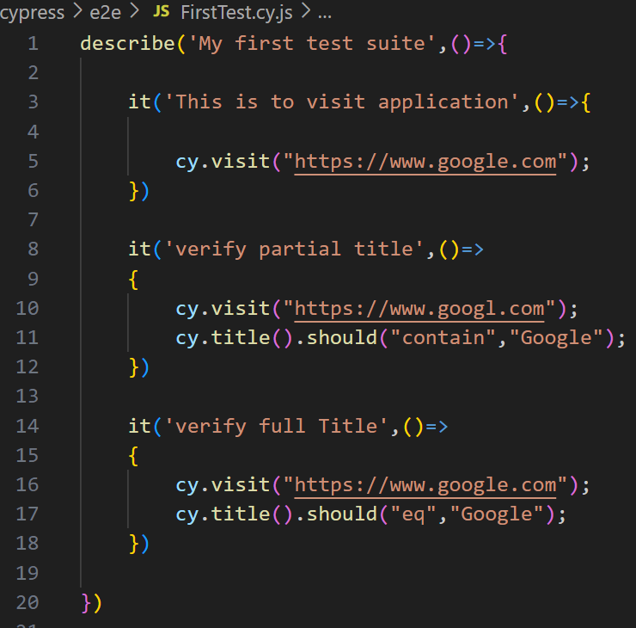
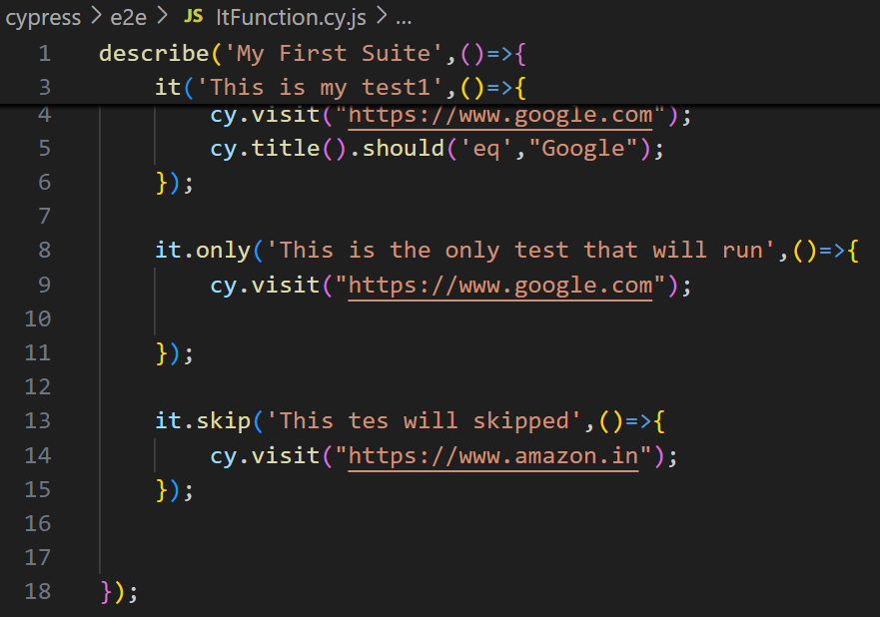
Test Case Examples

Slide 14
Run with Cypress Application/Runner
Using Cypress Runner(application)
npx cypress open
Using Terminal
By default test will run in headless mode & all test from e2e folder will run
npx cypress run
To run test in headed mode
npx cypress run --headed
To run specific test in headed mode
npx cypress run - -spec file relative path --headed
To run test on specific browser(By default test will run on Electron broswer)
npx cypress run - -spec file relative path - -headed - -browser chrome

Slide 15
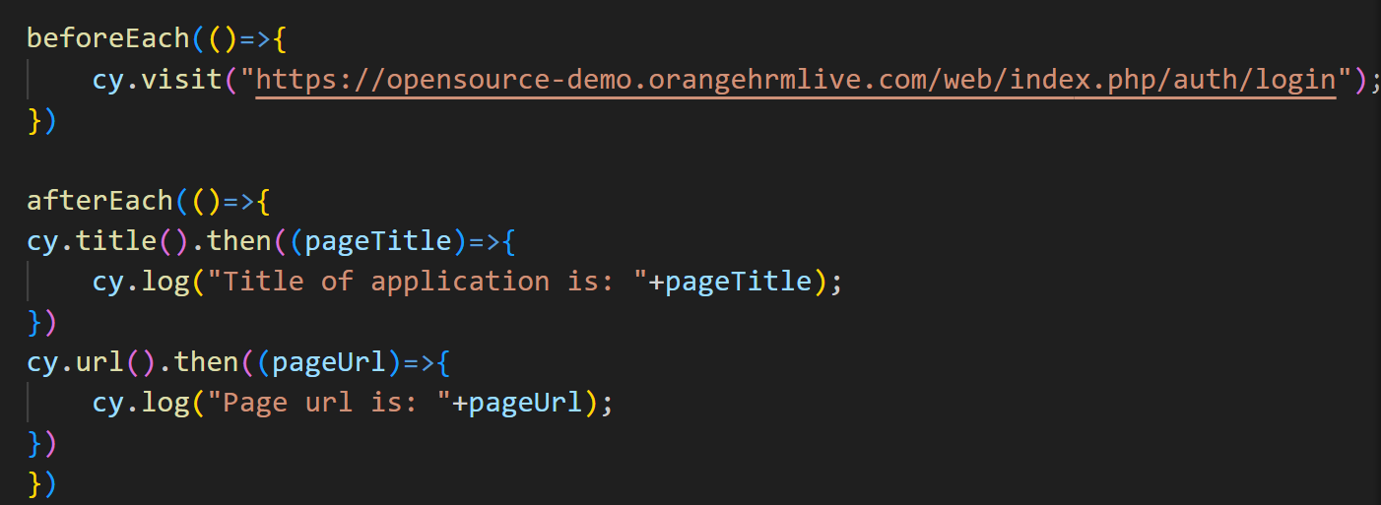
Hooks
Hook Runs When
before() Once before all tests in the block
after() Once after all tests in the block
beforeEach() Before each test in the block
afterEach() After each test in the block

Slide 16
Viewport
Cypress doesn’t support true minimize/maximize like a real browser window (because it runs inside a browser controlled by Electron or Chrome).
But you can simulate this behavior using cy.viewport()
Maximize browser: cy.viewport(1920, 1080) // Example of full HD screen
Minimize the browser: cy.viewport(100, 100) // Very small window size
What is cy.viewport()?
It sets the size of the browser's viewport in your tests.
Useful for testing responsiveness (e.g., mobile, tablet, desktop views).
Syntax: cy.viewport(width, height) or cy.viewport(preset)
Width & Height
cy.viewport(1280, 720) // Sets custom resolution
Presets
cy.viewport('iphone-6') // Uses predefined device size
cy.viewport('ipad-2', 'landscape') // Optional orientation

Slide 17
Navigation Commands
cy.visit()
This command is used to visit a URL. It can be an absolute or relative URL. The cy.visit() command will automatically prepend baseUrl (defined in the cypress.comfig.js configuration) to the relative URL.
cy.visit('http://example.com/login'); // Visits the login page
cy.url()
This command allows us to get the current URL of the application, which we can then use for assertions.
cy.url().should('include', '/login'); // Asserts that the current URL includes '/login’
cy.title()
Get the document.title property of the page that is currently active.
cy.title().should('eq', 'My Awesome Application’)//assert the current title

Slide 18
Navigation Commands
cy.reload()
This command is used to reload the current page.
cy.reload(); // Reloads the current page
cy.go()
This command is used to navigate the user's browsing history. It accepts eithes a string or a number. The string can be forward' or 'back. The number is the number of pages to go forward or back.
cy.go('back'); // Goes back one page in the browsing history cy-go(-1); // Goes back one page in the browsing history

Slide 19
Locators
Text
You can locate elements based on their text content:
<a>New User</a>
cy.contains(‘New User’).click();
Tag Name:
Target elements by their tag name:
cy.get('button’)
CssSelector(By default)
Xpath

Slide 20
CssSelector
Tagname with id
tagname#id
Tagname with attribute
tagname[attribute=‘value’]
Tagname with class
Tagname.class
Tagname with class and attribute
Tagname.class[attribute=‘value’]
Positioning:
Access elements based on their index
cy.get('li').eq(0) // First list item
Contains: tagname[attribute*=‘value’]
Startswith:
tagname[attribute ^=‘value’
Endswith:
tagname[attribute $=‘value’]
For child element:
> Or space
Eg: .social-btn > a
Indexing in css
.social-btn:nth-child(1)>a
.social-btn:nth-of-type(2)>a

Slide 21
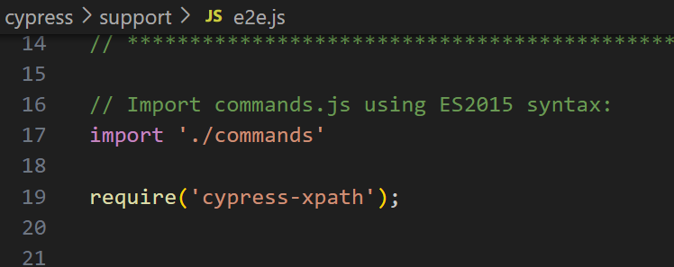
Xpath
Xpath stands for XML Path Language which employs a syntax resembling a “path” to locate and traverse nodes within an XML document.
There are two main types of Xpath
Absolute XPath and Relative Xpath.
Xpath no longer support in Cypress
Step1:Add plugin npm install -D cypress-xpath
Step2:Add cmd in Support file under e2e.js file
require('cypress-xpath');

Slide 22
Querying DOM Commands
cy.get()
This command is used to get one or more DOM elements by selector. We can use any selector that's valid in document.querySelector.
cy.get('.my-class'); // Gets elements with class 'my-class’
cy.contains()
This command is used to get a DOM element by its contents. It can accept a string, a regular expression, or a function that returns a string or a regular expression.
cy.contains('Submit'); // Gets elements that contain the text 'Submit’
.find()
This command is used to find a descendant DOM element by a selector.
cy.get('.articles').find('.title'); // Finds elements with class 'title' within elements with class 'articles'

Slide 23
Action Commands
.click(): This command is used to click a DOM element.
cy.get('button').click(); // Clicks a button element
.type(): This command is used to type into a DOM element.
cy.get('input').type('Hello, World'); // Types 'Hello, World' into an input element
.select(): This command is used to select an option in a select element.
cy.get('select').select('option'); // Selects 'option' in a select element

Slide 24
Action Commands
.selectFile(): This command selects a file in an HTML5 input element or simulates dragging a file into the browser.
cy.get('input[type=file]').selectFile('file.json")
.check(): This command is used to check checkboxes or radio inputs.
cy.get('input[type="checkbox"]').check(); // Checks a checkbox
.uncheck(): This command is used to uncheck checkboxes.
cy.get('input[type="checkbox"]').uncheck(); // Unchecks a checkbox
.clear(): This command is used to clear the value of an input or text area.
cy.get('input').clear(); // Clears an input element

Slide 25
Handling WebElements
Text Input
Text inputs are the most common form of data entry on web
In cypress you can simulate typing into a text input field using .type()
cy.get(‘input[name=‘username’]’).type(‘Priyanka’);
In cypress to clear the text .clear()
cy.get(‘input[name=‘username’]’).clear();
Cypress allows us to delay option, this slows down typing by a specific delay in milliseconds
cy.get(‘input[name=‘username’]’).type(“AutomationTesting,{delay:1000});

Slide 26
Handling WebElements
Clicking and Double clicking
Cypress provides .click() and .dbclick() commands
Cy.get(‘.my_button’).click();
Cy.get(‘.my_button’).dbclick();
Cypress provide .rightclick() command to simulate rightclick action
Cy.get(‘.context-menu’).rightclick();

Slide 27
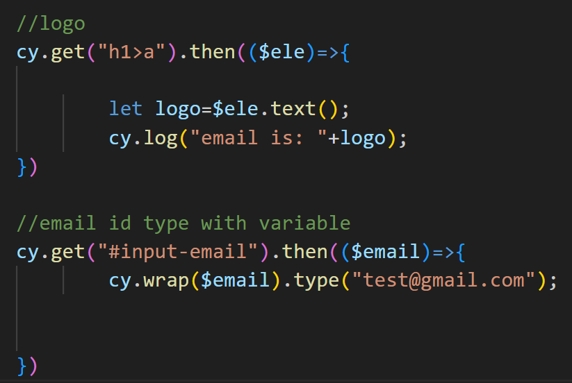
Store DOM Element Into Variables
In Cypress, if you want to store a DOM element into a variable and perform actions on it later, you should use .then() to access the resolved value of a Cypress command (like cy.get()).
Cypress commands are asynchronous and don’t return the actual element immediately, so you can’t store them directly in regular JavaScript variables.
Here’s how to correctly store an element and perform an action on it:
Correct approach using .then()
cy.get('selector').then(($el) => {
// $el is the jQuery-wrapped element
// You can perform actions or assertions here
$el.click(); // manually trigger click
});

Slide 28
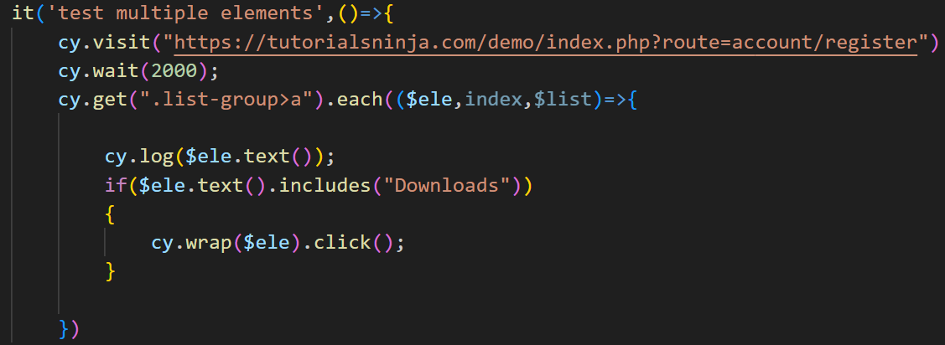
Iterate Over array of DOM Elements
.each
Iterate through an array like structure (arrays or objects with a length property).
Syntax: .each(callbackFn)
Iterate over an array of DOM elements
cy.get('ul>li').each(($el, index, $list) => {
// $el is a wrapped jQuery element
if ($el.someMethod() === 'something') {
// wrap this element so we can
// use cypress commands on it
cy.wrap($el).click()
}
})

Slide 29
Handling WebElements
Checking and Unchecking the checkbox
Cypress provide .check() and .uncheck() command
Cy.get(‘.my_checkbox’).check();
Cy.get(‘.my_checkbox’). uncheck();
Multiple checkbox also we can handle by passing array of values
Cy.get(‘.my_checkbox’).check([‘choice1’,’choice2’]);
Cy.get(‘.my_checkbox’).uncheck([‘choice1’,’choice2’]);
Cy.get(‘.my_checkbox’).first().click();
Cy.get(‘.my_checkbox’).last().click();
Cy.get(‘.my_checkbox’).eq(2).click(); //as per index we pass index value index=2 it click on 3rd option

Slide 30
Assertion Commands
.should()
This command is used to assert that the previous subject satisfies a particular state. It can be used with a function or a string argument.
cy.get('button').should('be.disabled'); // Asserts that a button is dis-abled
.and()
This command is like cy.should(), and it's used to chain multiple assertions together.
cy.get('button').should('be.visible').and('contain', 'Submit'); // As-serts that a button is visible and contains the text 'Submit'
expect()
This command asserts that a particular value meets a set of criteria.
cy.wrap(5).should((num) => {
expect(num).to.equal(5); // Asserts that num equals 5 });

Slide 31
Assertions
Chai assertion library is an external javascript library used to write assertions.
Cypress comes by default with Chai library so we don't need to download separately.
Chai support assert, expect ,should
cy.get('').should('be.visible')
cy.get('').should('not.be.visible')
cy.get('').should('be.enabled')
cy.get('').should('not.be.enabled')
cy.get('').should('be.disabled')
cy.get('').should('not.be.disabled')
cy.get('').should('be.checked')
cy.get('').should('not.be.checked')
cy.get('').should('have.class', 'disabled')
cy.get('').should('not.have.class', 'disabled’)
cy.get('').should('exist')
cy.get('').should('not.exist')
cy.get('').should("have.value","Hello")
cy.get('').should("not.have.value","Hello")
cy.get('').should("have.text","Hello")
cy.get('').should("not.have.text","Hello")
cy.get('').should('have.length', 3)
cy.get('').should('not.have.length', 3)
cy.get('').should('have.attr', "type"))

Slide 32
Page Load Vs Assertion command Timeout
🕒 pageLoadTimeout
What it controls: The max time Cypress waits for a page to load completely after a cy.visit() or cy.reload().
Default: 60000 ms (60 seconds)
Triggers on: When Cypress is waiting for the load event from the browser.
Example:cy.visit('/dashboard', { timeout: 90000 }) // wait up to 90s for page load
⌛ defaultCommandTimeout
What it controls: The max time Cypress waits for most commands to succeed — like cy.get(), cy.click(), etc.
Default: 4000 ms (4 seconds)
Used when: You're interacting with DOM elements or asserting their state.
Example:cy.get('.menu-item', { timeout: 10000 }) // wait up to 10s for element

Slide 33
Assertion Timeout
By default, Cypress will automatically retry assertions until they pass or until the command's timeout expires (the default is 4 seconds).
However, if our application has longer asynchronous behavior, we might need to use the 'timeout' option to increase this timeout
.cy.get('#my-element', { timeout: 10000)). should('contain', 'Hello World’);
This will make Cypress wait up to 10 seconds for the element to contain the 'Hello World' text.
In conclusion, assertions are a powerful tool in Cypress that allow us to validate the application's state and behavior. With a wide range of commands and styles at our disposal, we can write expressive, human-readable tests that ensure our application works as expected.

Slide 34
Dropdowns
Dropdowns or <select> elements are common in webform
Cypress simplifies interacting with these elements through its .select() command
Cy.get(‘select[name=‘country’]’).select(“India”);
Selection is possible with index,value and visible text
Index
Cy.get(‘select[name=‘country’]’).select(4);//starts with index 0
Value
Cy.get(‘select[name=‘country’]’).select(“value”);
Visible text
Cy.get(‘select[name=‘country’]’).select(“India”);

Slide 35
Dealing with Popups and alerts
Alerts are a simple way for a web application to provide information to the user or ask for confirmation.
Cypress automatically handle alerts by clicking on ok button
But for validation we can trigger the events using cy.on() command and perform certain validations
For Simple Alert with Ok button
cy.on(‘window:alert’,(alt)=>{
expect(alt).to().equal(‘expected alert message’)
});
For confirmation alert for Auto dismiss(cancel)
cy.on(‘window:confirm’,()=>false);

Slide 36
Prompt Window
For prompt window before opening alert we need to take control of that window and pass text.
Cy.window().then((win)=>{
Cy.stub(win,’prompt’).returns(‘text’);
});
Here cypress is stubbing the window ,Stubbing means you replace a real function or request with a fake one that returns controlled data.
This is useful for:
Isolating front-end tests from back-end
Simulating errors or delays

Slide 37
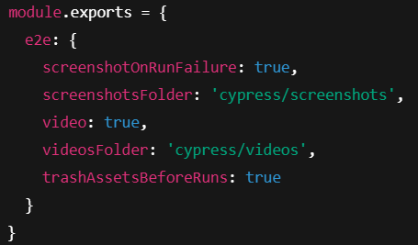
Screenshot and Video for Fail Test
In Cypress Screenshot and video for fail scenario automatically taken when we run test from CLI/terminal tool, screenshots will saved cypress/screenshots/ and videos will saved inside cypress/videos/
Manually take screenshot using cy.screenshot() it will capture full page screenshot
cy.get('#my-element').screenshot(); // Captures specific element
Custom name
cy.screenshot('login-page'); // Saves as login-page.png
Do configurations is cypress.config.js

Slide 38
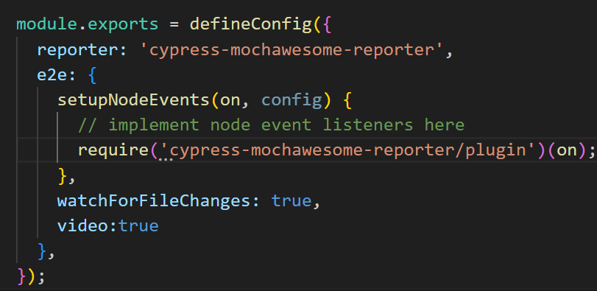
Cypress-mochawesome Report
cypress-mochawesome-reporter
Prerequisite is node version>=14
1.install cypress-mochawesome-reporter
npm i --save-dev cypress-mochawesome-reporter
2.Change cypress reporter & setup hooks
Edit config file (cypress.config.js by default)
3.Add to cypress/support/e2e.js
import 'cypress-mochawesome-reporter/register';
4.run test using CLI/terminal

