Slide 1

Playwright
-Priyanka Nigade

Slide 2
What is Playwright
Open-source end-to-end testing framework developed by Microsoft
Playwright supports all modern rendering engines including Chromium, WebKit, and Firefox.
Supports cross-browser testing (Chromium, Firefox, WebKit)
Enables automation of web applications using JavaScript, TypeScript, Python, Java, and C#.
Playwright Test was created specifically to accommodate the needs of end-to-end testing.
Test on Windows, Linux, and macOS, locally or on CI, headless or headed with native mobile emulation of Google Chrome for Android and Mobile Safari.

Slide 3
Key Feature
Cross-browser: Playwright supports all modern rendering engines including Chromium, WebKit, and Firefox.
Cross-platform: Test on Windows, Linux, and macOS, locally or on CI, headless or headed.
Cross-language: Use the Playwright API in TypeScript, JavaScript, Python, .NET, Java.
Test Mobile Web: Native mobile emulation of Google Chrome for Android and Mobile Safari. The same rendering engine works on your Desktop and in the Cloud.
Auto-wait: Playwright waits for elements to be actionable prior to performing actions. It also has a rich set of introspection events. The combination of the two eliminates the need for artificial timeouts - the primary cause of flaky tests.

Slide 4
Key Feature
Web-first assertions: Playwright assertions are created specifically for the dynamic web. Checks are automatically retried until the necessary conditions are met.
Tracing: Configure test retry strategy, capture execution trace, videos, screenshots to eliminate flakes.
Multiple everything:Test scenarios that span multiple tabs, multiple origins and multiple users. Create scenarios with different contexts for different users and run them against your server, all in one test.
Trusted events: Hover elements, interact with dynamic controls, produce trusted events. Playwright uses real browser input pipeline indistinguishable from the real user.
Test frames, pierce Shadow DOM: Playwright selectors pierce shadow DOM and allow entering frames seamlessly.

Slide 5
Powerful Tooling
Codegen: Generate tests by recording your actions. Save them into any language.
Playwright inspector: Inspect page, generate selectors, step through the test execution, see click points, explore execution logs.
Trace Viewer: Capture all the information to investigate the test failure. Playwright trace contains test execution screencast, live DOM snapshots, action explorer, test source, and many more.
Built-in Reports: Reporting on test results plays a crucial role in the QA process. Playwright comes with various default reporters, including List, Line, Dot, HTML, JSON, and JUnit. Additionally, the framework allows the creation of custom reports and supports integration with third-party reporters such as Allure, Monocart, Tesults, ReportPortal, Currents, and Serenity/JS.
Video and Screenshot Support: The framework provides the capability to use photos and video recordings of test results, enabling QA automation engineers to quickly identify issues through Playwright automation.
Test Retries: This feature automatically retries failed tests, which is especially useful for tests prone to occasional failures.
Parallel Test Execution: The tool supports parallel test execution by running multiple worker processes simultaneously. Moreover, Playwright can achieve even greater test parallelization by running tests on different machines.

Slide 6
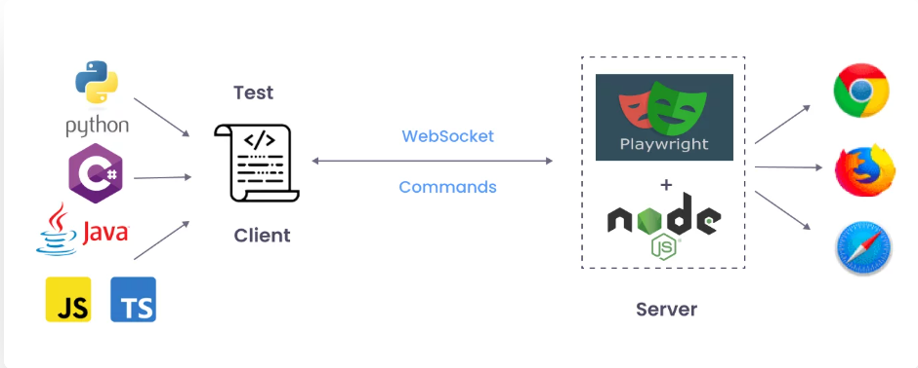
Playwright Architecture
Client:Playwright provides API bindings in various languages (JavaScript, Python, Java, etc.) that developers use to write test scripts.
Playwright Server:This server acts as an intermediary, translating the client's commands into browser-understandable instructions and manages browser instances. It's powered by Node.js.
WebSockets: Playwright utilizes WebSockets for efficient, bidirectional communication between the client and the server. WebSockets, unlike HTTP, allow for persistent, full-duplex communication, meaning the connection remains open throughout the test and allows for simultaneous sending of multiple messages.
Browsers:Playwright supports various browsers, including Chromium, Firefox, and Safari.

Slide 7
Selenium Vs Cypress Vs Playwright
Feature | Playwright | Selenium | Cypress
Browsers Supported | Chromium, WebKit (Safari), Firefox | Chrome, Firefox, Safari, Edge, IE, etc. | Chrome, Firefox, Edge
Programming Languages | Java, Python, JavaScript, .NET (C#) | Java, C#, Python, etc. | JavaScript, TypeScript
Operating Systems | Windows, macOS, Linux | Windows, macOS, Linux | Windows, macOS, Linux
Headless Mode | ✅ Yes | ✅ Yes | ✅ Yes
Cross-Browser Testing | ✅ Yes | ✅ Yes | ✅ Yes
Parallel Execution | ✅ Yes | ✅ Yes | ✅ Yes
Auto Waits | ✅ Yes | ❌ No | ✅ Yes
Multi-tab/Window Support | ✅ Yes | ✅ Yes | ❌ No
Real-Time Test Execution | ❌ No | ❌ No | ✅ Yes
Debugging Support | Built-in debuggers and DevTools integration | Uses browser developer tools | Built-in debuggers and DevTools
API Testing | ✅ Yes | ❌ No | ✅ Yes
Community Support | Growing community | Large community | Growing community
Testing Frameworks | Compatible with Jest, Mocha, etc. | Compatible with TestNG, JUnit, etc. | Uses Mocha
Performance | ⚡ High performance | 🚀 Good performance | ⚡ High performance

Slide 8
Installation
Download and Install node.js & Visual Studio Code
Create a new folder and open it in Visual Studio
Open Terminal and execute first command
Run the install command and select the following to get started:
npm init playwright@latest
Choose between TypeScript or JavaScript (default is TypeScript)
Name of your Tests folder (default is tests or e2e if you already have a tests folder in your project)
Add a GitHub Actions workflow to easily run tests on CI
Install Playwright browsers (default is true)
Note Using VsCode Extention Install Playwright
Add Plugin Playwright test for vscode
View → command palette → Test install playwright → ok

Slide 9
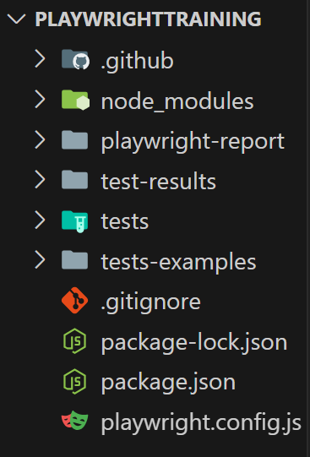
Folder Structure
e2e:The e2e (end-to-end) folder is dedicated to housing the end-to-end test files that you create using Playwright's testing framework. These tests simulate real user interactions with your application, covering scenarios that span multiple components and workflows.
tests: The tests folder is where you store your test files. These files might be named with a .spec.js extension to indicate that they are test specifications, This is where you write your Playwright tests, defining different scenarios and expected behaviours of your application.
test-examples: This folder might contain additional test files as needed
package-lock.json: This file is automatically generated and updated by npm when installing packages. It locks the versions of the installed dependencies to ensure consistency across different installations of your project.
package.json: This file holds your project's metadata, configuration settings, and a list of its dependencies. You define scripts, project name, version, author, and other essential information here. You also manage your project's dependencies by listing them here, so others can install them easily using npm or yarn.
playwright.config.js: The playwright.config.js file is a configuration file specific to Playwright. It allows you to set up various options and settings for your Playwright tests. This includes configuring different browser environments, specifying test environment variables, setting up custom browser contexts, and more. This file helps tailor Playwright's behavior to your project's requirements.

Slide 10
Fixture
Fixtures in Playwright gives the specific environment in which the test will be performed.
This offers the test what it needs and nothing else.
With fixtures, you can group tests based on their meaning, instead of their common setup.
1.Page
2.Request
3.Browser
4.Browser Name Context

Slide 11
Fixture
Page Fixture
This fixture is an isolated page instance created for every test
test(‘Basic Test', async ({ page }) => {
});
Request Fixture
This fixture is an isolated API Request context instance for each test
test(‘Basic Test', async ({ request }) => {
});

Slide 12
Fixture
Browser Fixture
Browsers instances are shared across all the tests to optimize resources.
test(‘Window Handle', async ({ browser }) => {
});
Browser Name Context
Name of the browser that runs test
test(‘skip this test in Firefox', async ({ page,browserName }) => {
test.skip(browserName==‘firefox’);
});

Slide 13
Asynchronous Nature
JavaScript is asynchronous programming language.
Executes all statements parallelly.
When Javascript asynchronous nature align with browser task which often needs waiting for the elements to load ,making request and handling callbacks.
Playwright API having utilize async/await syntax making it easier to write clean & readable code for handling asynchronous operations.

Slide 14
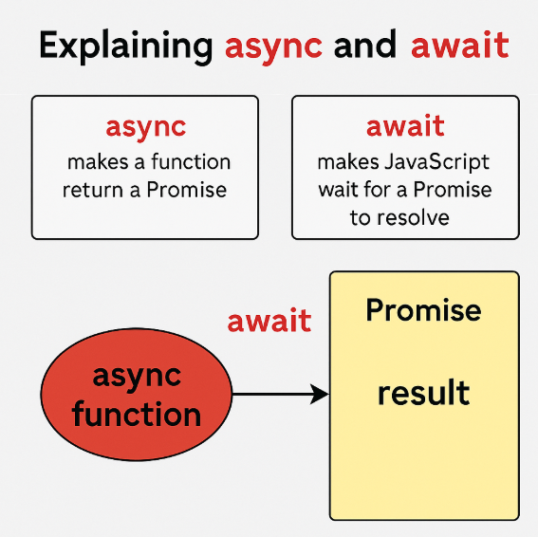
Asynchronous Nature
What is a Promise?
A Promise is something that will give you a value later — it may succeed (resolve) or fail (reject).
What is async?
Add async before a function to say:
"This function will return a promise."
What is await?
Inside an async function, use await to wait for a promise to finish before moving to the next line.

Slide 15
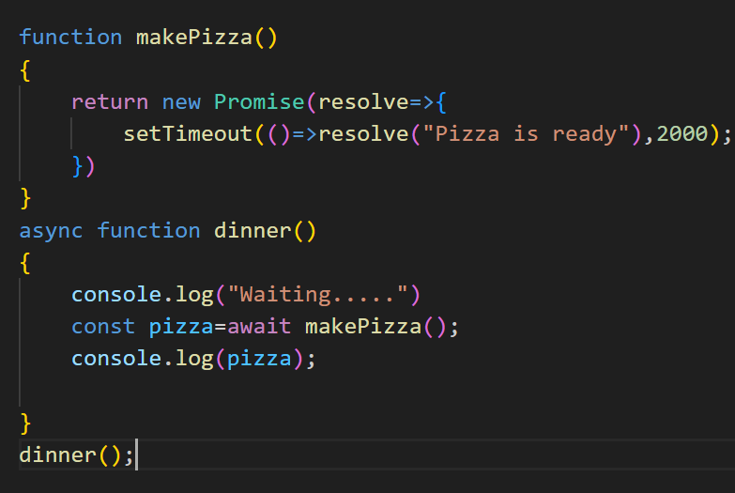
Asynchronous Nature Analogy
Imagine you order pizza. While it’s being made, you don’t stand still
— you might watch TV or do something else. Once the pizza is ready, you eat it.
In code:
Pizza order = Promise
Waiting for pizza = await
You = JavaScript (can do other things until pizza is ready)

Slide 16
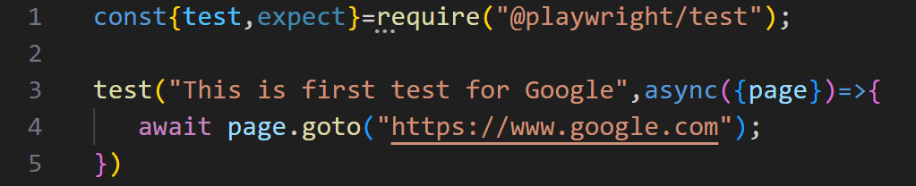
First Spec File
Line 1: require() is node inbuild function help you to import specific module
This line import the test & expect functions from the @playwright/test library.
These functions are use to write and run the playwright tests
Line 3: In this line code begins with a test() using test keyword
Test () function accept two arguments
1.Description of test
2.Asynchronous call back function that receive object with page property
Line 4: Page.goto() method navigates the browser to the provided URL

Slide 17
Execute Test
Runs the end-to-end tests
npx playwright test
Starts the interactive UI mode.
npx playwright test –ui
Runs the tests in a specific file.
npx playwright test example.spec.js
Run test in headed mode
npx playwright test example.spec.js --headed

Slide 18
Execute Test
Runs the tests only on Desktop Chrome.
npx playwright test --project=chromium
Runs the tests in debug mode.
npx playwright test --debug
Auto generate tests with Codegen.
npx playwright codegen

Slide 19
Navigation Methods
Page.goto(): await page.goto(url);
Navigate the browser to provided URL
Page.reload(): await page.reload();
This method reloads the current page, in the same way as if the user had triggered a browser refresh.
Page.goForward(): await page.goForward();
Navigates to the next page in the browser history.
Page.goBack(): await page.goBack();
Navigates to the previous page in the browser history.

Slide 20
Playwright Methods
Page.waitForNavigation(): page.waitForNavigation()
Waits for the page to navigate. Typically used after an action like a click or form submission.
Page.url(): await page.url());
Returns the current URL of the page.
Page.title(): await page.title();
The page.title() method in Playwright is used to retrieve the title of the current web page.

Slide 21
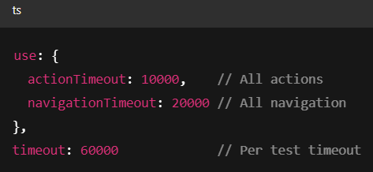
⏱️ Default Timeouts in Playwright
Scenario | Default Timeout
Actions (click, fill, etc.) | 30 seconds (30,000 ms)
Assertions (expect) | 5 seconds (5,000 ms)
Navigation (page.goto) | 30 seconds
Overall test timeout | 30 seconds per test
Overall Per Test Maximum timeout is 60sec
1. For Actions
await page.click('#submit', { timeout: 10000 }); // waits up to 10s
2. For Assertions
await expect(page.locator('#msg')).toHaveText('Success', { timeout: 7000 });
3. For Navigation
await page.goto('https://example.com', { timeout: 20000 });
4. Global Timeout Configuration
You can configure globally in playwright.config.js:

Slide 22
Locators
XPath: XPath is a language used to navigate Extensible Markup Language (XML) documents and is commonly used to locate elements in web pages
CSS: CSS selector is another approach frequently used to find components on a website. They are particularly beneficial when choosing items based on their styles and characteristics.
ID locators: ID locators are used to locate elements by their unique HTML ID attribute. This method is efficient because IDs should be unique within a web page.
Name locators: Name locators locate elements by their name attribute, which is not necessarily unique but can be useful for finding elements within forms.
Class name locators: Class name locators locate elements based on their HTML class attribute. This is useful for selecting multiple elements with the same class.
Link text and partial link text: These locators are specific to locating anchor (a) elements in web pages. You can locate links based on their visible text.
Tag name locators: Tag name locators locate elements based on their HTML tag name, such as div, input, button, etc.

Slide 23
Built-In Locators
page.getByRole(): Used to locate elements by explicit and implicit accessibility attributes.
page.getByText(): Used to locate elements by text content.
page.getByLabel(): Used to locate form controls by associated label text.
page.getByPlaceholder (): Used to locate inputs by their placeholder attribute
page.getByAltText(): Used to locate elements, typically images, by their text alternative.
page.getByTitle(): Used to locate elements by their title attribute.
page.getByTestId(): Used to locate elements based on their data-testid attribute (other attributes can be configured).

Slide 24
Built-In Locators
Locator | When to Use | Example Use
getByRole() | For semantic, accessible elements (buttons, links, inputs) | page.getByRole('button', { name: 'Login' })
getByLabel() | For inputs linked to <label> tags | page.getByLabel('Username')
getByPlaceholder() | For fields with a placeholder attribute | page.getByPlaceholder('Enter password')
getByText() | For elements with visible text (any tag) | page.getByText('Sign Out')
getByTitle() | For elements with a title attribute | page.getByTitle('Help')
getByAltText() | For <img> or elements with alt="..." | page.getByAltText('Product Image')
getByTestId() | For custom test IDs (data-testid, etc.) | page.getByTestId('login-button')

Slide 25
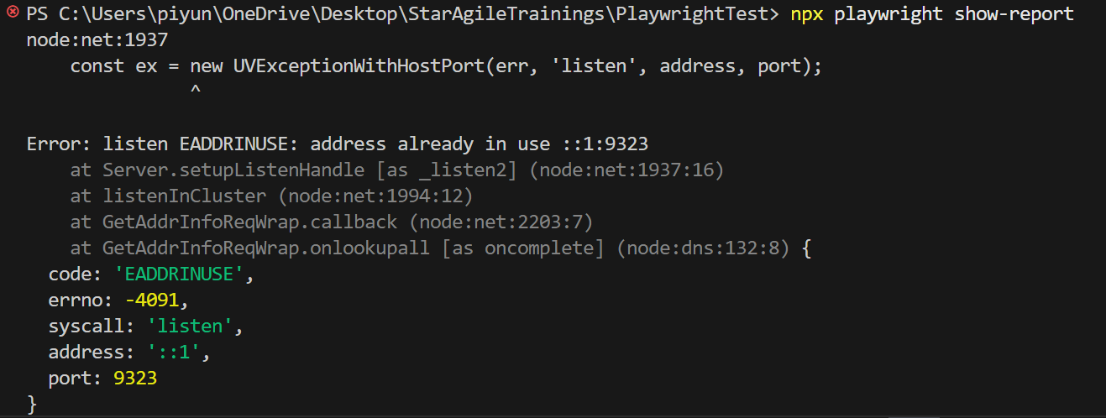
If Error-Solution
Kill the Process Using Port 9323
On Windows, you can find and kill the process using that port:
Find the PID:
netstat -aon | findstr :9323
Look for the line that ends in LISTENING and note the PID.
Kill the Process:
taskkill /PID <pid_number> /F
Replace <pid_number> with the one you found.

Slide 26
Run Test Using Codegen
Playwright comes with the ability to generate tests out of the box and is a great way to quickly get started with testing.
It will open two windows, a browser window where you interact with the website you wish to test and the Playwright Inspector window where you can record your tests, copy the tests, clear your tests as well as change the language of your tests.
https://playwright.dev/docs/codegen
To run test with Codegen
npx playwright codegen
To check all supportable options
npx playwright codegen --help

Slide 27
Codegen Options
To Record script directly in file
npx playwright codegen –o tests/MyTest.spec.js
To Record script in different language
npx playwright codegen - - target javascript
To Record script on specific browser
npx playwright codegen –b chromium |webkit|firefox
To Record script on different device
npx playwright codegen - - device “iphone 13”
To check list of device options write wrong command
npx playwright codegen - - device “iphone12”

Slide 28
Hard Assertions
https://playwright.dev/docs/test-assertions
Playwright includes test assertions in the form of expect function.
Page Has url
await expect(page).toHaveUrl();
Negative validation on url
await expect(page).not.toHaveUrl();
Page Has title
await expect(page).toHaveTitle();
Negative validation on title
await expect(page).not.toHaveUrl();

Slide 29
Hard Assertions
To check element visibility
await expect(locator).toBeVisible();
To check element is enabled
await expect(locator).toBeEnabled();
To check element is disabled
await expect(locator).toBeDisabled();
To check radiobutton/checkbox is checked
await expect(locator).toBeChecked();
To check element matches text
await expect(locator).toHaveText();
To check element contains text
await expect(locator).toContainText();
To check element have value
await expect(locator).toHaveValue();
To check list of element length
await expect(locator).toHaveCount();

Slide 30
Soft Assertions
By default, failed hard assertion will terminate test execution. Playwright also supports soft assertions when soft assertions fail it do not terminate test execution, but mark the test as failed.
await expect.soft(page).toHaveTitle('xyz');
await expect.soft(page).toHaveUrl('xyz');
await expect.soft(locator).toHaveText('Success');
await expect.soft(locator).toHaveText('Test');

Slide 31
Handling Web Elements
https://playwright.dev/docs/actionability#introduction
Fill():Set a value to the input field.
await page.getByRole('textbox').fill('example value');
Clear():Clear the input field.
await page.getByRole('textbox').clear();
Click():Click an element.
await page.getByRole('button').click();
Check():Ensure that checkbox or radio element is checked.
await page.getByRole('checkbox').check();
Uncheck():Ensure that checkbox or radio element is unchecked.
await page.getByRole('checkbox').uncheck();

Slide 32
Handling Multiple Web Elements
Handling Elements with locator.all()
If you need to get an array of web elements (as opposed to interacting with them one-by-one), you can use locator.all().
Selecting a Specific Element from a List
If you need to select a specific element from a list based on dynamic content, you can use the nth() method on the locator.
In Playwright, the $$ (double dollar sign) is a shorthand function that you can use to query multiple elements on the page, just like document.querySelectorAll() in vanilla JavaScript. It returns an array of elements that match the selector.
$$: A shorthand for querying multiple elements. It's essentially querySelectorAll in Playwright but more convenient when working directly with the Playwright API.
locator: The recommended way in Playwright for querying elements, as it provides more flexibility and supports Playwright-specific actions like waiting for elements, clicking, etc.
While $$ is fine for basic usage, locator is generally more robust for handling dynamic elements and more complex test interactions.

Slide 33
Dropdown
To select an option in a <select> dropdown, you can use the selectOption() method. You can pass either the value, label, visible text or index of the option you want to select.
Select by label
await page.locator('#country').selectOption({label: 'India’})
Select By visible text
await page.locator('#country').selectOption('India')
Select by Value
await page.locator('#country').selectOption({value: 'uk'})
Select by index
await page.locator('#country').selectOption({index: 3})

Slide 34
Alert Dialog
https://playwright.dev/docs/dialogs
Playwright runs your tests headlessly (without a UI), or in an automated browser.
When a JavaScript alert appears:
You won’t see it , The script waits for you to handle it , If unhandled, the test will fail.
By listening for the dialog event and responding (accept() or dismiss()), you allow your test to keep running smoothly.
page.on('dialog', async dialog => {
console.log('Dialog message:', dialog.message());
await dialog.accept(); // or dialog.dismiss()
});

Slide 35
Alert Dialog
The callback receives a dialog object, which gives access to:
dialog.message() → the text in the alert.
dialog.type() → the type (alert, confirm, prompt, etc.).
dialog.accept([input]) → accepts it (with optional text input).
dialog.dismiss() → dismisses it (like pressing "Cancel").
Prints the dialog message
console.log('Dialog message:', dialog.message());
To accept alert
await dialog.accept();
To prompt alert
await dialog.accept('My input');
To cancel alert
await dialog.dismiss();

Slide 36
File Upload In Playwright
setInputFiles()
Upload file or multiple files into <input type=file>.
For inputs with a [webkitdirectory] attribute, only a single directory path is supported.
Select one file
await page.getByLabel('Uploadfile').setInputFiles(relative path'myfile.pdf'));
Select multiple files
await page.getByLabel('Upload files').setInputFiles(['file1.txt’, 'file2.txt’]);

Slide 37
Hooks
Playwright provides hooks to manage setup and teardown logic for your tests.
These hooks are part of the @playwright/test test runner and are very similar to those in testing frameworks like Jest or Mocha.
Use test.beforeEach(async()=>{})
Hook | Runs
beforeAll | Once before all tests in a describe block
afterAll | Once after all tests in a describe block
beforeEach | Before each test in the file or group
afterEach | After each test in the file or group

Slide 38
Grouping Test
To run groups in playwright we use describe block
Feature | Syntax
Group tests | test.describe('group', () => {})
Skip a group | test.describe.skip()
Run only a group | test.describe.only()

Slide 39
Screenshots
https://playwright.dev/docs/screenshots
Here is a quick way to capture a screenshot and save it into a file:
await page.screenshot({ path: 'screenshot.png' });
await page.screenshot({path: "tests/Screenshots/“+Date.now()+“filename.png"});
Screenshots API accepts many parameters for image format, clip area, quality, etc.
Full page screenshots
Full page screenshot is a screenshot of a full scrollable page, as if you had a very tall screen and the page could fit it entirely.
await page.screenshot({ path: 'screenshot.png', fullPage: true });
Element screenshot
Sometimes it is useful to take a screenshot of a single element.
await page.locator('.header').screenshot({ path: 'screenshot.png' });

Slide 40

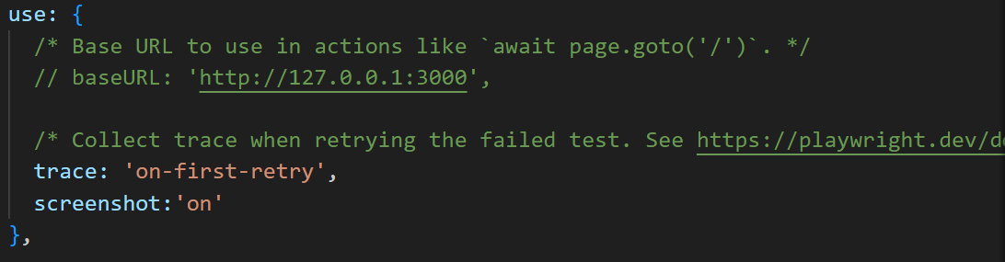
Note
To capture screenshot for every test by default do the configuration in playwright.config.js file and screenshot will be store in test-result folder and attached in report also.

Slide 41
Video
https://playwright.dev/docs/videos
Playwright Test can record videos for your tests, controlled by the video option in your Playwright config.
By default videos are off.
'off' - Do not record video.
'on' - Record video for each test.
'retain-on-failure' - Record video for each test, but remove all videos from successful test runs.
'on-first-retry' - Record video only when retrying a test for the first time.
Video files will appear in the test output directory, typically test-results.

Slide 42
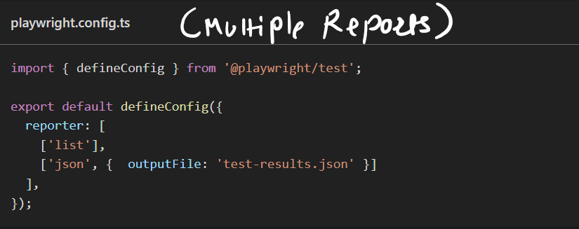
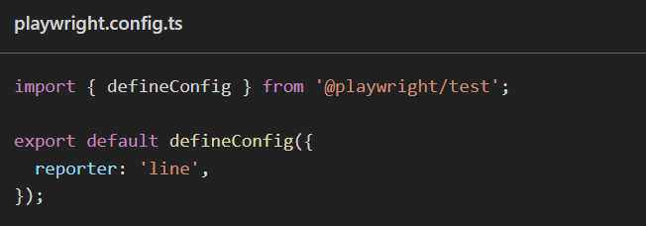
Reporters
https://playwright.dev/docs/test-reporters
Playwright Test comes with a few built-in reporters for different needs and ability to provide custom reporters.
The easiest way to try out built-in reporters is to pass --reporter command line option.
npx playwright test --reporter=line

