Slide 1
DVD Rental Business Analysis
Priyanka Pawar
Power BI

Slide 2
Project Objective The goal of this project is to analyze the DVD rental business using the Sakila dataset and create an interactive Power BI dashboard.
Objectives
• Analyze revenue trends • Understand customer rental behavior • Identify top performing films • Evaluate store and staff performance • Generate business insights

Slide 3
Dataset Overview
Sakila DVD Rental Database
The dataset represents the operations of a DVD rental business including customers, films, rentals, payments, stores, and staff.
Key Tables
Customer – customer details
Film – film information
Rental – rental transactions
Payment – payment details
Inventory – film inventory in stores
Store – store information
Staff – employee information

Slide 4
Data Cleaning & Preparation
Data Cleaning Steps
• Checked for missing values • Verified primary keys for duplicates • Converted date columns into correct format • Created additional columns for analysis • Validated relationships between tables
Example
• Created YearMonth column to analyze monthly trends.

Slide 5
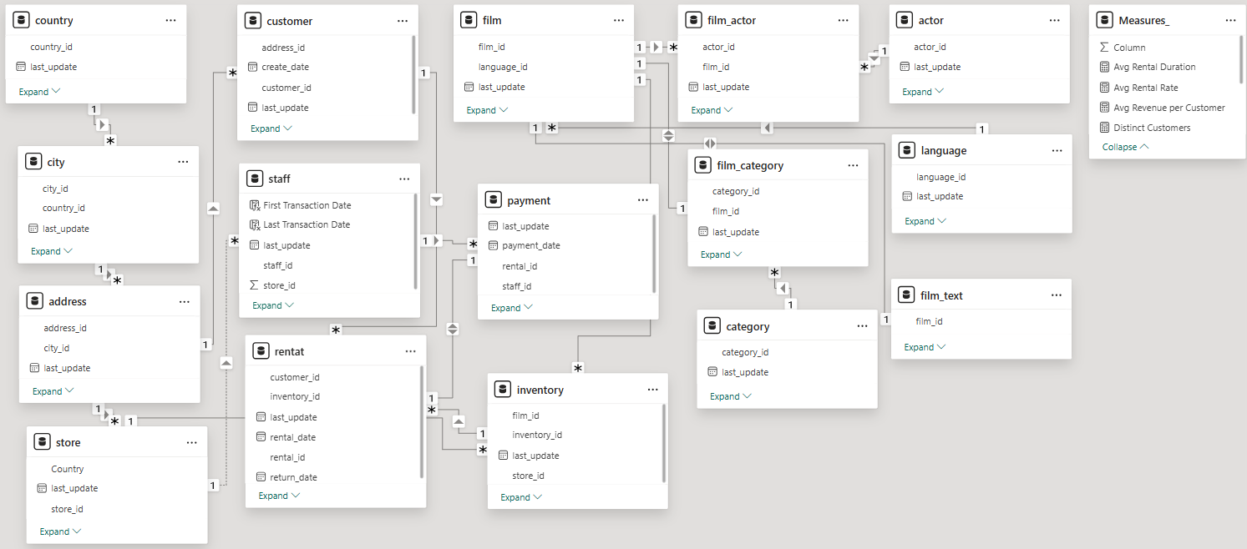
Data Model
Key Relationships
• Payment → Rental
• Rental → Customer
• Inventory → Film
• Staff → Store
These relationships allow Power BI to combine data from different tables for accurate analysis.

Slide 6




Key Business KPIs
These KPIs provide a quick overview of business performance and help track overall growth and efficiency.

Slide 7
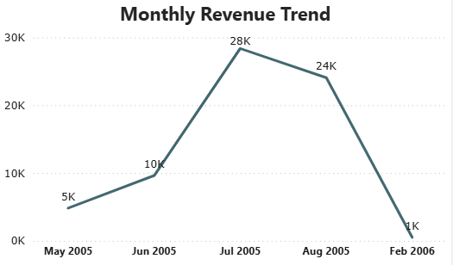
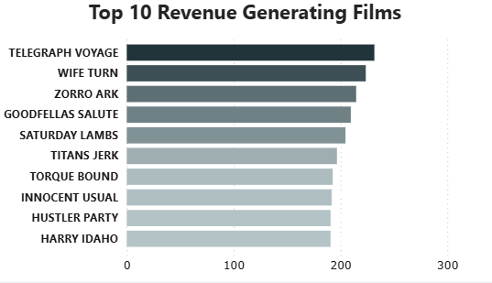
Sales Analysis
Revenue varies across months indicating demand patterns.
A few films generate higher revenue than others.

Slide 8
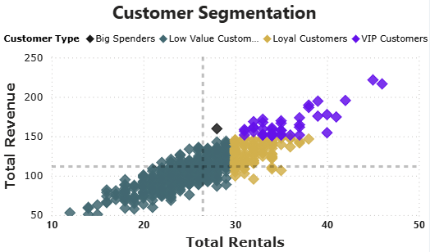
Customer Analysis
Customers are segmented based on rental frequency and revenue
A small group of customers generates higher revenue and rentals, indicating strong customer segmentation.

Slide 9
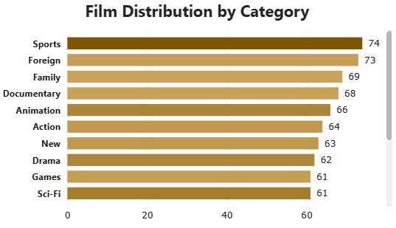
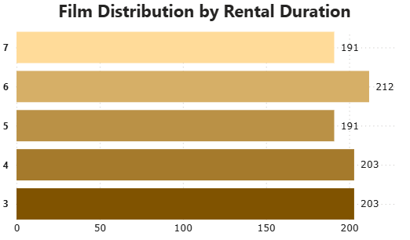
Film & Inventory Analysis
Films are evenly distributed across categories.
Most rentals fall within a standard duration range..

Slide 10
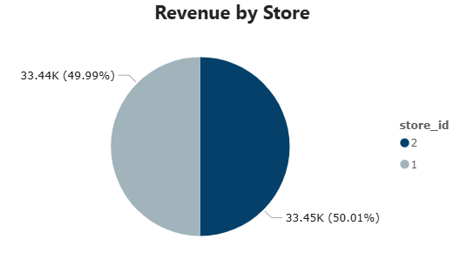
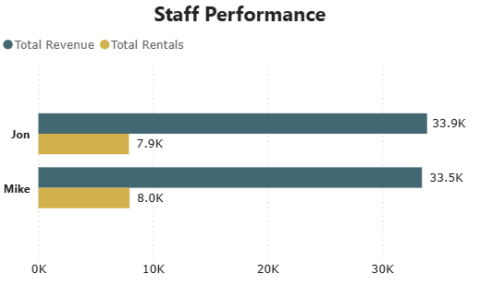
Store & Staff Performance
Store performance is relatively balanced.
Staff contribution varies based on rentals handled..

Slide 11
Key Insights & Recommendations
Key Insights
• Revenue fluctuates across different months • A few films contribute a large portion of revenue • High-value customers drive business performance
Recommendations
• Increase inventory for high-demand films • Focus on retaining high-value customers • Monitor and improve staff performance

Slide 12
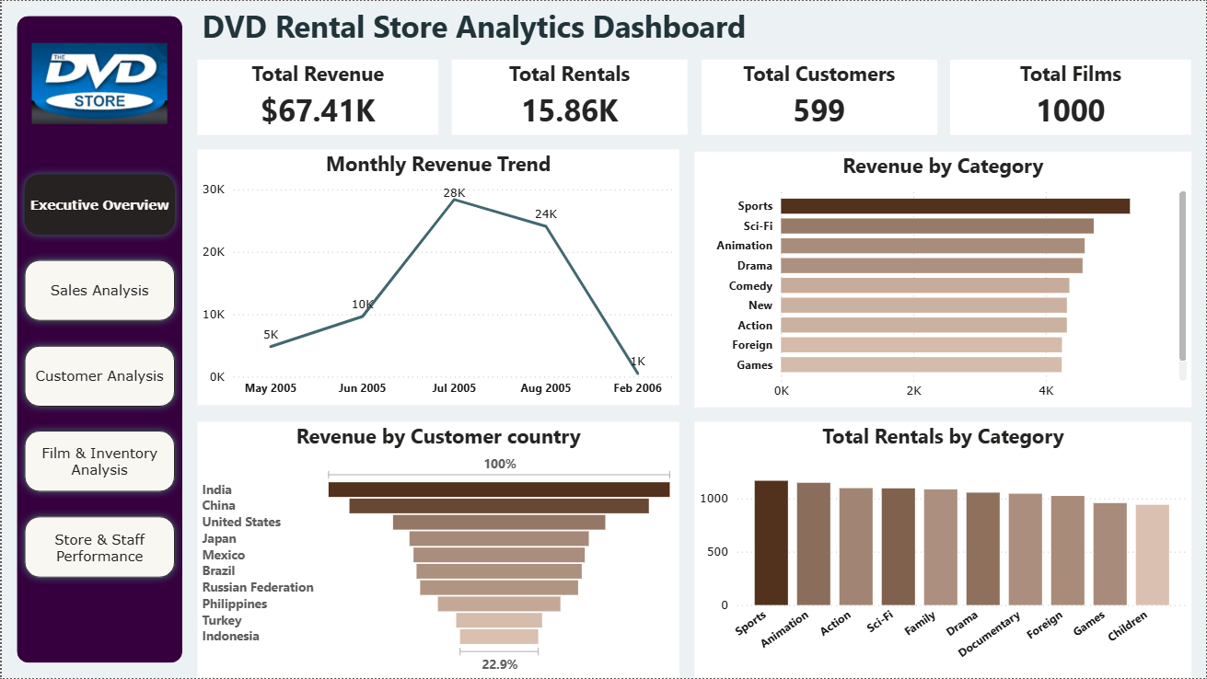
Power BI Dashboard
Gives a high-level view of overall business performance
Allows easy navigation to detailed analysis pages

Slide 13
Conclusion
Built an end-to-end Power BI dashboard covering sales, customers, inventory, store and staff performance.
Converted raw data into clear insights to support business decisions

