Slide 1
Northwind Sales Analysis
SQL | Excel | Power BI
Prepared by Priyanka P

Slide 2
Project Objective
Analyze sales performance using Northwind database
Identify trends, key customers, and top products
Generate actionable business insights

Slide 3
Dataset Overview
Source: Northwind sample database
Key tables: Orders, Order Details, Customers, Products
Supporting tables: Categories, Suppliers, Employees, Shippers

Slide 4
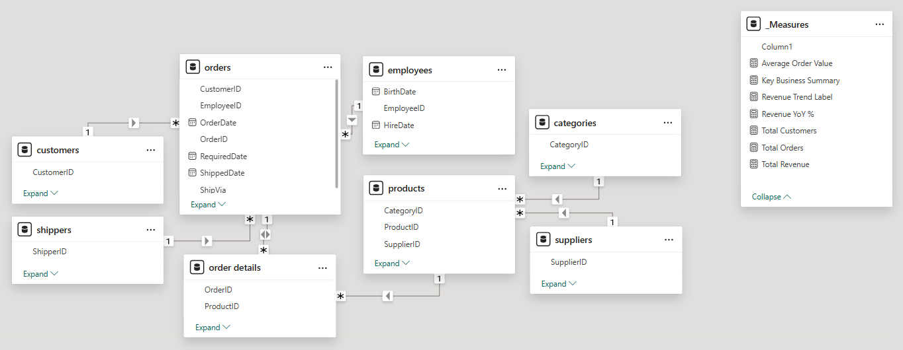
Data Model
Fact table: Order Details
Transaction table: Orders
Dimension tables: Customers, Products, Categories, Employees, Suppliers, Shippers
Measures table: Disconnected (DAX only)
Star-schema model with Order Details as fact table and Orders acting as a transactional bridge.

Slide 5
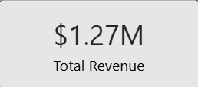
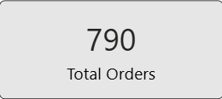
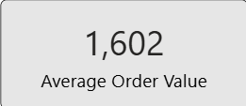
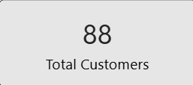
Key Business KPIs

Slide 6
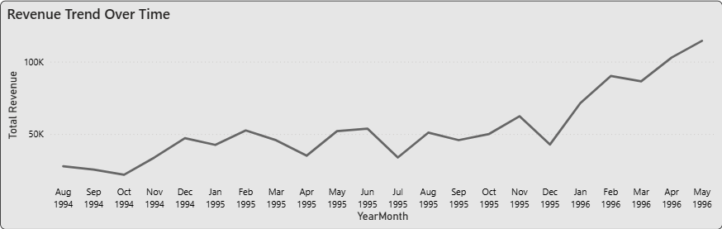
Sales Trend Over Time
Overall revenue trend is positive, with noticeable acceleration in later periods.
Month-to-month variability exists, but the long-term trajectory remains strong.

Slide 7
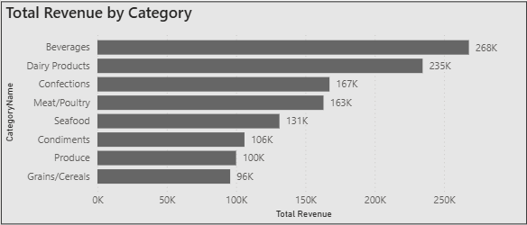
Product Analysis
Sales are heavily driven by Beverages and Dairy Products, making them key focus areas for revenue growth.
Lower-revenue categories may benefit from targeted promotions.

Slide 8
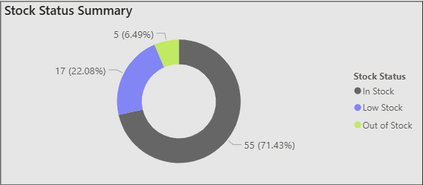
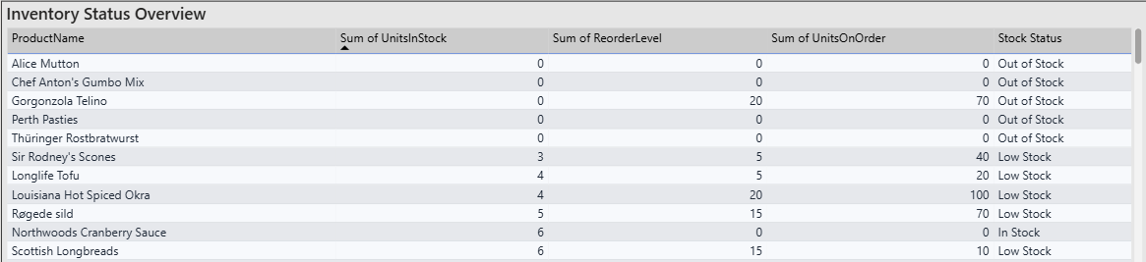
Inventory Analysis
Out-of-stock items can directly impact sales and customer experience.
Low-stock items show that replenishment is in progress but needs close monitoring.

Slide 9
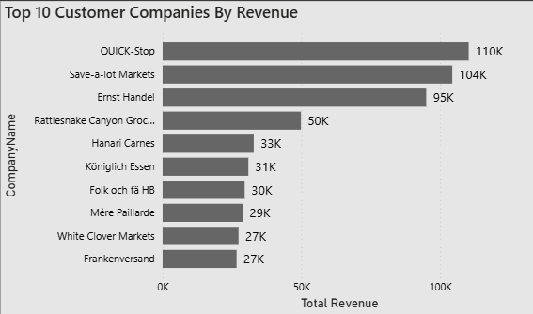
Customer Analysis
A small group of customers contributes a large share of total revenue.
High-value customers are key for retention and repeat business.

Slide 10
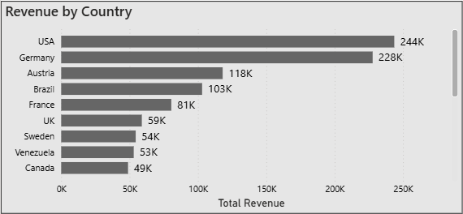
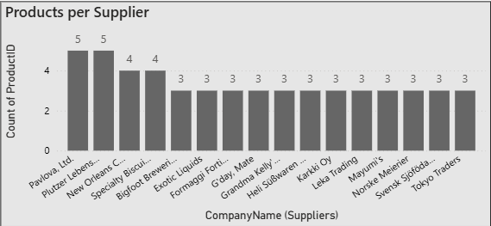
Regional & Supplier Analysis
USA and Germany are the highest revenue-generating countries, showing strong regional performance.
Product supply is spread across multiple suppliers, with a few handling more products than others.

Slide 11
Anomalies & Key Insights
Some products have high stock but low sales, which may lead to excess inventory.
These insights help in taking action to reduce waste and improve stock management.

Slide 12
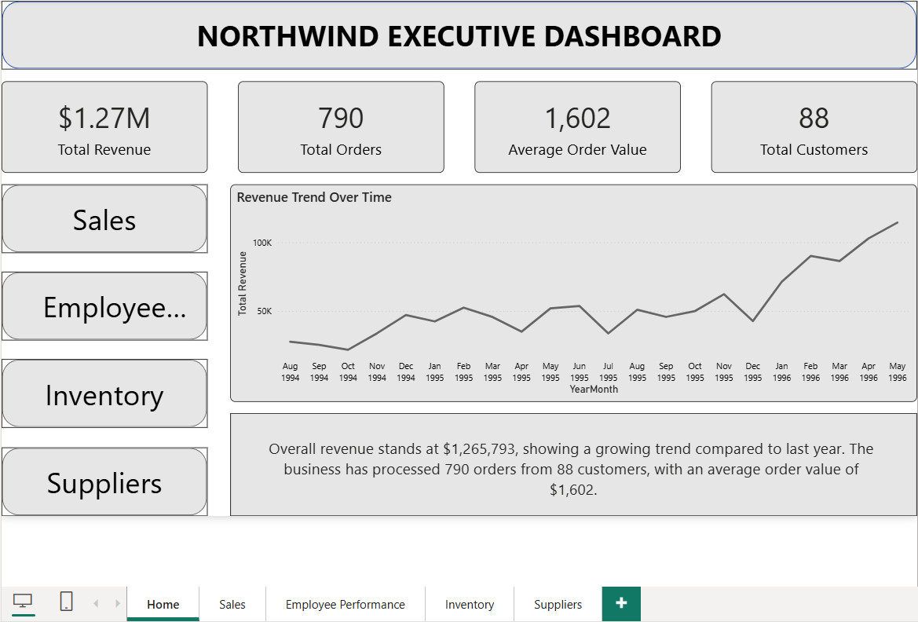
Power BI Dashboard
Gives a high-level view of overall business performance
Allows easy navigation to detailed analysis pages

Slide 13
Recommendations
Focus more on high-revenue categories and top-performing countries to maximize growth.
Reduce excess inventory for low-selling products and improve stock planning.
Strengthen relationships with key suppliers who provide more products and consistent supply.

Slide 14
Conclusion
Built an end-to-end Power BI dashboard covering sales, customers, inventory, and suppliers
Converted raw data into clear insights to support business decisions

