Slide 1

Welcome

Slide 2
NAME :
Priyanka Vijay Patil
BATCH:
August Python DA
POWER BI PROJECT
PROJECT NAME :
PROJECT MANAGEMENT DASHBOARDS

Slide 3

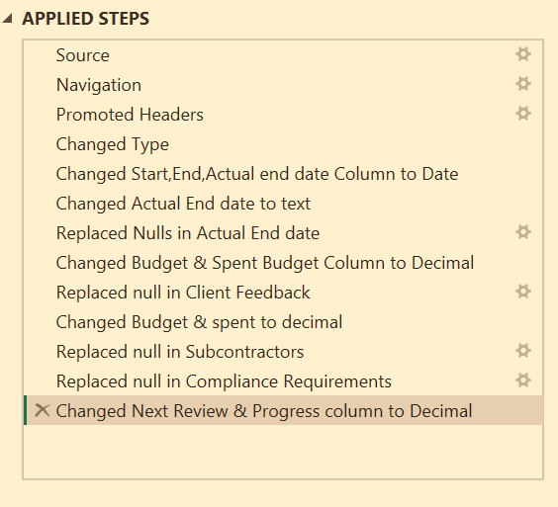
Data Cleaning Process
The following steps were taken to prepare the data for analysis,
ensuring accuracy and consistency :
Changed Data Types:
Start Date, End Date, Actual End Date: Changed to Date format.
Converted the Actual End Date column to Text format where required to handle "In Progress" or missing values
Replaced nulls in Actual End Date with placeholders (e.g., "In Progress").
Budget, Spent Budget, Progress (%), Next Review: Changed to Decimal format.
.
Replaced Null Values:
Actual End Date: Filled with "In Progress."
Client Feedback: “Neutral”
Subcontractors, Compliance Requirements: Replaced with default values.

Slide 4

Dashboard Overview
Project Management Dashboard provides a comprehensive view of project performance by analyzing key aspects such as Budget Efficiency, Project Status, Risk Identification, Resource Allocation, and Client Feedback.
Key Visuals include:
Cards: Display essential project metrics (e.g., Total Projects, Average Progress, High-Risk Projects).
Charts: Visual representation of Budget vs. Spent, Project Risk Levels, and Milestone Achievements.
Tables: Breakdown of project details, such as Risk Levels, Budget Efficiency, and Milestone Completion.
Slicers: Allow for dynamic filtering based on factors like Project Manager, Department, or Risk Level.
Objective:
To enable stakeholders to monitor project health, track performance metrics, identify risks, and make data-driven decisions to optimize project outcomes.

Slide 5
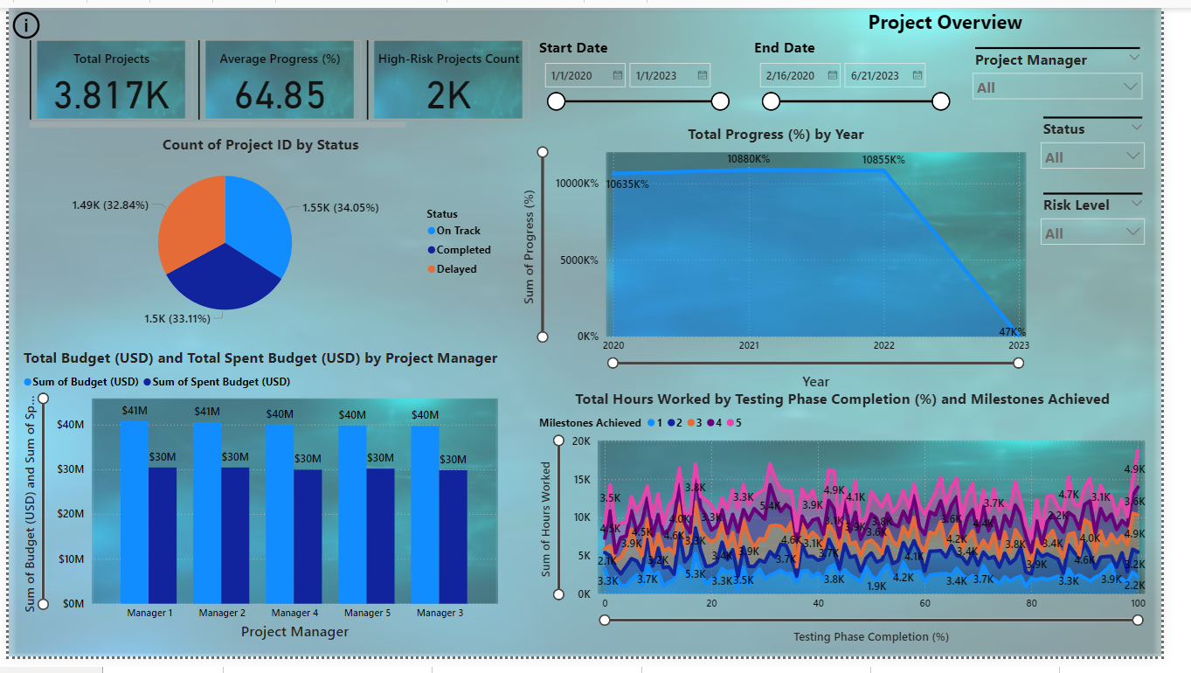

Slide 6
Problem Statement and Solutions & Insights by Dashboards
1.Project Status Tracking Dashboard :
Problem Statement:
Projects are often delayed or over-budget, causing inefficiencies and potential failure.
Solution and Insights:
The dashboard tracks Progress (%) and Milestone Achievements, highlighting delayed projects and those exceeding their budget.
Insight: Identifies projects that are behind schedule, enabling project managers to take corrective actions to bring them back on track.
2.Project Risk Identification Dashboard :
Problem Statement:
High-risk projects with delayed progress or exceeding budgets may lead to scope creep and project failure.
Solution and Insights:
The dashboard highlights High-Risk Projects based on Risk Level, Budget Utilization, and Progress (%).
Insight: Helps identify projects that need immediate attention, enabling timely interventions to mitigate risks and improve project outcomes.

Slide 7
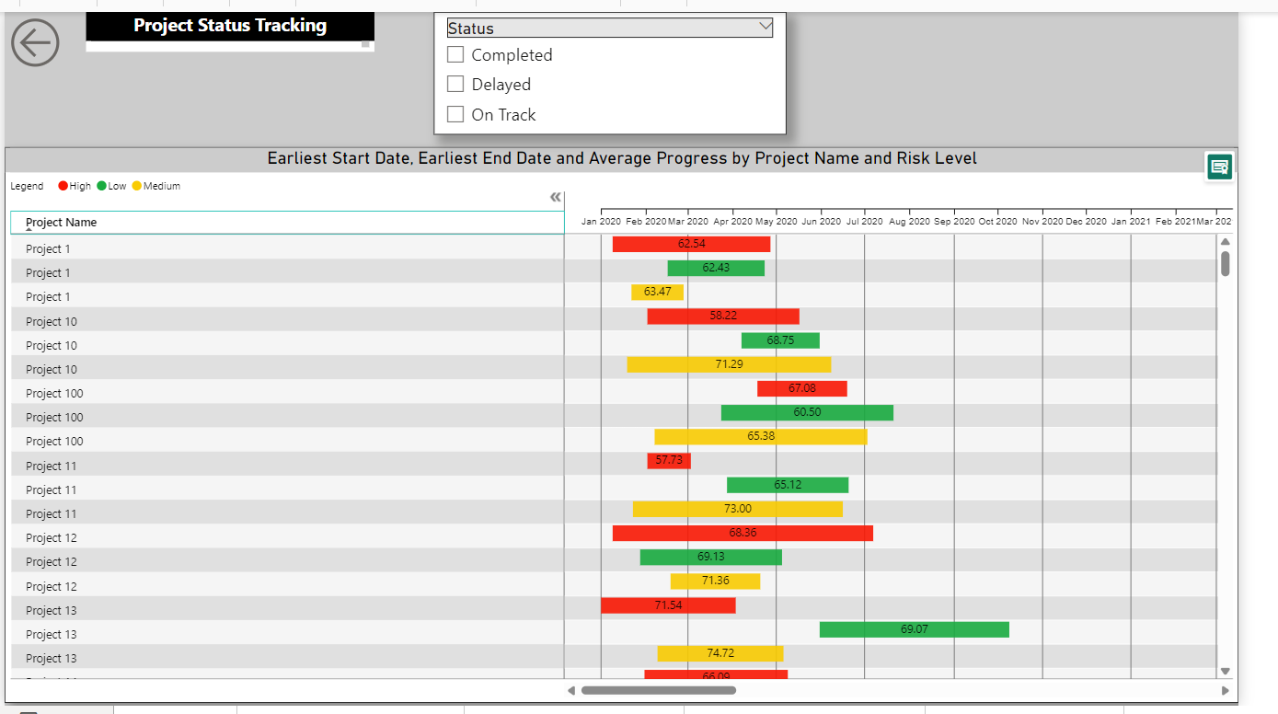

Slide 8
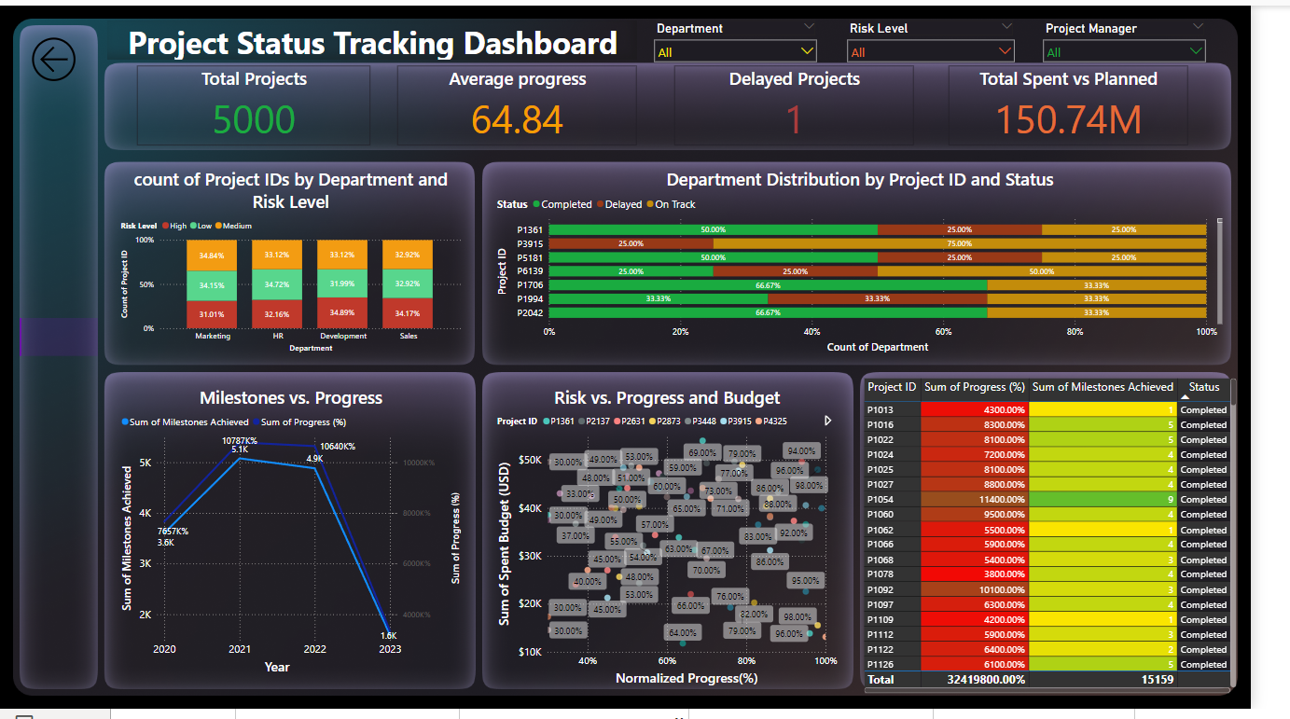

Slide 9
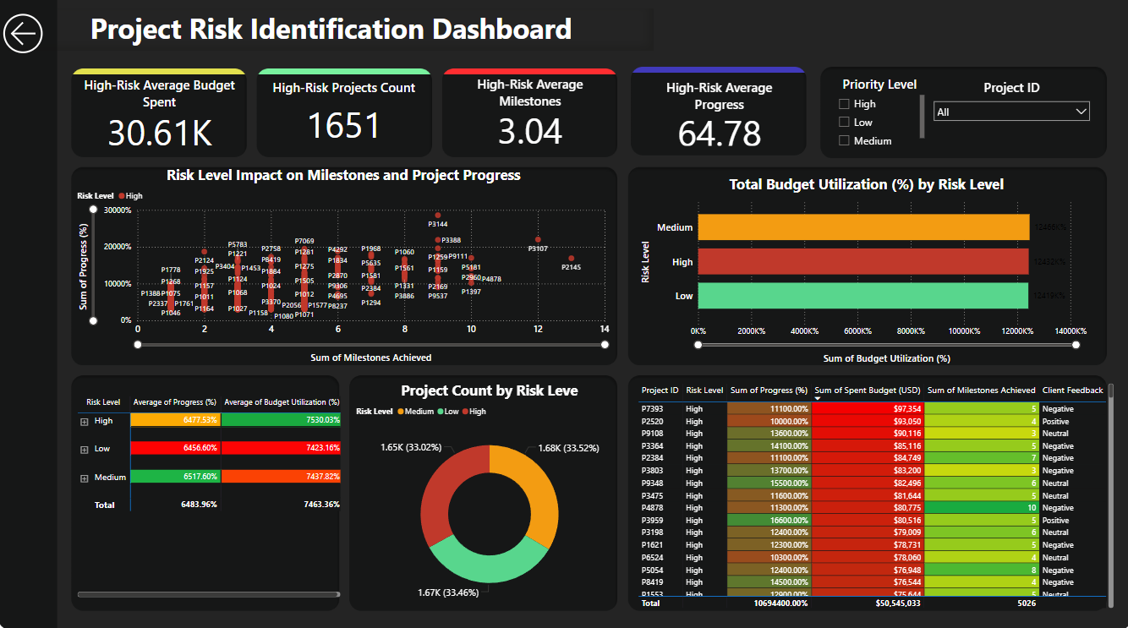

Slide 10
3.Budget Efficiency Dashboard :
Problem Statement:
Budget overspending or underspending indicates poor resource management or misallocation of funds.
Solution and Insights:
The dashboard compares Budget (Planned) with Spent Budget (USD) to show overspent or underspent projects.
Insight: Helps project managers identify financial inefficiencies, adjust budgets accordingly, and optimize resource allocation for better project financial management.
4.Client Satisfaction & Feedback Dashboard :
Problem Statement:
Lack of client satisfaction or negative feedback impacts project outcomes and future client relationships.
Solution and Insights:
The dashboard integrates Client Feedback with project progress and budget data to identify relationships between satisfaction and project success.
Insight: Projects with negative feedback may need reevaluation of execution or communication strategies, ensuring better future outcomes.

Slide 11
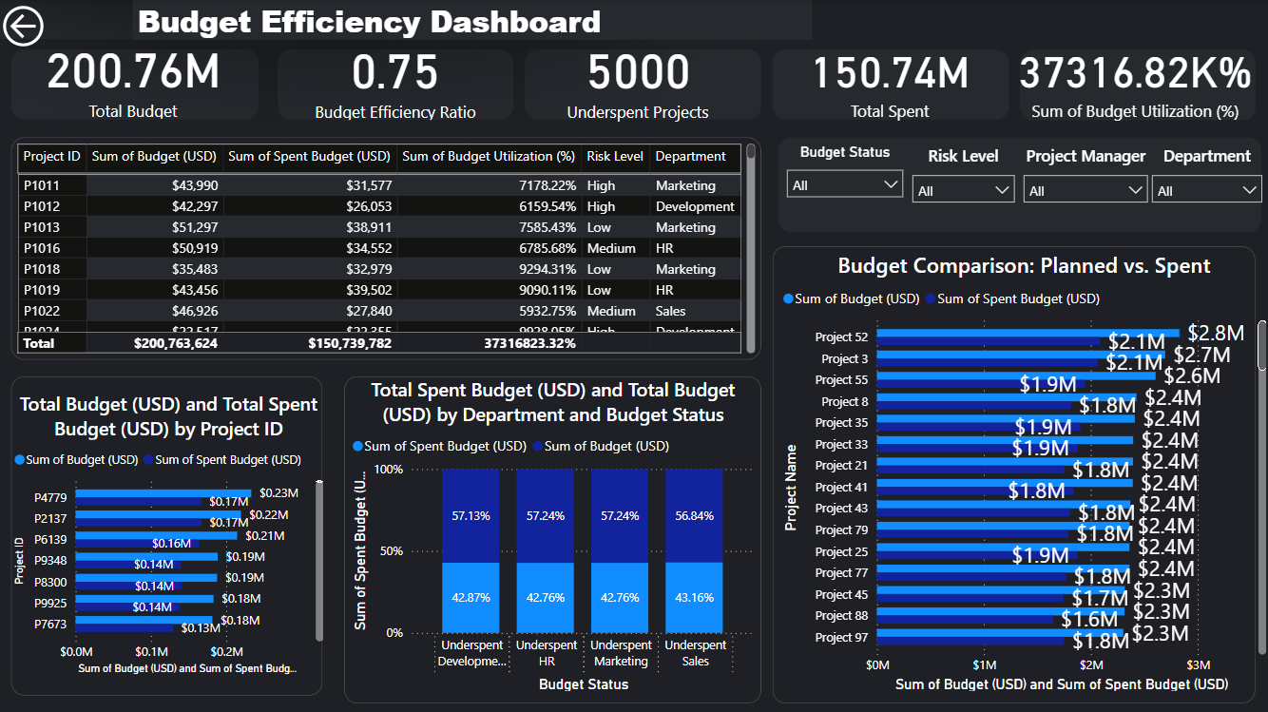

Slide 12
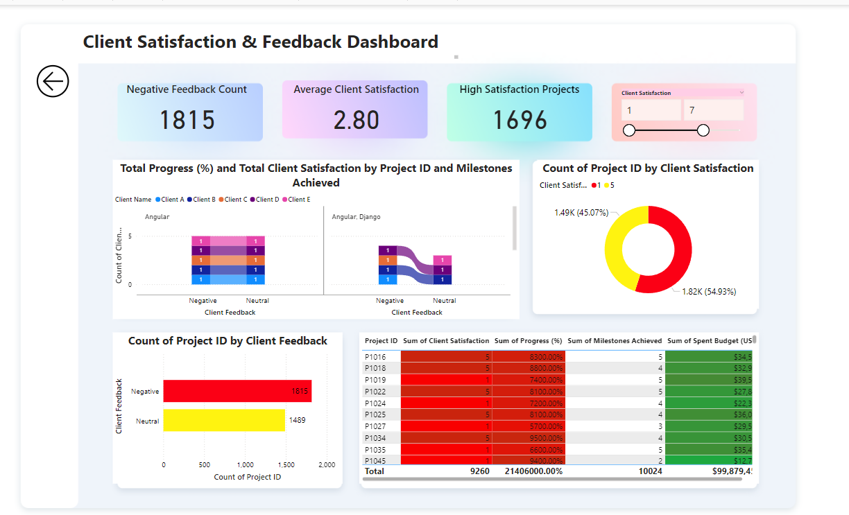

Slide 13
5.Resource Allocation and Team Performance Dashboard :
Problem Statement:
Misallocation of resources or underperformance by teams can hinder project success and delay timelines.
Solution and Insights:
The dashboard tracks Hours Worked, Project Manager, and Department performance to evaluate resource allocation.
Insight: Identifies overburdened or underperforming teams, suggesting resource redistribution to improve team efficiency and project success.
6.Milestone Analysis & Departmental Performance Dashboards :
Problem Statement:
Delayed milestones or inefficient departments hinder project timelines and completion.
Solution and Insights:
The Milestone Analysis identifies missed or delayed milestones, while Departmental Performance compares project success across different departments.
Insight: Focuses on bottleneck stages, identifies departmental inefficiencies, and provides insights to streamline the project process for better overall performance.

Slide 14
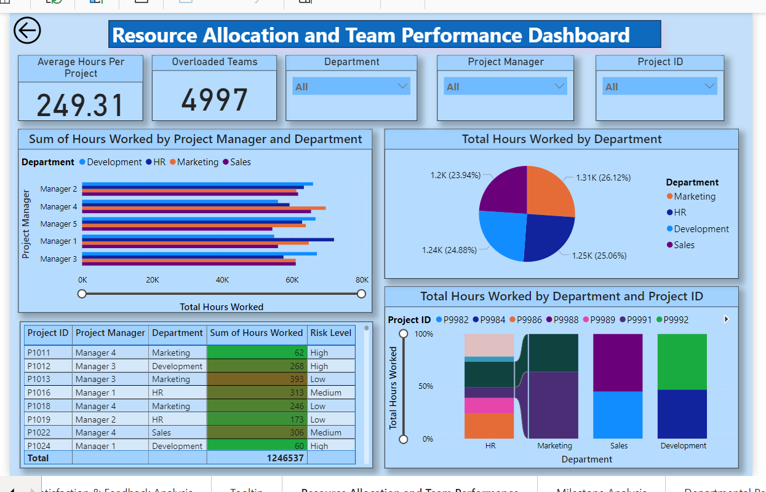

Slide 15
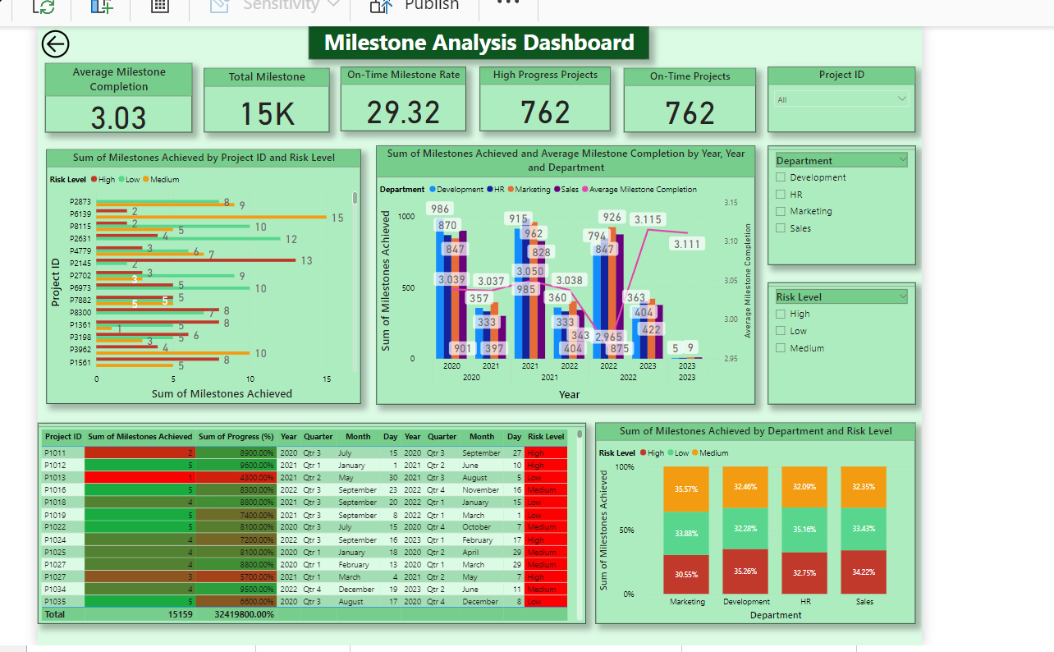

Slide 16
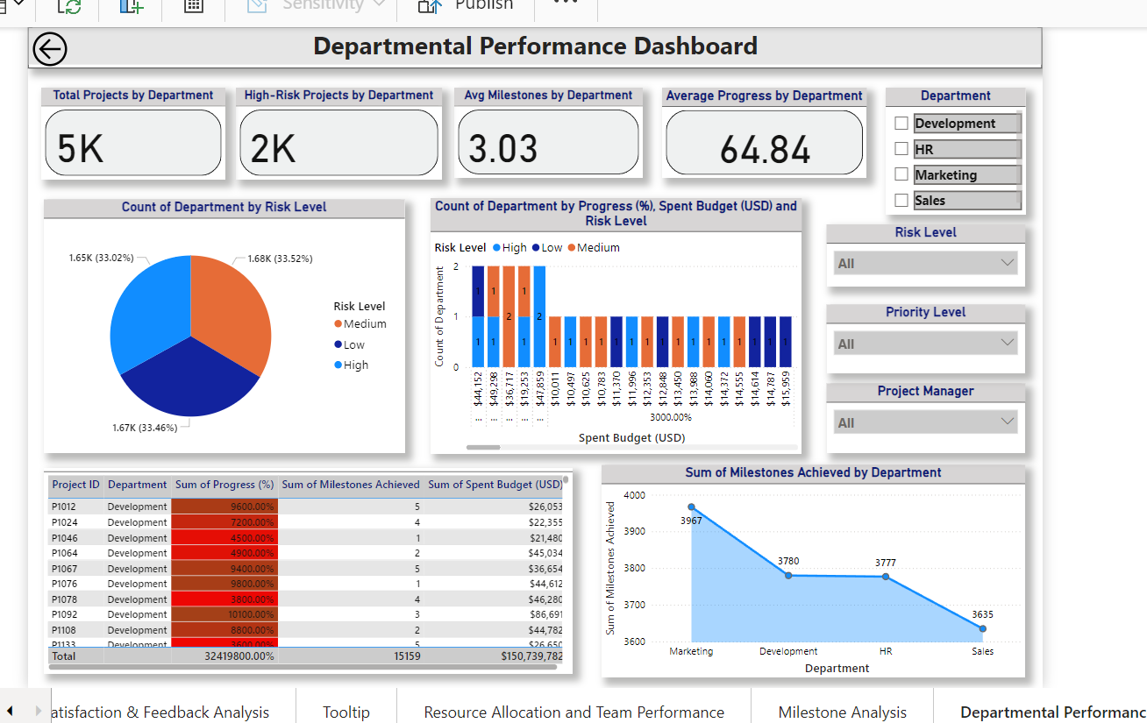

Slide 17
Conclusion
These dashboards provide clear, actionable insights to improve project management.
To help track progress, identify risks, optimize budgets, enhance resource allocation, and improve client satisfaction.
By visualizing key metrics, they empower decision-makers to address issues proactively, streamline workflows, and ensure successful project delivery.
In short: These dashboards transform data into decisions, driving efficiency, reducing risks, and improving outcomes.

Slide 18
Thank you

