Slide 1

ABC CALL VOLUME TREND ANALYSIS

Slide 2
PROJECT DESCRIPTION
ABC is a Call centre which has a Customer Experience team for the voice process. Typically, these teams fulfil various roles and responsibilities such as: Customer experience programs (CX programs), Digital customer experience, Design and processes, Internal communications, Voice of the customer (VoC), User experiences, Customer experience management, Journey mapping, Nurturing customer interactions, Customer success, Customer support, Handling customer data, Learning about the customer journey. I have been provided with the data of ABC call centre for the last 23 days and should analyze the data and help the company answer some of the business questions.
APPROACH
● Data cleaning and creating new columns if needed
● Create Pivot Tables and charts
● Drawing useful insights.
TECH STACK USED
Excel

Slide 3
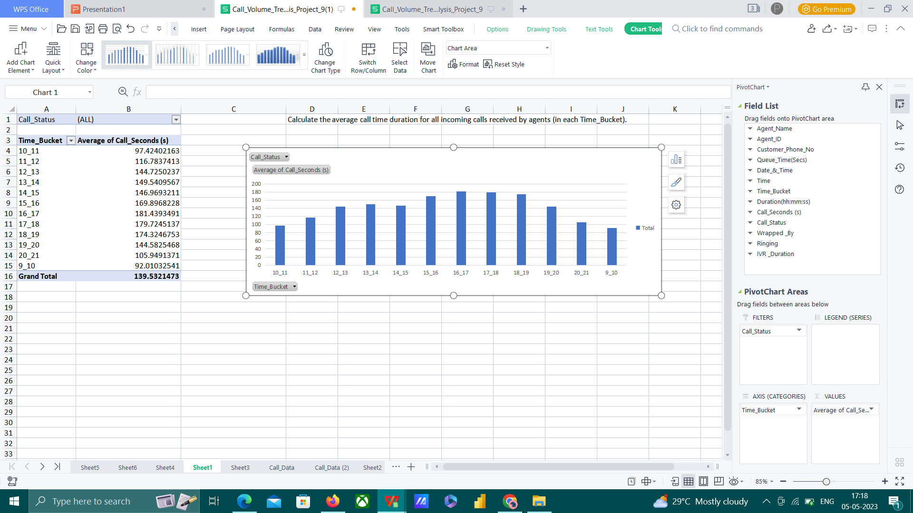
Task 1
Calculate the average call time duration for all incoming calls received by agents (in each Time_Bucket).
The average call time duration for all incoming calls is 139.53 seconds.
The average call time duration for answered incoming calls is 198.62 seconds.

Slide 4
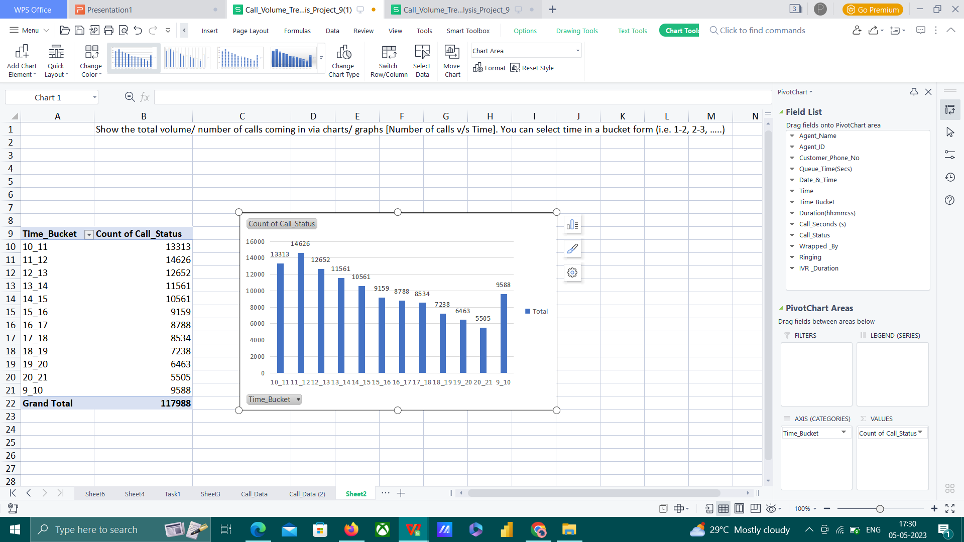
Task 2
Show the total volume/ number of calls coming in via charts/ graphs [Number of calls v/s Time]. You can select time in a bucket form (i.e. 1-2, 2-3, …..)

Slide 5
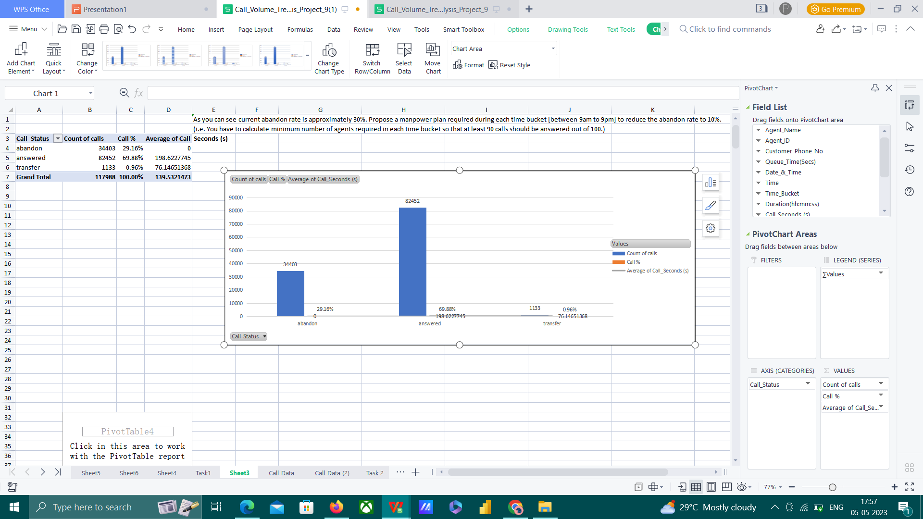
Task 3
As you can see current abandon rate is approximately 30%. Propose a manpower plan required during each time bucket [between 9am to 9pm] to reduce the abandon rate to 10%. (i.e. You have to calculate minimum number of agents required in each time bucket so that at least 90 calls should be answered out of 100.)

Slide 6
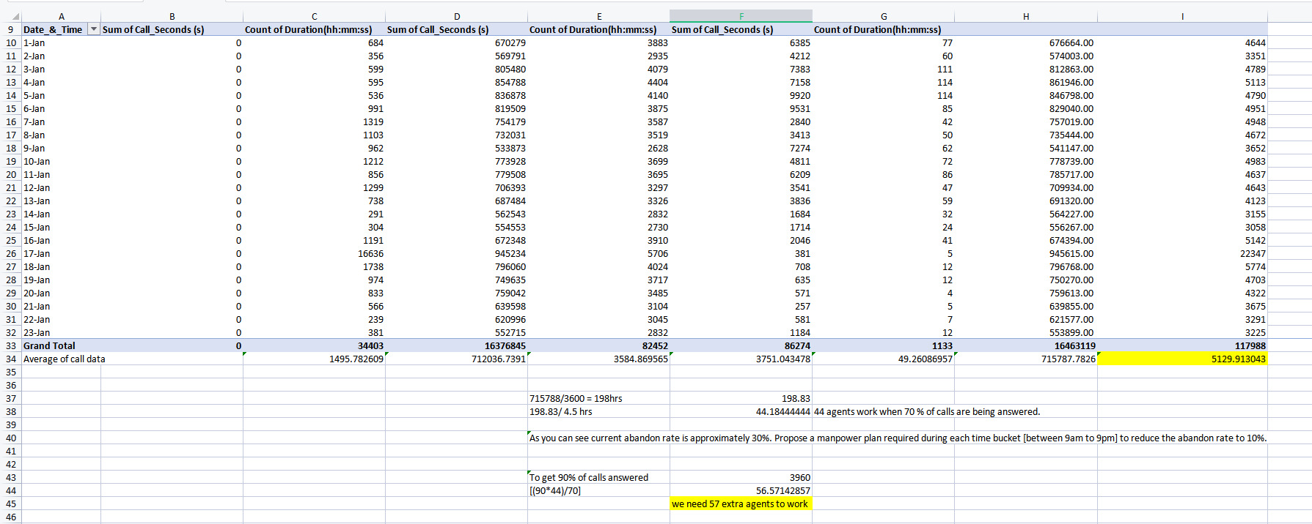
Assumption
In general average case,
Total working hours | 9 hrs
Snacks and lunch | 1.5 hrs
Other breaks | 3 hrs (i.e 60% of 7.5 Hrs)
Remaining work hours | 4.5 hrs

Slide 7
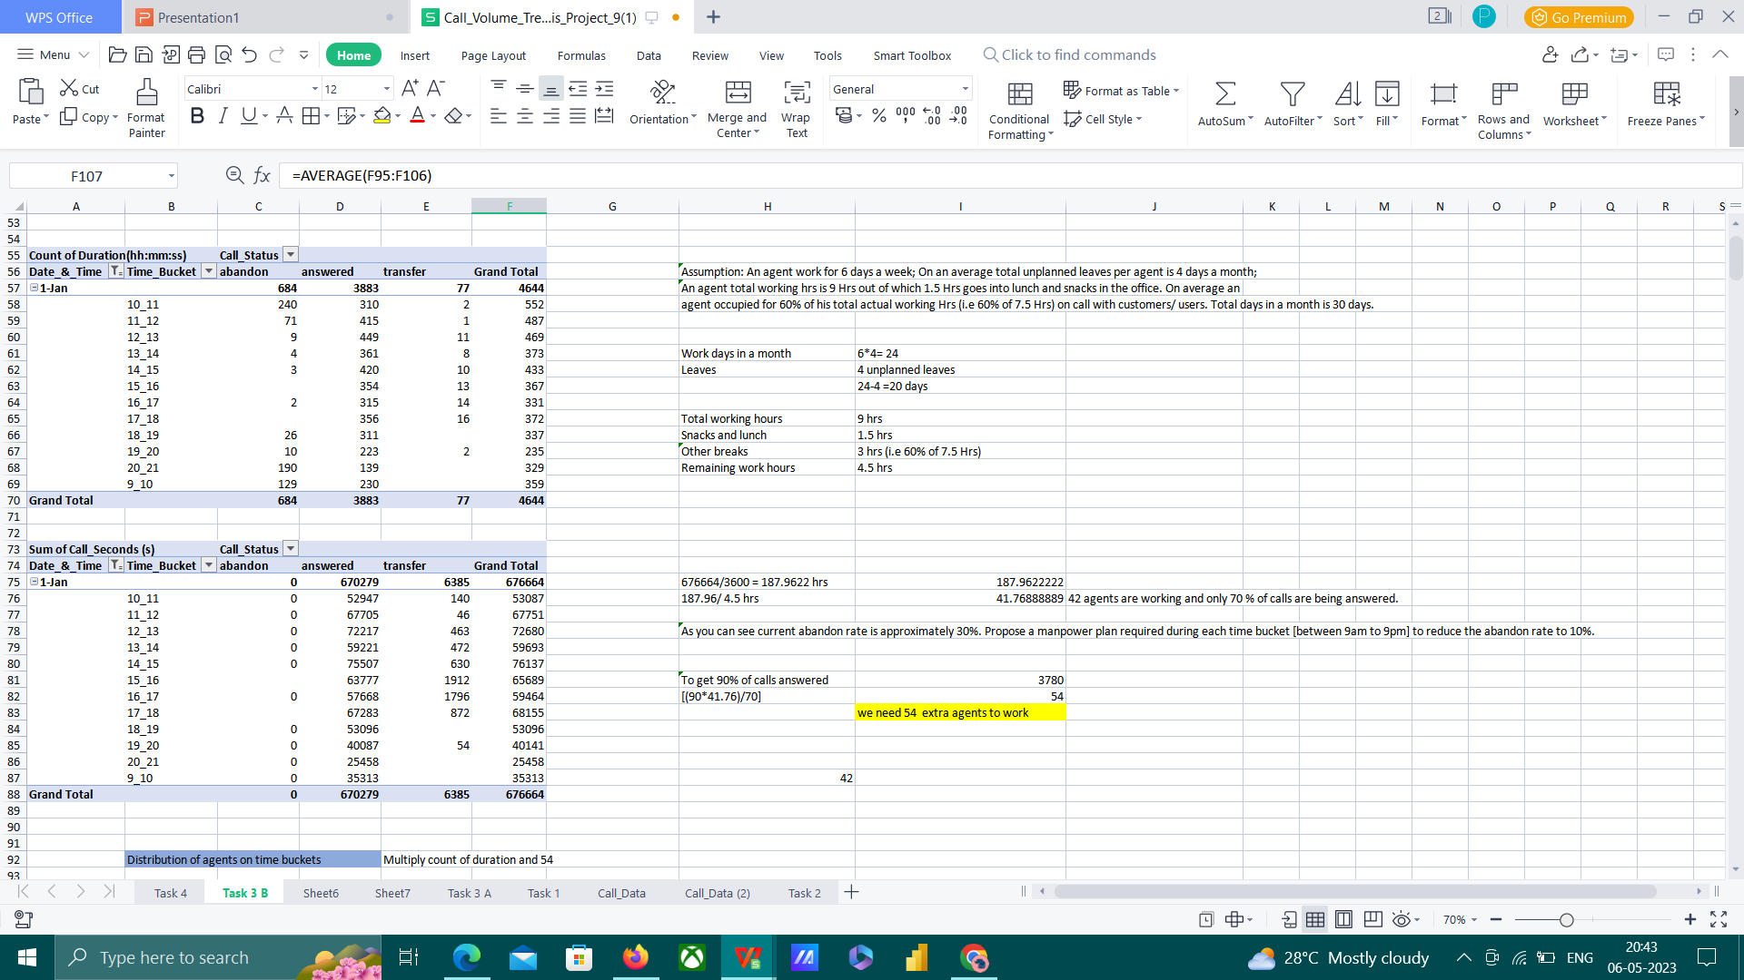
We need 54 extra agents to work to get 90% of the calls answered.

Slide 8
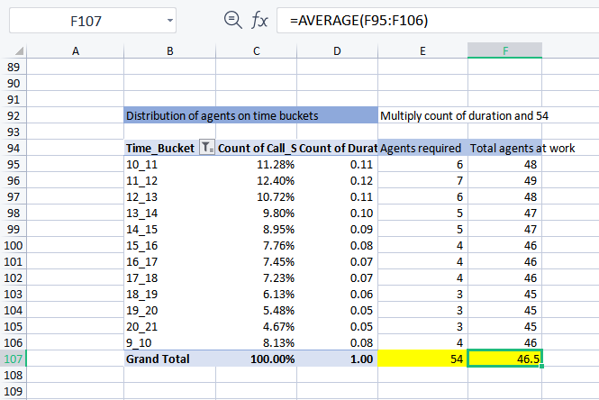
When these 54 agents are distributed according to the requirement an average of 47 agents are at work to get 90% of the calls answered on that day

Slide 9
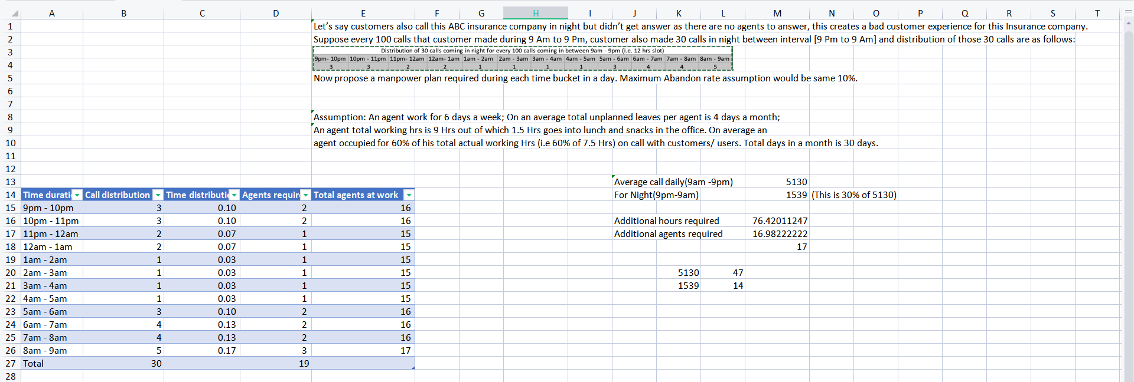
Task 4
Let’s say customers also call this ABC insurance company in night but didn’t get answer as there are no agents to answer, this creates a bad customer experience for this Insurance company. Suppose every 100 calls that customer made during 9 Am to 9 Pm, customer also made 30 calls in night between interval [9 Pm to 9 Am] and distribution of those 30 calls are as follows:
Now propose a manpower plan required during each time bucket in a day. Maximum Abandon rate assumption would be same 10%.

Slide 10
Excel file link https://docs.google.com/spreadsheets/d/1ScEYypLZe1GgukWff0fQWJG7bgek3Gy0/edit?usp=share_link&ouid=101239664220826941199&rtpof=true&sd=true
Loom link
https://www.loom.com/share/51e84df6872044969d781ce67c986161

Slide 11
THANKS

