Slide 1
Analyzing the Impact of Car Features on Price and Profitability

Slide 2
Table of Content
Project Description
Approach
Tech Stack used
Insights
Result

Slide 3
Project Description
The automotive industry has been rapidly evolving over the past few decades, with a growing focus on fuel efficiency, environmental sustainability, and technological innovation. With increasing competition among manufacturers and a changing consumer landscape, it has become more important than ever to understand the factors that drive consumer demand for cars.
The analysis of the relationship between a car's features, market category, and pricing, and identifying which features and categories are most popular among consumers and most profitable for the manufacturer that will help the manufacturer develop a pricing strategy that balances consumer demand with profitability, and identify which product features to focus on in future product development efforts.
So DATA ANALYSIS is performed to determine the product features to focus on in future product development efforts and help the manufacturer improve its competitiveness in the market and increase its profitability over time.

Slide 4
Approach
Understanding the dataset.
Removing duplicate and removing blank cells.
Drawing pivot table, some new tables and charts to draw the insights.
Regression analysis techniques were used to determine the features impacting consumer demands.
Visualization used for better understanding of all the factors influencing the sales.
Building Dashboard.

Slide 5
Tech-Stack Used
Excel
• To perform data analysis using EDA and regression analysis methods
Power BI
• To create Visualization Dashboard for the insights asked.
PowerPoint
• To prepare the documentation of the project.
Loom.com
• To prepare the Video Presentation.

Slide 6
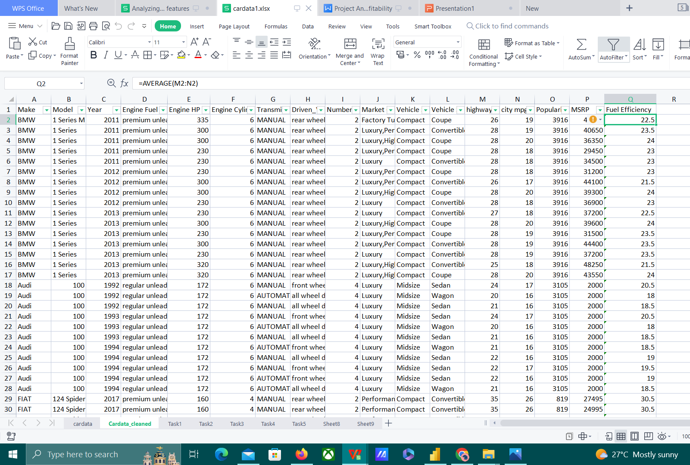
Data Set Description
Before Cleaning the dataset -
Total number of Rows = 11915
Total number of Columns = 16
After Cleaning the dataset -
Removing Duplicates - 715 duplicates removed
and 11199 rows retained.
Removing Blank columns - 11098 rows retained.
Renamed Columns -
Make - Brand
Vehicle style - Body Style
New Column - Fuel efficiency (Average of MPGs)

Slide 7
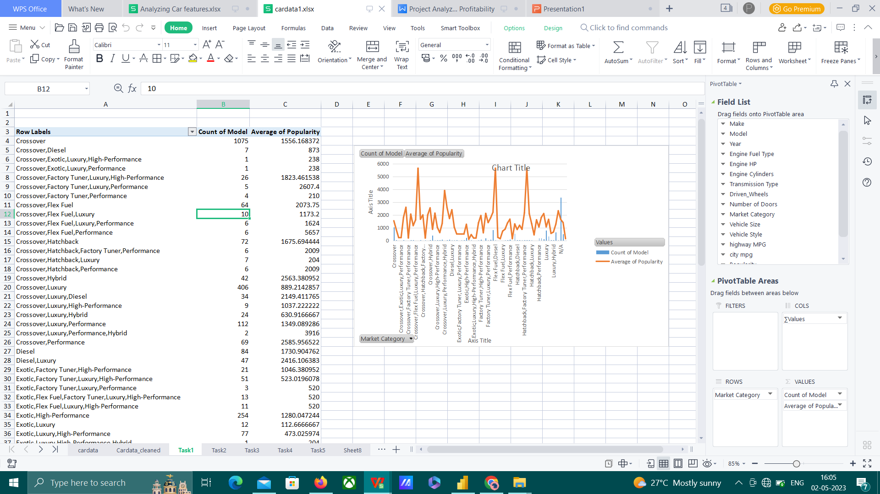
Insight Required: How does the popularity of a car model vary across different market categories? Task 1.A: Create a pivot table that shows the number of car models in each market category and their corresponding popularity scores. Task 1.B: Create a combo chart that visualizes the relationship between market category and popularity.
Hatchback, Flexfuel
Fuel Flex,Diesel
Crossover, Fuelflex, Performance
are the popular car models with average popularity score of 5657.

Slide 8
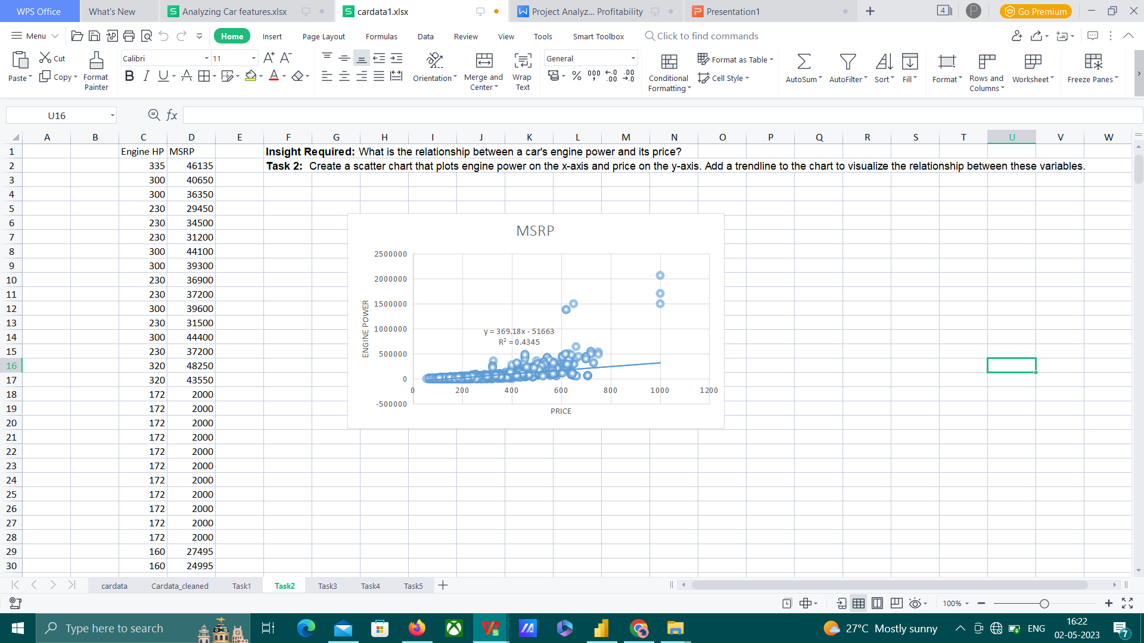
Insight Required: What is the relationship between a car's engine power and its price? Task 2: Create a scatter chart that plots engine power on the x-axis and price on the y-axis. Add a trendline to the chart to visualize the relationship between these variables.
The Car engine power is directly proportional to the price of the car.
If the power increases the price of the car increases.

Slide 9
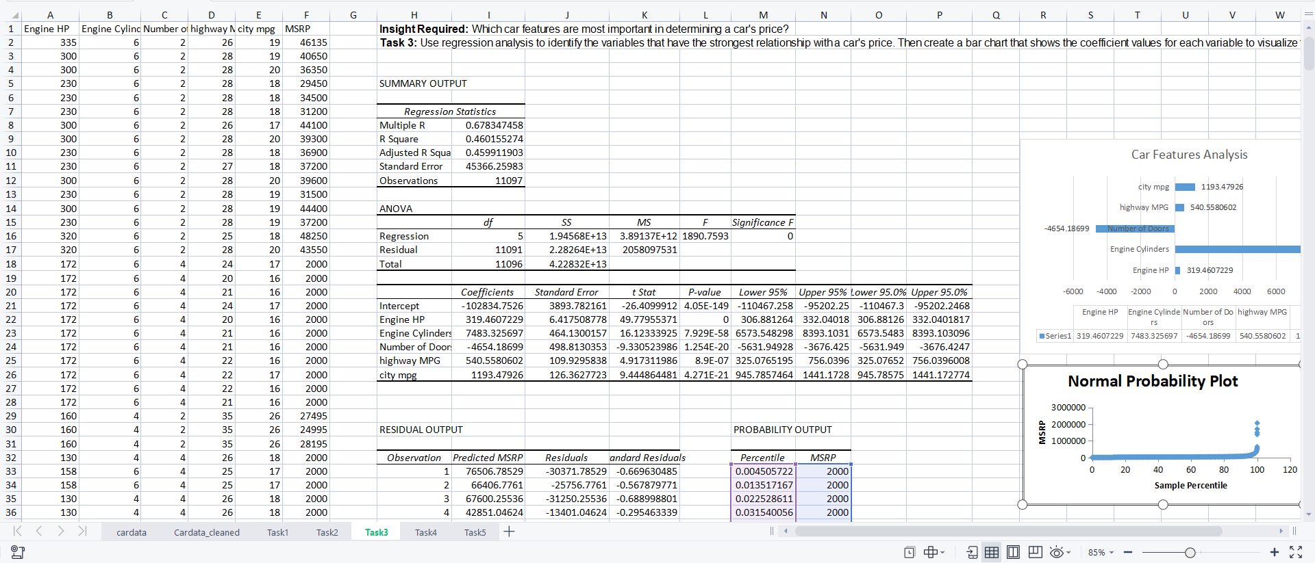
Insight Required: Which car features are most important in determining a car's price? Task 3: Use regression analysis to identify the variables that have the strongest relationship with a car's price. Then create a bar chart that shows the coefficient values for each variable to visualize their relative importance.
The car features have 46% impact on the price of the car.
Engine cylinder has the highest impact on the car price.

Slide 10
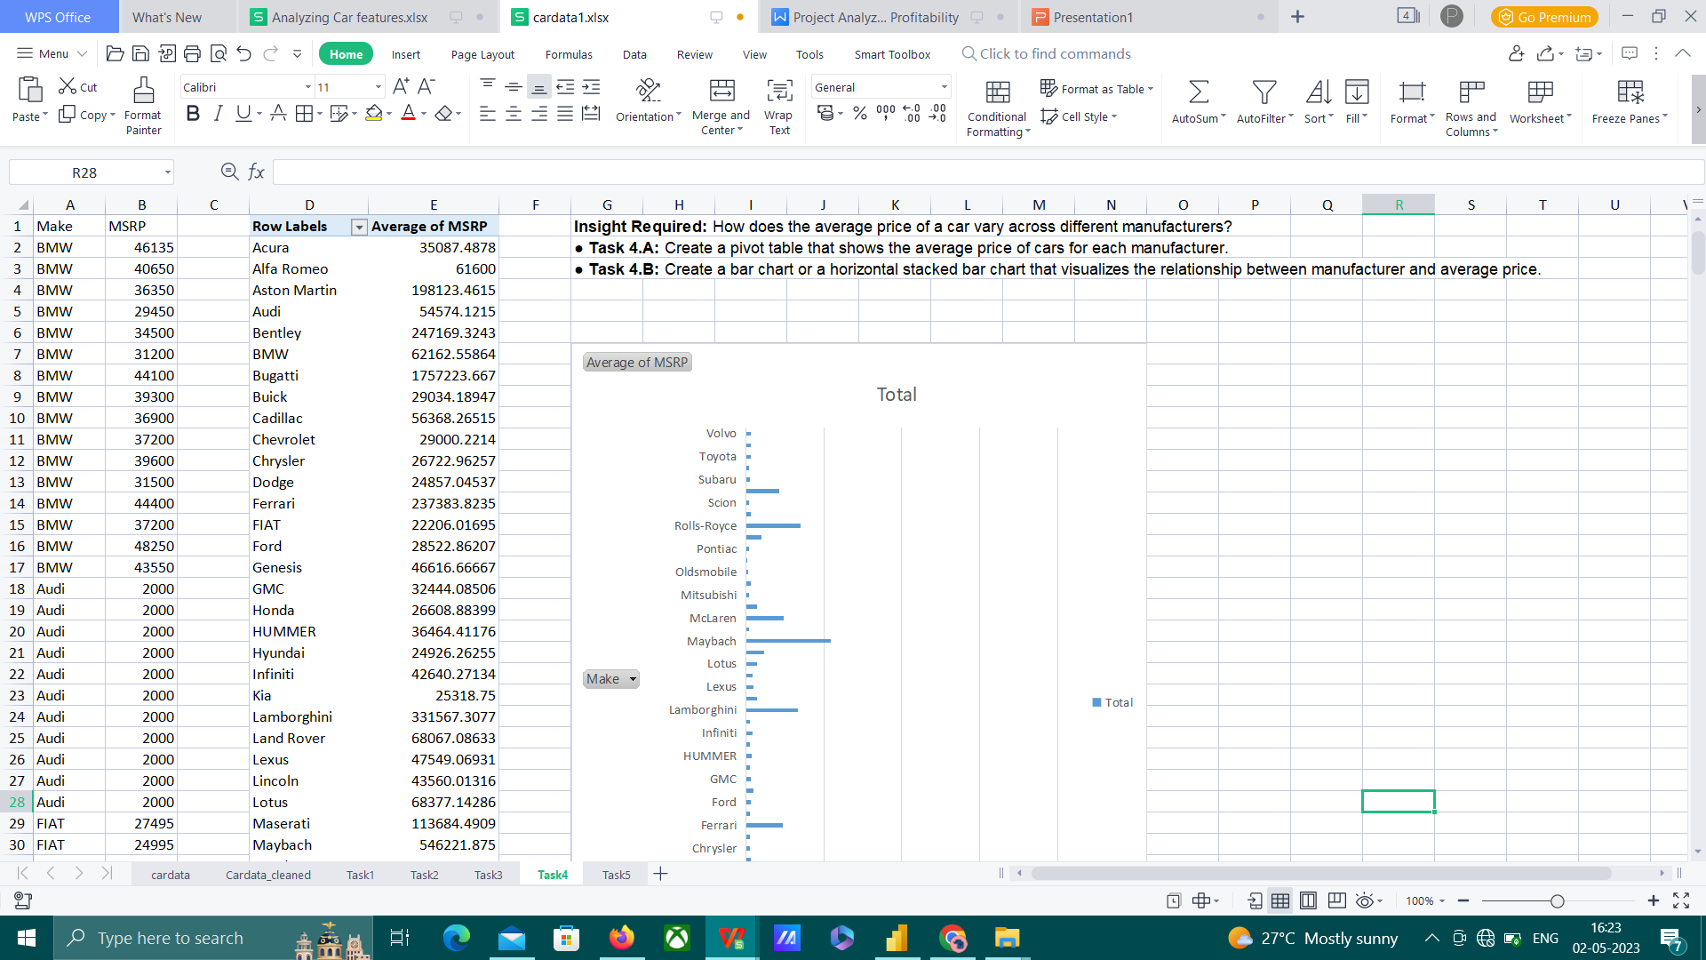
Insight Required: How does the average price of a car vary across different manufacturers? Task 4.A: Create a pivot table that shows the average price of cars for each manufacturer. Task 4.B: Create a bar chart or a horizontal stacked bar chart that visualizes the relationship between manufacturer and average price.
Bugatti has the highest average MSRP and Plymouth has the lowest average MSRP

Slide 11
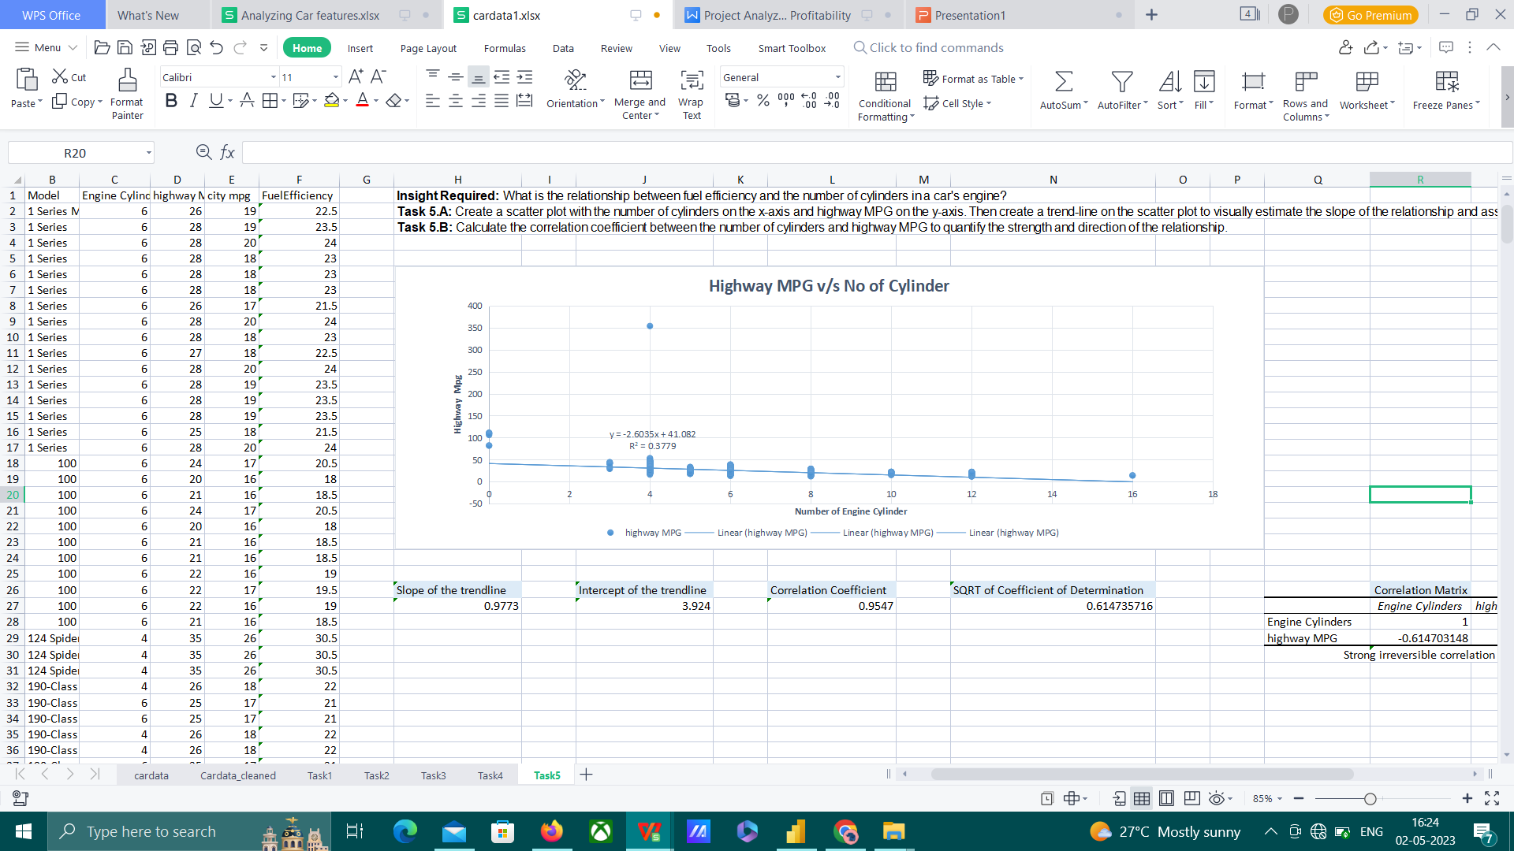
Insight Required: What is the relationship between fuel efficiency and the number of cylinders in a car's engine? Task 5.A: Create a scatter plot with the number of cylinders on the x-axis and highway MPG on the y-axis. Then create a trend-line on the scatter plot to visually estimate the slope of the relationship and assess its significance. Task 5.B: Calculate the correlation coefficient between the number of cylinders and highway MPG to quantify the strength and direction of the relationship.
Fuel Efficiency is inversely proportional to the number of cylinders

Slide 12
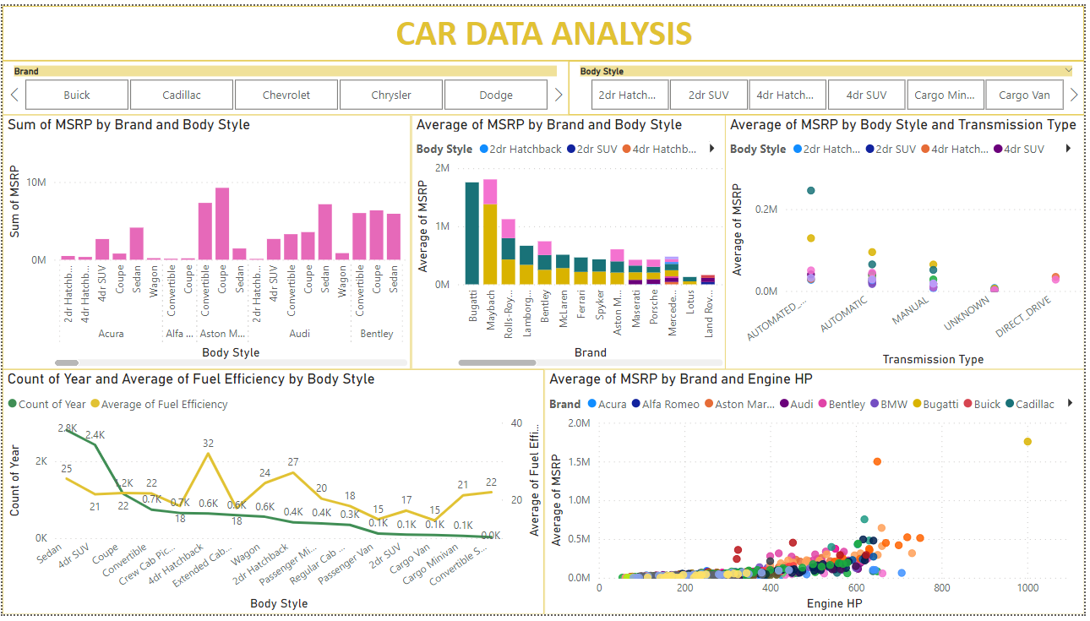
DASHBOARD

Slide 13
Insights and Results
Hatchback, Flexfuel, Fuel Flex,Diesel , Crossover, Fuelflex, Performance are the popular car models with average popularity score of 5657. Exotic, Luxury has the lowest popularity score of 112.
The car engine power is directly proportional to the price of the car. If the power increases the price of the car increases.

Slide 14
The car features city MPG, highway MPG, engine cylinder, engine HP have 46% impact on the price of the car.
Number of doors do not impact the car price. Engine cylinder has the highest impact on the car price.
Fuel Efficiency is inversely proportional to the number of cylinders. If the number of cylinder increases the Fuel Efficiency decreases.

Slide 15
FROM THE DASHBOARD
Bugatti has the highest average MSRP and Plymouth has the lowest average MSRP.
4dr Hatchback has the highest fuel efficiency of 32 and Cargo van has the least fuel efficiency of 14.61.
Automated Manual drive has the highest MSRP and Direct drive has the lowest MSRP.
Customer might prefer a car which is
Hatchback
Automated Manual drive
High performance engine
With less number of cylinders
MSRP of 500000.

Slide 16
Links
Analyzing the Impact of Car Features on Price and Profitability folder
https://drive.google.com/drive/folders/1KE1aHiVDWblLMru2rP0vQx2gbezL4VgJ?usp=share_link
PresentationFiles folder
https://drive.google.com/drive/folders/1WHEAmtVvanIMRCqBpqaM2pvVz_K9avoL?usp=share_link
AnalysisFiles folder
https://drive.google.com/drive/folders/1CcLMDFvW6yERD-lm4ZnrToHUk7PuSm1r?usp=share_link
Loom Link
https://www.loom.com/share/6b606a5684da4a7ab6b5ebab232c382f

Slide 17
THANK YOU

