Slide 1
Financial AI Robustness Evaluation
An integrated framework for downside-risk prediction, alert fusion, robustness, explainability, and cyber resilience
Dissertation defence presentation
Priyanka
Chapter-wise defence deck
15-slide academic presentation
Notes:
Open by stating the dissertation title and the central claim: this work is not only about predicting downside risk, but about evaluating whether a financial AI system remains useful when market conditions become disturbed. The claim supported by the full presentation is that an integrated pipeline reveals strengths and failure modes that a single headline metric would hide. Link forward by telling the examiner that the talk follows the dissertation chapter by chapter.

Slide 2
Roadmap
How the defence is organised
The dissertation is presented in the same order as the written work.
1
2
3
4
Problem
Method
Results
Evaluation
Aim, gap, research questions
Data, features, models, evaluation design
Performance, alerts, robustness, explainability
RQ answers, implications, recommendations
Chapter 4 receives the most time because it contains the evidence used to defend the dissertation.
Notes:
Use this slide to control the room early. Explain that the structure mirrors the dissertation: first the problem, then the research design, then the evidence, then the evaluation and conclusion. The most important defence decision is that Chapter 4 receives the largest share of time because the examiner will care most about what the system actually achieved. Link forward by moving into the research problem.

Slide 3
Chapter 1
Aim, problem, and research questions
Why the study was needed before any modelling began.
Core problem
Research questions
• Financial AI systems can look accurate while missing rare but important downside events.
• Performance alone is insufficient if alerts, explanations, and robustness fail under disturbance.
• The dissertation asks whether these checks can be evaluated together in one framework.
• RQ1: Can AI predict downside-risk events?
• RQ2: Can monitoring and alerting identify suspicious behaviour?
• RQ3: Does the system remain useful under disturbed conditions?
5 parts
3 RQs
1
prediction → resilience
directly evaluated
shared pipeline
Notes:
Start from the need, not from the code. The research problem is that financial AI can appear successful under ordinary metrics while still being unsafe or unhelpful when rare events matter most. State the three questions clearly because the rest of the defence answers them one by one. The slide supports the claim that the dissertation is evaluative, not merely a model-building exercise. Link forward by explaining what the literature had already solved and what it still left fragmented.

Slide 4
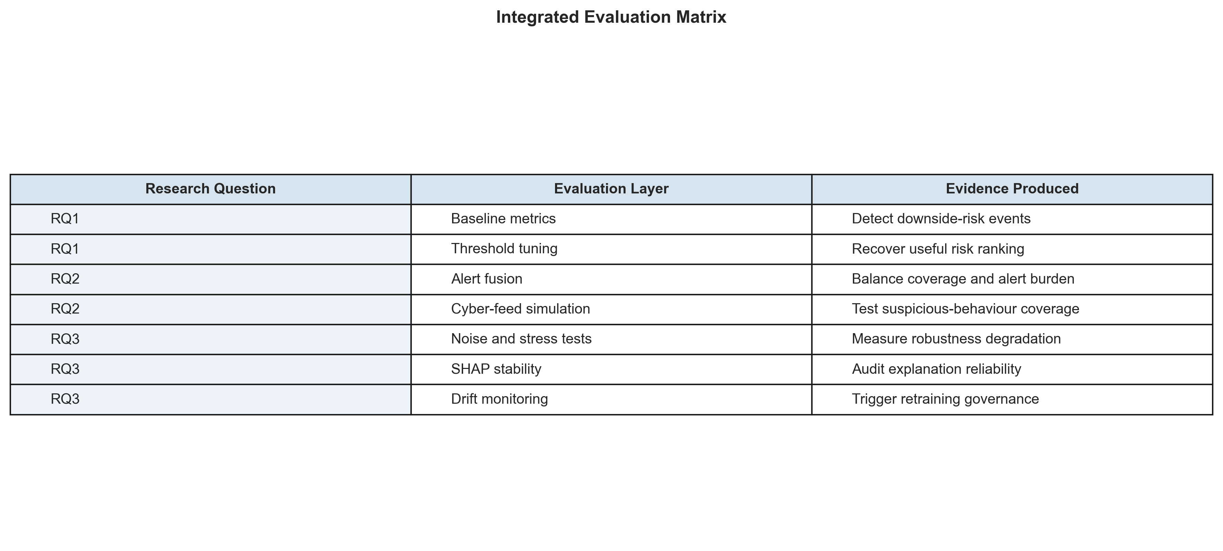
Chapter 2
Literature review and research gap
Existing studies solve pieces of the problem, but rarely evaluate them together.
What prior work usually covers
Research gap
• Prediction quality
• Explainability
• Adversarial robustness
• Drift monitoring
• Governance
The literature is strong in fragments, but weaker on integrated evidence: Can the same system remain predictive, explainable, alertable, and resilient under disturbance?
Used here as the conceptual bridge from literature gap to dissertation evaluation design.
Notes:
This replaces the earlier mistake of showing a methodology pipeline in the literature-review section. Explain that Chapter 2 finds many useful strands in prior work, but the gap is their separation. The matrix on the right is used as a conceptual bridge: each research question maps to an evaluation layer and to evidence later produced in Chapter 4. A likely challenge is whether this is really novel; answer that the contribution is not a brand-new classifier, but the integrated evaluation of prediction, alerts, robustness, explanations, and governance-relevant artefacts. Link forward by showing how the methodology was built to close that gap.

Slide 5
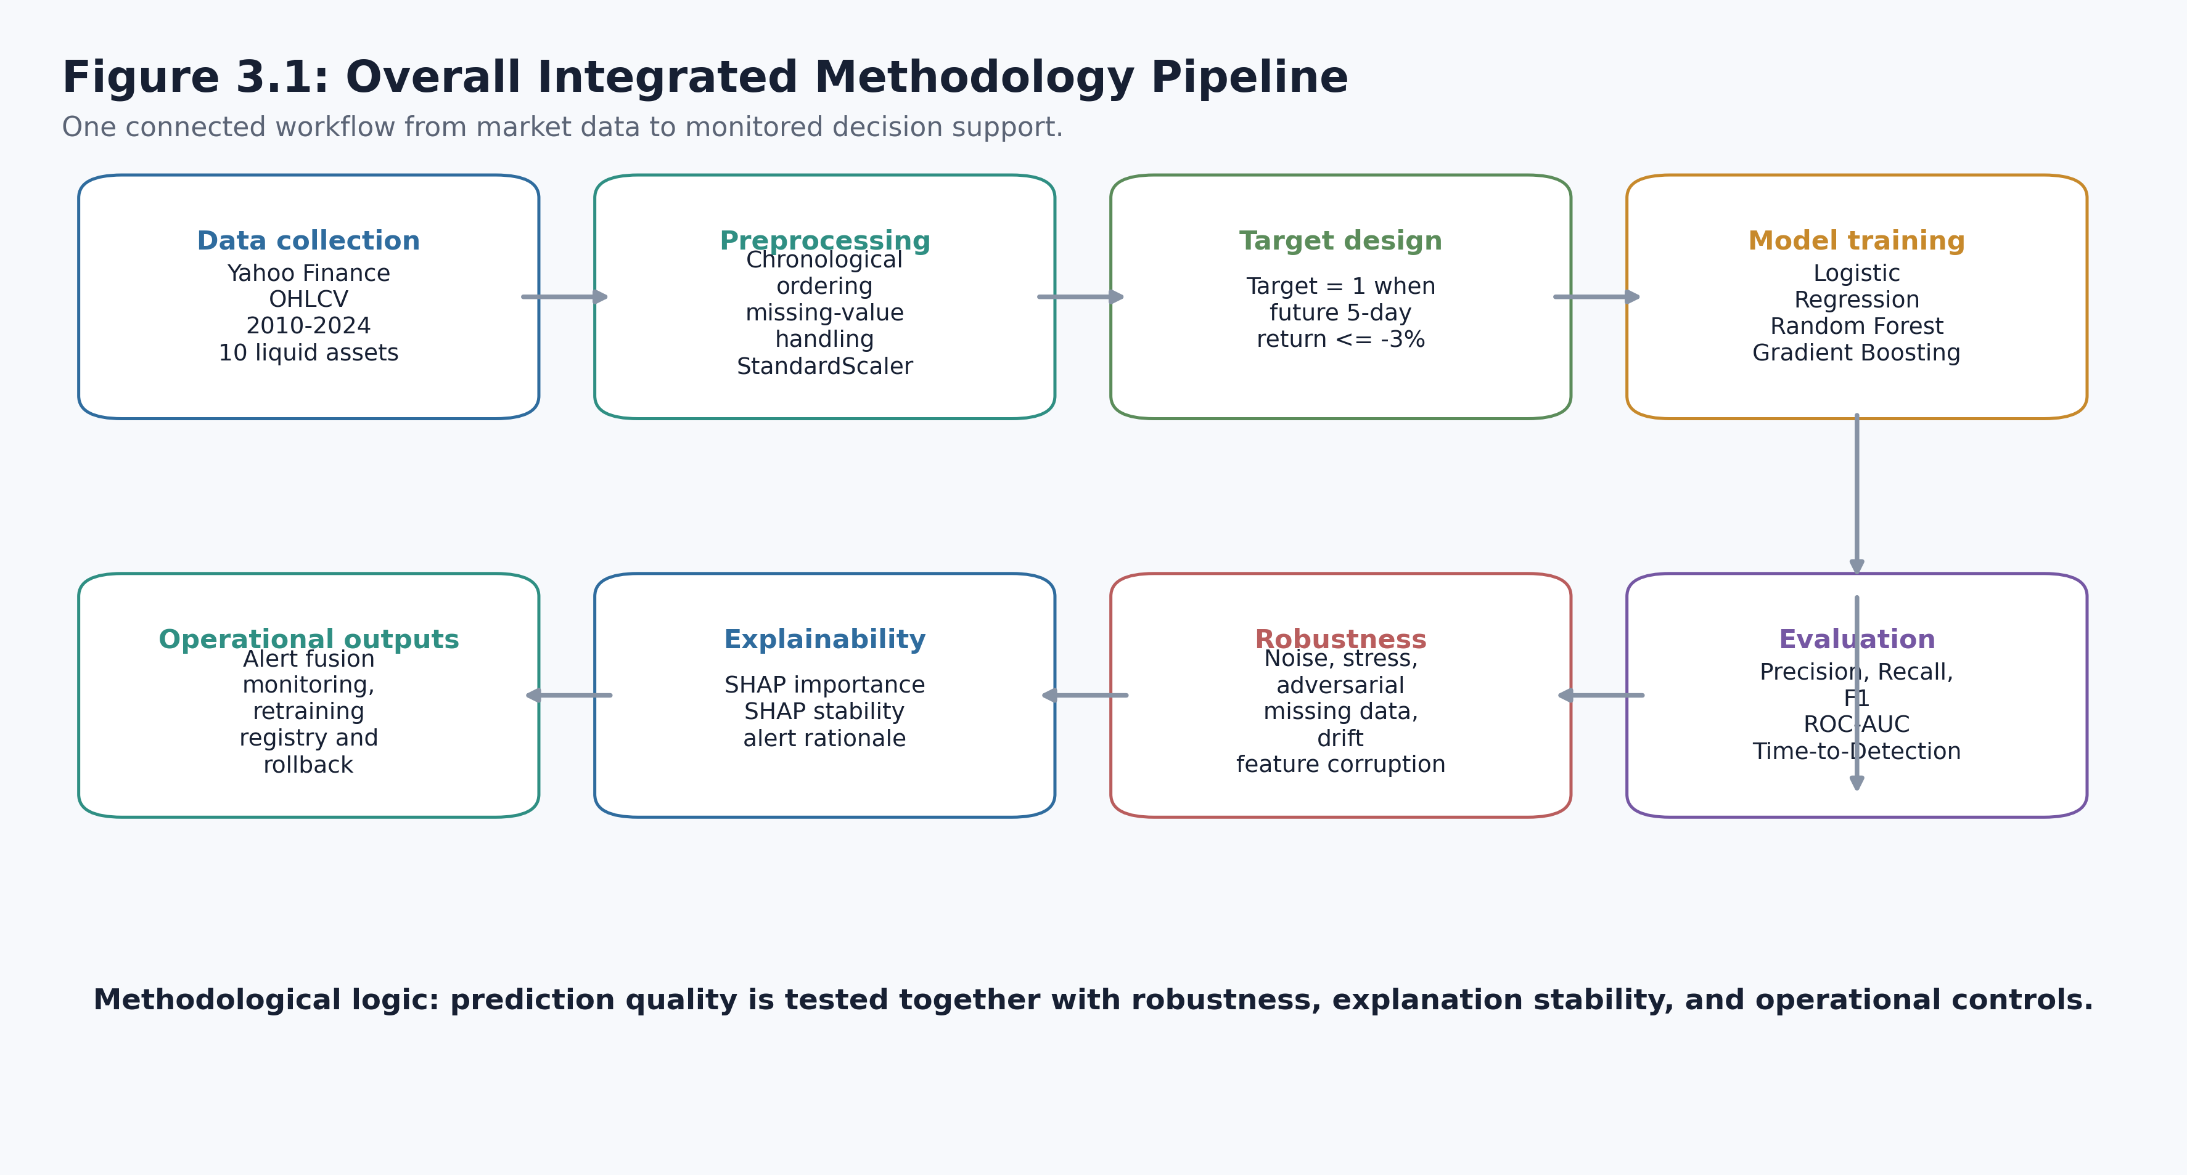
Chapter 3
Methodology overview
One integrated workflow rather than isolated experiments.
Notes:
This is the correct home for Figure 3.1. Walk through the pipeline from market data to feature engineering, model training, alert generation, robustness testing, explainability, and governance artefacts. Emphasise that each later result is produced from the same pipeline, which prevents disconnected claims. The slide supports the methodological integrity of the study. Link forward by zooming into the data, target, and chronological split.

Slide 6
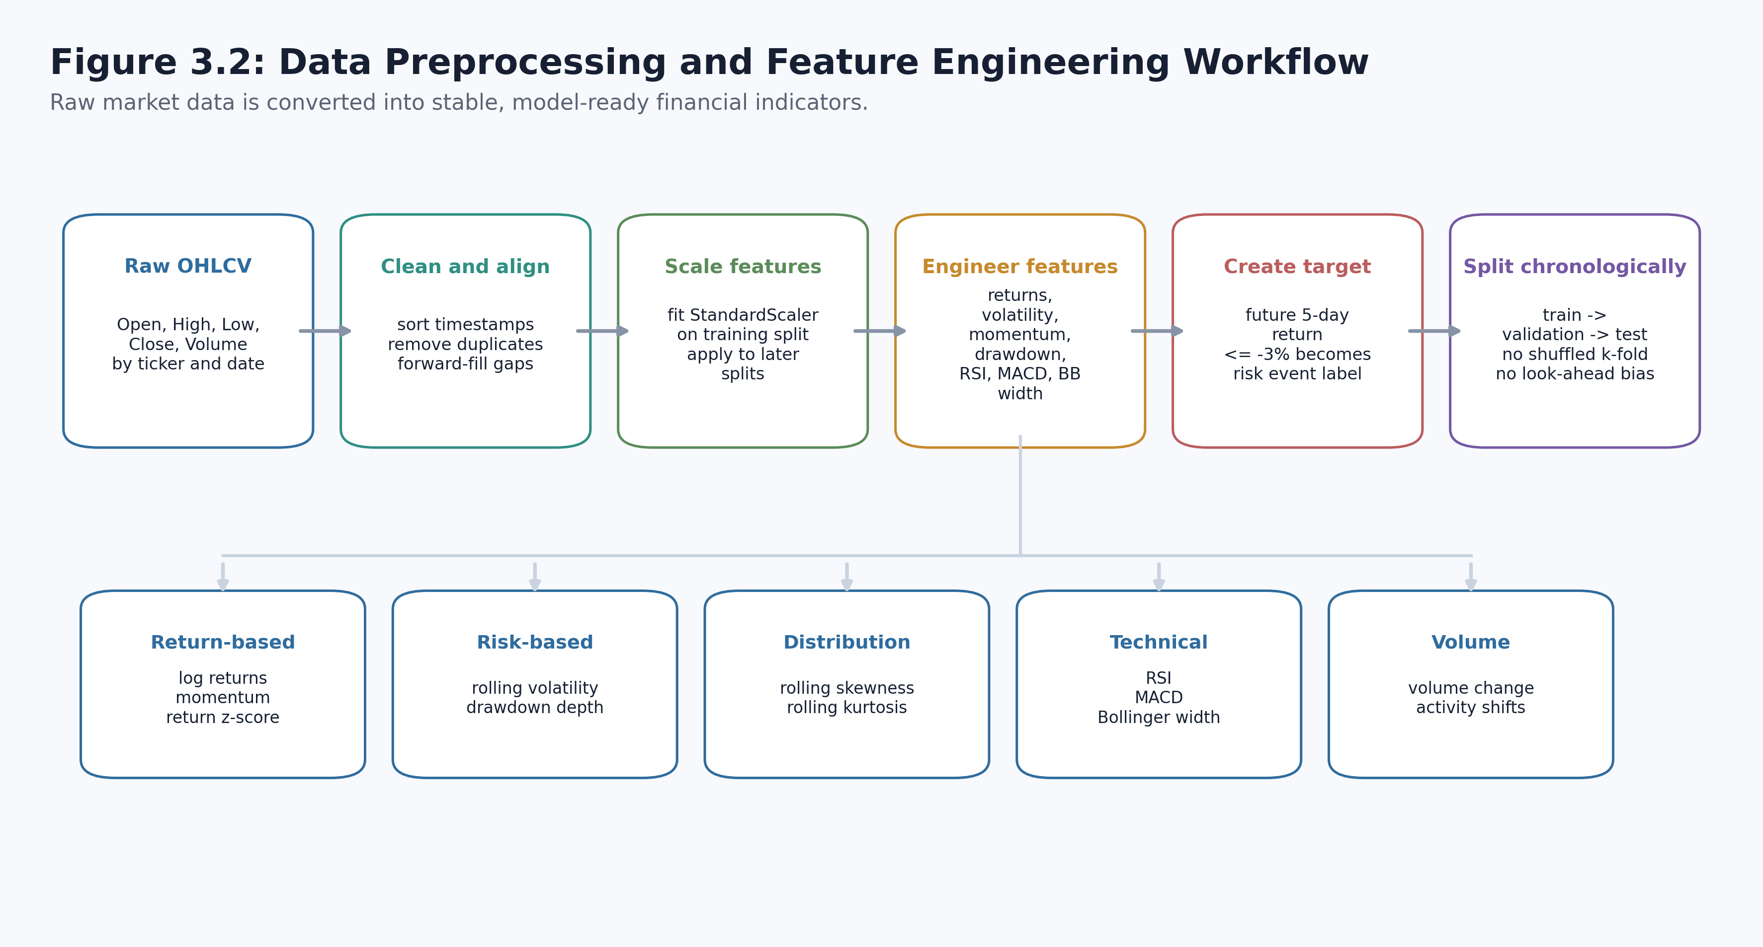
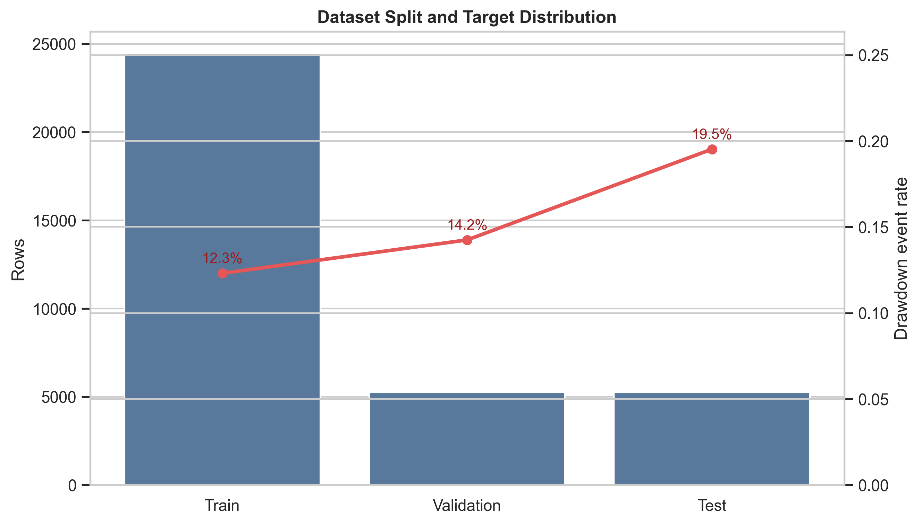
Chapter 3
Data, features, target, and chronological split
The system is trained and tested in time order to avoid future information leakage.
• Public market data transformed into technical, volatility, volume, and drawdown features.
• Target: financially meaningful future downside-risk event.
• Chronological split preserves the real deployment direction: past → future.
Notes:
Explain this in beginner-friendly language if asked: the system learns from earlier dates and is tested on later dates, just as it would be in practice. That is what chronological split means, and it avoids accidentally letting the model learn from the future. The left visual shows how raw market records become engineered features; the right visual shows the target distribution and split used in the experiment. Link forward by explaining the model families and the evaluation design.

Slide 7
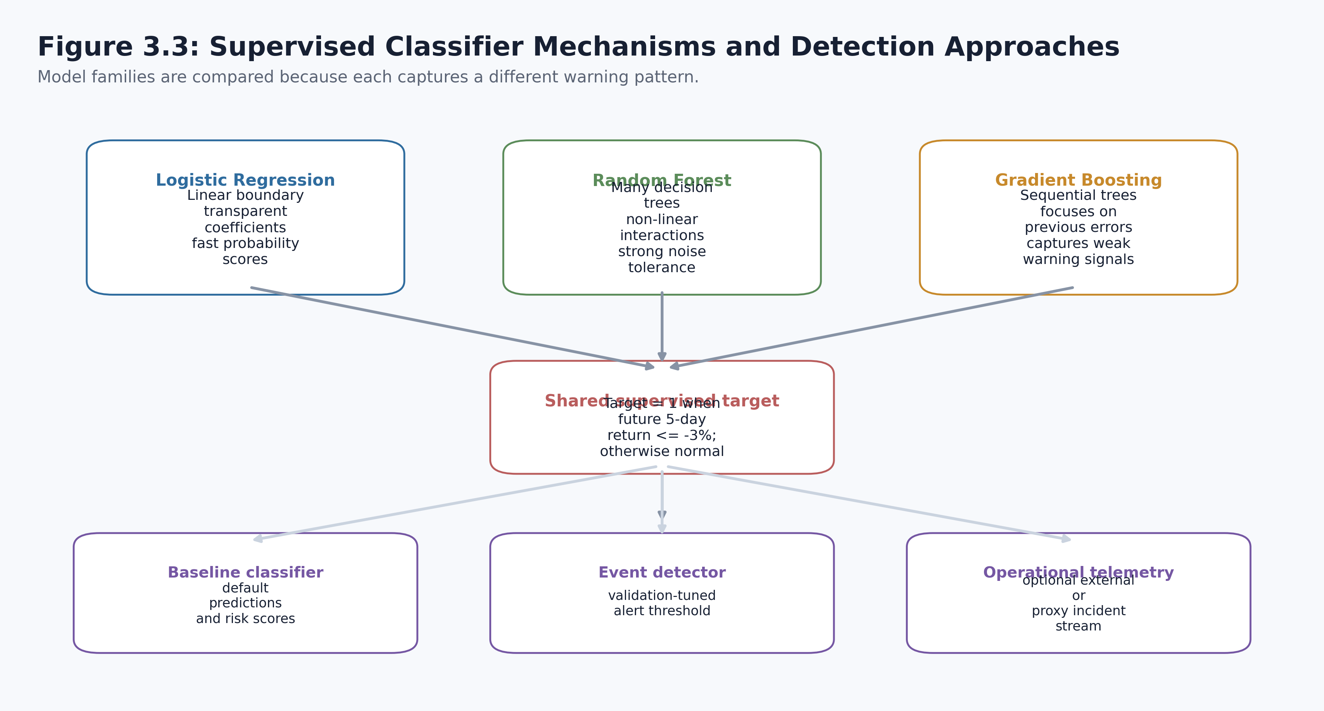
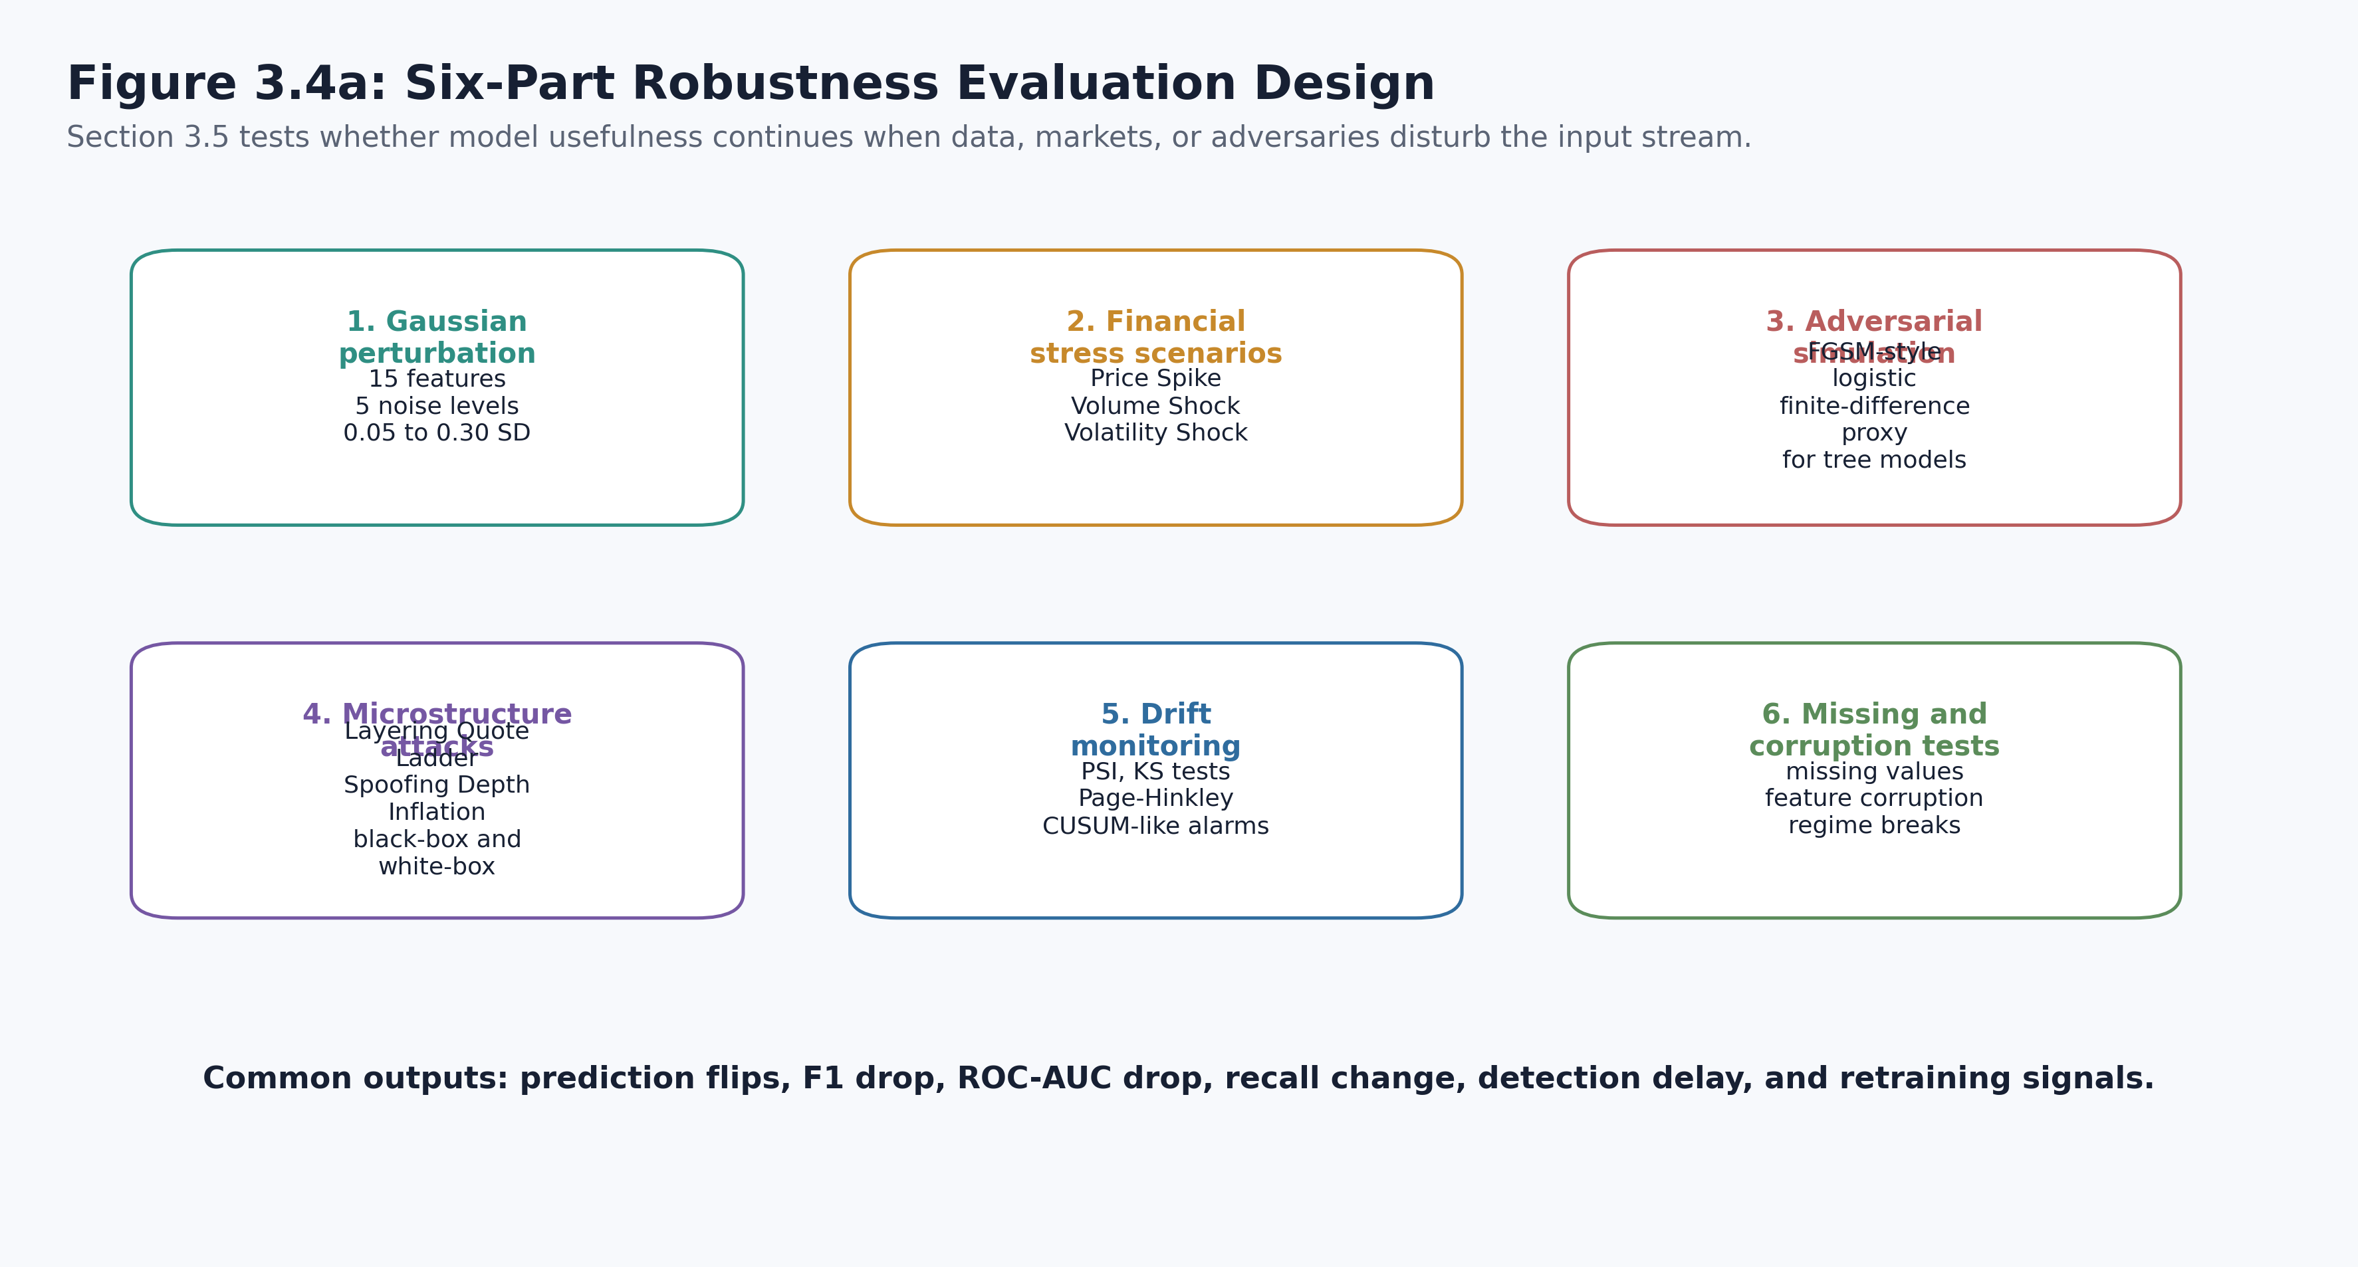
Chapter 3
Model development and evaluation design
The study compares detectors, then deliberately perturbs the system.
Evaluation layers
• Baseline classification
• Threshold optimisation
• Alert fusion
• Noise, stress, adversarial, explainability, drift, cyber-resilience checks
Notes:
This slide explains how the dissertation moves beyond one model and one score. The left figure distinguishes supervised and event-detection mechanisms; the right figure shows the six-part robustness evaluation. If challenged on why so many tests were needed, answer that a financial AI system can fail in more than one way: it may misclassify, degrade under noise, become unstable in its explanations, or trigger poor operational behaviour. Link forward into the results chapter, where these tests begin with the baseline models.

Slide 8
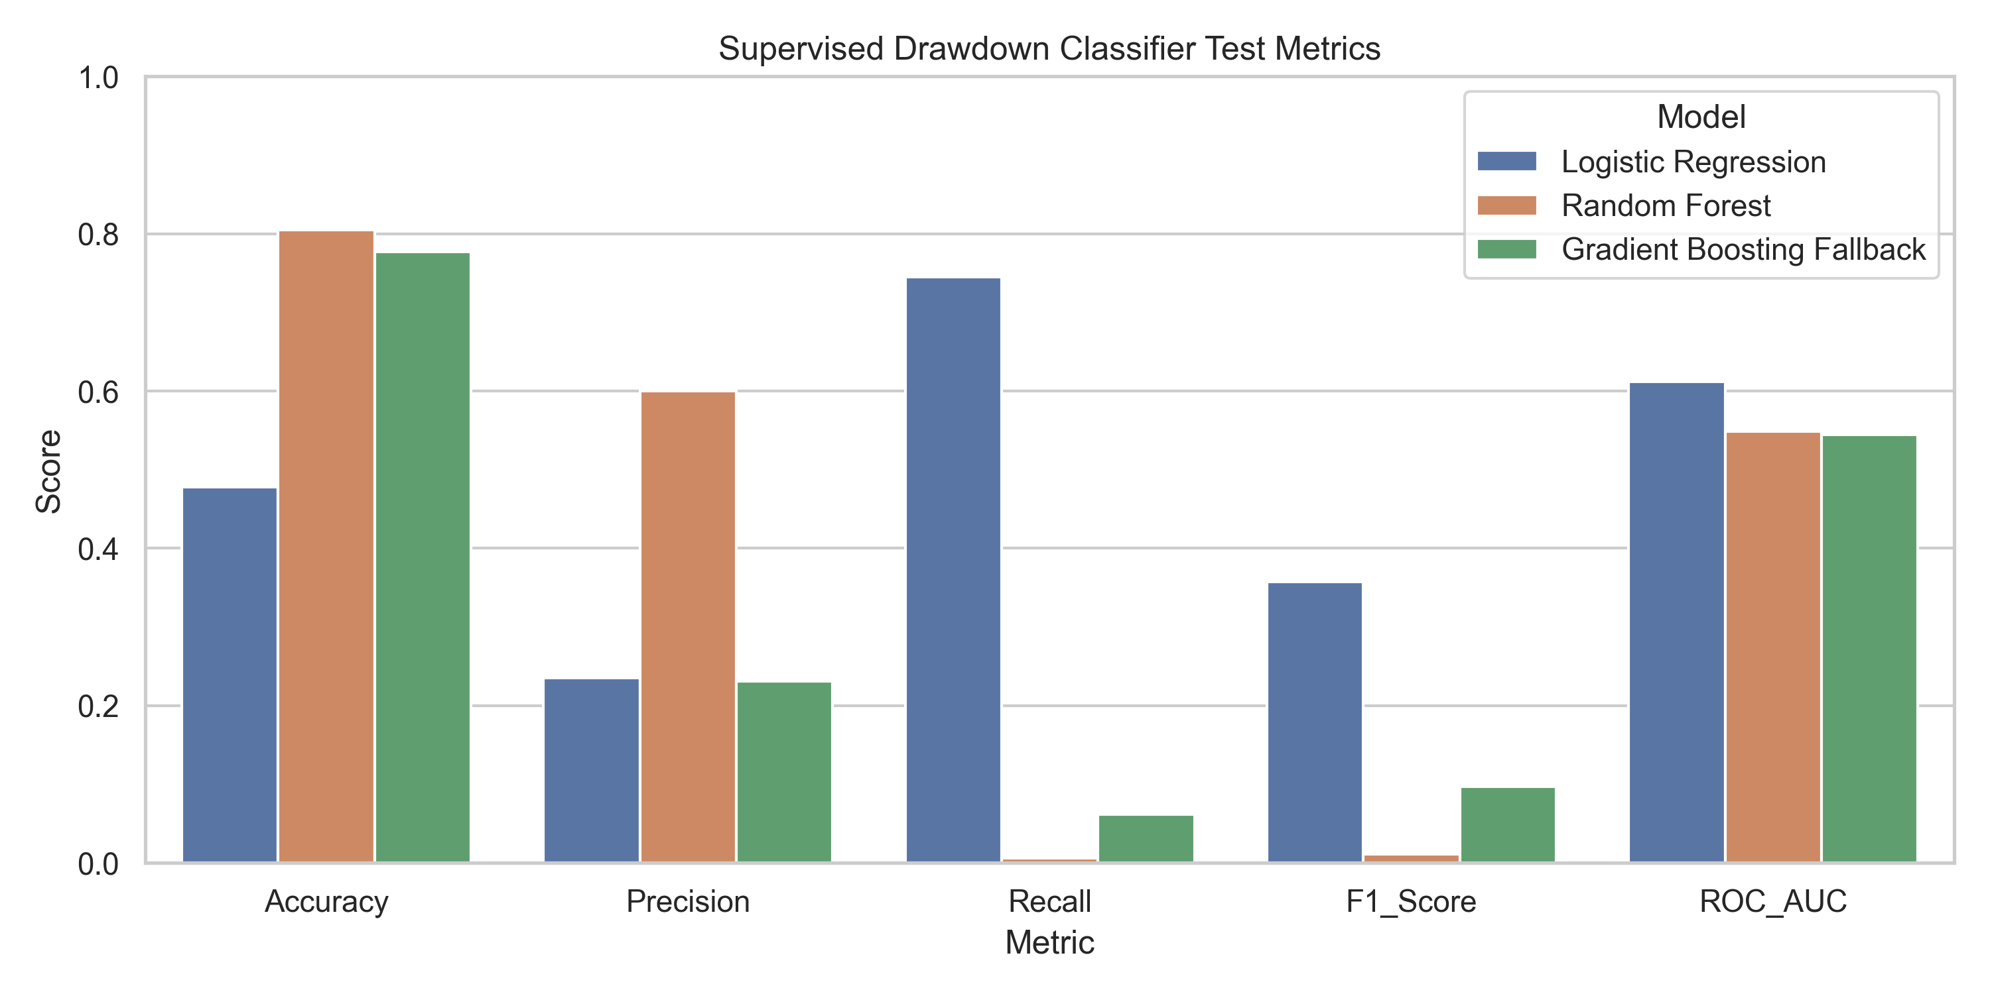
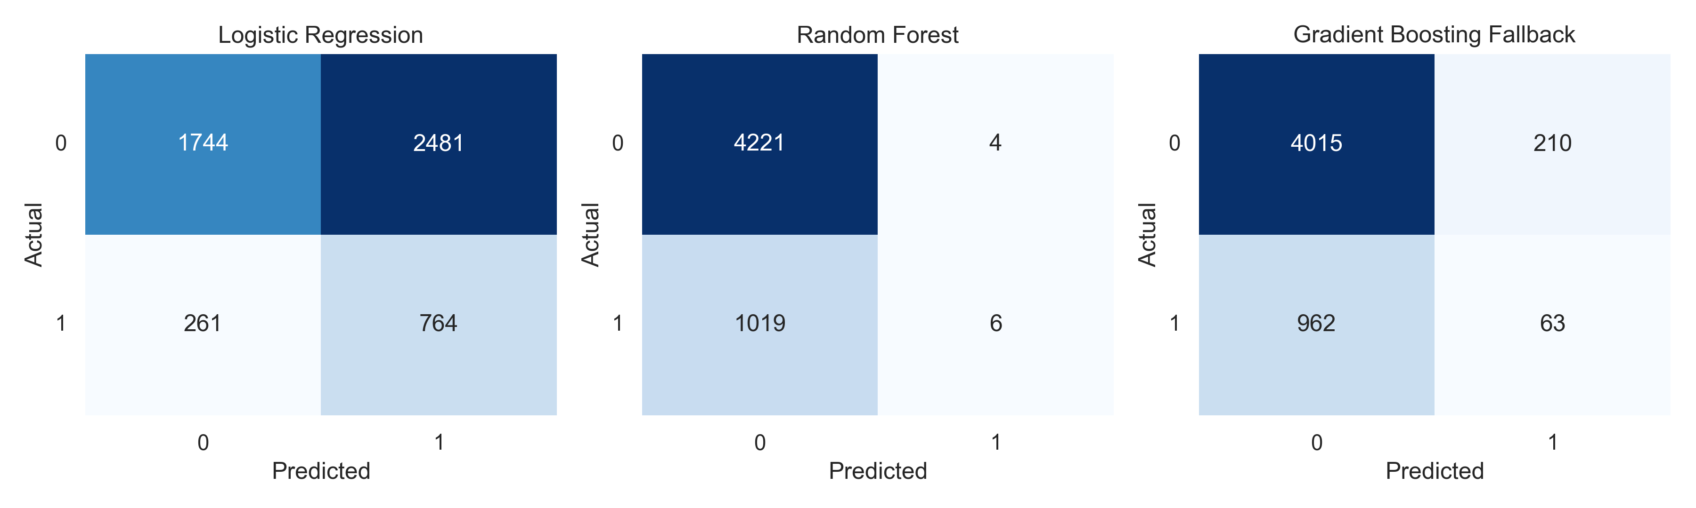
Chapter 4
Baseline results and threshold interpretation
Accuracy alone hid the real behaviour of the models.
0.745
0.006
764 / 1025
Interpretation: the seemingly stronger accuracy of Random Forest was misleading because it almost never found the rare downside events.
LogReg recall
RF recall
events found
Notes:
Lead with the main lesson: for imbalanced downside-risk classification, accuracy is the wrong headline metric. Logistic Regression found 764 of 1,025 test events with recall 0.745, while Random Forest achieved high accuracy but only 0.006 recall, meaning it nearly ignored the events that mattered most. This slide supports RQ1 and justifies the later threshold and alert analysis. A likely challenge is whether the weaker model should be discarded; answer that the result demonstrates why evaluation must be aligned to operational risk, not cosmetic accuracy. Link forward by showing how alert fusion turns model outputs into visible decisions.

Slide 9
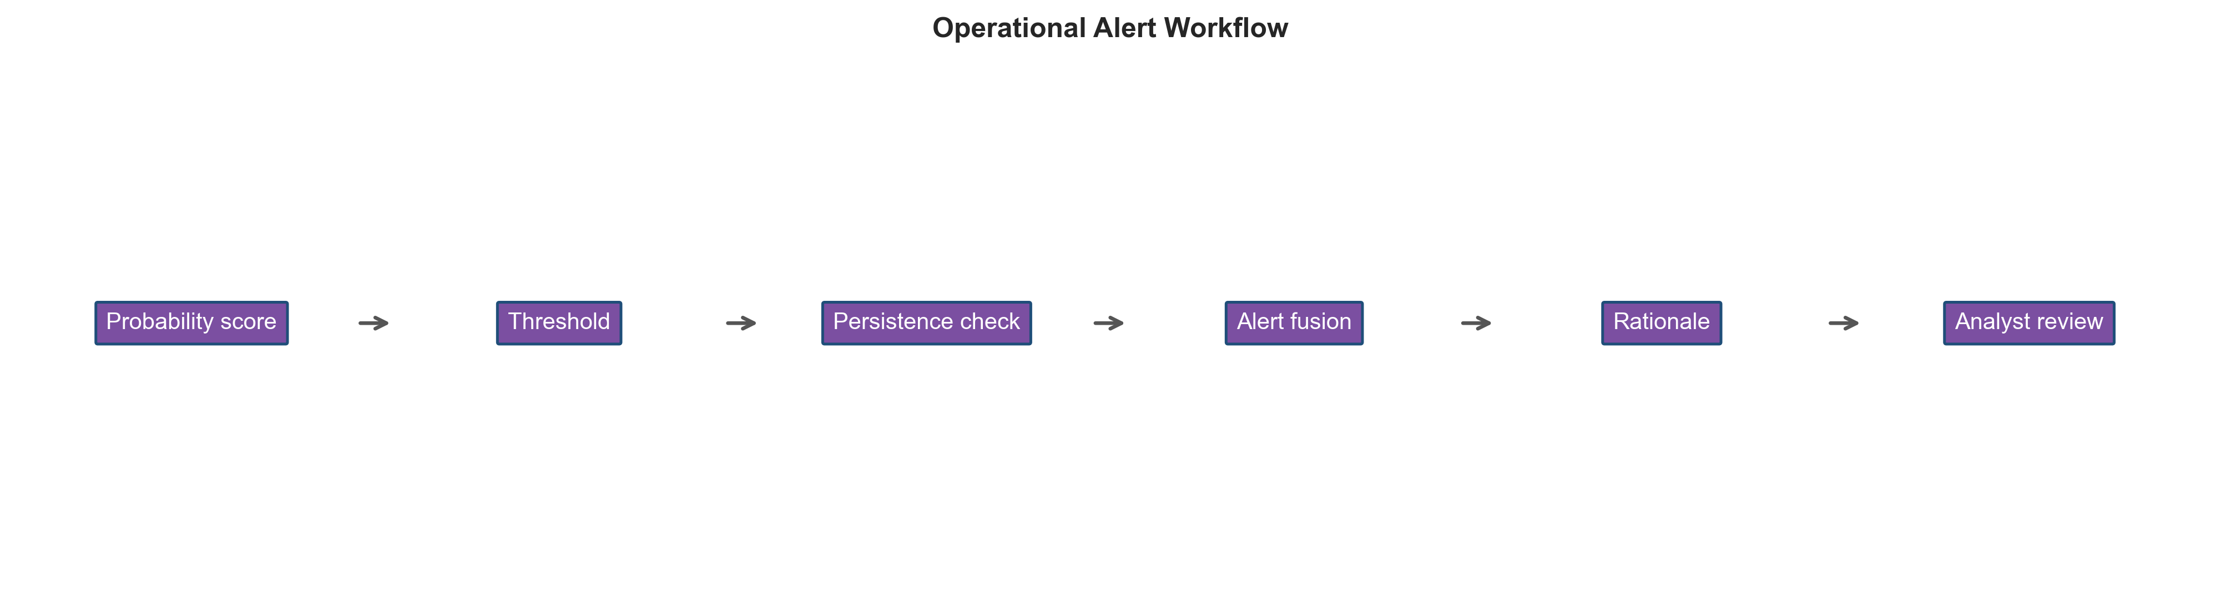
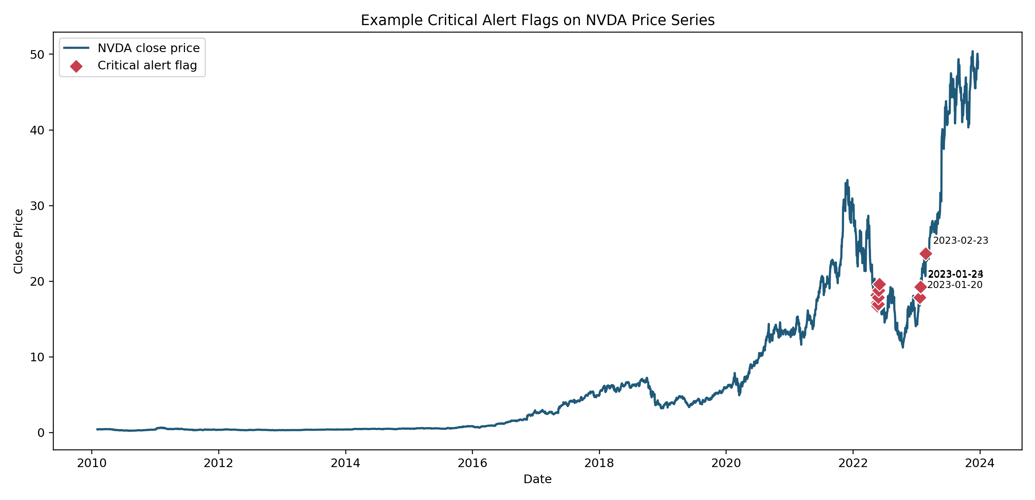
Chapter 4
Event detection, alert fusion, and visible alert evidence
The system produces concrete flags, not only aggregate metrics.
0.957
0.357
Fusion OR recall
Consensus F1
Visible example: flagged dates are overlaid on the stock path, making the alerting subsystem explainable in a presentation and auditable in practice.
Notes:
This is the slide that makes the alert system tangible. Explain that alerting is not based solely on the five-day fall label; the system combines model outputs, anomaly evidence, and alert logic. The left workflow shows the operational process, and the right plot demonstrates real flagged instances on a stock chart. Fusion OR reached 0.957 recall, while consensus produced a more selective F1 of 0.357, so the trade-off is coverage versus alert burden. Link forward by asking the next defence question: what happens when the environment is deliberately disturbed?

Slide 10
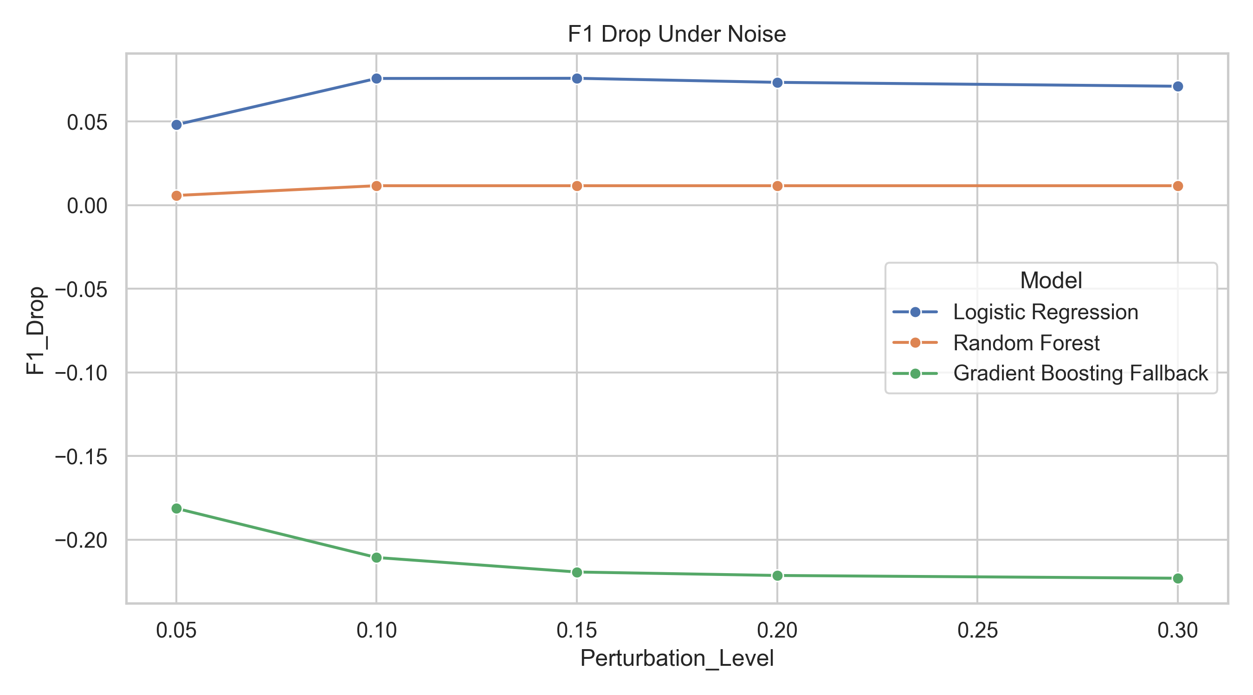
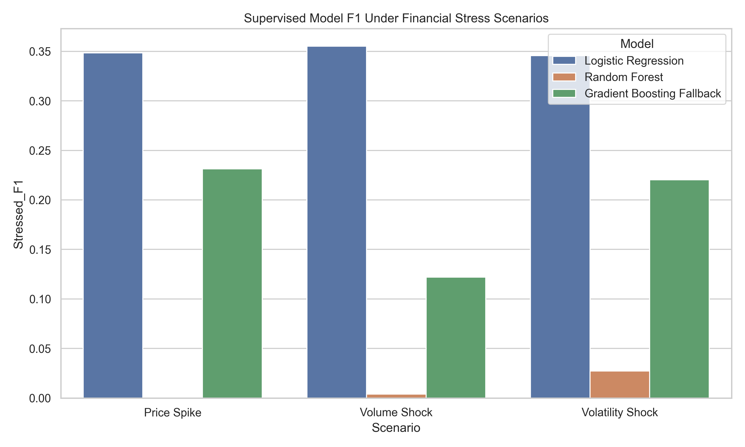
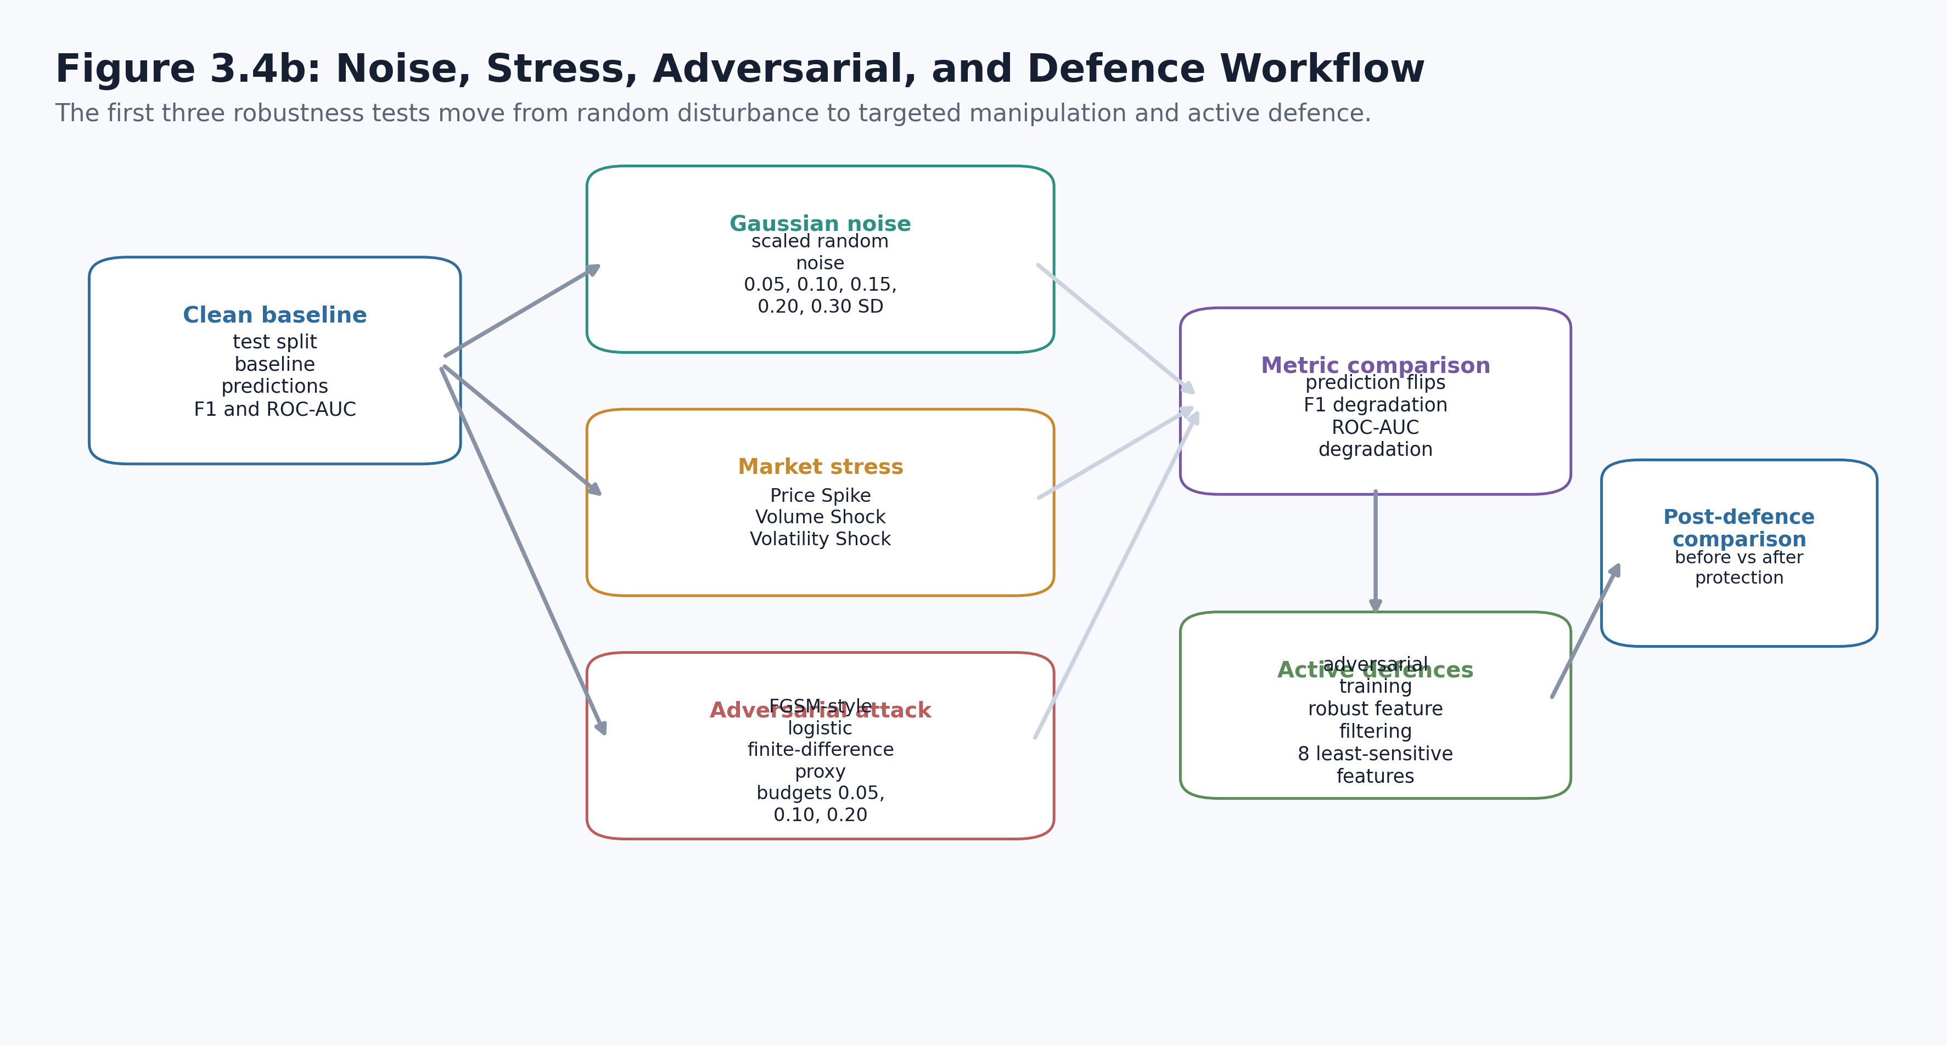
Chapter 4
Robustness, stress, and adversarial testing
The study measures how performance changes when conditions worsen.
• Noise and stress expose performance degradation.
• Adversarial tests reveal vulnerability beyond ordinary market variation.
• The contribution is measured resilience, not an assumption of resilience.
Notes:
Use this slide to show that robustness was actively tested rather than claimed. The first two figures show F1 degradation under noisy and stressed conditions; the workflow figure explains how the adversarial and defence logic fits into the evaluation. This supports RQ3 by demonstrating what changes when data quality or market behaviour worsens. If challenged on whether the model is robust, answer precisely: it is only partially robust, and the dissertation's value is that it quantifies the degradation instead of hiding it. Link forward by moving from output stability to explanation stability and monitoring over time.

Slide 11
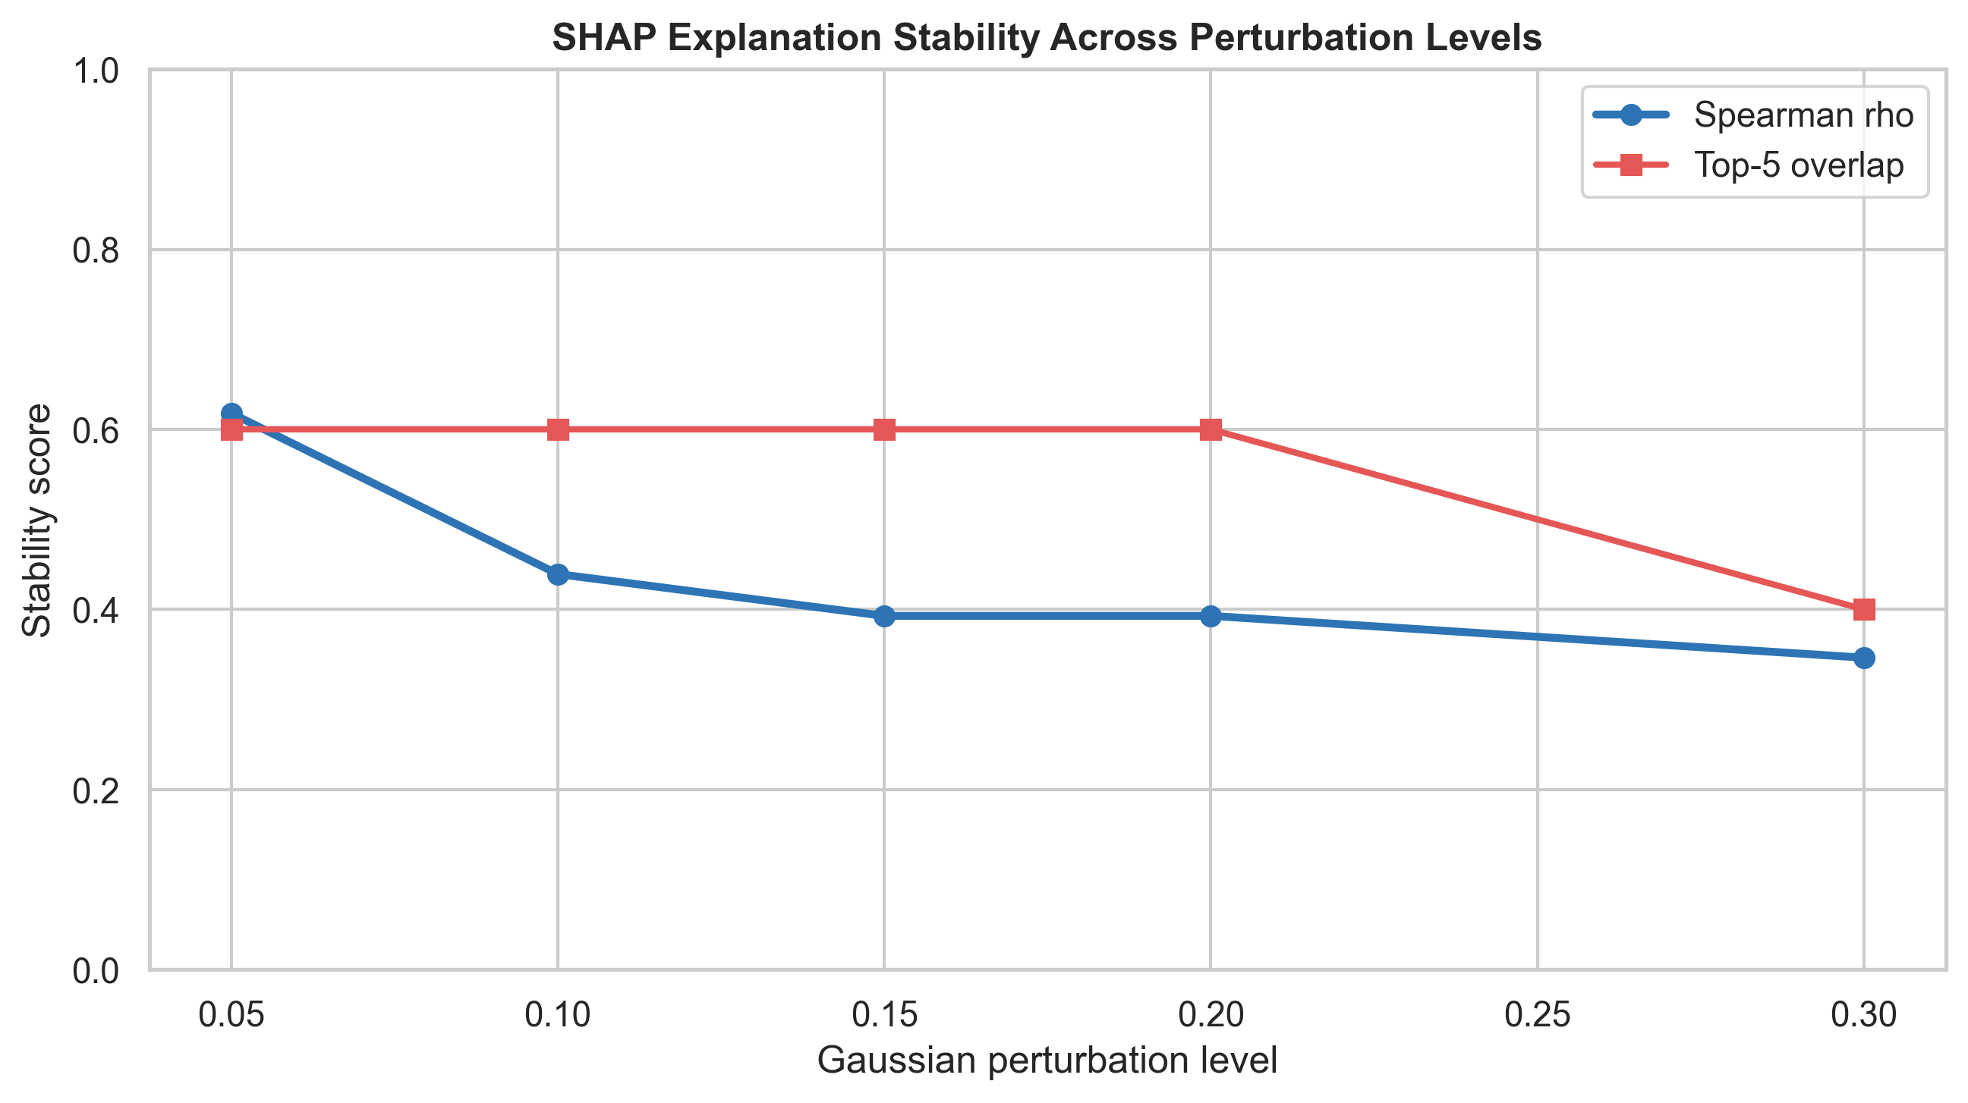
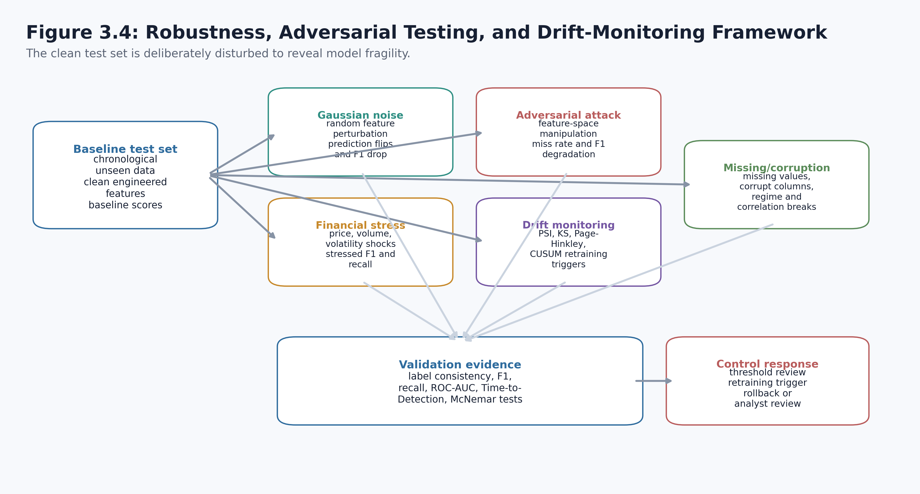
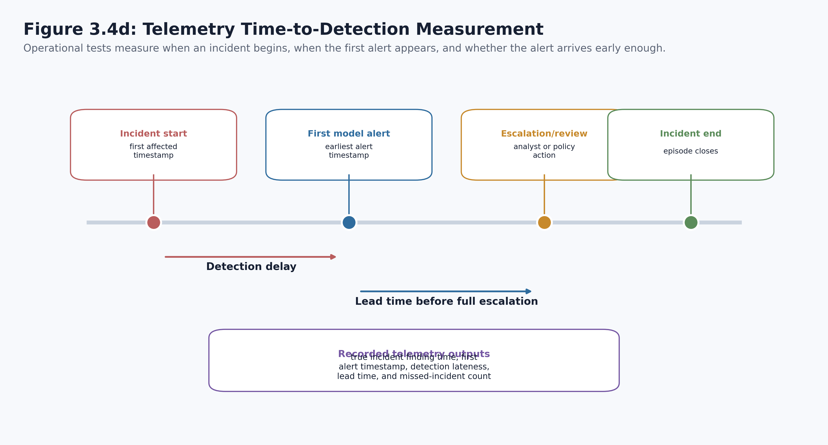
Chapter 4
Explainability, time-to-detection, and drift monitoring
Operational usefulness requires more than a prediction at one timestamp.
• SHAP checks whether explanations remain stable under disturbance.
• Time-to-detection checks whether alerts arrive early enough to matter.
• Drift monitoring creates a governance trigger for review or retraining.
Notes:
Explain that a technically correct prediction is still not enough if the explanation becomes unreliable, the alert arrives too late, or the model quietly drifts after deployment. These three evaluations extend the dissertation from model performance into operational usefulness. The slide supports the broader RQ3 argument that robustness includes explanation stability and monitoring, not only classification scores. Link forward by showing how the dissertation also considered hostile cyber scenarios and implementation coverage.

Slide 12
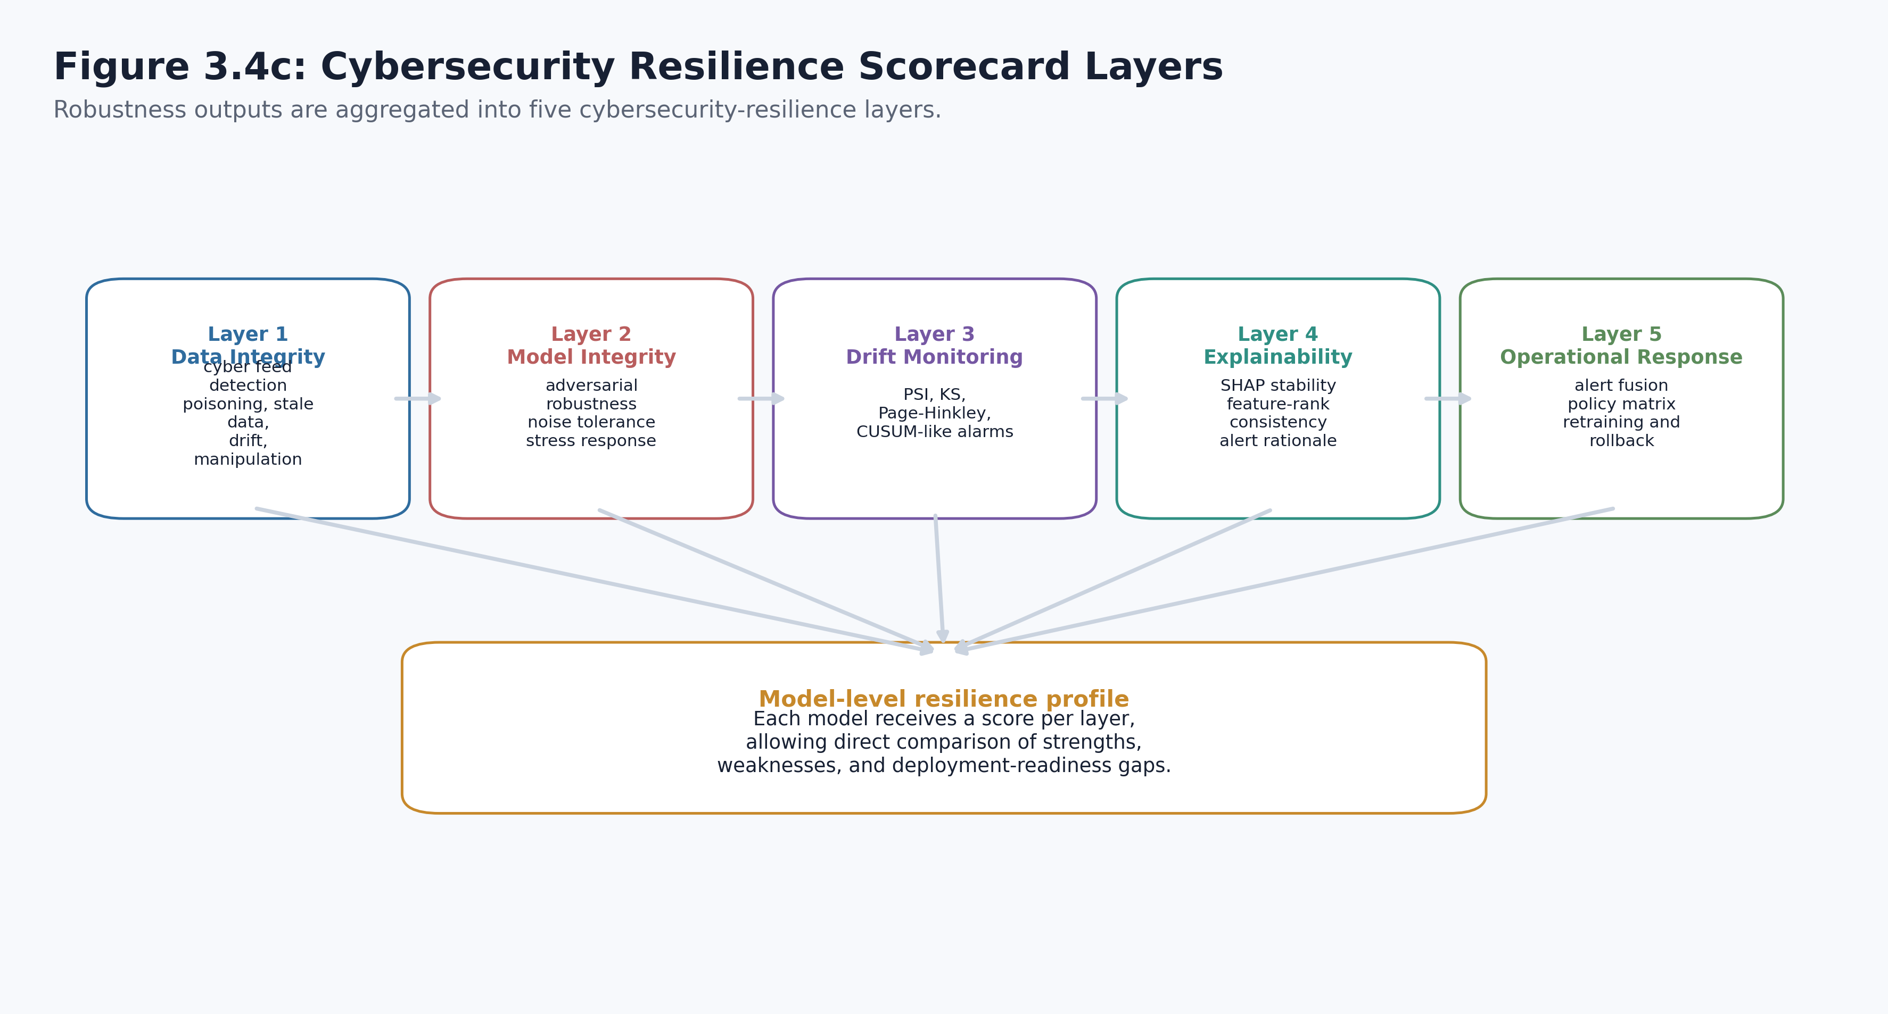
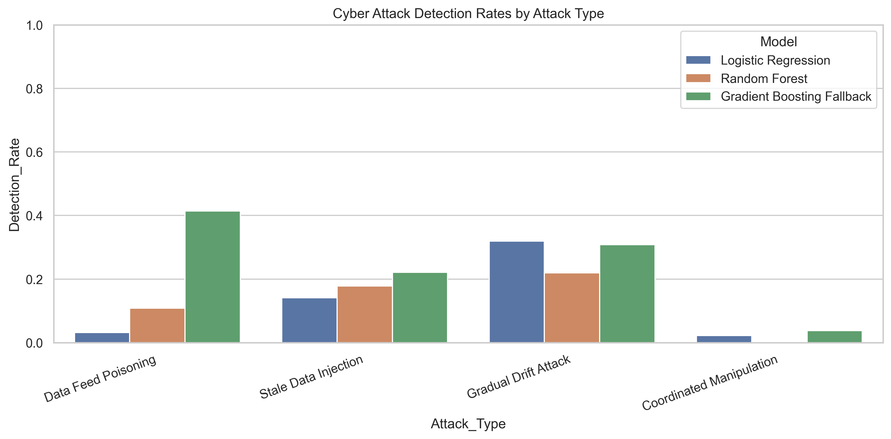
Chapter 4
Cybersecurity resilience and implementation coverage
The prototype was evaluated as a system, not only as a classifier.
• Cyber scenarios test suspicious behaviour coverage.
• Layered resilience separates what is implemented from what remains governance work.
• The integrated matrix confirms that every RQ is supported by explicit evidence.
Notes:
This slide protects you from an examiner treating the dissertation as only a stock-prediction exercise. It shows that cyber-resilience scenarios and implementation coverage were explicitly considered. The important distinction is that the work delivers a functional research prototype and deployment-ready artefacts, not a production-authorised trading system. A likely challenge is overclaiming readiness; answer that the dissertation itself states further engineering, validation, and governance are required. Link forward by summarising the findings against the three research questions.

Slide 13
Chapter 5
RQ-by-RQ evaluation and broader implications
The findings answer the questions, but with important trade-offs.
RQ1
Yes, but metric choice matters
Useful downside-risk detection was achieved; accuracy alone misled.
RQ2
Yes, with alert trade-offs
Fusion improved coverage, while precision and alert burden still matter.
RQ3
Partly, and measurably
Robustness, explanations, and drift degraded under disturbance.
Broader implication: financial AI should be judged by prediction, monitoring, resilience, explanation stability, and governance together.
Notes:
This slide is your synthesis slide. Answer the research questions directly rather than leaving the examiner to infer the answer. RQ1 is supported, but only when the right metrics are used. RQ2 is supported because alert fusion improves suspicious-behaviour coverage, though the precision burden remains. RQ3 is only partly positive because the system remains evaluable under disturbance, but the tests also reveal degradation. The dissertation's broader implication is that financial AI evaluation must be multidimensional. Link forward into the conclusion, contribution, limitations, and recommendations.

Slide 14
Chapter 6
Conclusion, contribution, limitations, recommendations
A strong conclusion is precise about both achievement and boundary.
Contribution
Limitations
Recommendations
• Integrated evaluation framework
• Visible alert evidence
• Deployment-oriented artefacts
• US large-cap scope
• Public data source
• Prototype, not production
• Use recall-sensitive metrics
• Monitor drift continuously
• Retain human review
Final claim: the dissertation demonstrates a usable research prototype that exposes when a financial AI system works, when it degrades, and what must be monitored before deployment.
Notes:
Conclude with balance. State the contribution clearly, but also state the boundaries clearly so the examiner does not need to force them out of you. The work contributes an integrated evaluation framework and concrete artefacts, but it is limited by data scope and by prototype status. The recommendations follow directly from the evidence: use recall-sensitive metrics, maintain drift monitoring, and preserve human review. Link forward to the final closing slide.

Slide 15
Thank you
Questions and discussion
Defence anchor: A financial AI system should be judged by what it predicts, what it flags, how it degrades, and whether humans can still trust it.
Notes:
Close cleanly. If the examiner opens with a broad question, return to the defence anchor on the slide: prediction, alerting, degradation, and trust. This final slide does not introduce new evidence; it gives the room one concise sentence to remember.

Slide 16
MIXED PRESENTATION
Dissertation Structure with Code Evidence
A combined deck based on the defence presentation, enriched with selected reference outputs from the implementation notebook.
01
02
03
04
Context
Gap & RQs
Method
Results
Problem setting and need for robust financial AI evaluation.
Research questions linked to reliability, stress response, explainability, and resilience.
Chronological split, feature engineering, detector comparison, and integrated pipeline.
Baseline model behaviour, alert fusion, and operational metrics.
05
06
07
08
Stress Tests
SHAP & Drift
Findings
Limits & Future
Noise perturbation, financial stress scenarios, and adversarial manipulation checks.
Feature attribution stability and drift monitoring evidence.
RQ-by-RQ interpretation and practical implications.
Scope boundaries, data realism, deployment readiness, and future extensions.
This slide bridges the clean dissertation storyline with the implementation evidence included in the appendix.

Slide 17
DECK MIX
How the Two Presentations Were Combined
The dissertation defence deck remains the main storyline; the downloaded deck and code outputs inform the evidence appendix.
Base dissertation deck
Presentation framing
Code-output reference
Keeps the 15-slide chapter-by-chapter defence flow.
Uses the widescreen visual system already built for the dissertation.
Maintains existing narrative anchors and conclusion slides.
Uses the requested section order: context, gap, RQs, method, results, stress, SHAP, findings, limits.
Preserves thesis-facing language from the dissertation presentation.
Avoids duplicate full-slide copies where content overlaps.
Adds selected tables and figures exported by the notebook pipeline.
Includes model metrics, stress tests, SHAP, drift, cyber resilience, and alert fusion.
Supports examiner questions without overloading the main talk.
Referenced source deck: Priyanka_Dissertation_Presentation.pptx

Slide 18
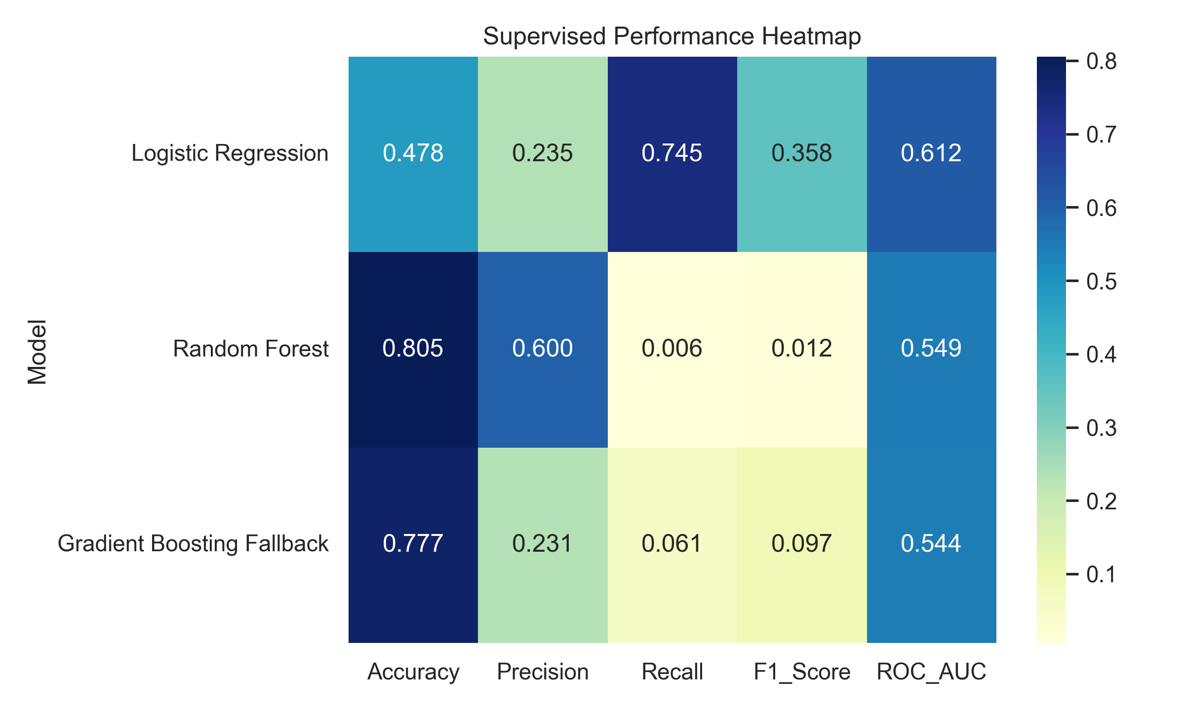
CODE OUTPUT REFERENCE
Baseline Supervised Model Metrics
Direct table output from supervised_model_metrics.csv, paired with the exported model-performance heatmap.
Model | Acc. | Prec. | Recall | F1 | AUC | FP | FN
Logistic Reg. | 0.478 | 0.235 | 0.745 | 0.358 | 0.612 | 2,481 | 261.00
Random Forest | 0.805 | 0.600 | 0.006 | 0.012 | 0.549 | 4.00 | 1,019
GB Fallback | 0.777 | 0.231 | 0.061 | 0.097 | 0.544 | 210.00 | 962.00
Reference note
Highest test recall appears for Logistic Regression (0.745).
The table makes the accuracy-recall trade-off visible for examiner follow-up.
Use this slide as backup evidence for the Chapter 4 model-performance discussion.
Code outputs are included as reference evidence from dissertation_outputs.

Slide 19
CODE OUTPUT REFERENCE
Robustness and Stress-Test Evidence
Figures exported from the notebook show how model behaviour changes under perturbation and stress scenarios.
Model | Noise | Flip | Base F1 | Pert. F1 | AUC Drop
Logistic Reg. | 0.050 | 0.429 | 0.358 | 0.310 | 0.078
Random Forest | 0.050 | 0.003 | 0.012 | 0.006 | 0.024
GB Fallback | 0.050 | 0.525 | 0.097 | 0.278 | 0.061
Logistic Reg. | 0.100 | 0.454 | 0.358 | 0.282 | 0.109
Random Forest | 0.100 | 0.002 | 0.012 | 0.000 | 0.062
GB Fallback | 0.100 | 0.716 | 0.097 | 0.308 | 0.061
Code outputs are included as reference evidence from dissertation_outputs.

Slide 20
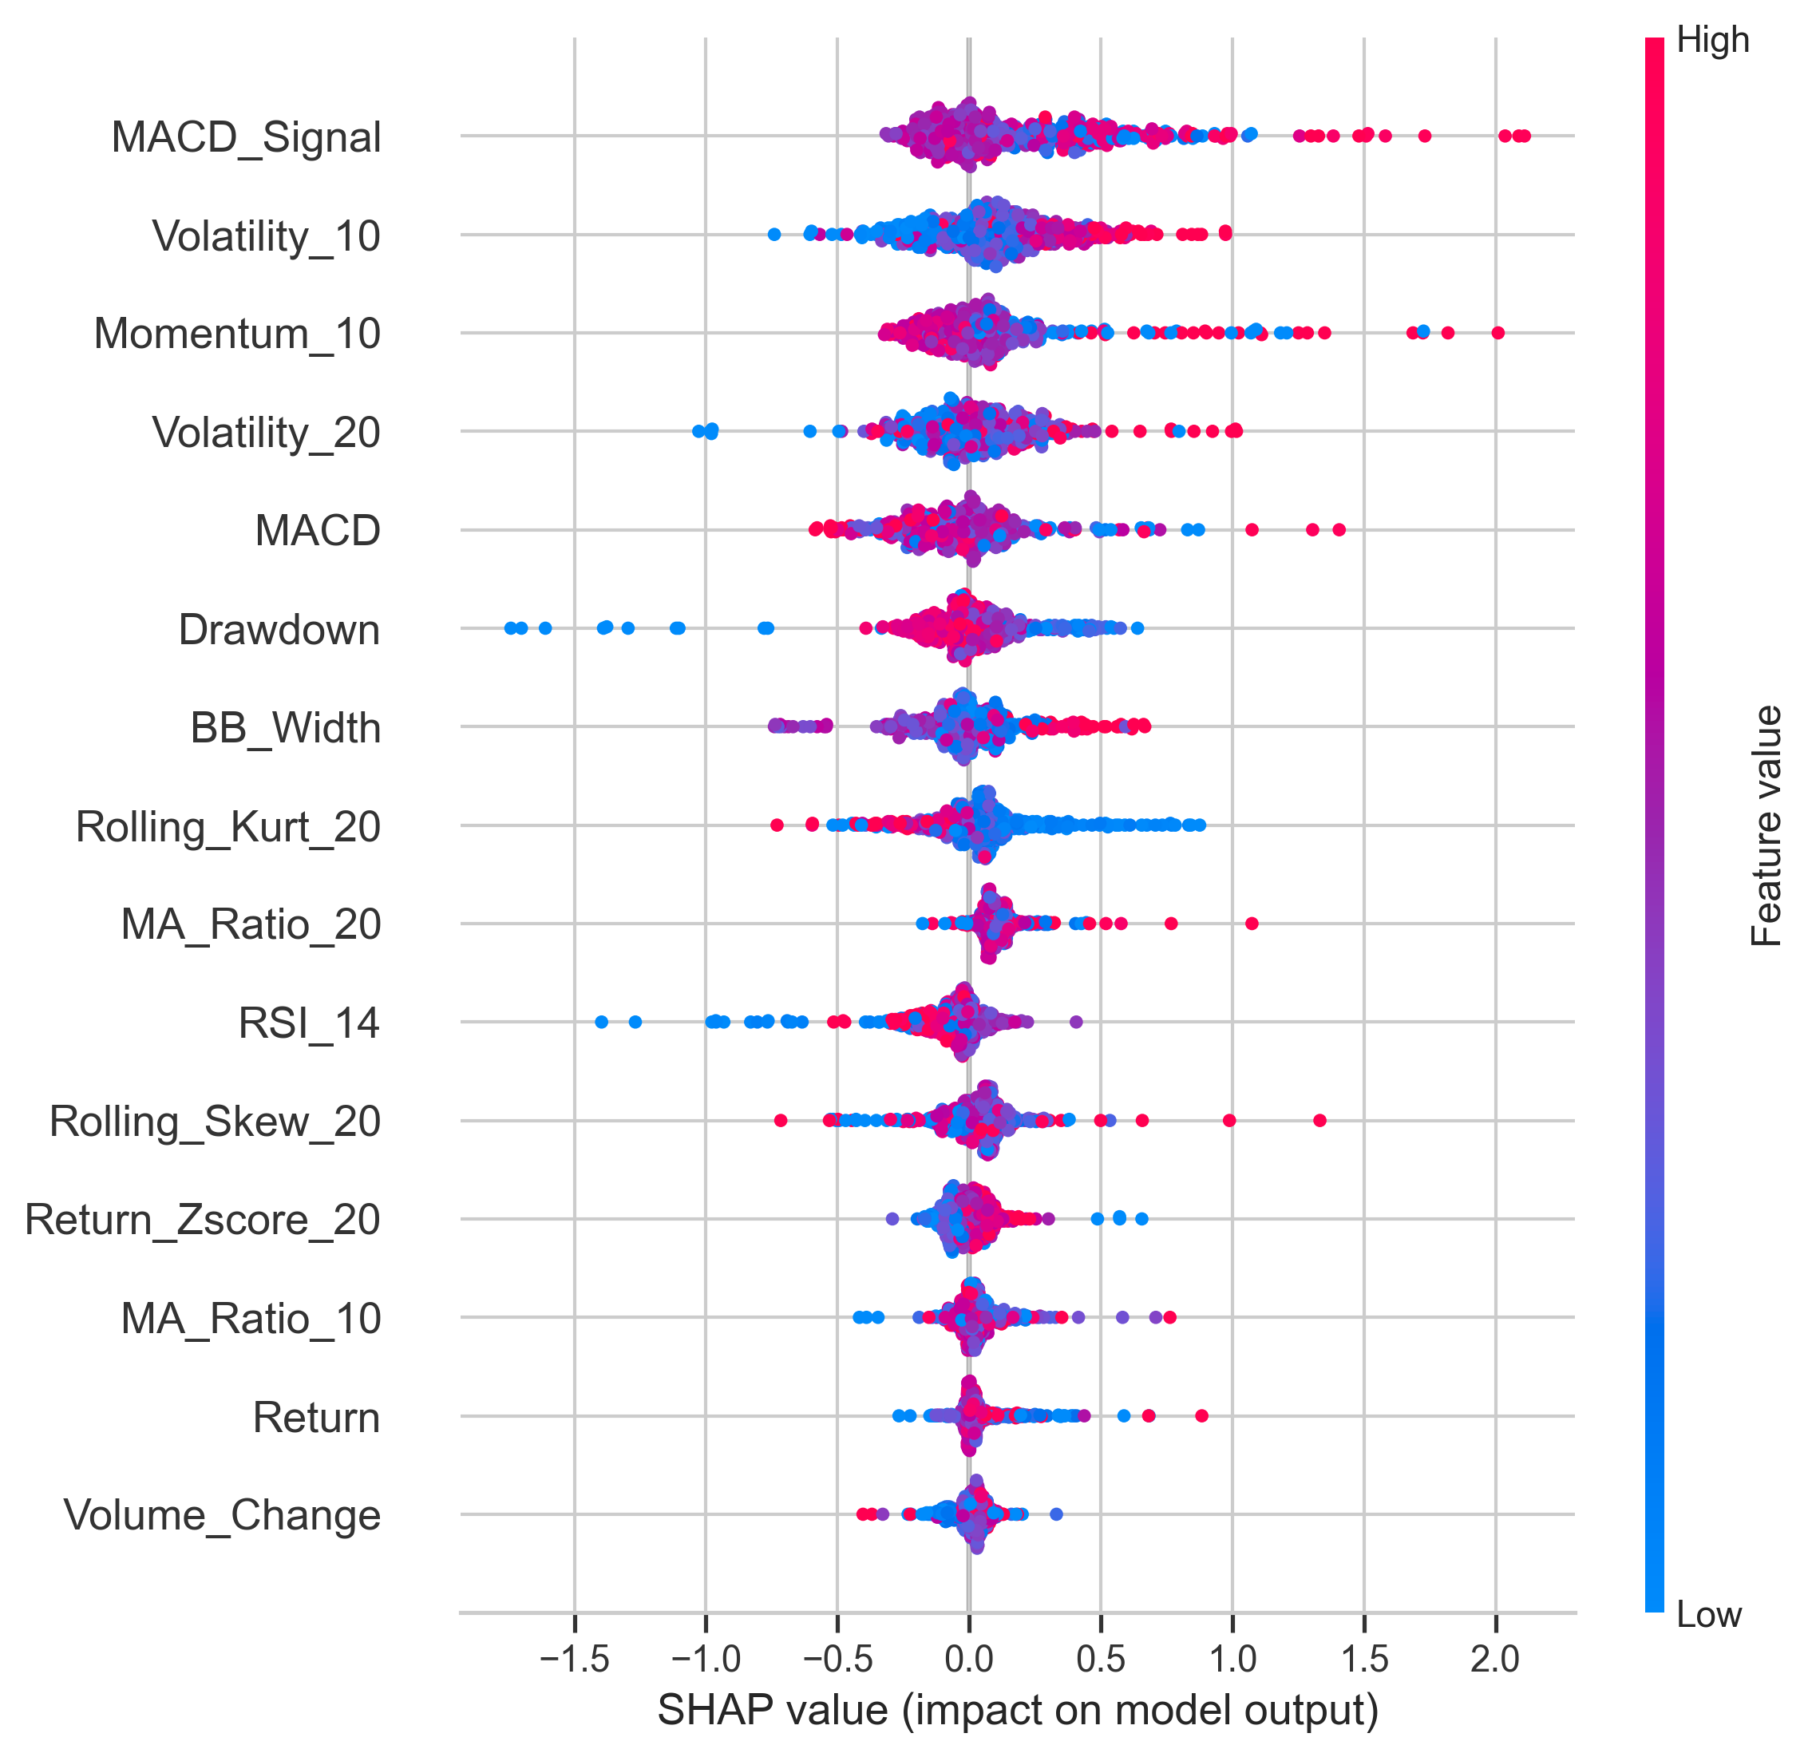
CODE OUTPUT REFERENCE
SHAP Explainability and Drift Monitoring
Feature-attribution and drift outputs support the explainability and monitoring claims in Chapter 4.
Top SHAP Feature | Mean |SHAP|
MACD_Signal | 0.279
Volatility_10 | 0.209
Momentum_10 | 0.180
Volatility_20 | 0.166
MACD | 0.165
Drawdown | 0.144
BB_Width | 0.139
Split | Window Start | Window End | Features Checked
Test | 2021-10-21 | 2022-01-20 | 15.00
Test | 2022-01-21 | 2022-04-21 | 15.00
Test | 2022-04-22 | 2022-07-22 | 15.00
Test | 2022-07-25 | 2022-10-20 | 15.00
Test | 2022-10-21 | 2023-01-23 | 15.00
Reference use
Use this as backup for questions about which variables drive alerts and how drift monitoring was operationalised.
Code outputs are included as reference evidence from dissertation_outputs.

Slide 21
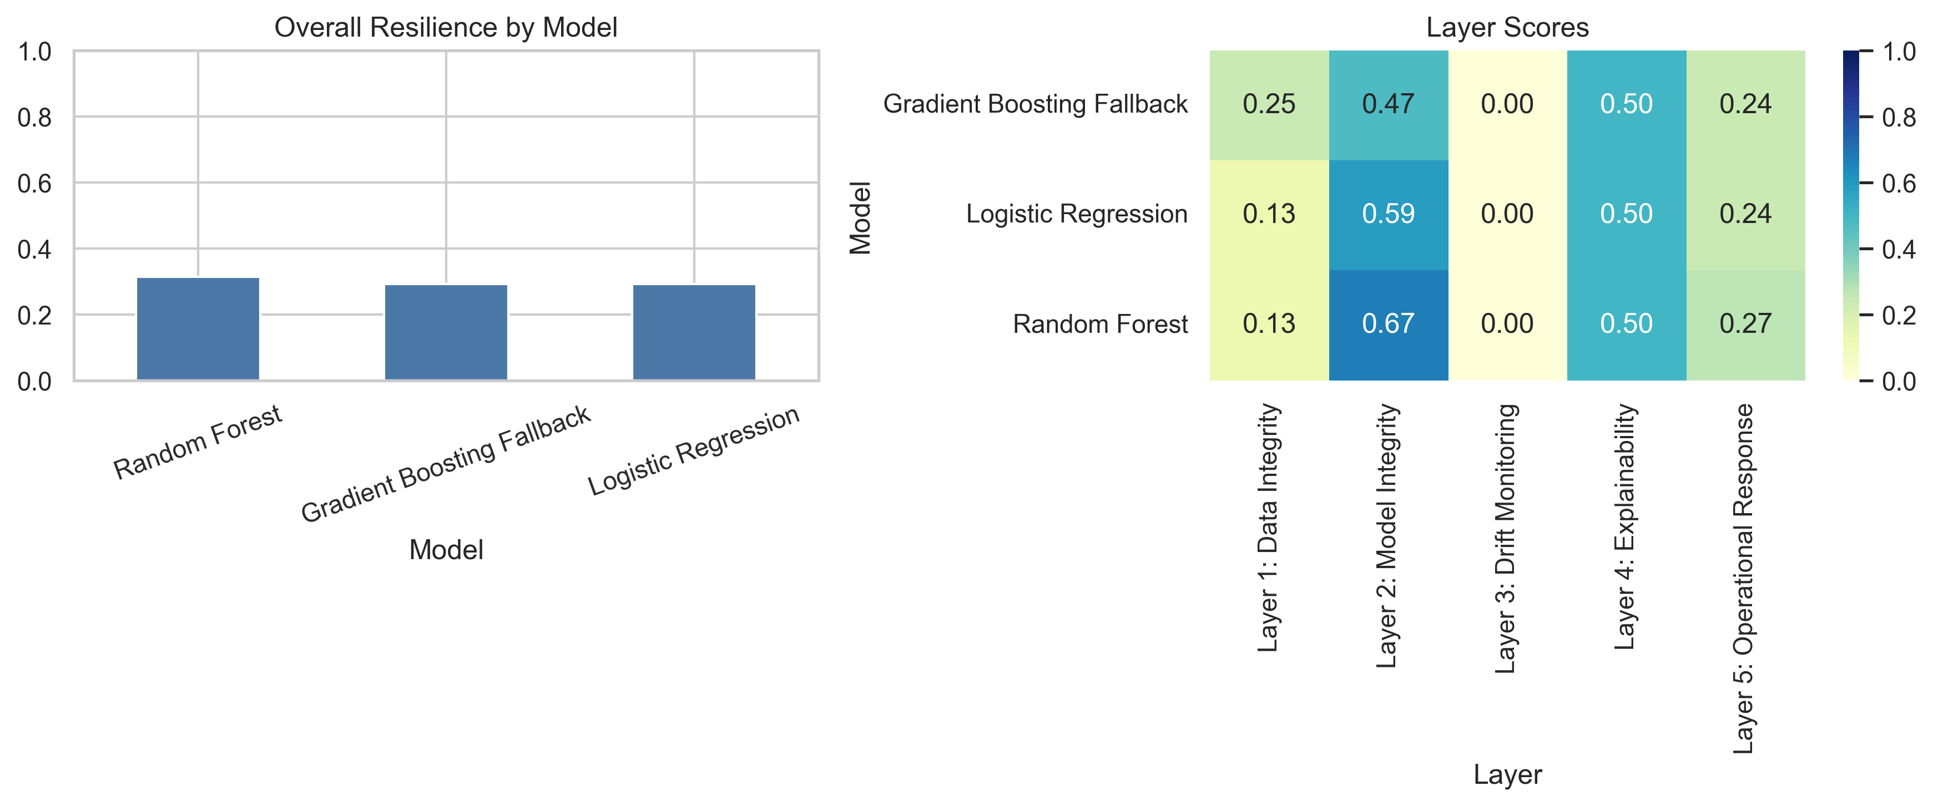
CODE OUTPUT REFERENCE
Cyber Resilience and Alert Evidence
Implementation outputs connect the model evaluation to cyber-resilience and operational alerting claims.
Policy | Split | Precision | Recall | F1 Score
Fusion_OR_Alert | Test | 0.208 | 0.957 | 0.342
Fusion_Consensus_Alert | Test | 0.234 | 0.748 | 0.357
Fusion_OR_Alert | Validation | 0.157 | 0.951 | 0.270
Model | Layer | Resilience Score | Score Percent
GB Fallback | Layer 1: Data Integrity | 0.245 | 24.50
GB Fallback | Layer 2: Model Integrity | 0.473 | 47.30
GB Fallback | Layer 3: Drift Monitoring | 0.004 | 0.400
Code outputs are included as reference evidence from dissertation_outputs.

Slide 22
REFERENCE APPENDIX
Where to Find the Code Outputs
A compact map of the evidence files used in the mixed presentation.
Model metrics
dissertation_outputs/results/supervised_model_metrics.csv
dissertation_outputs/figures/supervised_model_performance_heatmap.png
Stress tests
dissertation_outputs/results/supervised_robustness_results.csv
dissertation_outputs/figures/supervised_stress_scenario_f1_comparison.png
SHAP & drift
dissertation_outputs/results/shap_feature_importance_test_sample.csv
dissertation_outputs/results/drift_alarm_summary.csv
Cyber & alerts
dissertation_outputs/results/cybersecurity_resilience_scorecard.csv
dissertation_outputs/figures/alert_flags_nvda_example.png
All added reference slides are editable and can be moved into the main talk if required.

