Slide 1
X Education
Lead Scoring Case Study
Group Members:-
Priyanka Sharma
Mahesh

Slide 2
Background
X Education , An education company named sells online courses to industry professionals
Many interested professionals land on their website
The company markets its courses on several websites like Google. Once these people land on the website, they might browse the courses or fill up a form for the course or watch some videos

Slide 3
Problem Statement
X Education gets a lot of leads but its lead conversion rate is very poor
To make this process more efficient, the company wishes to identify the most potential leads, also known as ‘Hot Leads’
If they successfully identify this set of leads, the lead conversion rate should go up as the sales team will now be focusing more on communicating with the potential leads rather than making calls to everyone.
We will help them to select the most promising leads, i.e. the leads that are most likely to convert into paying customers.
We are required to build a model wherein we need to assign a lead score to each of the leads such that the customers with higher lead score have a higher conversion chance
The CEO, in particular, has given a ballpark of the target lead conversion rate to be 80%.

Slide 4
Lead – Conversion Process
Lead Generation:
1. Ads on websites like Google
2. Referrals
Visit to X Education website by these potential customers (professionals)
Visitors either provide Email id & Contact Details
Or
View videos etc
Tele calling and Emailing activity to all the leads
~30% leads get converted
Lead to Conversion
process
Proposed Solution:
A model to filter leads so that leads to conversion ratio is 80%+

Slide 5
Proposed Solution
Selection of Hot Leads
Communicating with Hot Leads
Conversion of Hot Leads
Leads Clustering
We cluster the leads into certain categories based on their tendency or probability to convert, thus, getting a smaller section of hot leads to focus more on.
Focus Communication
Since we would have a smaller set of leads to have communication with, we might make more impact with effective communication.
Increase conversion
Since we focussed on hot leads, which were more probable to convert, we would have a better conversion rate, and hence we can achieve the 80% target.

Slide 6
Loading & Observing the past data provided by the Company
Univariate, Bivariate, and Heatmap for numerical and categorical columns
Performing pre-requisites for RFE and Logistic Regression
Data Gathering
Data Cleaning
Performing EDA
Data Preparation
Model Building
Duplicate removal, null value treatment, unnecessary column elimination, etc.
Outlier Treatment, Feature-Standardization

Slide 7
Selection of top 25 features using RFE
Reduction of columns and Model re-building
Verifying our Final Model Accuracy etc. with model built with PCA
Feature Selection
Model Building
Model Improvement
Final Model
Verifying with PCA
Model building using RFE for selected columns
Final Model Analysis and performance on Test Data

Slide 8
Plots (Visualization)

Slide 9
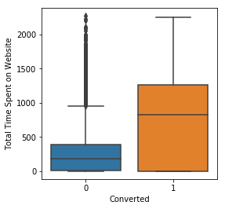
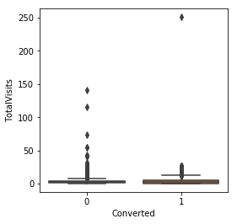
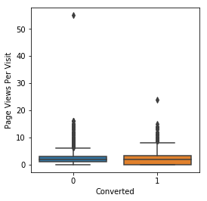
EDA plots depicting variation in numerical columns for those who Converted and those who didn't.

Slide 10
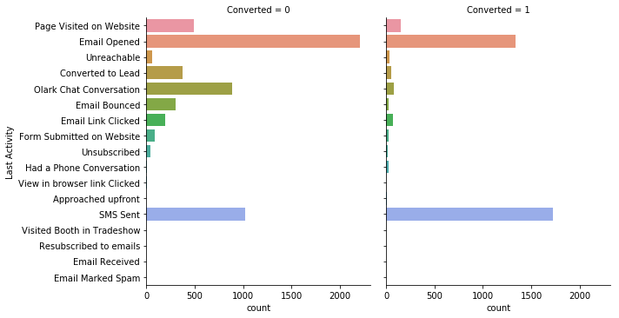
EDA plots depicting variation in categorical column (Last Activity) for those who Converted and those who didn't.

Slide 11
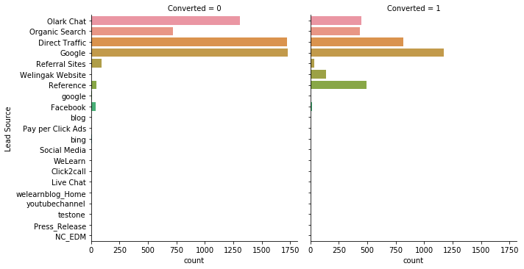
EDA plots depicting variation in categorical column (Lead Source) for those who Converted and those who didn't.

Slide 12
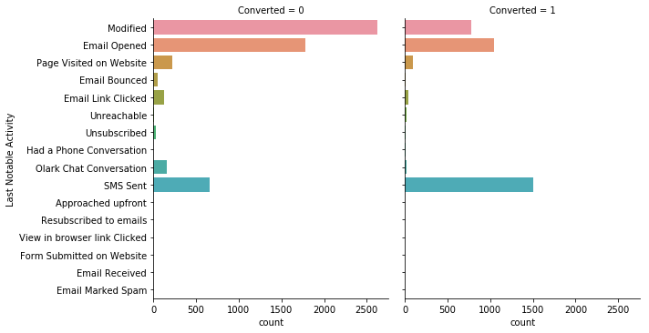
EDA plots depicting variation in categorical column (Last Notable Activity) for those who Converted and those who didn't.

Slide 13
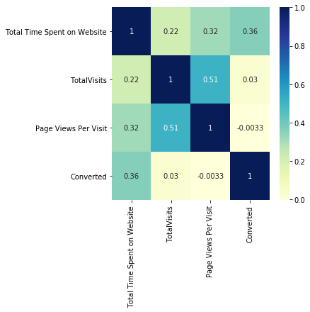
EDA plots depicting correlation (Heat Map) of all selected numerical columns.

Slide 14
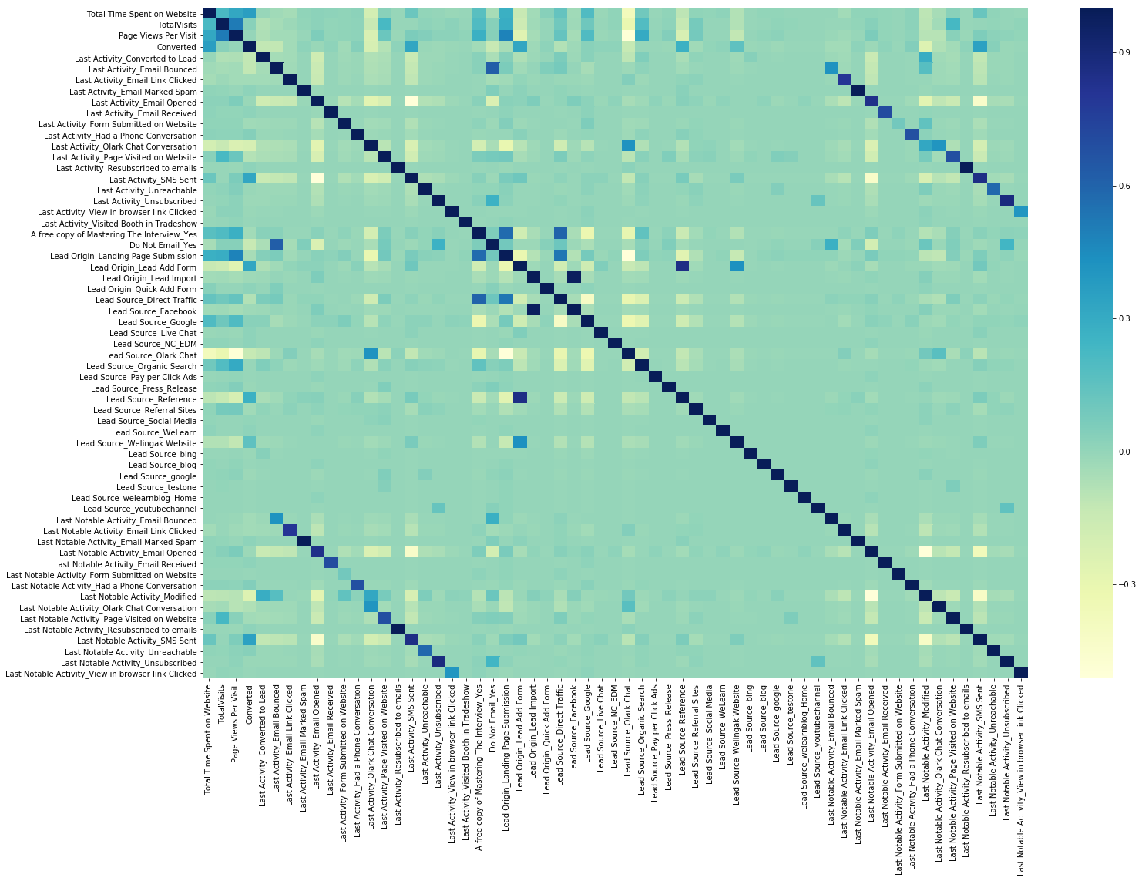
EDA plots depicting correlation (Heat Map) of all selected columns (numerical columns and dummy columns).

Slide 15
Conclusion 1 (LR Model)
Our Logistic Regression Model is decent and accurate enough, when compared to the model derived using PCA, with 78.6 % Accuracy on Test Set, 73.3 % Sensitivity and 82.3 % Specificity.
We can vary these parameters by varying the cut-off value and thus predict Hot leads based on scenarios like availability of extra resources and vice-versa.

Slide 16
Conclusion 2 (Recommendation)
X Education Company needs to focus on following key aspects to improve the overall conversion rate:
Increase user engagement on their website since this helps in higher conversion
Increase on sending SMS notifications since this helps in higher conversion
Get Total visits increased by advertising etc. since this helps in higher conversion
Improve the Olark Chat service since this is affecting the conversion negatively

