Slide 1
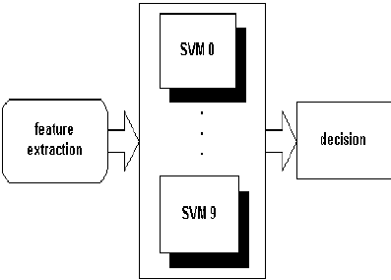
SVM – To classify handwritten digits
Linear SVM tries to find maximum margin hyperplane that separates training data in to two classes (either digit or not).
Each pixel in 28 by 28 image is represented in its own one dimension. So, Image is a point in 28 * 28 = 784-dimensional space.
Hyperplane divides the data points into two classes in 784-dimensional space.
Multiple SVMs are trained to recognize Image between 0 -9.
SVM with highest confidence score is considered.

Slide 2
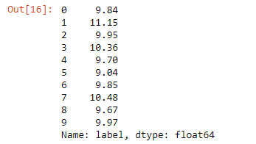
Data Analysis & Cleaning
Training data set has 785 columns, first column is label and rest are pixels associated with image.
Each label has about 9 to 11 % fraction in dataset. SVM doesn’t perform well with unbalanced data set.
There are no missing values in dataset.

Slide 3
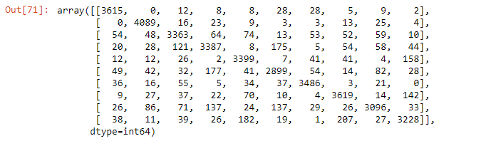
Linear SVM model
Data set is split into training and test sets.
SVM model is trained with linear kernel using training data set.
Predictions are made on test set and confusion matrix and accuracy score is used as analysis metric.
Accuracy achieved by model is 90.4%

Slide 4
Future plans with SVM
Build non-linear SVM model with RBF kernel.
Perform grid search cross validation to tune hyperparameters C and gamma.
Plot graphs to visualize better values for C and gamma.
Build final model with chosen hyperparameters.
Evaluate the final model using confusion matrix and accuracy.
GitHub Link : https://github.com/PriyankaSiripurapu/SVM_DigitRecogniser

