Slide 1




GLOVE: GLOBAL VECTORS FOR WORD REPRESENTATION
Jeffrey Pennington, Richard Socher, Christopher D. Manning
PRESENTED BY:
ANUSHA SALIMATH
BILAL
PRIYANKA SORATHIYA

Slide 2
INTRODUCTION
The paper presents a method to create word vectors that represent both word meaning and structure, helping computers understand language. These vectors show word relationships through mathematical operations like addition and subtraction.
Two different approaches to creating word vectors:
Matrix factorization methods
Shallow window-based methods.
These methods help turn words into numerical representations (vectors) that allow computers to understand and work with language.

Slide 3
MATRIX FACTORIZATION METHODS
THESE METHODS CREATE LARGE MATRICES (TABLES OF NUMBERS) THAT CAPTURE STATISTICAL INFORMATION ABOUT WORDS IN A TEXT.
THE GOAL IS TO REDUCE THESE LARGE TABLES INTO SMALLER, LOW-DIMENSIONAL REPRESENTATIONS THAT STILL CARRY IMPORTANT MEANING.

Slide 4
TYPES OF ALGORITHMS
1. LATENT SEMANTIC ANALYSIS (LSA): IN LSA EACH ROW REPRESENTS A WORD, AND EACH COLUMN REPRESENTS A DOCUMENT. THE MATRIX CAPTURES HOW OFTEN A WORD APPEARS IN DIFFERENT DOCUMENTS.
Example: A row for "apple" might show how many times "apple" appears in various articles or books.
2. HYPERSPACE ANALOGUE TO LANGUAGE (HAL): HAL, WHERE BOTH ROWS AND COLUMNS REPRESENT WORDS ONE WORD APPEARS NEXT TO ANOTHER WORD.
Example: THE MATRIX WOULD COUNT HOW MANY TIMES "APPLE" APPEARS NEAR "FRUIT," "JUICY," OR "TREE" IN THE TEXT.

Slide 5
EXAMPLE
IF "APPLE" APPEARS WITH "THE" 1,000 TIMES AND WITH "FRUIT" 100 TIMES, THE MODEL MIGHT ADJUST THE COUNTS SO THAT "APPLE" AND "FRUIT" ARE SEEN AS MORE STRONGLY RELATED THAN "APPLE" AND "THE." THIS MAKES THE REPRESENTATION MORE ACCURATE.

Slide 6
2. SHALLOW WINDOW-BASED METHODS
THESE METHODS FOCUS ON SMALL WINDOWS OF WORDS AROUND A TARGET WORD. THE GOAL IS TO PREDICT WHAT WORDS WILL APPEAR NEARBY.
EXAMPLE: THEY MIGHT PREDICT THE WORDS SURROUNDING "APPLE" IN A SENTENCE LIKE, “I ATE A JUICY APPLE.”.

Slide 7
GLOVE MODEL:
What is GloVe?
GloVe, or Global Vectors for Word Representation, combines strengths of global matrix factorization and local context window approaches.
Why? Both approaches have limitations in balancing local and global information.

Slide 8
GLOVE MODEL:
What problem does GloVe solve?
Key Issue: Standard methods often miss hidden relationships between words.
Solution: GloVe combines global context (all word co-occurrences) with local context (nearby words) for a fuller picture.

Slide 9
HOW GLOVE MODEL WORKS:
In simple terms:
Analogy: GloVe checks how often words like ice and steam appear with words like solid and gas.
Ratios help distinguish related terms, so ice pairs more often with solid than with gas.
Simple formula explanation: It uses ratios of probabilities to find which words are most alike.

Slide 10
Key ingredients of glove
Uses a word-word co-occurrence matrix.
Adds a weighted least squares approach to prioritize frequent word pairs.
Keeps the word structure linear to make calculations simpler.

Slide 11

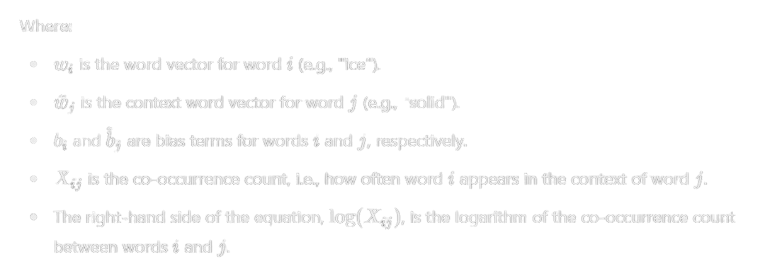
GLOVE MODEL: FORMULA
1. MATHEMATICAL MODELING:
GloVe builds word vectors by focusing on co-occurrence relationships between words. Specifically, it models how words like "ice" and "steam" relate to other words like "solid" or "gas."
The core formula of the GloVe model is:

Slide 12
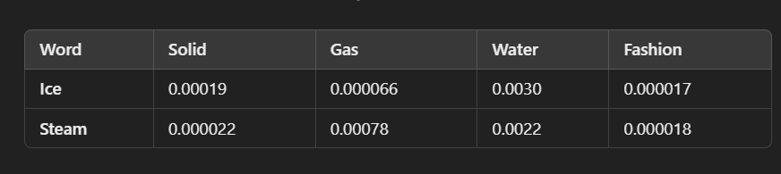
GLOVE MODEL: FORMULA
EXAMPLE
In this matrix, X that records how often words appear together within a specified context window. In this case, we'll focus on the words "ice," "solid," "water," "gas," and "fashion" to create a smaller sample matrix. Each cell Xij in the matrix represents how often word j appears near word i.

Slide 13
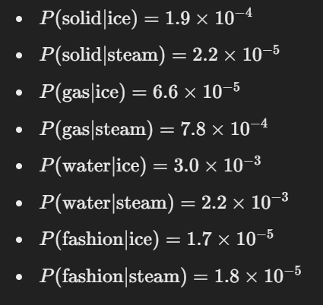
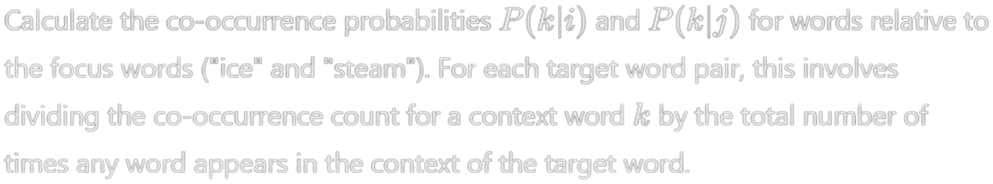
GLOVE MODEL: FORMULA
Computing the co-occurrence matrix

Slide 14
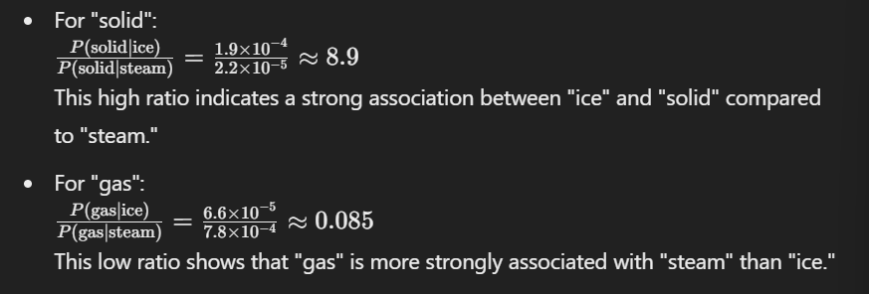
GLOVE MODEL: FORMULA
Computing probability ratios

Slide 15
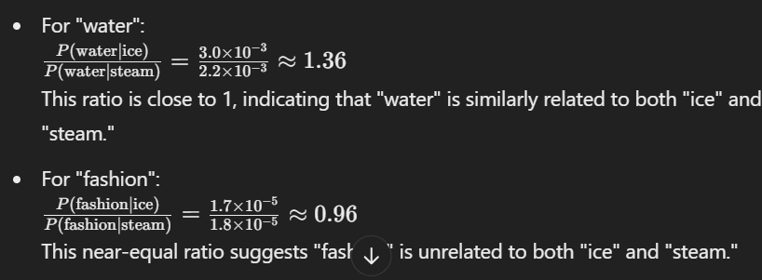
GLOVE MODEL: FORMULA
Computing probability ratios

Slide 16
GLOVE MODEL: FORMULA
2. LOGARITHMIC SCALING:
The GloVe model uses a logarithmic function to compress co-occurrence frequencies, ensuring that both frequent pairs (like "ice" and "solid") and rare ones (like "ice" and "fashion") fit into a manageable scale without distorting training. This helps balance the impact of common and rare word pairs.

Slide 17
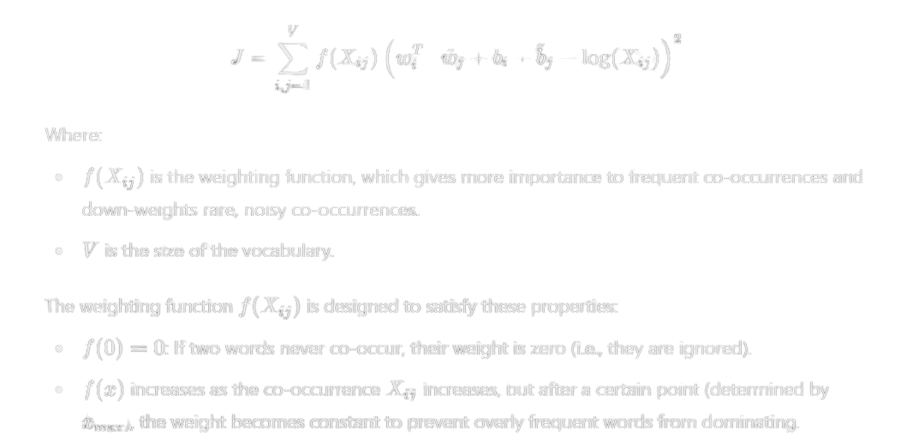
GLOVE MODEL: FORMULA
weighted least squares approach to prioritize frequent word pairs.
GloVe then applies a weighted least squares approach, giving more weight to word pairs that appear frequently and less to rare or noisy pairs. This helps reduce the impact of unrelated words.

Slide 18
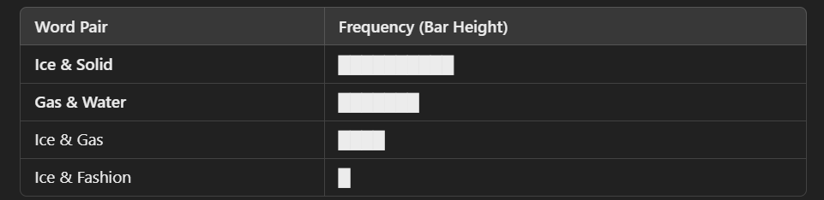
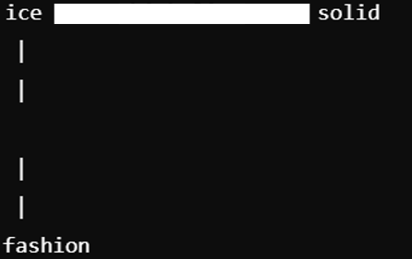
GLOVE MODEL: FORMULA
Keeps the word structure linear to make calculations simpler.
GloVe keeps the structure linear, meaning it uses simple vector math to create embeddings and calculate relationships without complex, multi-layered structures.

Slide 19
GLOVE MODEL: FORMULA
4. SYMMETRY:
GloVe ensures symmetry by treating target and context words equally, training both word vectors and context vectors simultaneously. This prevents bias in how word relationships are modeled.
EXAMPLE:
GloVe treats "ice" with "solid" and "solid" with "ice" the same way, ensuring symmetry in word relationships.

Slide 20
GLOVE MODEL: MODERNIZE
Skip-Gram and ivLBL (inverse vector Log By Linear) models try to predict how often words appear together, but doing this for all word pairs can be slow.
To speed things up, they use a co-occurrence matrix and suggest using least squares instead of cross-entropy to make error calculation faster and easier.

Slide 21
COMPLEXITY OF A MODEL
THE MODEL FOCUSES ON FREQUENTLY CO-OCCURRING WORD PAIRS INSTEAD OF ALL POSSIBLE COMBINATIONS, AS MOST PAIRS ARE RARE AND INSIGNIFICANT. THIS APPROACH REDUCES COMPUTATIONAL COMPLEXITY AND ENHANCES EFFICIENCY.
Computational complexity is reduced, as fewer calculations are needed. Storage efficiency is improved, as fewer entries need to be stored in the matrix. Model quality is enhanced by focusing on meaningful co-occurrences, reducing the impact of noise from rare, insignificant pairs.

Slide 22
EVALUATION METHODS
The study shows that the GloVe model, trained on 42 billion words using Adagrad, outperforms other models in word analogy, similarity, and named entity recognition tasks.

Slide 23
RESULTS
THE GLOVE MODEL CONSISTENTLY OUTPERFORMED OTHER MODELS IN WORD ANALOGY AND SIMILARITY TASKS, DEMONSTRATING SUPERIOR EFFICIENCY AND EFFECTIVENESS, ESPECIALLY WITH LARGER DATASETS.
IT ALSO EXCELLED IN NAMED ENTITY RECOGNITION, MAKING IT A VALUABLE TOOL FOR NATURAL LANGUAGE PROCESSING TASKS.

Slide 24
CONCLUSION
This research compares count-based and prediction-based methods, with the GloVe model combining both for improved performance in word analogy and similarity task. GloVe Model has 75% of Accuracy, when compared to other models.

Slide 25
THANK YOU

