Slide 1

CHATBOT INTERACTION WITH ARTIFICIAL INTELLIGENCE: HUMAN DATA AUGMENTATION WITH T5 AND LANGUAGE TRANSFORMER ENSEMBLE FOR TEXT CLASSIFICATION

Slide 2

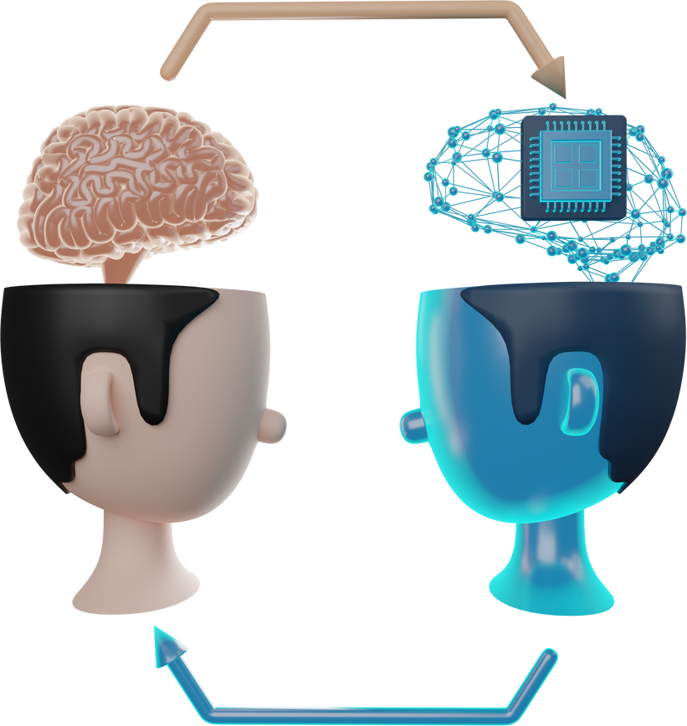

WHAT IT IS ABOUT?
The study is about creating a smarter chatbot system that understands natural, everyday language better. It does this by using AI to expand its training data and testing on advanced models to improve accuracy.
The ultimate goal is to make AI systems more user-friendly, so people can interact with them naturally, like talking to Siri or Alexa, without needing special commands.

Slide 3
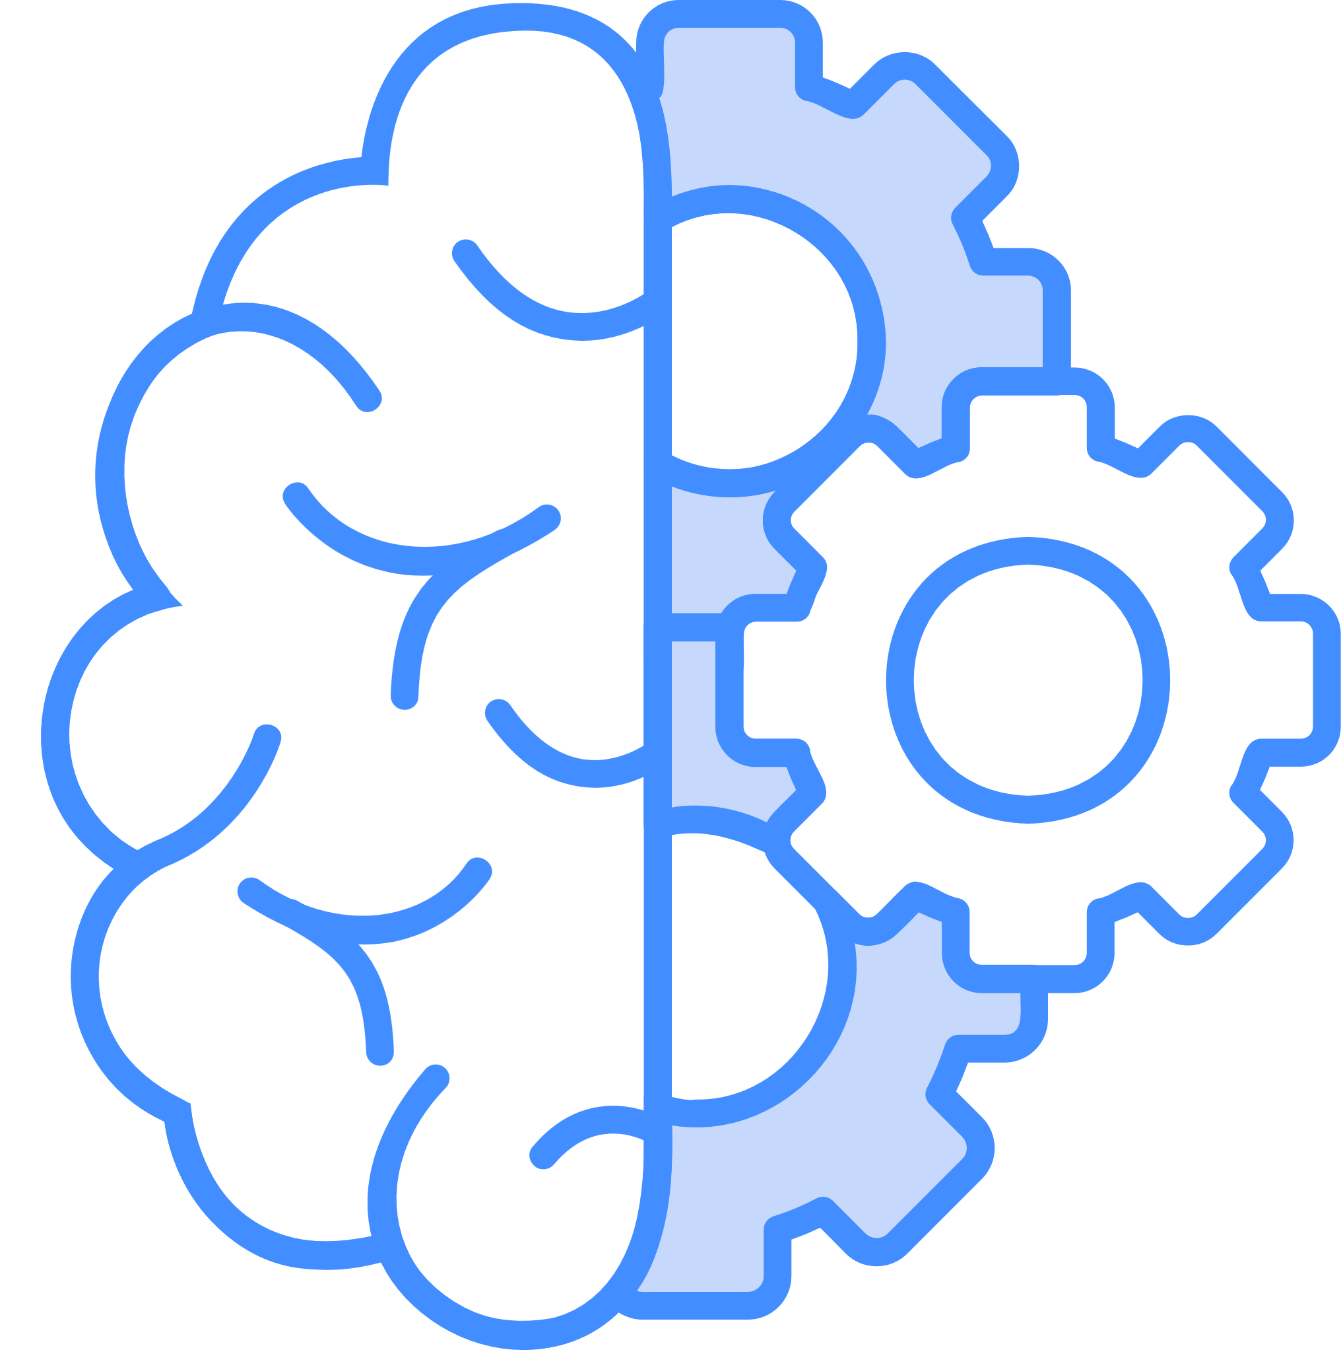
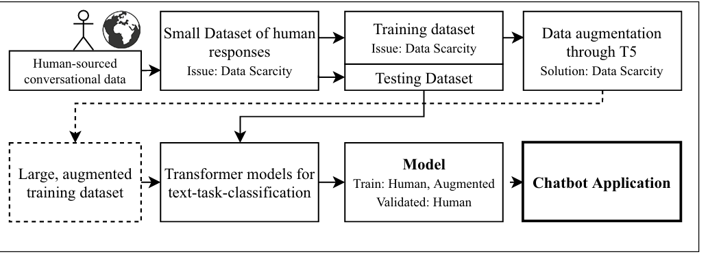
WORKFLOW

Slide 4
WORKFLOW
Human Input:
Humans provided 483 paraphrased (reworded) versions of commands and questions for task classification.
These were split into training and validation datasets.
Data Augmentation Using T5 Model:
To generate more training data, the T5 (a transformer-based model for text generation) was used to create additional paraphrased variations of the training set.
Benchmarking Models:
Seven advanced AI models for text classification were tested:
BERT, DistilBERT, RoBERTa, DistilRoBERTa, XLM, XLM-RoBERTa, and XLNet.
The models were fine-tuned (adjusted for better performance on the dataset) over two epochs (iterations through the data).

Slide 5
BACKGROUND CHECKS
DATA SCARCITY: NLP tasks require large datasets for effective training, but the amount often falls short even with data from 100+ subjects.
Solution?
Data Augmentation.
DATA AUGMENTATION: It involves creating new, useful data from existing data to improve model performance through techniques like random token changes (slightly altering words), back-translation (translating text to another language and back), and paraphrasing (rewriting text while retaining meaning). Paraphrasing is particularly effective for enhancing language understanding and generation.

Slide 6
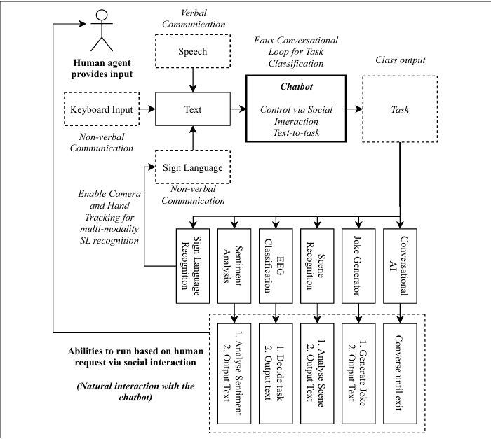
WHAT IS THE PROPOSED APPROACH?

Slide 7
WHAT IS THE PROPOSED APPROACH?
Purpose of the System: The system is designed to make machine learning tools and studies more accessible to people. It allows users to request tasks through natural interaction (like text, speech, or sign language). The chatbot recognizes the request and activates the appropriate task.
Types of Tasks Supported:
Scene Recognition: Identifies scenes using a camera and microphone.
EEG Classification: Analyzes brainwave data from a headband to detect:
Mental states (e.g., focused, relaxed).
Emotional states (e.g., positive, negative).
Sentiment Analysis: Determines the sentiment (positive, negative, neutral) in a given text.
Sign Language Recognition: Allows interaction using sign language via a camera and hand-tracking.
Conversational AI: Enables a general conversation with the chatbot.
Joke Generator: Generates and tells jokes.

Slide 8

TRANSFORMERS
TRANSFORMERS: Transformers revolutionize NLP by processing all words simultaneously instead of one at a time (like LSTMs), enabling them to focus more effectively on key parts of a sentence, similar to human reading.
Why are Transformers better?
Transformers use an "attention" mechanism to compare words in a sentence and identify the most important ones. This enables superior performance in tasks like classification, translation, and sentiment analysis by focusing on relevant context (e.g., identifying keywords like "great" or mapping "Hello" ↔ "Hola").

Slide 9
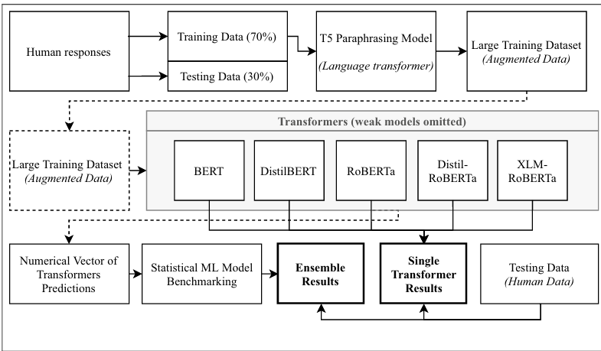

Slide 10
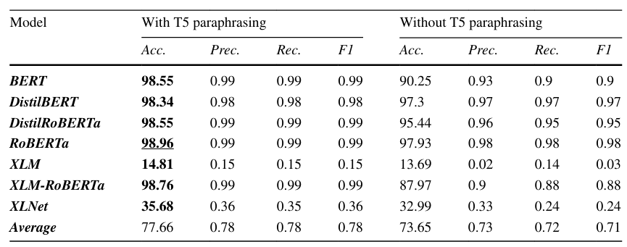
RESULTS

Slide 11
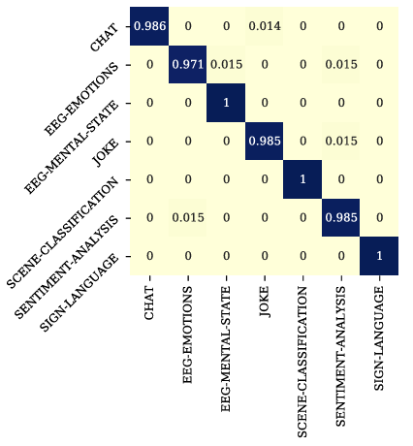
RESULTS
As you can see from the confusion matrix, the tasks of EEG—MENTAL—STATE, SCENE—CLASSIFICATION, and SIGN—LANGUAGE are classified perfectly. Whereas, tasks of CHAT, JOKE, and SENTIMENT ANALYSIS are classified imperfectly.
The model sometimes mixed up tasks that are similar in nature, like chat and jokes (both social), or EEG emotional state and sentiment analysis (both involve emotions). These mistakes make sense because the language used for these tasks can overlap.
RoBERTa Model

Slide 12
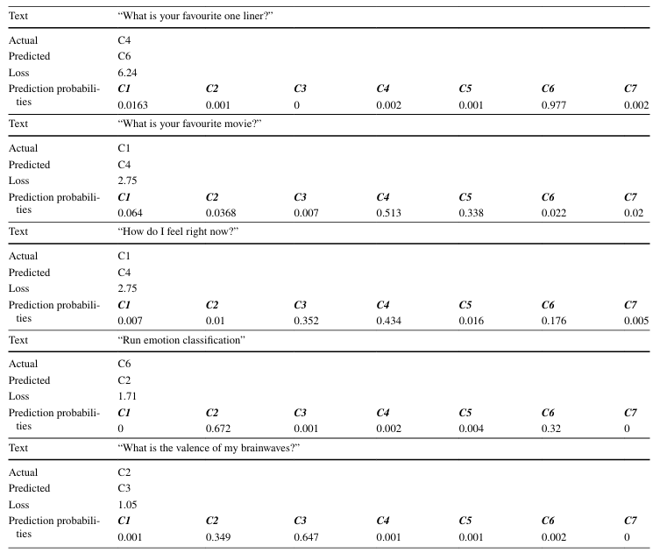
MISTAKES AND PROBABBILITIES
RARE WORDS:
The phrase "What is your favourite one liner?" was misclassified because the term "one liner" wasn’t in the training data. The model didn't know how to handle it.
Similarly, "What is the valence of my brainwaves?" caused confusion because the word "valence" wasn’t part of the training, and "brainwaves" was mostly linked to mental state tasks, not emotional ones.

Slide 13
MISTAKES AND PROBABBILITIES
AMBIQUITY:
For "Run emotion classification", the model was unsure whether the task was EEG emotional state recognition or Sentiment Analysis.
It guessed EEG emotions with a probability of 67.2% and Sentiment Analysis with 32%, showing uncertainty.
This highlights a challenge: natural language can sometimes have multiple interpretations.

Slide 14
The solution is straightforward and something we all do naturally: ask a follow-up question when we don’t understand a statement or task.
When the model is uncertain, it could ask the user a follow-up question like: If the task could be divided into two categories, the system could ask the user, "Do you mean emotion detection from brainwaves or analyzing written sentiment?"

Slide 15
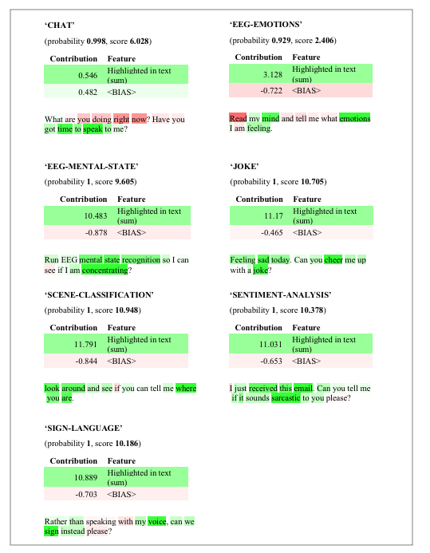
UNSEEN DATA PERFORMANCE
CHAT: In “What are you doing right now? Have you got time to speak to me?”, the model focused on words like “time to speak” and ignored less important ones like “right now.”

Slide 16
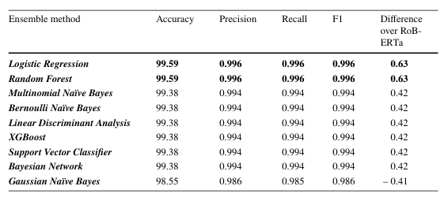
TRANSFORMER ENSEMBLE RESULTS
This section explains how combining multiple models improved the accuracy of classifying tasks.
Combining Models:
BERT, DistilBERT, RoBERTa, Distil-RoBERTa, and XLM-RoBERTa
Logistic Regression& Random Forest gave the best accuracy. With a increase 0.63 when compared to RoBERTa

Slide 17
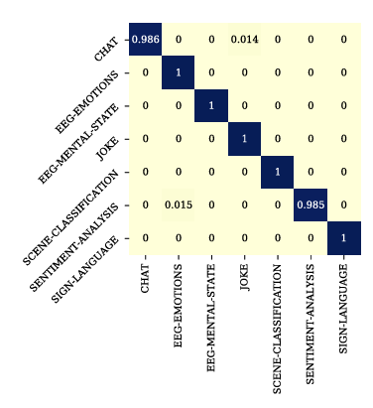
UNSEEN DATA PERFORMANCE
Combining models fixed many mistakes that individual models made.
A few small errors remained:
Confusion between "CHAT" and "JOKE" tasks (likely because both involve social interactions).
Confusion between "SENTIMENT ANALYSIS" and "EEG EMOTIONS" (because both use emotional language).

Slide 18
THANK YOU!

