Slide 1
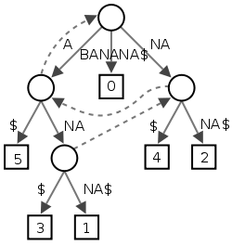
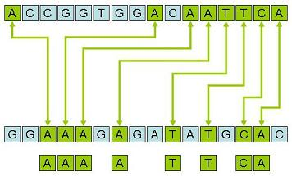
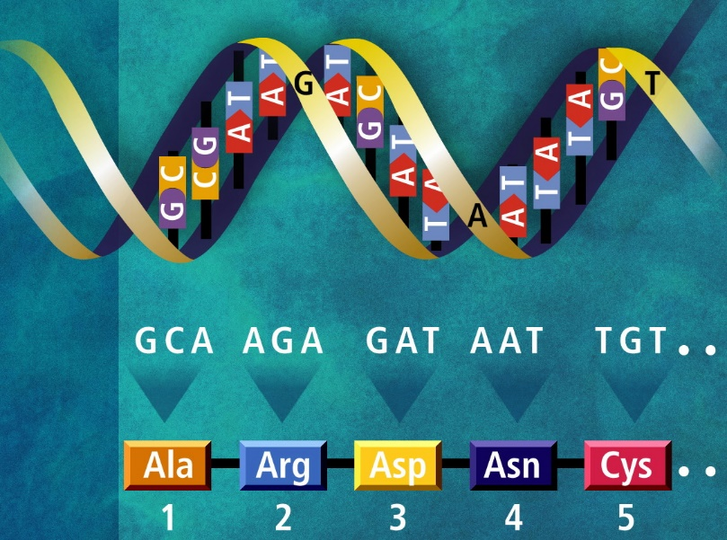
SUFFIX TREE ALGORITHMS
Priyanka Tayade Srinivas Maram Vijaykumar Jatti

Slide 2

An Algorithm must be seen to be believed.
-Donald Ervin Knuth

Slide 3

Why to study Suffix tree?
Suffix trees can be built in linear time and space.
Provides fundamental data structure with a huge number of applications.
String Matching
Longest Common Subsequence
Longest common subsequence
DNA contamination
Genome scale projects

Slide 4
Preprocessing Strings
Preprocessing the pattern speeds up pattern matching queries
After preprocessing the pattern, KMP’s algorithm performs pattern matching in time proportional to the text size
If the text is large, immutable and searched for often (e.g., works by Shakespeare), we may want to preprocess the text instead of the pattern
A trie is a compact data structure for representing a set of strings, such as all the words in a text
A tries supports pattern matching queries in time proportional to the pattern size

Slide 5
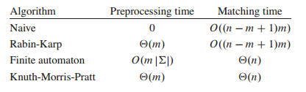
Preprocessing of Strings
If we consider the algorithms like KMP, Rabin Karp and Finite automation, even though preprocessing time of each algorithm sums up to O(m). What really bothers us is the matching time!!! Why???

Slide 6
Trie
The name 'trie' comes from its use for "Retrieval". A trie is an ordered tree data structure representing a collection of strings with one node per common prefix.
To implement the kind of storage which stores strings as the search keys , there is a need to have special data structures which can store the strings efficiently and the searching of data is based on the string keys, is easier efficient and faster.
One such data structure is a tree based implementation called Trie.

Slide 7
Standard Tries
The standard trie for a set of strings S is an ordered tree such that:
Each node but the root is labeled with a character
The children of a node are alphabetically ordered
The paths from the external nodes to the root yield the strings of S
Example: standard trie for the set of strings
S = { bear, bell, bid, bull, buy, sell, stock, stop }

Slide 8
Compressed Tries
A compressed trie has internal nodes of degree at least two
It is obtained from standard trie by compressing chains of “redundant” nodes

Slide 10
Compact Representation
Compact representation of a compressed trie for an array of strings:
Stores at the nodes ranges of indices instead of substrings
Uses O(s) space, where s is the number of strings in the array
Serves as an auxiliary index structure

Slide 11
Suffix tree
Given a string s a suffix tree of s is a compressed trie of all suffixes of s
The suffix trie of a string X is the compressed trie of all the suffixes of X
To make these suffixes prefix-free we add a special character, say $, at the end of s

Slide 12
Suffix tree (Example)
Let s=abab, a suffix tree of s is a compressed trie of all suffixes of s=abab$
{
$
b$ ab$ bab$ abab$
}
$
a
b
b
$
a
a
$
b
b
$
$

Slide 13
Trivial algorithm to build a Suffix tree
Put the largest suffix in
a
b
a
b
$
Put the suffix bab$ in
a
b
b
a
a
b
b
$
$

Slide 14
a
b
Put the suffix ab$ in
b
a
a
b
b
$
$
a
b
b
a
b
$
a
$
b
$

Slide 15
a
b
b
a
b
Put the suffix b$ in
$
a
$
b
$
a
b
b
$
a
a
$
b
b
$
$

Slide 16
a
b
b
Put the suffix $ in
$
a
a
$
b
b
$
$
$
a
b
b
$
a
a
$
b
b
$
$

Slide 17
$
a
b
b
$
a
a
$
b
b
$
$
s=abab$
$
a
b
b
5
$
a
a
$
b
b
$
4
$
3
2
1

Slide 18
Analysis
Takes O(n²) time to build.
We will see how to do it in O(n) time !!

Slide 19
Generalized suffix tree
Given a set of strings S a generalized suffix tree of S is a compressed trie of all suffixes of s ∈ S
To make these suffixes prefix-free we add a special char, say $, at the end of s
To associate each suffix with a unique string in S add a different special character to each s

Slide 20
Generalized suffix tree (Example)
Let s1=abab and s2=aab here is a generalized suffix tree for s1 and s2
#
$
{
$ #
b$ b#
ab$ ab#
bab$ aab#
abab$
}
a
b
5
4
#
a
$
b
a
b
3
b
#
$
4
a
$
#
b
1
2
$
3
2
1

Slide 21
So what can we do with it ?
Matching a pattern against a database of strings

Slide 22
What can we do with it ?
Exact string matching:
Given a Text T, |T| = n, preprocess it such that when a pattern P, |P|=m, arrives you can quickly decide when it occurs in T.
W e may also want to find all occurrences of P in T

Slide 23
Drawbacks
Even though Suffix Trees are O(n) space, the constant hidden by the big-Oh notation is somewhat “big”:≈20 bytes / character in good implementations
If you have a 10Gb genome, 20 bytes / character = 200Gb to store your suffix tree. “Linear” but large
Suffix arrays are a more efficient way to store the suffixes that can do
most of what suffix trees can do, but just a bit slower

Slide 24
Suffix array
Let s = abab
Sort the suffixes lexicographically:
ab, abab, b, bab
The suffix array gives the indices of the suffixes in sorted order
3
1
4
2

Slide 25
How do we it?
The time complexity of above method to build suffix array is O(n^2Logn) if we consider a O(nLogn) algorithm used for sorting.
The sorting step itself takes O(n^2Logn) time as every comparison is a comparison of two strings and the comparison takes O(n) time.

Slide 26
How do we build it ?
Build a suffix tree
Traverse the tree in DFS, lexicographically picking edges outgoing from each node and fill the suffix array.
O(n) time

Slide 27
How do we search for a pattern ?
If P occurs in T then all its occurrences are consecutive in the suffix array.
Do a binary search on the suffix array
Takes O(mlogn) time

Slide 28
Example
Let S = mississippi
L
i
11
ippi
8
5
issippi
Let P = iss
2
ississippi
1
mississippi
M
10
pi
9
ppi
7
sippi
sisippi
4
ssippi
6
R
3
ssissippi

Slide 29
Construction of suffix tree in linear time

Slide 30
Algorithms:
McCreight algorithm
Ukkonen's algorithm
Farach’s algorithm
Kärkkäinen & Sanders Suffix Array and LCP array construction.

Slide 31
Steps
Create a suffix array from the string in O(n) time.
Using suffix array create a LCP array in O(n).
Using Suffix Array and LCP Array , Create a suffix tree in O(n).

Slide 32
Suffix Array(SA) Construction
Let S0 , S1 , S2 , …, Sn-1 be all the n suffixes. Si starts at i-th position.
• Uses divide and conquer. • Two sets SA0= {Si : i = 0 mod 3} and SA12={Si : i=1 or 2 mod 3}.
• 1. Sort SA12 recursively. • 2. Sort SA0 in linear time.
• 3. Merge sort SA0 and SA12 in linear time.
• The time complexity T(n) = O(n) + T(2n/3). So it is linear.

Slide 33
step1
Construct triplets of for all the positions which have (i mod 3 not equal to 3)
i.e (S[i],S[i+1],S[i+2])
Sort the triplets by radix sort
Give a rank { 1,2,3,… (2/3)n) to the each distinct triplet.
If all triplets are distinct => all suffices are sorted
Else give the ranks to the original triplet sets and make a string S’ from S which only consists of ranks and recursively from step1

Slide 34
step2
Perform radix sort on tuples (s[i],rank of s[i+1] from step1 )

Slide 35
Step3
Merge the sorted array using the information we got from the step1
Lets see this with an example.

Slide 36
Example
Let S be “dadbcddadbcd”
index | 1 | 2 | 3 | 4 | 5 | 6 | 7 | 8 | 9 | 10 | 11 | 12 | 13 | 14 | 15
S | d | a | d | b | c | d | d | a | d | b | c | d | $ | $ | $
I mod3 | 1 | 2 | 0 | 1 | 2 | 0 | 1 | 2 | 0 | 1 | 2 | 0 | 1 | 2 | 0

Slide 37
Create triplets starting at (i mod 3)
Let S0 denote the triplets of string starting at positions I mod 3 = 0
S0=(dbc,dda,dbc,d$$)
S1=(dad,bcd,dad,bcd,$$$)
S2=(adb,cdd,adb,cd$)
1 2 3 4 5 6 7 8 9 10 11 12 13 14 15
d a d b c d d a d b c d $ $ $

Slide 38
Now concatenate S1 and S2 , then perform radix sort on them.
Give them a rank.

Slide 39
If all the ranks given are unique then we can directly create a suffix tree based on the ranks.
If not
Create S’ by using ranks and original index.
Then recursively call the suffix function for S`

Slide 40
Sort S0 by using the result of the step1
Merge SA(suffix array) of S0 and SA of S1.S2
Construct LCP array from Suffix Array

Slide 41
Constructing LCP array
Resulting Suffix Array:
sa[ 0] = 8 = adbcd$
sa[ 1] = 2 = adbcddadbcd$ LCP[1] = 5;
sa[ 2] = 10 = bcd$ LCP[2] = 0;
sa[ 3] = 4 = bcddadbcd$ LCP[3] = 3;
sa[ 4] = 11 = cd$ LCP[4] = 0;
sa[ 5] = 5 = cddadbcd$ LCP[5] = 2;
sa[ 6] = 12 = d$ LCP[6] = 3;
sa[ 7] = 7 = dadbcd$ LCP[7] = 1;
sa[ 8] = 1 = dadbcddadbcd$ LCP[8] = 6;
sa[ 9] = 9 = dbcd$ LCP[9] = 1;
sa[10] = 3 = dbcddadbcd$ LCP[10] = 4;
sa[11] = 6 = ddadbcd$ LCP[11] = 1;
We have a linear time algorithm for constructing LCP array.

Slide 42
Construction of suffix tree
Now we will look at construction of suffix tree form suffix array and LCP array.
Example:
String S=“banana”
Sa[0] = 7 =$
sa[ 1] = 6 = a$ LCP[0]=0;
sa[ 2] = 4 = ana$ LCP[1]=1;
sa[ 3] = 2 = anana$ LCP[2]=3;
sa[ 4] = 1 = banana$ LCP[3]=0
sa[ 5] = 5 = na$ LCP[4]=0
sa[ 6] = 3 = nana$ LCP[5]=2

Slide 43
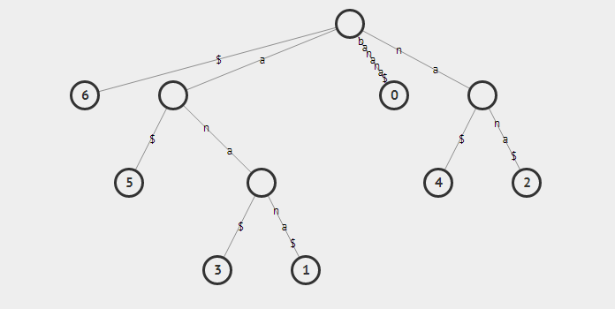
Construction of suffix tree

Slide 44
Application
Exact String Matching
Longest common subsequence
Search all Patterns
Longest palindromic number
Genome Project

Slide 45
Exact string matching
In preprocessing we just build a suffix tree in O(n) time in text T
$
a
b
b
5
$
a
a
$
b
b
$
4
$
3
2
1
Given a pattern P = ab we traverse the tree according to the pattern.

Slide 46
$
a
b
b
5
$
a
a
$
b
b
$
4
$
3
2
1
Start with the root
Follow all the edges in pattern
Fall of the tree the P is not in T
If we exhaust all s without falling out then P is in T

Slide 47
Longest common substring problem
Build a generalized suffix tree for S₁$₁S₂$₂. Here $₁ and $₂ are different new symbols not occurring in S₁ and S₂.
Mark every internal node of the tree with {1}, {2}, or {1,2} depending on whether its path label is a substring of S₁ and/or S₂.
Find the internal node which is labeled by {1,2} and has the largest “string depth”.

Slide 48
Longest common substring (of two strings)
Every node with a leaf descendant from string s_{1=abab} and a leaf descendant from string s_{2 =aab}
represents a maximal common substring and vice versa.
#
$
a
b
5
4
#
a
$
b
a
b
3
b
Find such node with largest “string depth”
#
$
4
a
$
#
b
1
2
$
3
2
1

Slide 49
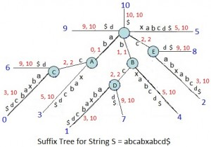
Applications
Search all Patterns

Slide 50
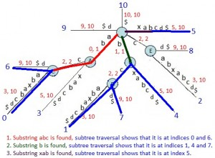
Applications
Search all Patterns

Slide 51
FIN

