Slide 1
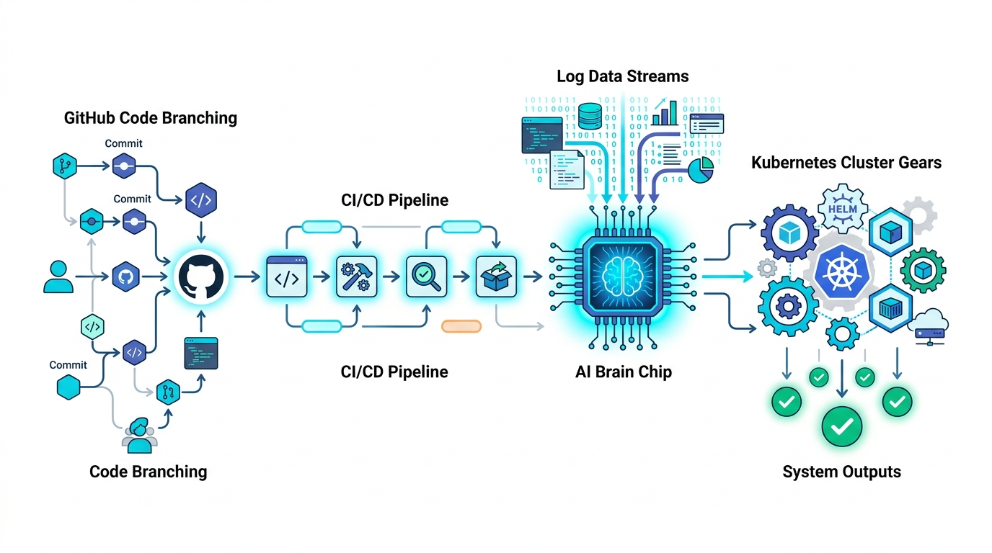
DEVOPS AUTOMATION PROJECT
AI-Powered CI/CD Failure Triage Agent
Automatically analyze build errors, find solutions, and notify developers, Devops.
What This Project Delivers
• Triggered on Failure Only: Runs automatically only when a CI pipeline fails (zero cost on passing builds).
• Smart Log Filter: Cleans up 10,000+ lines of messy terminal output down to the exact error lines.
• Past Error Memory: Searches team runbooks and previous solved issues to see how it was fixed before.
• Standard Tool Connections (MCP): Uses a standard plugin interface to fetch logs and post summaries across repos.
• Triage & Alert Only: Tells developers what broke in plain English—never changes production code.
Built with: Python | GitHub Actions / Webhooks | Google Gemini | Vector Search | Amazon EKS

Slide 2
PROJECT MOTIVATION
Why We Need This: The Everyday DevOps Pain
Saving developers from spending 20 to 30 minutes reading terminal logs on every failed build
The Problem We Face Today
What Our Agent Does
❌ Builds fail frequently across multiple repositories (syntax errors, missing packages, test failures).
❌ CI logs are huge: 10,000+ lines of clutter make finding the actual error slow and frustrating.
❌ Engineers waste 20–30 minutes per failure just hunting for the relevant stack trace.
❌ Many errors are recurring issues that another teammate already solved last week.
✔ Catches the build failure automatically via a GitHub webhook (zero manual steps).
✔ Strips out all the terminal noise and extracts only the 50 lines that show what broke.
✔ Checks our team database to see if we've seen and fixed this error before.
✔ Posts a short, clear explanation on the Pull Request in under 15 seconds.
CORE SAFETY RULE: THE AGENT NEVER MODIFIES PRODUCTION CODE
The agent is built purely for diagnosis and alerting. It reads logs, explains the failure, and suggests practical steps. The human engineer stays in 100% control to review the findings and make the code fix.
AI-Powered DevOps Agent | Practical CI/CD Failure Triage
Slide 2 of 8

Slide 3
SYSTEM WORKFLOW
End-to-End Failure Triage Flowchart
A simple 5-step pipeline that runs only when a build failure occurs
1. Build Fails
2. Send Webhook
3. Clean Logs
4. Smart Search
5. Alert Devs
Pipeline Step
Instant Trigger
Noise Filter
Knowledge Check
Clear Summary
A compile or test step fails in CI (e.g. exit code 1)
GitHub sends a failure webhook alert to our central service
Script strips terminal junk & pulls the 50 error lines
Searches past runbook notes & asks Gemini to explain error
Posts a human-readable comment on GitHub PR & Slack
⚡ Runs Only on Failure
🔍 Filters 10K+ Lines
🛡️ Safe for Teams
Zero compute waste on successful builds. Runs strictly when a failure occurs.
Pulls out only the failure stack trace so developers never read log dumps.
Acts as an intelligent helper; provides clear diagnosis without touching git code.
AI-Powered DevOps Agent | Practical CI/CD Failure Triage
Slide 3 of 8

Slide 4
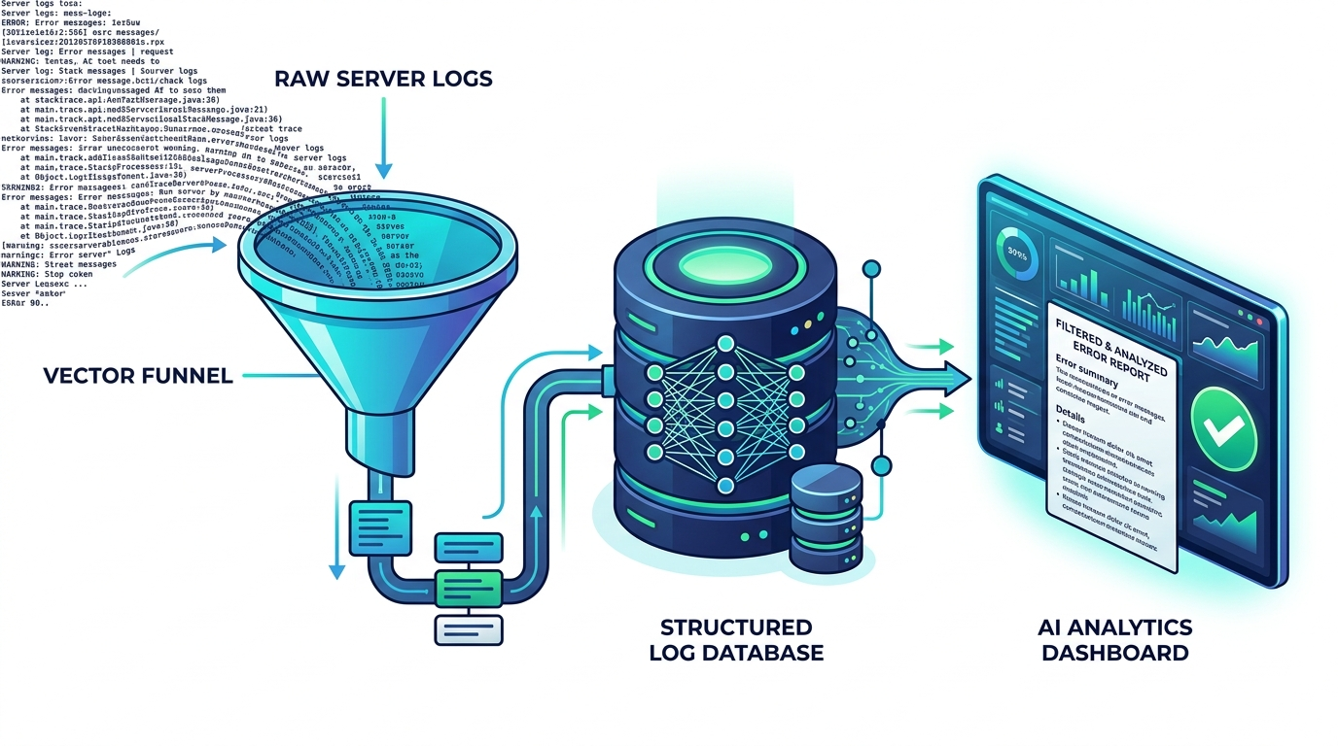
LOG FILTERING & SMART SEARCH
How We Handle 10,000+ Line Logs: Simple Filtering
How software engineers turn massive terminal dumps into clean, readable answers
1. Noise Pruning (Regex)
Remove ANSI color codes, ISO timestamps, and routine 'downloading...' or 'PASS test' lines. This instantly cuts out 80% to 90% of the junk.
2. Boundary Chunking
Scan for failure markers ('error:', 'Exception in thread', 'Traceback'). Keep the 50 lines around the error line—this has everything needed.
3. Vector Store Match (Qdrant)
Check our team error database (Qdrant) for similar past errors. If this broke before, fetch the previous engineer's fix notes and runbook.
4. Compact Prompt (<10K Tokens)
Send the clean 50-line error snippet + runbook notes to Gemini AI. It produces a clear 3-sentence summary of what broke and what to do.
AI-Powered DevOps Agent | Practical CI/CD Failure Triage
Slide 4 of 8

Slide 5
TOOLING INTERFACE
Connecting Repositories & Tools (Using MCP)
A clean, standard way for our AI agent to talk to GitHub, databases, and Slack
AI DevOps Agent (Central Controller)
Think of MCP as a standard API contract: the AI calls clean, named functions to get data.
GitHub Tool (MCP)
Database Tool (Vector DB)
Notification Tool
• get_job_logs(job_id): Fetches build logs.
• get_commit_author(): Gets who pushed the code.
• post_pr_comment(): Posts the summary to the PR.
• search_past_fixes(): Finds previous fixes.
• get_team_runbook(): Pulls approved team rules.
• save_new_fix(): Stores new solutions for later.
• send_slack_alert(): Sends message to #devops.
• send_teams_card(): Posts alert to MS Teams.
• link_jira_issue(): Connects to open tickets.
WHY SOFTWARE ENGINEERS LIKE THIS: Standard MCP tools mean our agent connects to 100+ repositories easily. Repositories don't need custom scripts or local installs—they simply send standard failure events to our central service.
AI-Powered DevOps Agent | Practical CI/CD Failure Triage
Slide 5 of 8

Slide 6
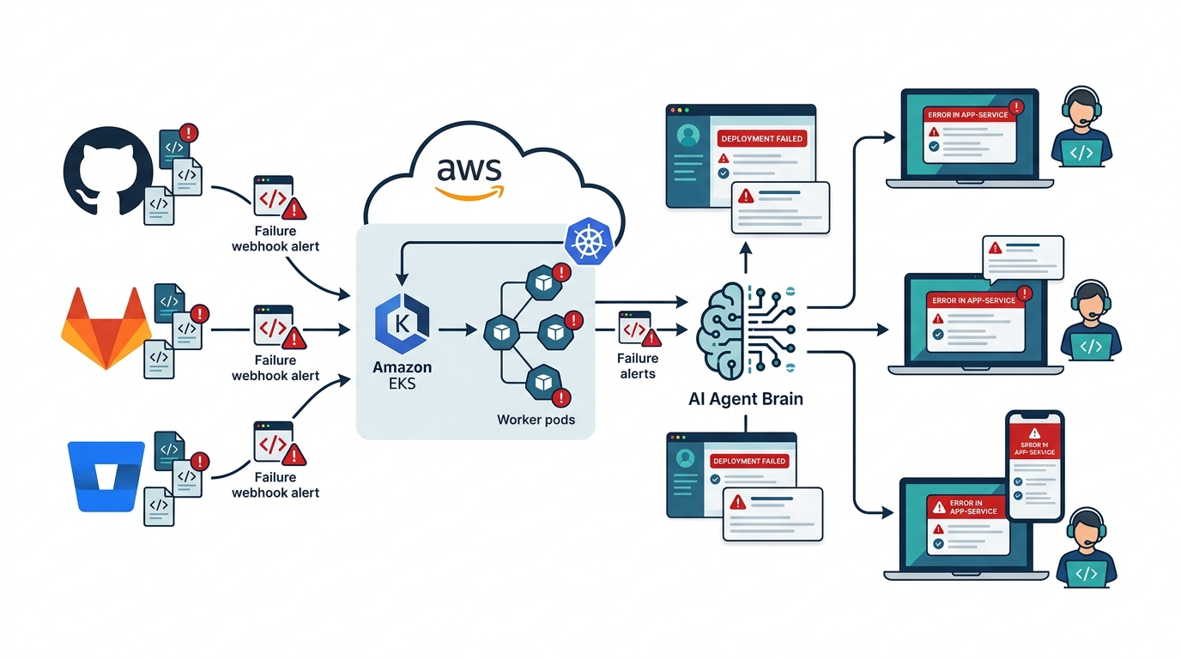
CLOUD DEPLOYMENT
Deployment: Running on Amazon EKS
A simple, reliable cloud setup that software and DevOps engineers know well
1. Webhook Listener (FastAPI)
A lightweight Python web service behind an AWS Load Balancer that receives failure alerts from GitHub, GitLab, or Bitbucket.
2. Message Queue (AWS SQS)
Buffers incoming failure events so our system never crashes during heavy sprint-end merge spikes. Guarantees no dropped alerts.
3. Worker Pods (Docker on EKS)
Standard Python worker containers running in Kubernetes that pull failure events from the queue, clean the logs, and call Gemini AI.
4. Auto-Scaling (KEDA)
Automatically spins up more worker pods when many builds fail at once, and scales down to baseline when quiet to keep AWS bills low.
AI-Powered DevOps Agent | Practical CI/CD Failure Triage
Slide 6 of 8

Slide 7
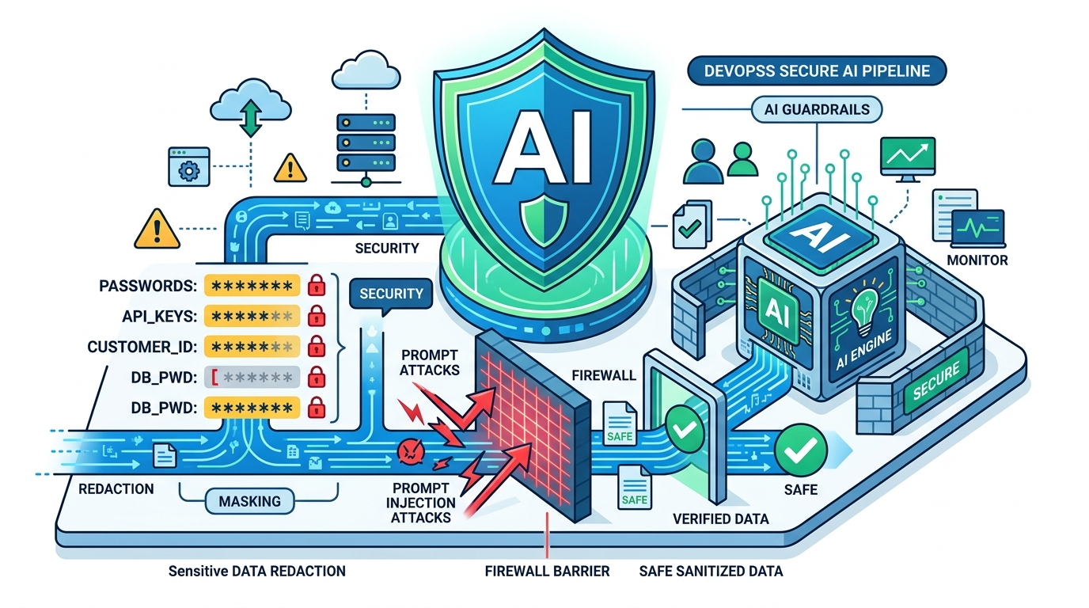
SECURITY & GOVERNANCE
AI Security & Guardrails: Protecting Enterprise Code
Automated secret redaction, prompt injection defense, and read-only safety rules
1. Pre-LLM Secret Redaction
Automated regex & entropy scanner intercepts logs before AI analysis. Replaces API keys (ghp_*, AKIA*), DB passwords, and SSH keys with '***REDACTED***'.
2. Prompt Injection Firewall
Logs and source files are treated as untrusted data. Wrapped in strict XML boundaries (<untrusted_log>). The AI is hardcoded to never execute commands found in logs.
3. Read-Only Safety (No Code Writes)
The agent has zero write access to Git branches. It cannot merge PRs or push commits to master/main. It only outputs explanatory comments and reports.
4. Enterprise Data Privacy
Enterprise code and logs are never stored by external LLMs or used for model training. All analysis is private, stateless, and audited in AWS CloudWatch.
AI-Powered DevOps Agent | Practical CI/CD Failure Triage
Slide 7 of 8

Slide 8
DEVELOPER EXPERIENCE
What the Developer Sees: Clean, Actionable Report
Delivering a clear 15-second diagnosis right where developers work (PR & Slack)
Example Report Posted to Pull Request
Why Developers Love It
🔴 Status: Build Failed | Root Cause Identified (High Confidence)
Failed Step: ci / Compile Java (TestingCode.java)
Error Type: Java Syntax Error (Missing Parenthesis)
Plain English Root Cause: TestingCode.java at line 16 is missing a closing parenthesis ')' in the System.out.println statement.
Exact Error in Log:
TestingCode.java:16: error: ')' expected
System.out.println("Total names: " + names.size();
^
Suggested Fix: Add a ')' right before the semicolon on line 16. (Developer reviews and commits the fix).
✔ Zero Manual Log Digging: No more downloading massive 10,000-line logs and searching with Ctrl+F.
✔ Instant 15-Second Answer: The explanation appears directly in the PR discussion before you even open the logs.
✔ Developer Stays in Control: The agent explains the issue clearly and leaves the code change to the developer.
✔ Where You Already Work: Posted right in the GitHub PR, Job Summary, and the team Slack channel.
✔ Easy to Maintain: Standard Python + Docker + AWS tools that any software engineer can run and support.
AI-Powered DevOps Agent | Practical CI/CD Failure Triage
Slide 8 of 8

