Slide 1
Project Definition-”Video Processing for extracting electricity meter readings”

Slide 2

Project coordinator- Mr Viraj Choksi
Project Guide- Mr Manoj Pandya
Project Team members - 1)Malaika Rastogi (2016B1A70926P)
2)Priyanka Verma (2016B3A70492P
3)Mayur Dhwaj (2016B3A30543P)

Slide 3
Project overview and objectives
The back camera of the mobile phones is used to acquire the video of the electricity meter. The system then applies a sequence of video processing functions to automatically extract and recognize the digits and units of the meter reading image.
It was taken under the guidance of BISAG and Gujarat Power Research and Development(GPRD).
Our objectives :
To digitally extract the readings from electricity meter.
To increase the accuracy of detecting the units.
To take the image of the screen when the reading is detected and save it in a file

Slide 4
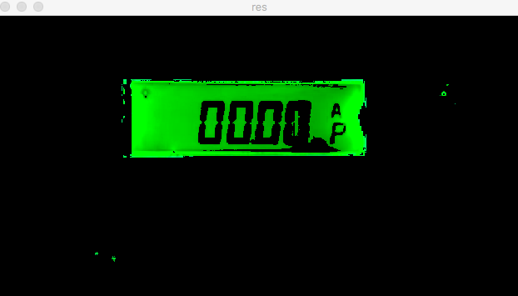

PRE-PROCESSING
EARLIER
Noise reduction not proper result
NOW
100% efficiency …

Slide 5
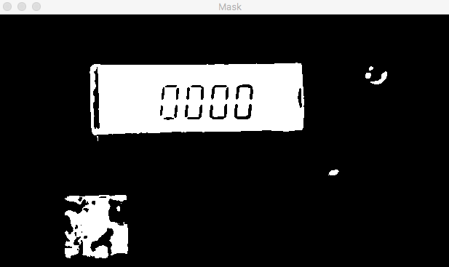
Contour Detection
Color filtered the video for green by giving it a range with lower and upper array to detect the colour.
Mask it for image binarization i.e. object in white and background in black.

Slide 6
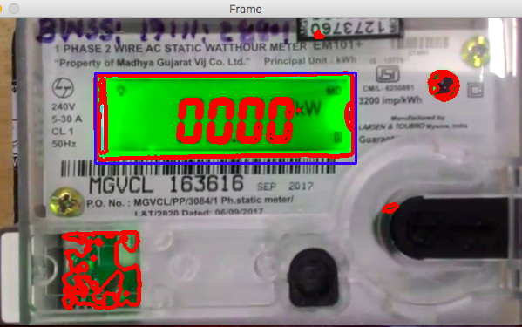
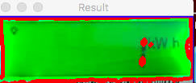
Contour Detection
Find contours in that region using findContours() function.
The contour with largest area i.e. the digital reading area is calculated.
Taken as the region of interest which is desired.

Slide 7
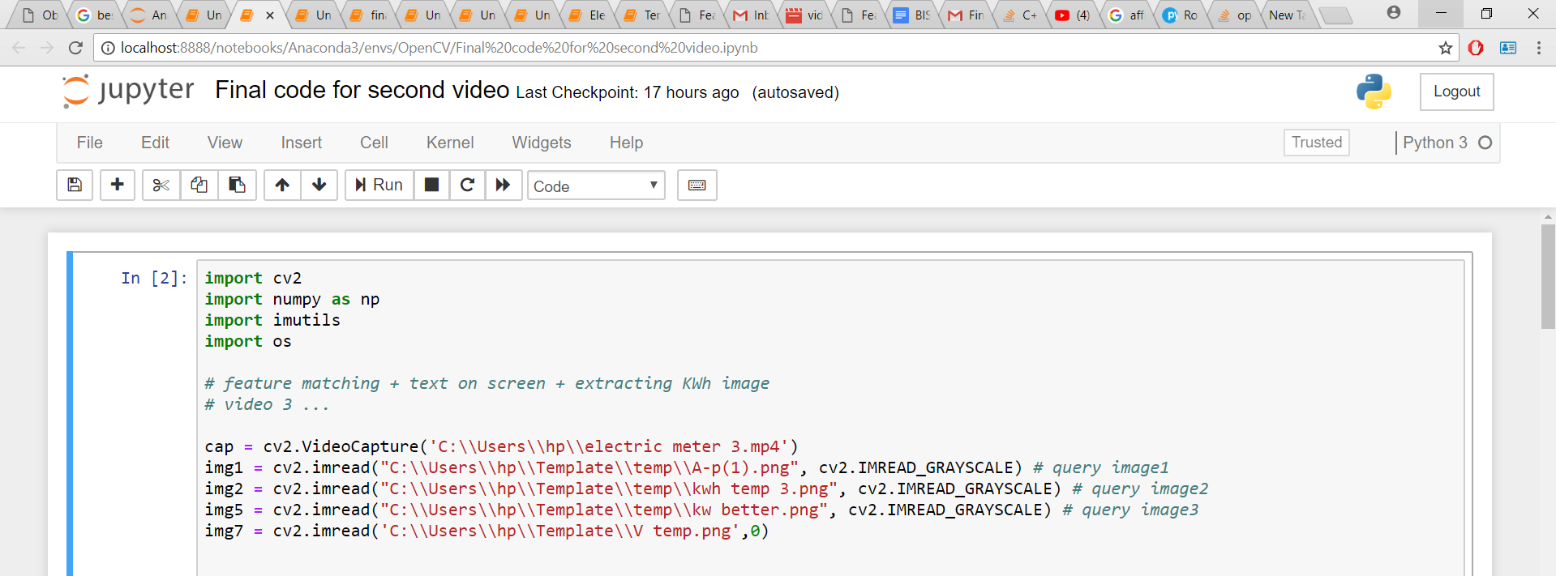
Feature Matching : Code Snippets
Import various python libraries .
cv2.VideoCapture() :- Loading videos .
cv2.imread :- Loading images .

Slide 8
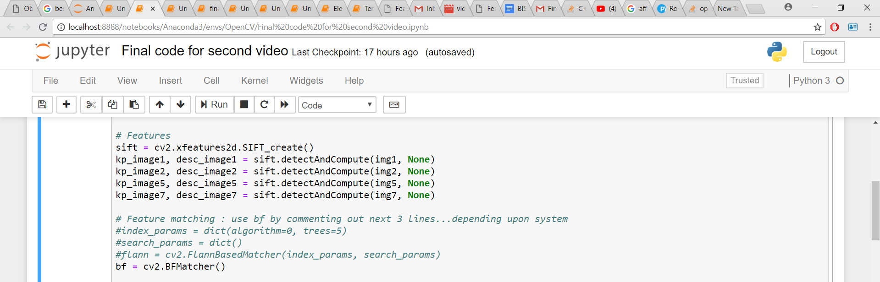
Feature Matching : Code Snippets
SIFT :- Describe and detect Features .
cv2.BFMatcher :- Brute Force Matching .

Slide 9
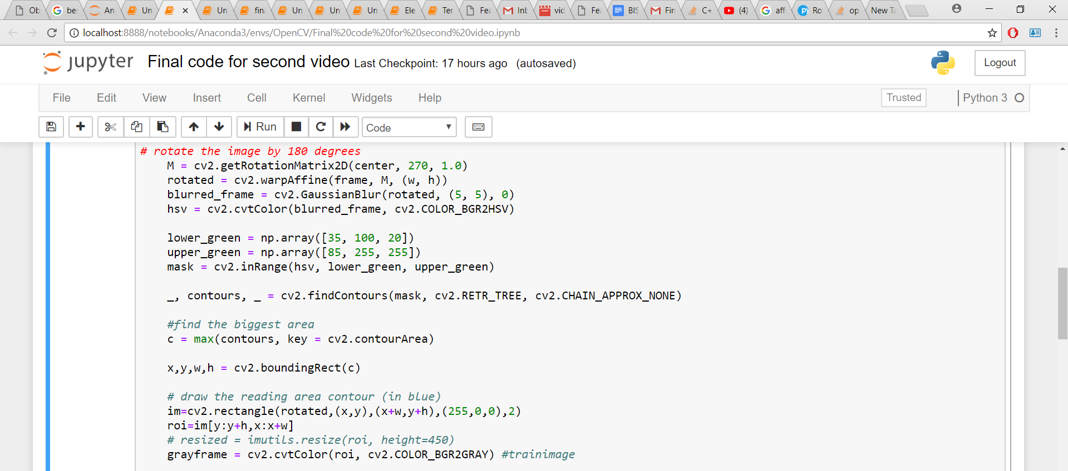
Feature Matching : Code Snippets
Rotation using Affine transformation.
Preprocessing :- To extract roi.

Slide 10
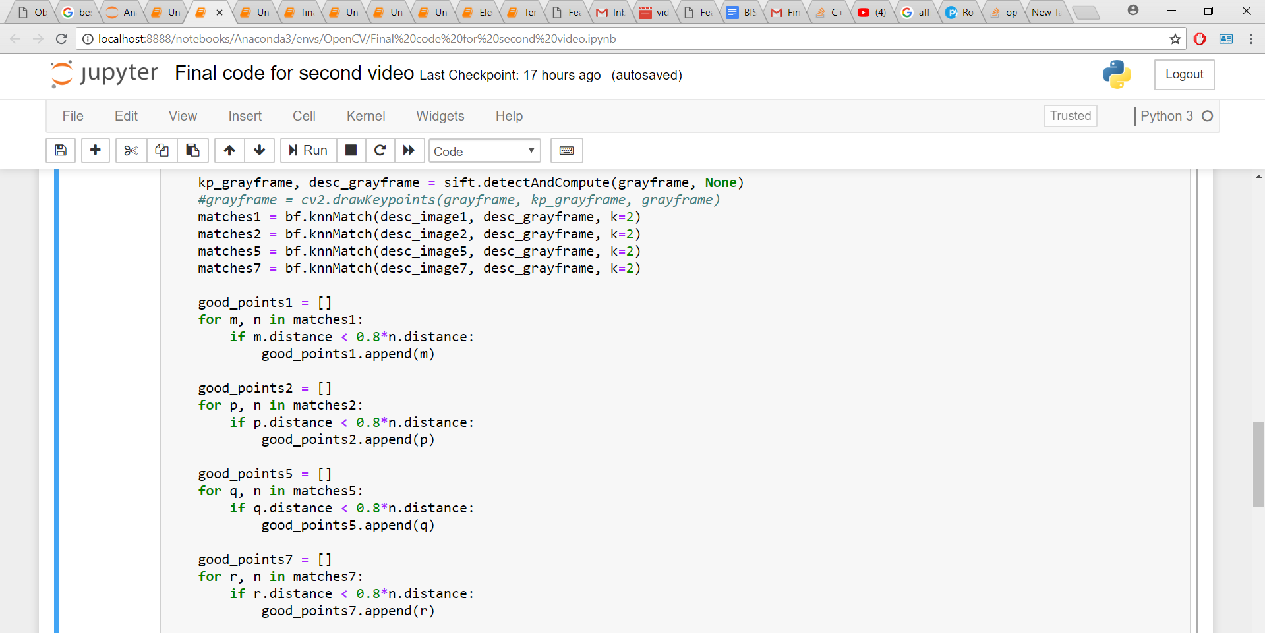
Feature Matching : Code Snippets
bf.knnMatch :- Matches descriptor of both the features
Ratio Test :- Proposed by David lowe.

Slide 11
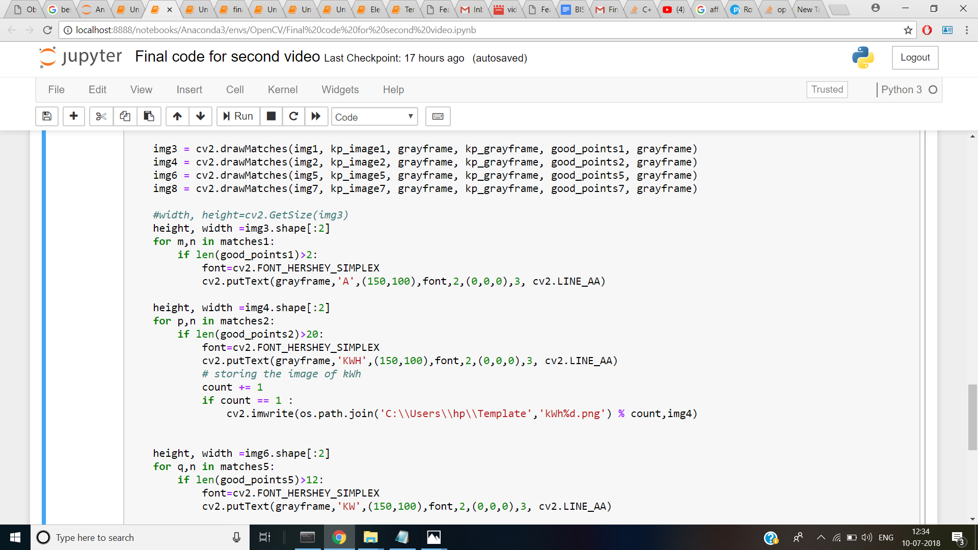
Feature Matching : Code Snippets
cv2.drawMatches() :- To draw lines .
cv2.putText() :- To display the text on the screen.

Slide 12
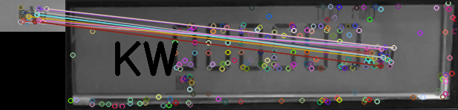
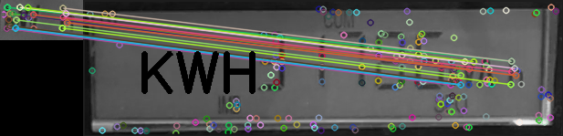
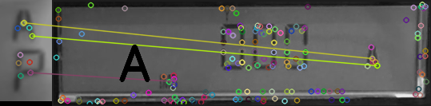
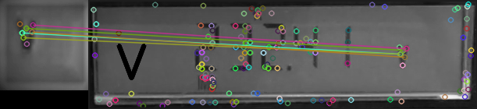
FEATURE MATCHING

Slide 13
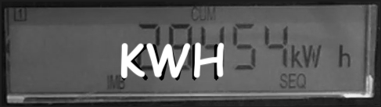
Extracting the captured video
As soon as the kWh is detected the first time, it is captured and saved in system
Required for future reference and verification
KWh is saved because it is used in electricity billing

Slide 14
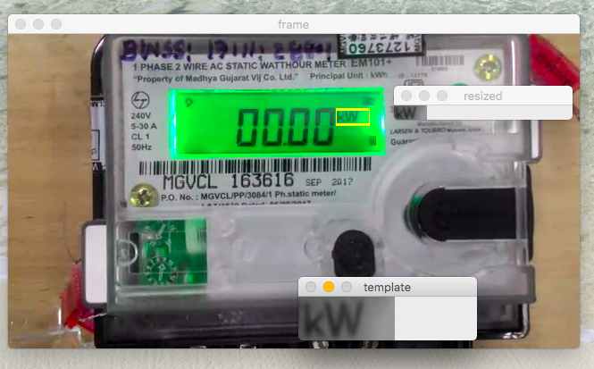
Progress
PROBLEMS :
Different types of meters would require corresponding templates from same meter
Different fonts
quality as the video
Difficult to read if background brightness is not good
FEATURE MATCHING :
Independent of size
Same Templates work for different videos if good resolution

Slide 15
Limitations
Distance from which the video is captured
Uniformity in lighting is preferred
Resolution of the video
The project can be extended to three phase meters.
QR code verification before capturing the video
Addition of Geolocation software to the application
Future Scope

Slide 16
Conclusion
We started by improving efficiency of template matching to read V , Kwh ,Kw, A.
Successfully cropped out the entire digital reading area
Further improved the efficiency of reading the units by feature matching
This work can make the electricity billing system time and cost effective for both the company and the user. With the help of this application manpower will be saved and human errors reduced, moreover making the payment frequency will be faster than before.

