Slide 1
Project Definition-”Video Processing for extracting electric meter readings”

Slide 2

Project coordinator- Mr Viraj Choksi
Project Guide- Mr Manoj Pandya
Project Team members - 1)Malaika Rastogi (2016B1A70926P)
2)Priyanka Verma (2016B3A70492P
3)Mayur Dhwaj (2016B3A30543P)

Slide 3
Project Details
The existing method of manual electric meter reading has lots of disadvantages : It is very tedious, time consuming, man power consuming and is prone to lot of errors.
The back camera of the mobile phones is used to acquire the video of the electricity meter. The system then applies a sequence of video processing functions to automatically extract and recognize the digits of the meter reading image.
Bill is generated and sent to the customer.This would be time and cost effective for the company and the customer.

Slide 4

Implementation
Pre-processing
cropping the numeric reading area
color filtering
Individual digit reading :
segmentation of individual digits using horizontal and vertical scanning of the cropped numeric area
recognition of the reading by comparing each segmented digit with the digits templates.
Units reading
Template matching
Machine Learning
Technologies and Softwares Used : OpenCV and Python

Slide 5
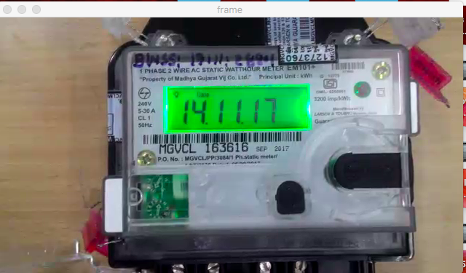
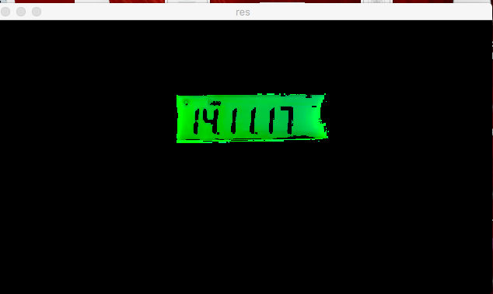
Pre-Processing
BGR -> HSV ->Color Filtering -> Mask -> Blurring -> Threshold -> Cropped out reading area -> Result

Slide 6
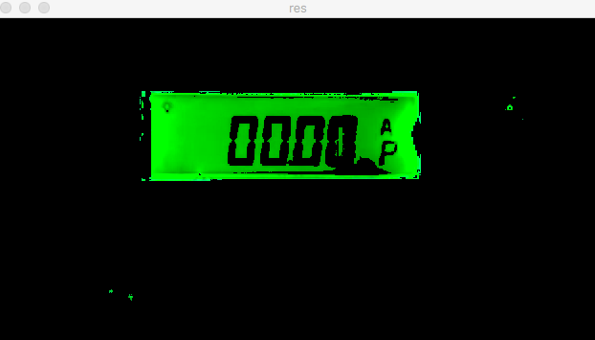
Challenges faced
Various other methods can be used for noise reduction.

Slide 7
Template Matching
Past status
voltage_temp = cv2.imread('C:/Users/Win10/Documents/4th Semester Summer/GUVNL/v_bin.png')
ampere_temp = cv2.imread('C:/Users/Win10/Documents/4th Semester Summer/GUVNL/a_bin.png')
kW_temp = cv2.imread('C:/Users/Win10/Documents/4th Semester Summer/GUVNL/kW_bin.png')
kWh_temp = cv2.imread('C:/Users/Win10/Documents/4th Semester Summer/GUVNL/kWh_bin.png')
voltage_temp = cv2.cvtColor(voltage_temp,cv2.COLOR_BGR2GRAY)
ampere_temp = cv2.cvtColor(ampere_temp,cv2.COLOR_BGR2GRAY)
kW_temp = cv2.cvtColor(kW_temp,cv2.COLOR_BGR2GRAY)
kWh_temp = cv2.cvtColor(kWh_temp,cv2.COLOR_BGR2GRAY)
print"V = ", np.max(cv2.matchTemplate(screen1_gray,voltage_temp,cv2.TM_CCOEFF_NORMED))
print"A = ", np.max(cv2.matchTemplate(screen1_gray,ampere_temp,cv2.TM_CCOEFF_NORMED))
print "kW =", np.max(cv2.matchTemplate(screen1_gray,kW_temp,cv2.TM_CCOEFF_NORMED))
print "kWh=", np.max(cv2.matchTemplate(screen1_gray,kWh_temp,cv2.TM_CCOEFF_NORMED))

Slide 8
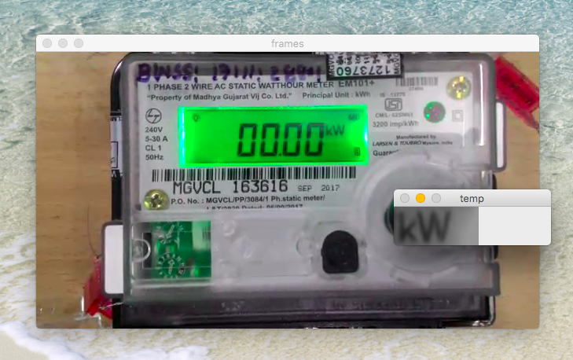
Problem 1 : Kw , KwH readings weren’t correctly processed .
Solution : Applying threshold value of 0.92 in the code.
Problem 2 : Three different types of fonts are available to for each of the units.
Solution : Multiple templates are to be passed by creating a list of all the template images.
X_data = [ ]
files1= glob.glob('*.png')
Problem 3 : These codes run and give correct output on images. But when applied on video the size of the template is bigger than the font size of the unit.
Solution : To resize the template
imutils.resize()

Slide 9
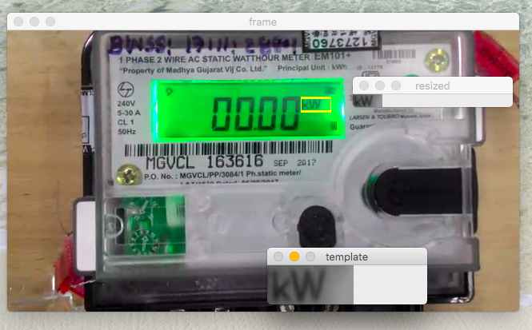

Slide 10
Present Status and Challenges
Have successfully applied various OpenCV and python libraries of template matching with correct output in 90% of the video frames
The processing of the video is little slow as the code is heavy.
We plan to optimise it by using lesser no frames and are exploring other possible options in machine learning.

Slide 11
Future Scope and Improvements
OCR using Image Classification:
K- Nearest Neighbors(K-NN)
Support Vector Machines(SVM)

Slide 12
K-NN Algorithm
(k-NN) rule: decide for the class that is most
frequent among the k nearest neighbors .
The computation time in K-NN = no. of training samples(m) * size of feature vector(n).
Implicit Assumption : All features are of equal value .

Slide 13
K-NN Algorithm
Feature weighting : A technique used to approximate the optimal degree of influence of individual features using a training set.
Relevant Features :- High weight value .
Irrelevant Features :- Very low weight value .

Slide 14
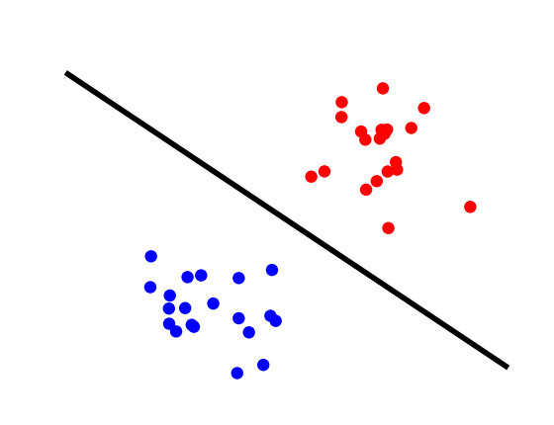
SVM Algorithm
Principle : to map the input data onto a higher dimensional feature space nonlinearly related to the input space and determine a separating hyperplane with maximum margin between the two classes in the feature space .

Slide 15
SVM Algorithm
SVM can be extended to Multi-class problems by using 2 different approaches :
One- vs- All : ‘n’ SVM’s tested
One -vs -One : ‘n*(n-1)/2’ binary SVM’s tested

Slide 16
Performance Comparison
SVM Algorithm
K-NN Algorithm
Training Time is proportional to the square of number of samples.
Adding new classes or new samples needs retraining with all samples.
Large number of SV’s are generated which requires large storage.
Training Time is linear with no. of samples.
A new class can easily be added to an existing classifier.
Consumes less storage and computation.

Slide 17
THANK YOU

