Slide 1


SSIP RESEARCH PROPOSAL 2026
AI-Based Smart Spectacles for Eye Health,
Stress Monitoring, and Mental Well-Being
SSIP RESEARCH PROPOSAL 2026
APPLICANT
MENTOR
Priyankaba P. Jadeja
Dr. Maheshkumar D. Mulani
MSc (CA & IT), Semester 4
Department of Computer Science
KSKV Kachchh University
Assistant Professor & Head
Department of Computer Science
KSKV Kachchh University
priyankaba2611@gmail.com
+91 72858 46840
mdm@kskvku.ac.in
+91 94094 93497
# KU/SSIP/Proposals/2025-2026/01 📍 Bhuj-Kachchh, Gujarat
KSKV Kachchh University | Department of Computer Science
Student Startup and Innovation Policy (SSIP)

Slide 2


Applicant & Mentor Details
APPLICANT
RESEARCH MENTOR
Priyankaba P. Jadeja
Dr. Maheshkumar D. Mulani
MSc (CA & IT) • Semester 4
Assistant Professor & Head of Department
Department of Computer Science
KSKV Kachchh University
Department of Computer Science
KSKV Kachchh University, Bhuj-Kachchh
Research Focus
Areas of Expertise
AI for Digital Health & Wearable Technology
• Artificial Intelligence & Machine Learning
• Computer Science & Data Analytics
• Applied Research & Innovation
Core Skills
Artificial Intelligence
Web Development
Java
Publications & Experience
Python
Computer Vision
Raspberry Pi
Peer-reviewed publications in computer science and AI domains with extensive academic and research supervision experience.
Git/Github
Contact Information
Role in Project
✉ priyankaba2611@gmail.com
📞 +91 72858 46840
Principal Mentor & Research Supervisor
Contact Information
LinkedIn Profile : Priyankaba-Jadeja-26
✉ mdm@kskvku.ac.in 📞 +91 94094 93497
SSIP Research Proposal Progress Report | KSKV Kachchh University | Page 2

Slide 3





Startup Potential
Problem Statement
Innovation
Digital eye strain and computer vision syndrome affect over 300 million users globally. Students and working professionals face prolonged screen exposure (8-12 hours daily) leading to eye fatigue, stress, reduced productivity, and mental health concerns.
AI-powered wearable smart spectacles with miniature inward facing cameras analyze real-time eye behavior including blink rate, gaze patterns, and fatigue biomarkers. Goes beyond screen-time tracking with behavioral analytics.
Target: High-risk digital users
First-of-its-kind wearable solution
Area it will Cover
Future Startup Potential
Global wearable technology and digital health market projected to exceed $96 billion by 2027. Growing demand in education, corporate wellness, and healthcare sectors.
Intellectual property on eye-behavior analytics algorithms. Strategic partnerships with educational institutions, optometry clinics, and corporate wellness programs. Subscription-based dashboard for continuous health monitoring and insights.
Multi-billion dollar addressable market
Scalable business model with IP
Competitive Advantage
Non-intrusive real-time monitoring • AI-driven personalized insights • Wearable form factor • Early fatigue detection • Preventive healthcare approach • Patent-eligible technology • Multi sector applicability
SSIP Research Proposal Progress Report | KSKV Kachchh University | Page 3

Slide 4



Abstract
Objectives
Key Technology
Develop a non-intrusive wearable system (prototype) to continuously monitor eye movement, blink rate, and visual fatigue patterns in real-time using AI-powered smart spectacles, enabling early detection of digital eye strain and stress indicators.
Miniature inward-facing cameras integrated into spectacle frames capture eye behavior data. Computer Vision algorithms (OpenCV library) analyze blink frequency, gaze patterns, and PERCLOS metrics to generate health insights.
Innovation
Expected Impact
Goes beyond traditional screen-time tracking by analyzing behavioral biomarkers such as blink closure duration, and fatigue trends. Provides actionable insights rather than passive monitoring.
Early detection of eye strain and mental stress leading to healthier digital habits. Promotes student wellness, improved productivity, and preventive healthcare approach for the growing digital-native population.
👥 Target: Students & Professionals 🖥 Platform: Wearable + AI Analytics 📈 Outcome: Real-Time Health Monitoring
SSIP Research Proposal Progress Report | KSKV Kachchh University | Page 4

Slide 5
Introduction
Problem Statement
Prolonged screen exposure (8-12 hours daily) among students and professionals leads to eye strain, fatigue, sleep disruption, and reduced mental focus. Current awareness methods are insufficient and reactive.
Smartphones & Digital Devices
↓
Prolonged Screen Exposure (8-12 hrs/day)
Why It Matters
Rising digital reliance in education and work environments creates urgent need for objective, real-time wellness indicators. Lack of preventive tools in academic settings puts student health at risk.
↓
Digital Eye Strain & Reduced Blinking
↓
Current Challenges
Visual Fatigue & Mental Stress
Screen-time tracking apps miss true eye behavior patterns. Medical eye examinations are episodic and intrusive. No continuous, non-invasive monitoring exists for real-time fatigue detection.
↓
Sleep Disruption & Reduced Focus
Expected Contribution
Non-intrusive wearable system providing continuous, interpretable fatigue and stress insights. Empowers users with actionable data to develop healthier digital habits and improve well-being.
👥 300M+ Affected Users Globally 🔴 8-12 hrs Daily Screen Time 📈 65%+ Students Report Eye Strain 🔄 Real-Time Continuous Monitoring
SSIP Research Proposal Progress Report | KSKV Kachchh University | Page 5

Slide 6
Literature Review
2008
2018
2022
2026
Loh & Reddy: Computer
Vision Syndrome
Sheppard & Wolffsohn:
Digital Eye Strain
Kaur et al.: Comprehensive
DES Review
This Project: AI Wearable
Solution
Study / Source | Key Findings | Limitations / Gaps
Sheppard & Wolffsohn (2018) BMJ Open Ophthalmology | Digital eye strain is prevalent among screen users. Symptoms include tired eyes, dryness, headaches, and difficulty focusing. Measurement and amelioration strategies were discussed. | Focuses on symptom reporting and surveys. No real-time continuous monitoring. Limited objective behavioral metrics like blink rate analysis.
Kaur et al. (2022) Ophthalmology and Therapy | Comprehensive review highlighting reduced blinking during screen use increases eye fatigue and discomfort. Behavioral factors play significant role in digital eye strain. | Retrospective analysis. Lacks wearable technology implementation. No AI-driven fatigue scoring or continuous data collection.
Loh & Reddy (2008) Malaysian Family Physician | Identified computer vision syndrome causes: poor lighting, prolonged screen time, improper viewing distance. Emphasised need for awareness and prevention strategies. | Relies on self-reported data. No technological intervention proposed. Limited quantitative behavioral monitoring.
American Optometric Association Clinical Guidelines | Excessive screen use linked to stress, poor sleep quality, and reduced productivity. Recommends regular breaks and ergonomic adjustments for computer users. | Passive recommendations only. No active monitoring system. Lacks personalized, data-driven intervention tools.
SSIP Research Proposal Progress Report | KSKV Kachchh University | Page 6

Slide 7






Methodology: End-to-End Workflow
STEP 1
→
STEP 2
→
STEP 3
→
STEP 4
→
STEP 5
Data Capture
Data Transmission
Data Filtering
Data Analysis
User Interface
Miniature cameras record pupil activity, blink frequency, and eye closure duration continuously
Stream captured data to microcontroller or edge processor for real-time processing
Computer vision models estimate blink rate, PERCLOS, and fatigue indicators using OpenCV.
Generate eye health, fatigue, and stress scores by correlating them with pre and post use cases.
Application displays insights and how it has damaged users eye health & mental well being.
Data Collected
Processing Pipeline
Blink frequency, PERCLOS (eye closure percentage), gaze patterns, screen exposure time, and pupil dilation metrics.
Real-time video processing, feature extraction, classification models, fatigue scoring algorithms, and personalized threshold calibration.
Tech Stack:
🐍 Python
🔵 OpenCV
🧠 TensorFlow
🍓 Raspberry Pi
⚙ Microcontroller
</> NumPy/Pandas
SSIP Research Proposal Progress Report | KSKV Kachchh University | Page 7

Slide 8








Budget (Total ₹38,359)
Budget Category
Amount (₹)
Share (%)
Budget Distribution
Spectacle Frame & Fitting
₹2,250
5.9%
Mini Camera Modules
₹10,050
26.2%
9.1%
Processing Unit (Raspberry Pi / sim.)
₹7,559
19.7%
Battery & Power Supply
₹2,500
6.5%
Software & AI Development
₹5,000
13%
App / Interface Development
₹5,500
14.3%
Assembly & Testing
₹2,000
5.2%
Miscellaneous
₹3,500
9.1%
TOTAL PROJECT BUDGET
38,359
100%
Resource Allocation Key
Spectacle Frame & Fitt… (5.9%)
Mini Camera Modules (26.2%)
Total Funding Required
₹38,359
Processing Unit (Raspb… (19.7%)
Battery & Power Supply (6.5%)
Software & AI Developm… (13%)
App / Interface Develo… (14.3%)
Assembly & Testing (5.2%)
Miscellaneous (9.1%)
SSIP Research Proposal Progress Report | KSKV Kachchh University | Budget Slide

Slide 9




Project Timeline (8 Months)
Month 1
Month 2
Month 3
Month 4
Month 5
Month 6
Month 7
Month 8
Research & Literature Review
M1-M2
System Design & Hardware Selection
M2-M3
Data Collection (Pilot)
M3-M4
Model Development (CV + Fatigue)
M4-M5
Prototype Integration
M6
Testing & Validation
M7
Report Writing & Presentation
M8
Key Milestones & Deliverables
Literature Survey
Complete
System Architecture
Finalized
Dataset Collection
Done
AI Model Trained
Working Prototype
Ready
Testing Validated
Final Report
Submitted
SSIP Research Proposal Progress Report | KSKV Kachchh University | Page 9

Slide 10

Possible Outcomes
Working Smart Spectacles Prototype
Real-Time Eye Activity Monitoring
AI-Derived Fatigue & Stress Scores
Functional wearable device with integrated miniature cameras capable of capturing eye behavior in real-time. Complete hardware-software integration with on-device processing capabilities.
Continuous tracking of blink frequency, gaze patterns, eye closure duration (PERCLOS), and pupil behaviors. Non-intrusive monitoring system providing second-by-second eye health insights.
Machine learning models generating personalized fatigue levels, stress indicators, and mental well-being scores. Predictive analytics with alerts for preventive health intervention.
User Wellness Dashboard
Digital Eye Health Solution
Interactive mobile interface displaying real-time health metrics, historical trends, and actionable insights. Personalized health nudges and break reminders to promote healthier digital habits.
Development of a scalable smart spectacles system that can assist students, professionals, and healthcare researchers in monitoring eye health and reducing digital eye strain.
👥 Student
Wellness
📊 Healthcare
Innovation
Preventive
📈 Data-Driven
Insights
🚀 Startup
Potential
SSIP Research Proposal Progress Report | KSKV Kachchh University | Page 10

Slide 11
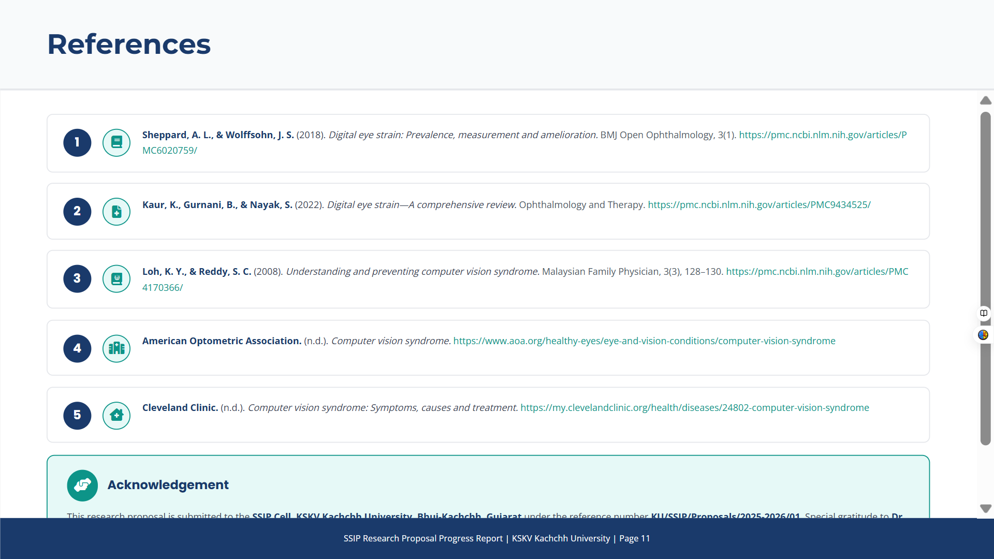
The above are the references I have referred.

