Slide 1


Organization Name- Ministry of housing and urban affairs
Project Name-DIP (Digital Info. Portal)
Team Name- Techno Warriors New
PS Number- BC79
Category- Software
Team Leader- Priyanka Bhatpagar
Team Members- Sharan Preet Kaur Sarao
Nishat Halwai
Deepesh Bendey Ashwani Ahirwar
Manish soni

Slide 2
Problems And Solution
Problems-
Cities provide more opportunities for people to grow economically. However, these opportunities are unequal because of the knowledge asymmetry. How can we ensure that people have more equal and wider access to better and relevant economic opportunities/jobs?
However, people's access to these opportunities varies due to various factors.
Unemployment Problem in India
People are unable to know the policy.
People are unable to know the Opportunities/jobs/works
Solution-
We are providing software solution where all the relevant opportunities including jobs, tenders in public domain, freelancing work, etc. would be listed & visible. Sectors can be but not limited to Opportunities in Government Sector, Private Sector, Technology, Science, etc.
Providing knowledge of private and govt. jobs information.
Making people aware of upcoming beneficial policies tenders.
Providing beneficial skills to upgrade knowledge.
Providing Freelancing work
Knowledge of new technology and science

Slide 3
Introduction of DIP
This web based portal basically concerned with different job services provided by different companies.
It is also concerned with details of jobseekers.
Jobseeker can view the list of different jobs and can apply for jobs.
Then the company going to select the required job seekers for their qualification and update the database.
The portal going to follow different companies policy.
Their be an admin to manage all things.

Slide 4
Scope of Project
The online job portal that is developed provide jobseekers
with different jobs information like:
online applying for jobs
search for jobs
Supported by well-designed database and web-based design.
A friendly user interface is provided to facilitate different
services.
The basic scope contains:
Jobseeker’s Area
Company’s Area
Administrator’s Area

Slide 5
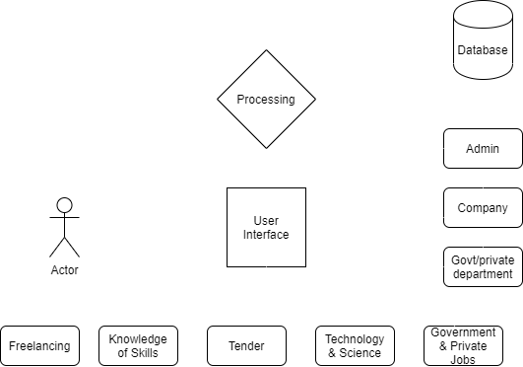
Features & Process diagram
Features-
Govt./ Pvt. Jobs Alert
Tender Information
Latest Course & Training
Providing a knowledge of business ideas
Providing a knowledge of start-up ideas
Providing a information of
technology & science
Providing a information of tenders

Slide 6

Job Seeker
Admin
Pvt. /Govt. Company /Agency
Login
Login
Login
Access
Upload other info
Chose field (to
apply)
Company requirement (add vacancy)
Stored
Stored
Advanced filtering for job seekers
Registration Table
Records Table
Match
Details of
candidate’s sent to Company representative

Slide 7
Functional Requirements
Modules:
User Module
Company Module
Admin Module
Characteristics:
The “User” is expected to be internet familiar and to be able to use the job portal.
The “Admin” is expected to be familiar with internet and database.

Slide 8
Non-Functional Requirements
Security:
The job portal will provide restriction against unauthorized
access.
Safety:
There will be a backup of data for any future mishap.
Performance:
The online job portal will never break down and work
consistently.

Slide 9
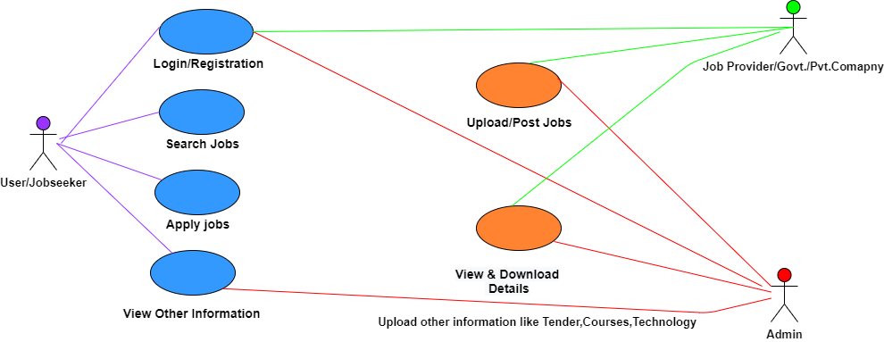
Uml/Class Diagram

Slide 10
Query
Continue…!

