Slide 1




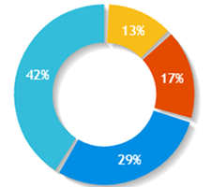


AICTE
Anil D Sahasrabudhe
Dashboard
38989
189
400
380
Grievances
Total Grievances
Open Grievances
Escalated Grievances
Addressed Grievances
Search Application
Type of Grievances
Important Information
Examination Cell
Admission Cell
Training & Placement
Miscellaneous
FAQs
Top 5 states having maximum Grievance
Voice
Terms of Use | Privacy Policy | Right to Information | Reports | Directory
Copyright © 2019. AICTE, Nelson Mandela Marg, Vasant Kunj, New Delhi -110070

Slide 2

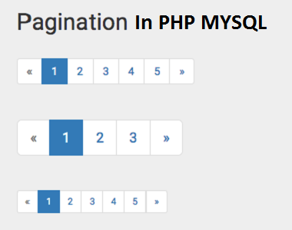
AICTE
Anil D Sahasrabudhe
Dashboard
Open Grievances
Grievances
Grievance Id
Student Id
College Id
Grievance Type
Date of Issue
ETA
Attachment
Connect
Search Application
IND038
ST01
IN038
Examination Cell
15-02-2019
20-02-2019
Comment
View History
Important Information
IND043
ST02
In039
Admission Cell
16-02-2019
23-02-2019
Comment
View History
IND045
ST03
IN040
Training & Placement Cell
11-02-2019
21-02-2019
Comment
View History
FAQs
IND089
ST08
IN041
Accounts Department
12-02-2019
17-02-2019
Comment
View History
IND038
ST01
IN038
Examination Cell
15-02-2019
20-02-2019
Comment
View History
IND043
ST02
In039
Admission Cell
16-02-2019
23-02-2019
Comment
View History
IND045
ST03
IN040
Training & Placement Cell
11-02-2019
21-02-2019
Comment
View History
IND089
ST08
IN041
Accounts Department
12-02-2019
17-02-2019
Comment
View History
IND038
ST01
IN038
Examination Cell
15-02-2019
20-02-2019
Comment
View History
IND043
ST02
In039
Admission Cell
16-02-2019
23-02-2019
Comment
View History
IND045
ST03
IN040
Training & Placement Cell
11-02-2019
21-02-2019
Comment
View History
IND089
ST08
IN041
Accounts Department
12-02-2019
17-02-2019
Comment
View History
IND038
ST01
IN038
Examination Cell
15-02-2019
20-02-2019
Comment
View History
IND043
ST02
In039
Admission Cell
16-02-2019
23-02-2019
Comment
View History
IND045
ST03
IN040
Training & Placement Cell
11-02-2019
21-02-2019
Comment
View History
IND089
ST08
IN041
Accounts Department
12-02-2019
17-02-2019
Comment
View History
Voice
Terms of Use | Privacy Policy | Right to Information | Reports | Directory
Copyright © 2019. AICTE, Nelson Mandela Marg, Vasant Kunj, New Delhi -110070

Slide 3
AICTE
Anil D Sahasrabudhe
Dashboard
Search Grievance
Grievances
Select
Select
Search
Search Application
Important Information
Grievance Id
University Id
College Id
Grievance Type
Date of Issue
ETA
Attachment
Comments
FAQs
Voice
Terms of Use | Privacy Policy | Right to Information | Reports | Directory
Copyright © 2019. AICTE, Nelson Mandela Marg, Vasant Kunj, New Delhi -110070

Slide 4
AICTE
Anil D Sahasrabudhe
Dashboard
Search Grievance
Grievances
Select
Select
Grievance Id
University Id
College Id
Grievance Type
Enter Grievance Id
Search
Search Application
Important Information
Grievance Id
University Id
College Id
Grievance Type
Date of Issue
ETA
Attachment
Comments
IND038
ST01
IN038
Examination Cell
15-02-2019
20-02-2019
View
FAQs
Voice
Terms of Use | Privacy Policy | Right to Information | Reports | Directory
Copyright © 2019. AICTE, Nelson Mandela Marg, Vasant Kunj, New Delhi -110070

Slide 5
AICTE
Anil D Sahasrabudhe
Dashboard
Important Information
Grievances
Enter University Code
UN07858656899
Search
Search Application
Important Information
University Code
University
Ombudsman Name
Contact number
Email Id
Open Grievances
UN07858656899
AKTU, Lucknow
Pranjal
9876543210
abc@gmail.com
878568
FAQs
Enter Institute Code
IN86959876
Search
Institute Code
Institute
Principal
Contact number
Email Id
Open Grievances
IN86959876
ABES IT
Pranjal
9876543210
abc@gmail.com
97897
Voice
Terms of Use | Privacy Policy | Right to Information | Reports | Directory
Copyright © 2019. AICTE, Nelson Mandela Marg, Vasant Kunj, New Delhi -110070

Slide 6
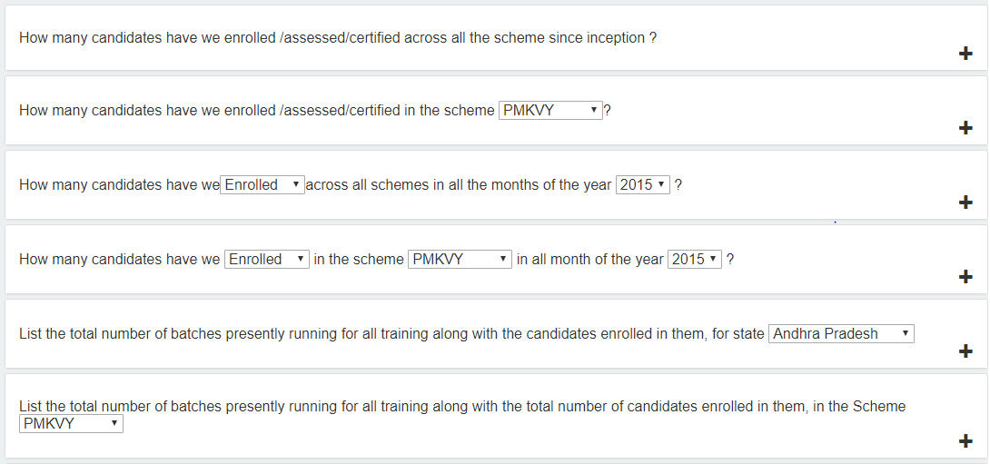
AICTE
Anil D Sahasrabudhe
Dashboard
Frequently Asked Questions (FAQs)
Grievances
Search Application
Important Information
FAQs
Voice
Terms of Use | Privacy Policy | Right to Information | Reports | Directory
Copyright © 2019. AICTE, Nelson Mandela Marg, Vasant Kunj, New Delhi -110070

