Slide 1




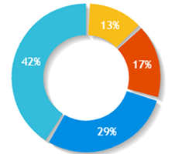


A.K.T.U. Lucknow
Ombudsman Name
Dashboard
38989
189
400
380
Grievances
Total Grievances
Open Grievances
Escalated Grievances
Addressed Grievances
Search Application
Select Institute
Select
Raised
In action
Addressed
Re-open
Delayed
FAQs
35
30
25
20
15
10
Academics Transport Canteen Hostel Others
Type of Grievances
Examination Cell
Admission Cell
Training & Placement
Others
Voice
Terms of Use | Privacy Policy | Right to Information | Reports | Directory
Copyright © 2019. AICTE, Nelson Mandela Marg, Vasant Kunj, New Delhi -110070

Slide 2

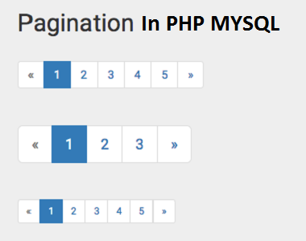
A.K.T.U. Lucknow
Ombudsman Name
Dashboard
Open Grievances
Grievances
Grievance Id
Student Id
College Id
Grievance Type
Date of Issue
ETA
Attachment
Connect
Search Application
IND038
ST01
IN038
Examination Cell
15-02-2019
20-02-2019
Comment
View History
FAQs
IND043
ST02
In039
Admission Cell
16-02-2019
23-02-2019
Comment
View History
IND045
ST03
IN040
Training & Placement Cell
11-02-2019
21-02-2019
Comment
View History
IND089
ST08
IN041
Accounts Department
12-02-2019
17-02-2019
Comment
View History
IND038
ST01
IN038
Examination Cell
15-02-2019
20-02-2019
Comment
View History
IND043
ST02
In039
Admission Cell
16-02-2019
23-02-2019
Comment
View History
IND045
ST03
IN040
Training & Placement Cell
11-02-2019
21-02-2019
Comment
View History
IND089
ST08
IN041
Accounts Department
12-02-2019
17-02-2019
Comment
View History
IND038
ST01
IN038
Examination Cell
15-02-2019
20-02-2019
Comment
View History
IND043
ST02
In039
Admission Cell
16-02-2019
23-02-2019
Comment
View History
IND045
ST03
IN040
Training & Placement Cell
11-02-2019
21-02-2019
Comment
View History
IND089
ST08
IN041
Accounts Department
12-02-2019
17-02-2019
Comment
View History
IND038
ST01
IN038
Examination Cell
15-02-2019
20-02-2019
Comment
View History
IND043
ST02
In039
Admission Cell
16-02-2019
23-02-2019
Comment
View History
IND045
ST03
IN040
Training & Placement Cell
11-02-2019
21-02-2019
Comment
View History
IND089
ST08
IN041
Accounts Department
12-02-2019
17-02-2019
Comment
View History
Voice
Terms of Use | Privacy Policy | Right to Information | Reports | Directory
Copyright © 2019. AICTE, Nelson Mandela Marg, Vasant Kunj, New Delhi -110070

Slide 3
A.K.T.U. Lucknow
Ombudsman Name
Dashboard
Search Grievance
Grievances
Select
Select
Search
Search Application
FAQs
Grievance Id
College Id
Grievance Type
Date of Issue
ETA
Attachment
Comments
Voice
Terms of Use | Privacy Policy | Right to Information | Reports | Directory
Copyright © 2019. AICTE, Nelson Mandela Marg, Vasant Kunj, New Delhi -110070

Slide 4
A.K.T.U. Lucknow
Ombudsman Name
Dashboard
Search Grievance
Grievances
Select
Search
Select
Select
Grievance Id
College Id
Grievance Type
Search Application
FAQs
Grievance Id
College Id
Grievance Type
Date of Issue
ETA
Attachment
Comments
Voice
Terms of Use | Privacy Policy | Right to Information | Reports | Directory
Copyright © 2019. AICTE, Nelson Mandela Marg, Vasant Kunj, New Delhi -110070

Slide 5
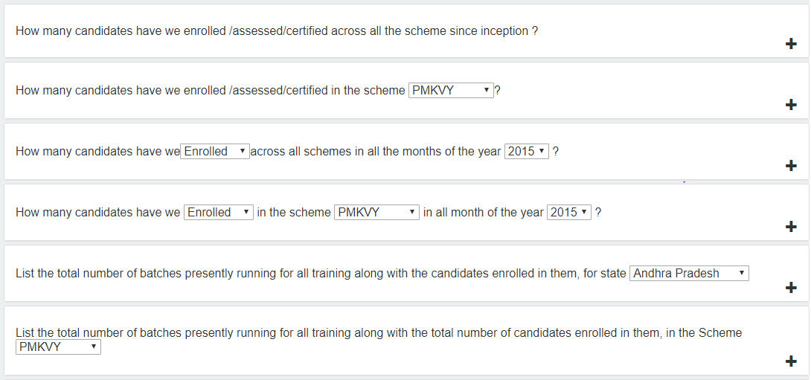
A.K.T.U. Lucknow
Ombudsman Name
Dashboard
Frequently Asked Questions (FAQs)
Grievances
Search Application
FAQs
Voice
Terms of Use | Privacy Policy | Right to Information | Reports | Directory
Copyright © 2019. AICTE, Nelson Mandela Marg, Vasant Kunj, New Delhi -110070

