Slide 1






C.V. Raman College of Engineering
Exam Cell (Committee Member)
Dashboard
38989
189
400
380
View Grievances
Total Grievances
Open Grievances
Escalated Grievances
Addressed Grievances
Search Application
Top 5 Course Wise Grievance registered
FAQs
Total
Resolved
35
30
25
20
15
10
B TECH BCA Diploma M TECH PHD
Voice
Terms of Use | Privacy Policy | Right to Information | Reports | Directory
Copyright © 2019. AICTE, Nelson Mandela Marg, Vasant Kunj, New Delhi -110070

Slide 2

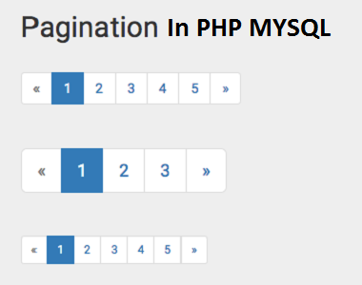
C.V. Raman College of Engineering
Exam Cell (Committee Member)
Dashboard
New Grievances
View Grievances
Grievance ID
Student Details
Grievance Type
Description
Attachment
ETA
Action
Search Application
IND038
View
Examination Cell
Text
20-02-2019
Take Action
IND043
View
Admission Cell
Text
23-02-2019
Take Action
FAQs
IND045
View
Training & Placement Cell
Text
21-02-2019
Take Action
In Action Grievances
Grievance ID
Student Details
Grievance Type
Description
Attachment
ETA
Connect
Action
Authority
IND038
View
Examination Cell
Text
20-02-2019
Comment
View History
SFA
Addressed
Self
IND043
View
Admission Cell
Text
23-02-2019
Comment
View History
SFA
Addressed
Principal
IND045
View
Training & Placement Cell
Text
21-02-2019
Comment
View History
SFA
Addressed
Self
IND089
View
Accounts Department
Text
17-02-2019
Comment
View History
SFA
Addressed
self
Resolved Grievances
Grievance ID
Student Details
Grievance Type
Description
Attachment
ETA
Closing Date
Closure Status
IND038
View
Examination Cell
Text
20-02-2019
20-02-2019
Normal
IND043
View
Admission Cell
Text
23-02-2019
23-02-2019
Delayed
Voice
Terms of Use | Privacy Policy | Right to Information | Reports | Directory
Copyright © 2019. AICTE, Nelson Mandela Marg, Vasant Kunj, New Delhi -110070

Slide 3
C.V. Raman College of Engineering
Exam Cell (Committee Member)
Dashboard
New Grievances
View Grievances
Grievance ID
Student Details
Grievance Type
Description
Attachment
ETA
Action
Search Application
IND038
View
Examination Cell
Text
20-02-2019
Take Action
IND043
View
Admission Cell
Text
23-02-2019
Take Action
Student Details
FAQs
IND045
View
Training & Placement Cell
Text
21-02-2019
Take Action
Student ID
Name
Institute
Course, Branch, Year
Contact
Email
In Action Grievances
ABES IT
B TECH, CSE, 4
IND038
Pranjal Kumar Singh
9876543210
abc@gmail.com
Grievance ID
Student Details
Grievance Type
Description
Attachment
ETA
Connect
Action
Authority
IND038
View
Examination Cell
Text
20-02-2019
Comment
View History
SFA
Addressed
Self
IND043
View
Admission Cell
Text
23-02-2019
Comment
View History
SFA
Addressed
Principal
IND045
View
Training & Placement Cell
Text
21-02-2019
Comment
View History
SFA
Addressed
Self
IND089
View
Accounts Department
Text
17-02-2019
Comment
View History
SFA
Addressed
self
Resolved Grievances
Grievance ID
Student Details
Grievance Type
Description
Attachment
ETA
Closing Date
Closure Status
IND038
View
Examination Cell
Text
20-02-2019
20-02-2019
Normal
IND043
View
Admission Cell
Text
23-02-2019
23-02-2019
Delayed
Voice
Terms of Use | Privacy Policy | Right to Information | Reports | Directory
Copyright © 2019. AICTE, Nelson Mandela Marg, Vasant Kunj, New Delhi -110070

Slide 4
C.V. Raman College of Engineering
Exam Cell (Committee Member)
Dashboard
Search Grievance
Grievances
Enter Grievance Id
IND038
Search
Search Application
FAQs
Grievance ID
Student Details
Grievance Type
Description
Date of Issue
ETA
Attachment
Status
IND038
View
Examination Cell
Text
15-02-2019
20-02-2019
Resolved
Voice
Terms of Use | Privacy Policy | Right to Information | Reports | Directory
Copyright © 2019. AICTE, Nelson Mandela Marg, Vasant Kunj, New Delhi -110070

Slide 5
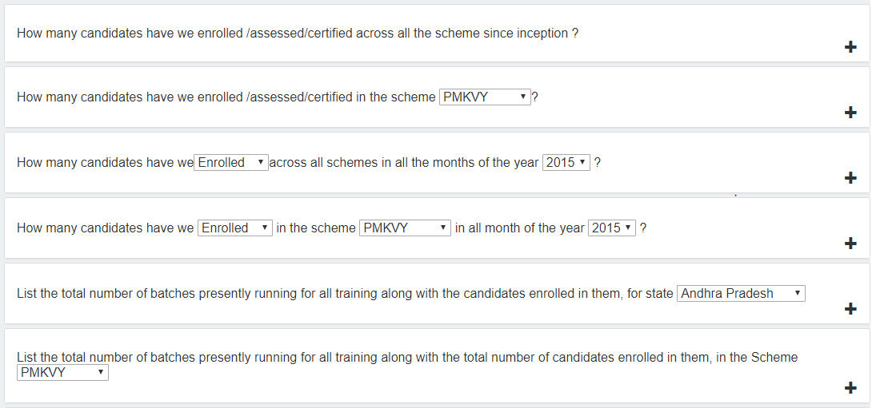
C.V. Raman College of Engineering
Exam Cell (Committee Member)
Dashboard
Frequently Asked Questions (FAQs)
Grievances
Search Application
FAQs
Voice
Terms of Use | Privacy Policy | Right to Information | Reports | Directory
Copyright © 2019. AICTE, Nelson Mandela Marg, Vasant Kunj, New Delhi -110070

